Slide 1
the story in the grass spider web trampoline
6. mateřská škola Plzeň, Republikánská 25, příspěvková organizace

Slide 2
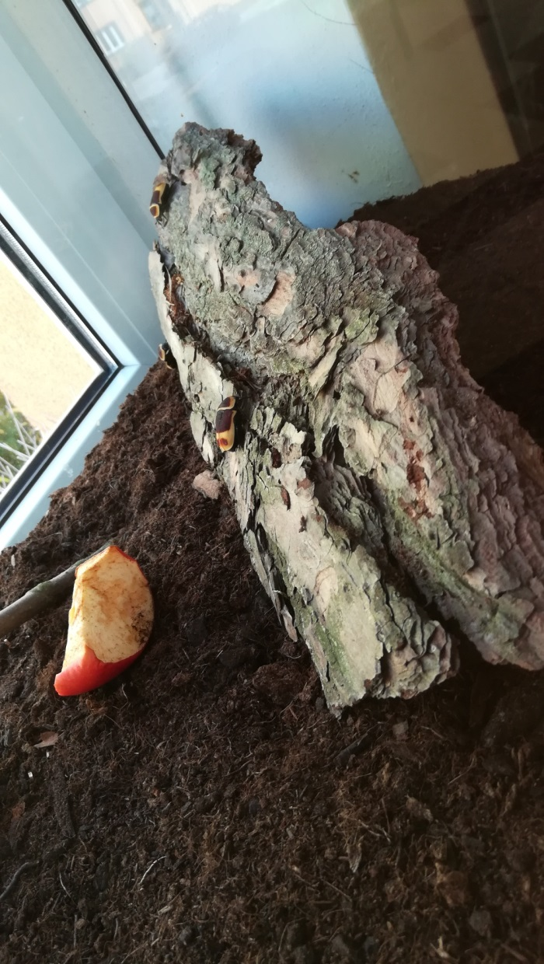
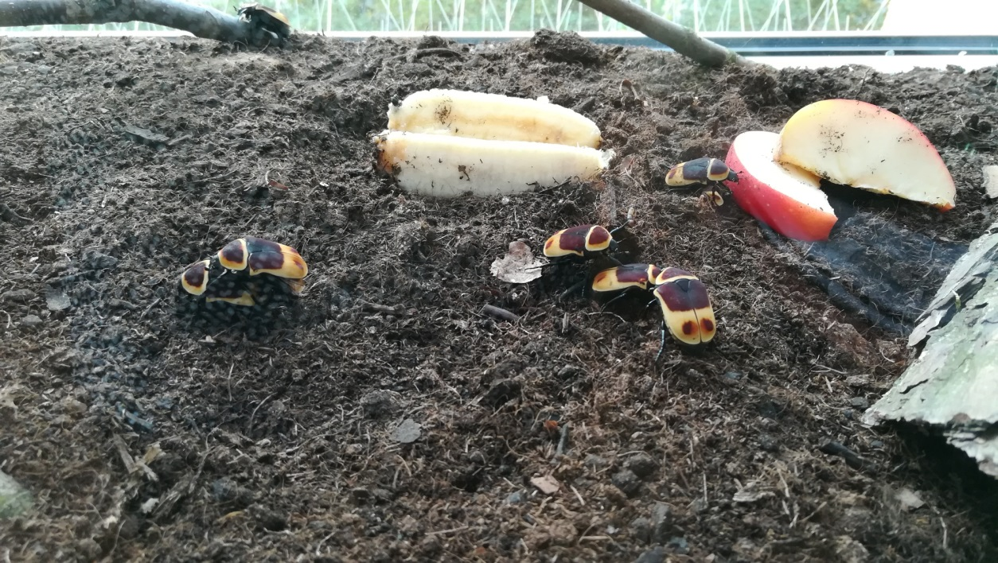
We observed a wild nature

Slide 3
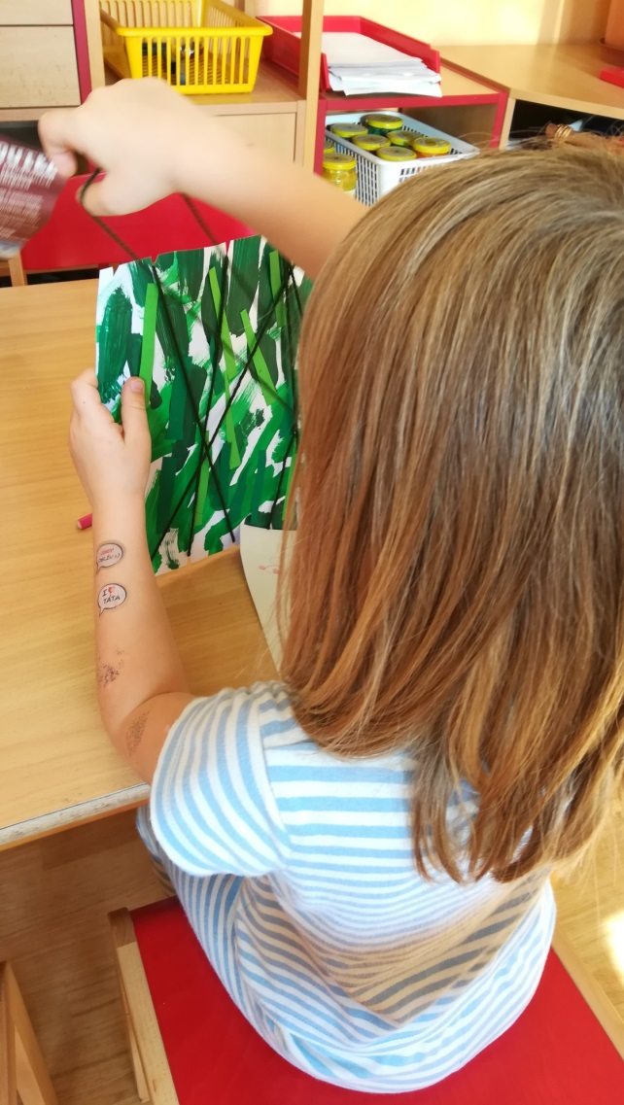
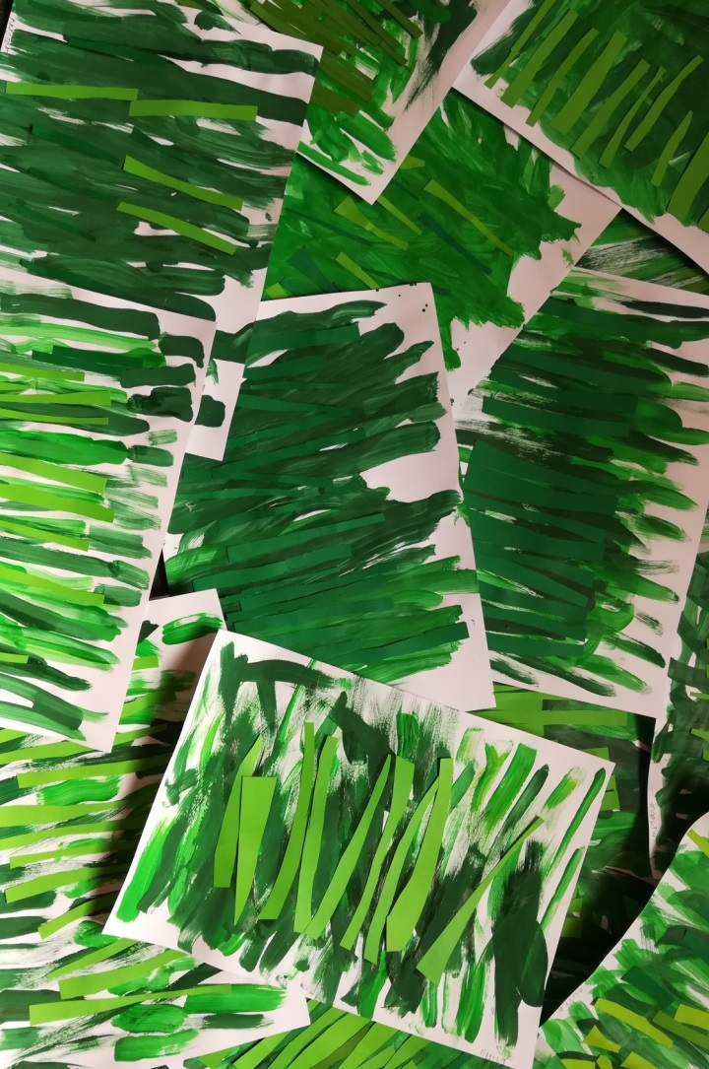
We watched a nature and create the story
We painted grass-blades, cut, sticked and add next grass-blades from pieces of green paper…
… and at the end we joined wool-cords to catch-up the small animals

Slide 4
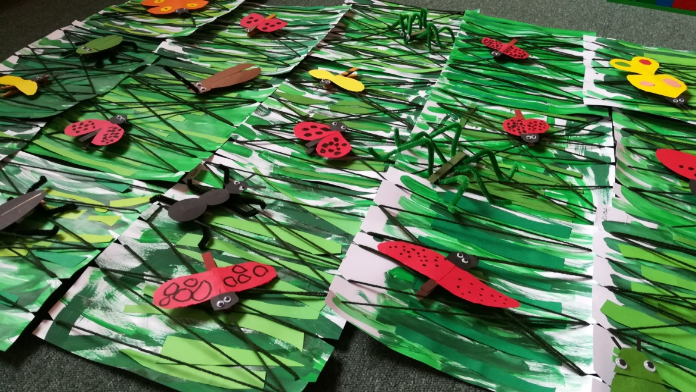
We made common small animals
From color strips of paper we cut parts of animal bodies and stick eyes and drew details and joined legs from chenille wires. Finally we fasten them by clothes-pins to the grass-blades.

Slide 5
We made a meadow with a various small animals

Slide 6
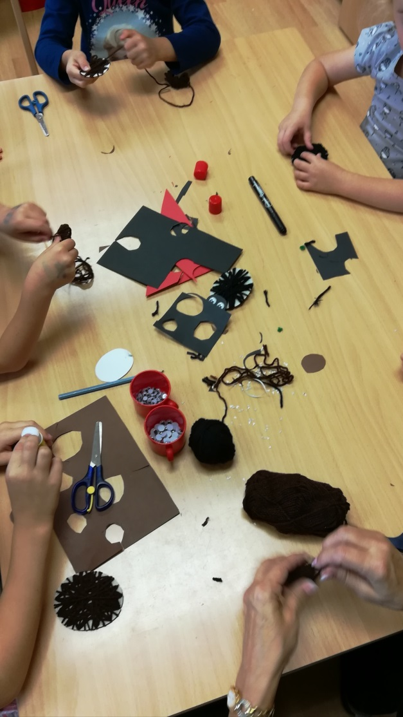
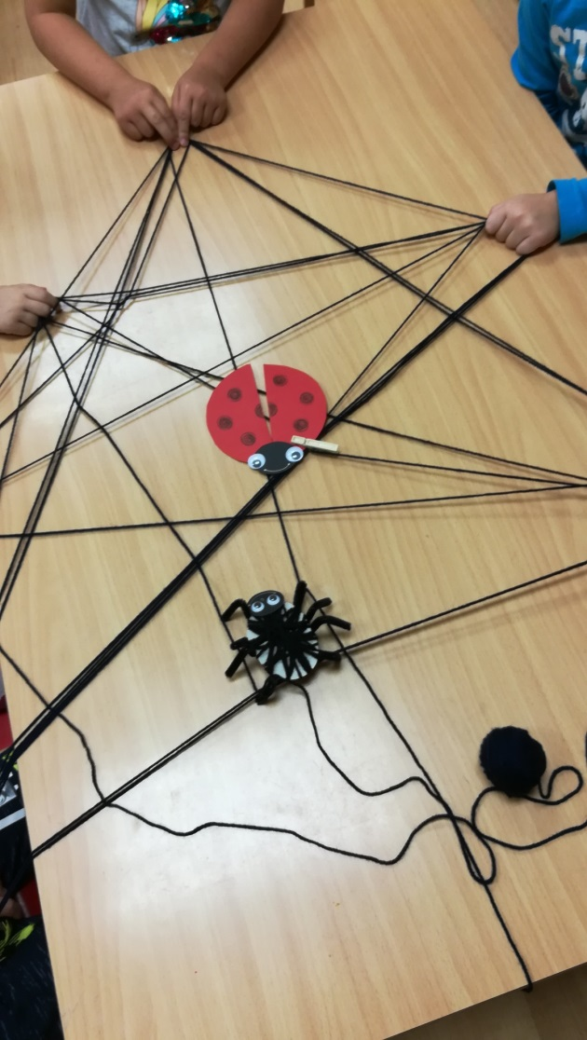
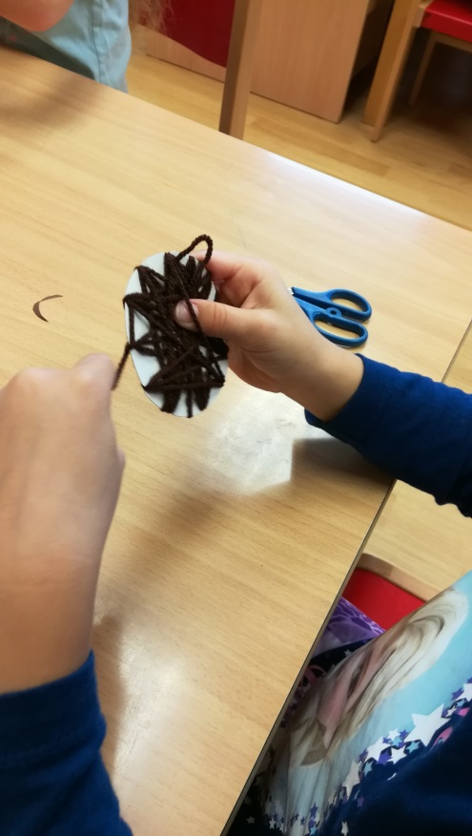
During our work we noticed a spider… ..and started to talk about
… and create
… and play

Slide 7
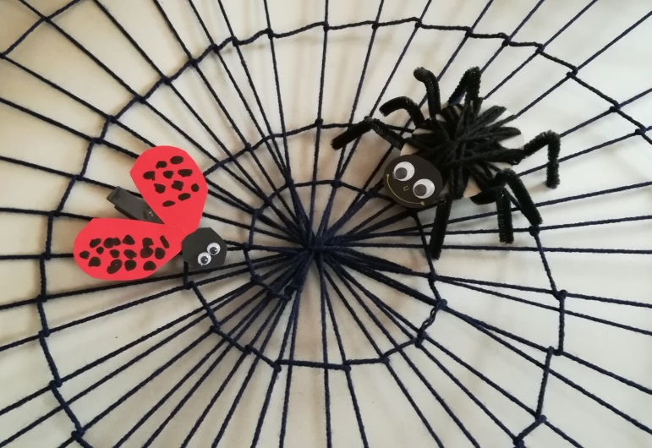
And thinking about an interesting story

Slide 8
A spider web was at the beginning of our story…

Slide 9
… a vznikl tento příběh

Slide 10
… and started this story

Slide 12
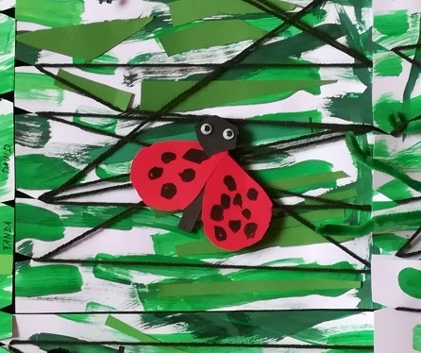
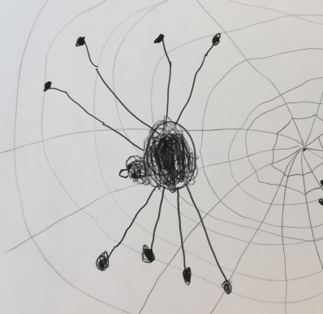
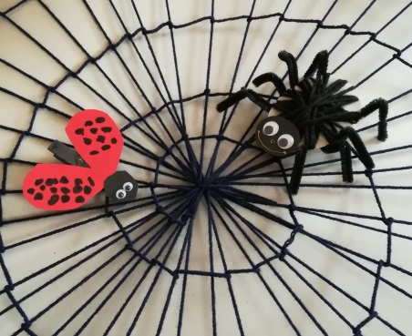
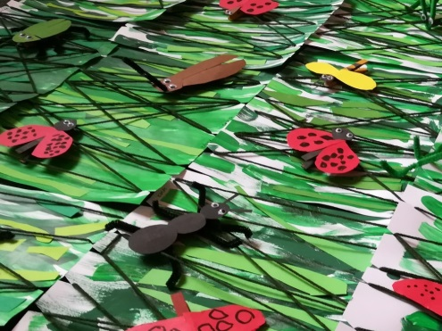
Slovníček vocabulary
sluníčko tráva beruška sun grass ladybug
pavouk pavučina brouci
spider spider web bugs

