Slide 1
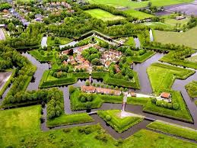
City of Slavonski Brod

Slide 2
during the Roman Empire it was called Marsonia
Slavonski Brod was known until 1934 as Brod na Savi
6th biggest city in Croatia
2009 declared the most beautiful city in Croatia

Slide 3
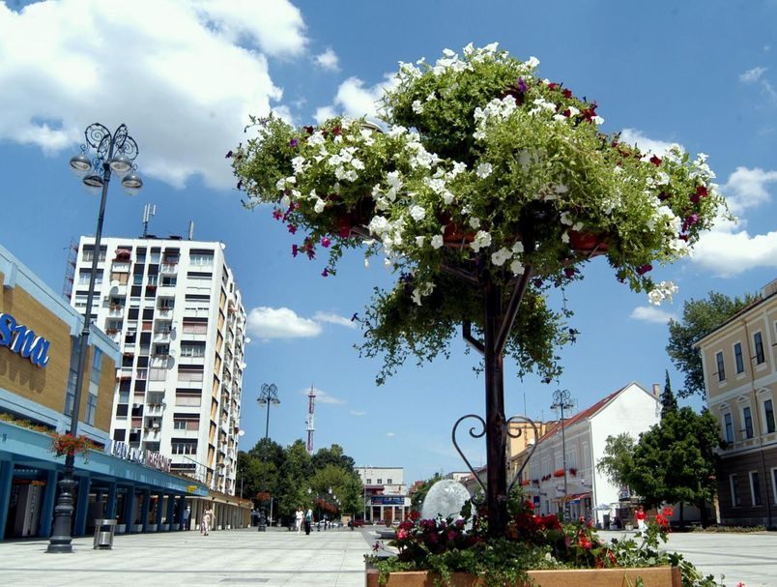
the main town square is the largest in Croatia

Slide 4
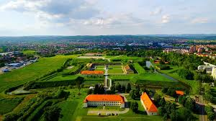
MONUMENTS AND SIGHTS
FORTRESS BROD

Slide 5
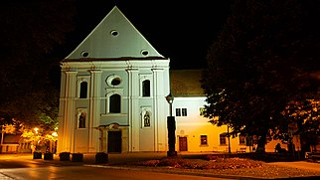
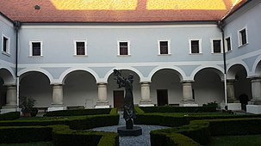
FRANCISCAN MONASTERY AND CHURCH OF THE HOLY TRINITY

Slide 6
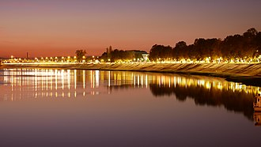
PROMENADE BY THE SAVA RIVER

Slide 7
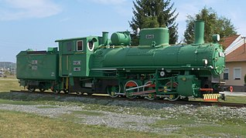
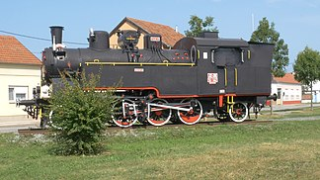
INDUSTRIAL PARK

Slide 8
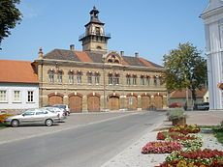
FIRE STATION

Slide 9
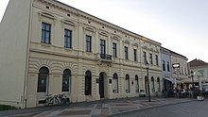
PALACE OF THE BRLIĆ FAMILY

Slide 10
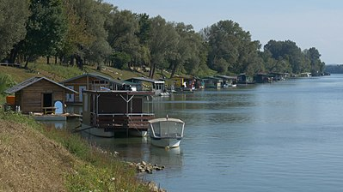
SPLAVARSKA STREET

Slide 11
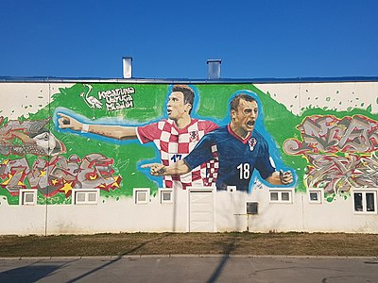
MURAL DEDICATED TO MARIO MANDŽUKIĆ AND IVICA OLIĆ

Slide 12
COME AND ENJOY OUR BEAUTIFUL CITY

