Slide 1
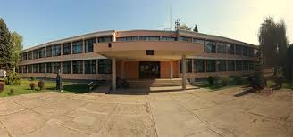
PRIMARY SCHOOL BOGOSLAV ŠULEK

Slide 2
we are elementary school „Bogoslav Šulek” in Slavonski Brod
our students are aged from 6 to 14 and they are responsible, hard-working and interested in all sort of activities
student attend the first to eight grade
we have 1021 students in this year in 55 class department

Slide 4
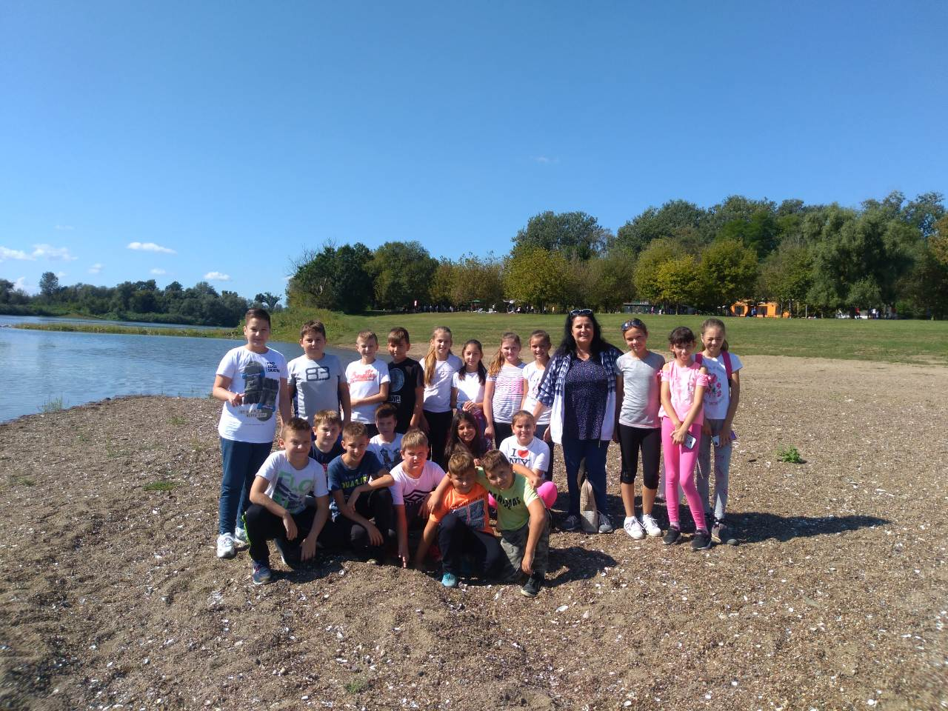

Slide 5
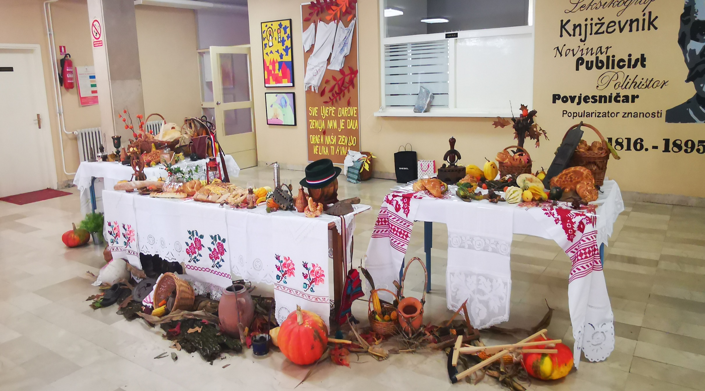

Slide 6
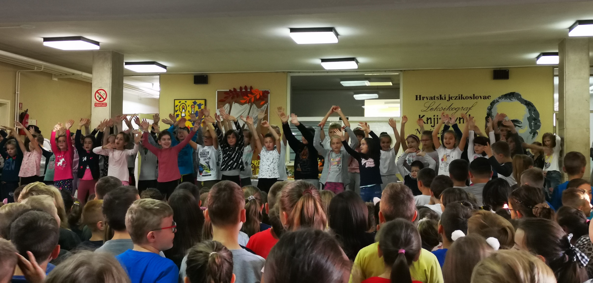

Slide 7
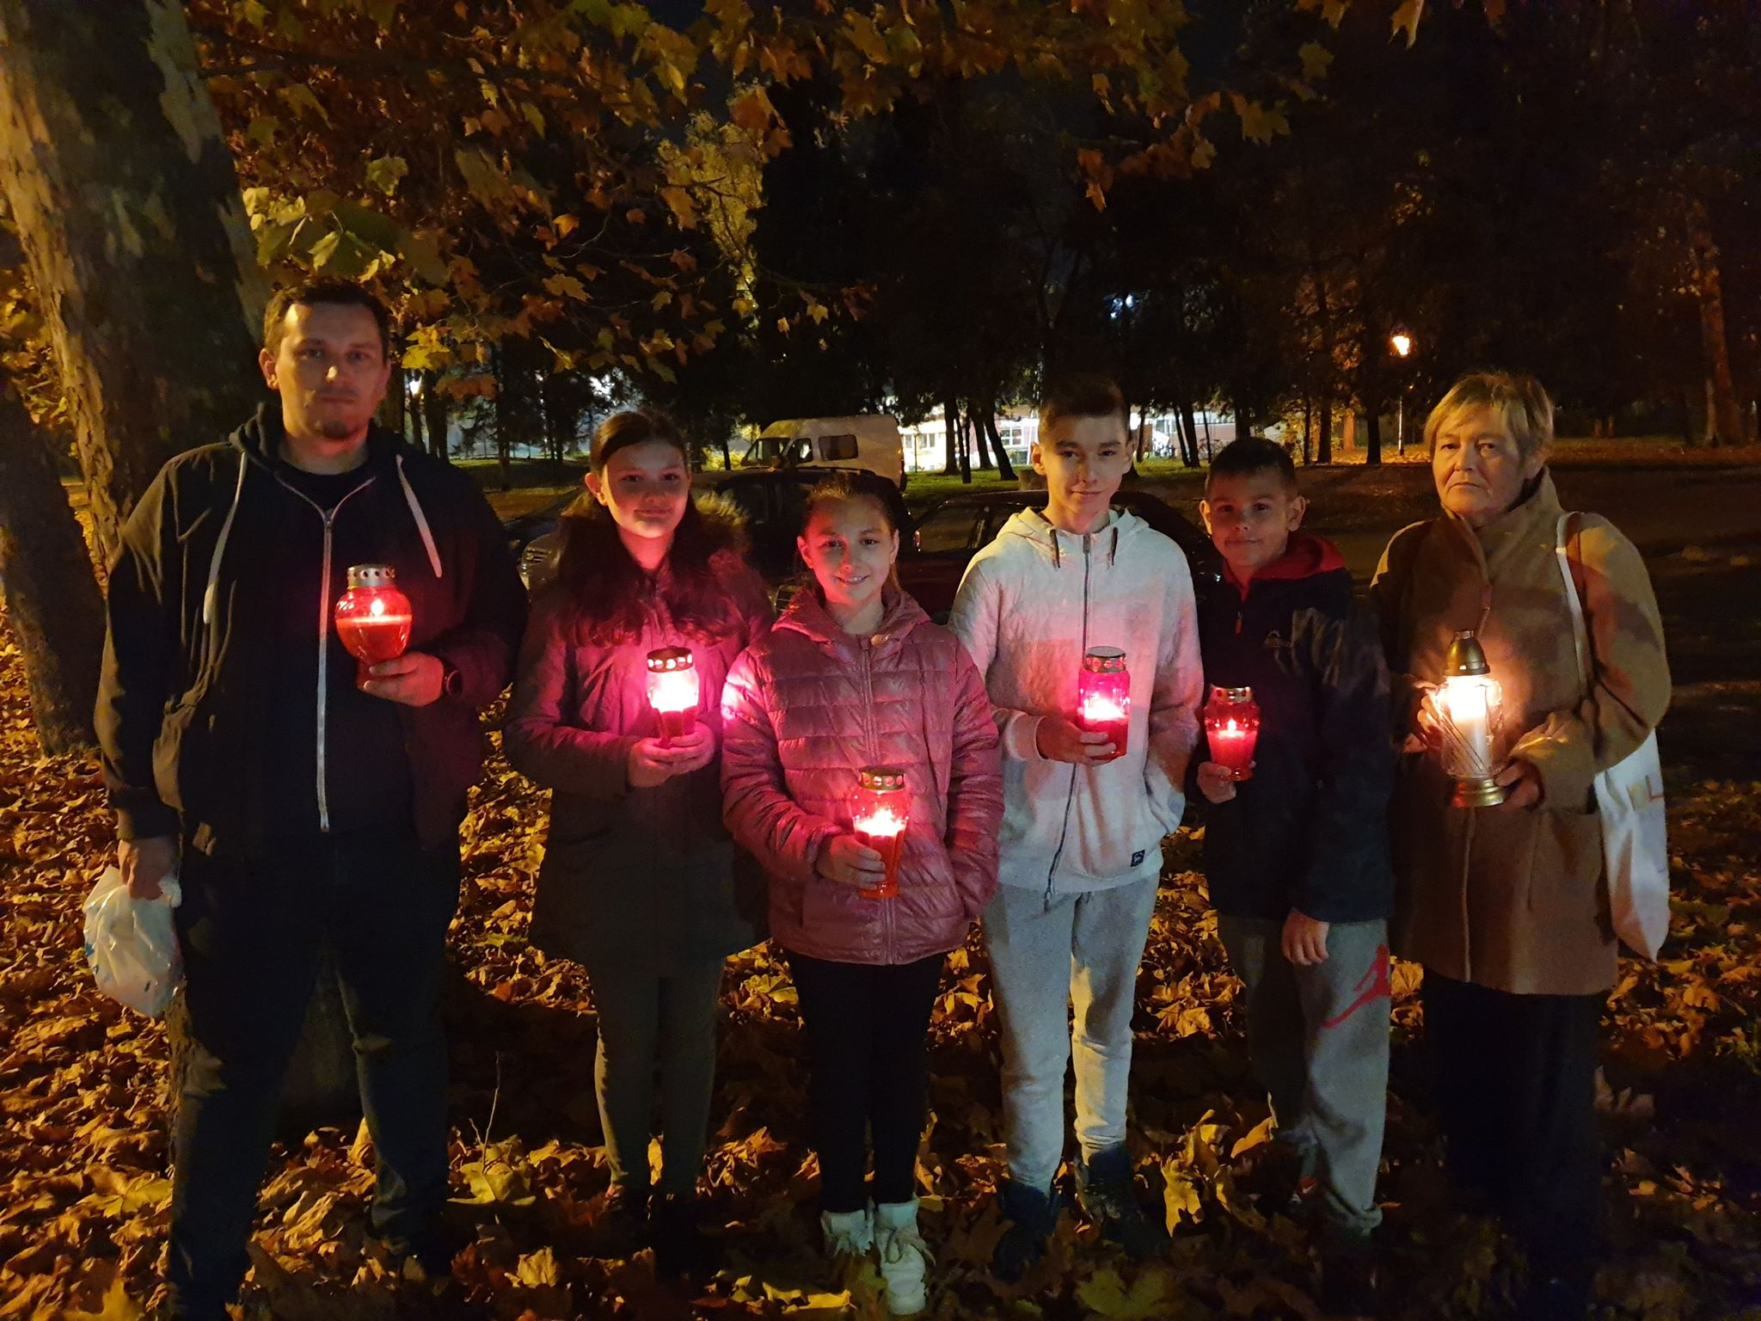

Slide 8
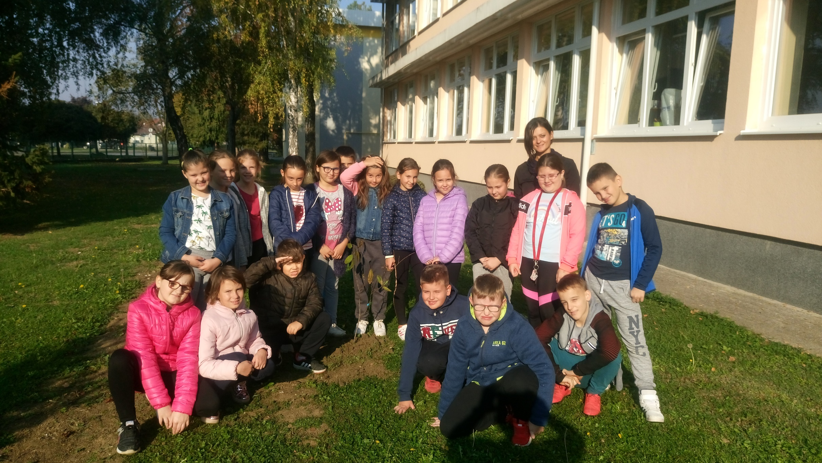

Slide 9
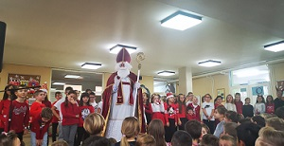

Slide 10
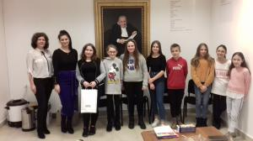

Slide 11
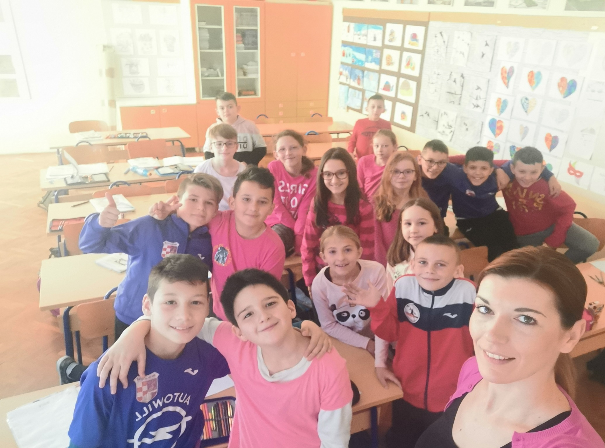

Slide 12
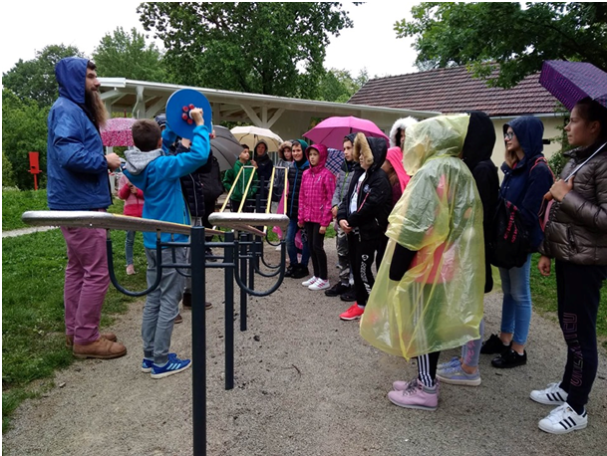

Slide 13
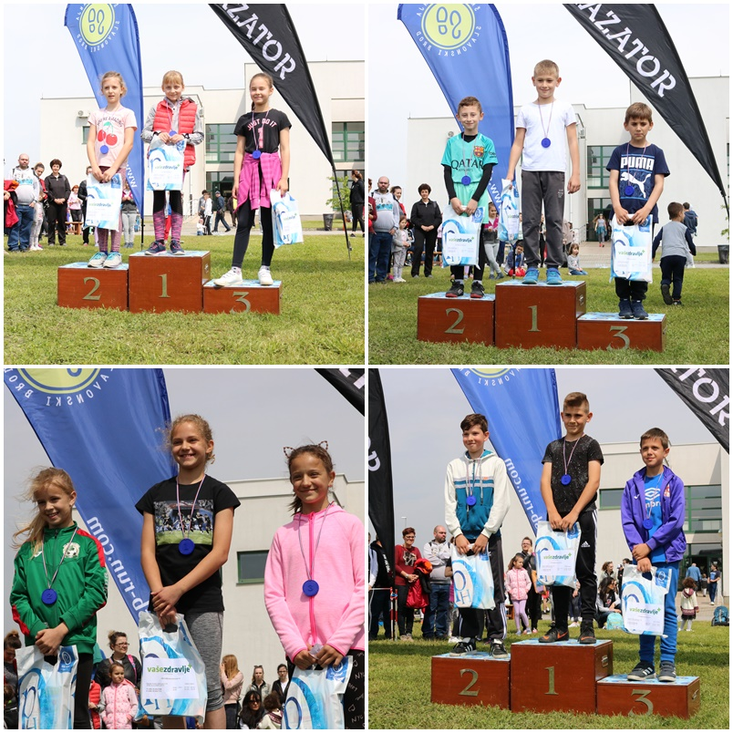

Slide 14
