Slide 1
BEAUTY OF TURKISH PEOPLE

Slide 2
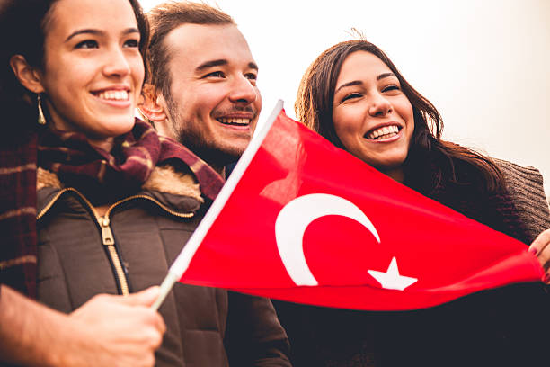
There are so many the beauties of Turkish people.

Slide 3
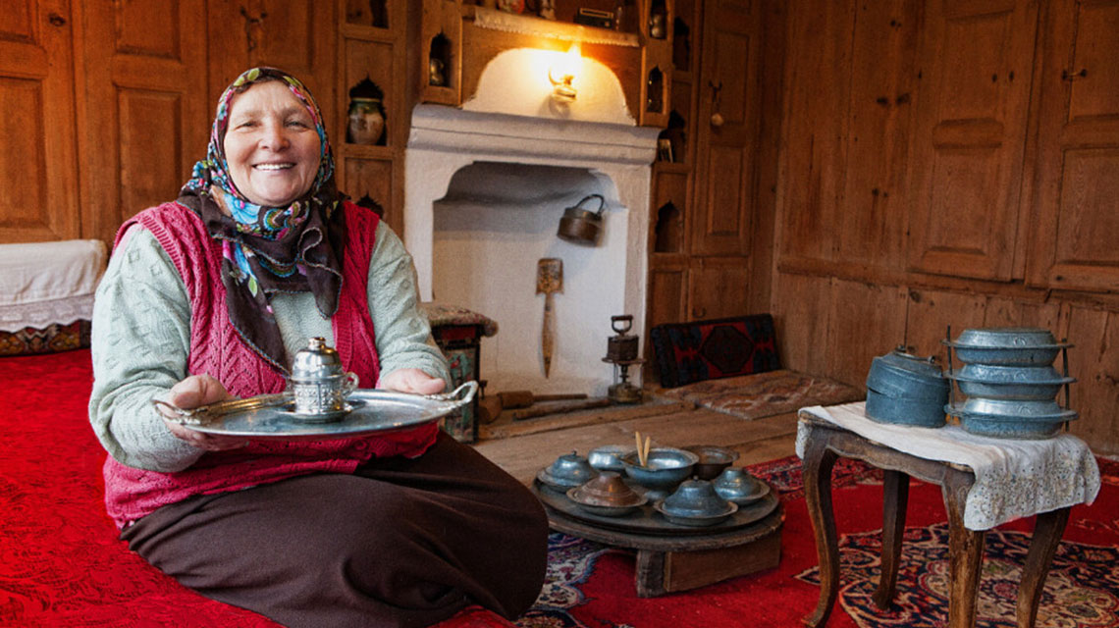
1.Hospitality
Turkish people are known for their hospitality.
They are very friendly, helpful and generous people.
They love helping others and welcoming to guests and visitors.

Slide 4
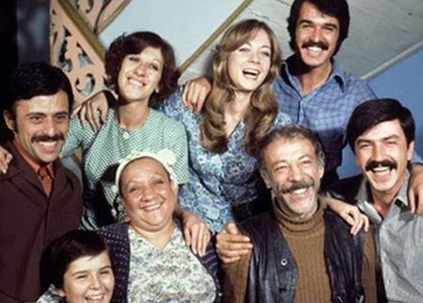
2. Their respect for family
Family is very important in Turkey, and Turkish people always put family first, making sure to respect and take care of them. Many Turkish people prefer to live with their parents until they marry and start their own families.

Slide 5
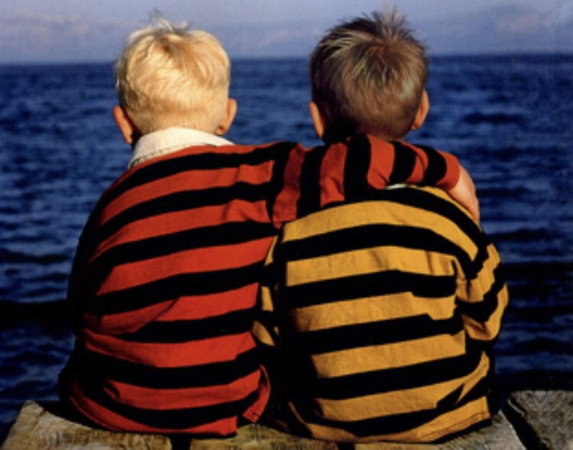
3. Their close friendships
As well as their family, Turkish people are very close to their friends, and have a deep respect for friendships. In Turkey, you can rely on your friends to be by your side during the best and worst of days.

Slide 6
4. Their belief in love and romance
Turkish people are very much in love with love. They believe in soulmates and true love, and savour all the emotions that come with falling for a special someone. Turkish songs, whether pop or thousand-year-old folk, are almost always about the joys and woes of love.

Slide 7
5. Their fantastic cooking skills
One element that every visitor to Turkey will talk about extensively is the amazing food – and Turkish people have a true talent for creating amazing dishes.

Slide 8
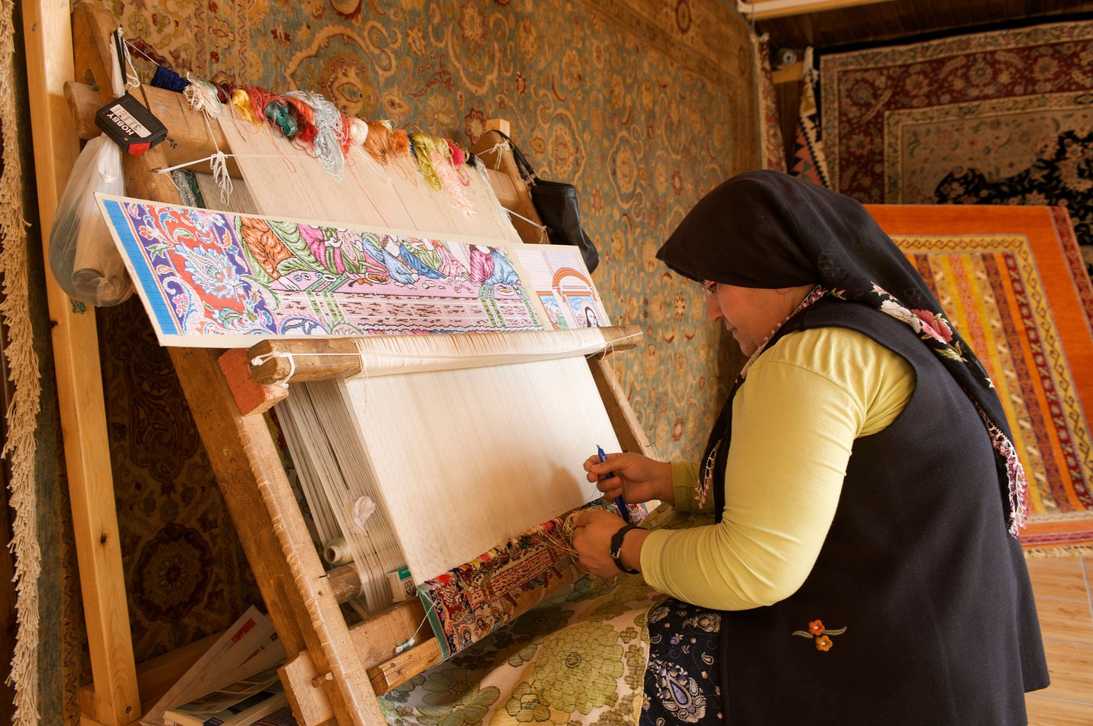
6. Their many talents
As well as their amazing cooking skills, Turkey’s people have many talents, whether they are traditional craftspeople, fashion designers, actors, singers, athletes, film directors, authors or intellectuals.

Slide 9
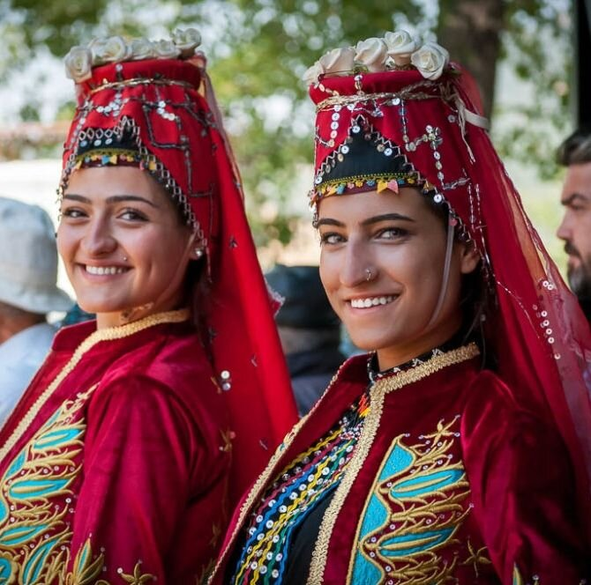
7.Their timeless traditions and culture
Even though Turkey is quite the modern country, there are many traditions and cultural elements that have survived through the ages. From folk dance and music to literature and art, Turkey’s past is celebrated and preserved.

Slide 10
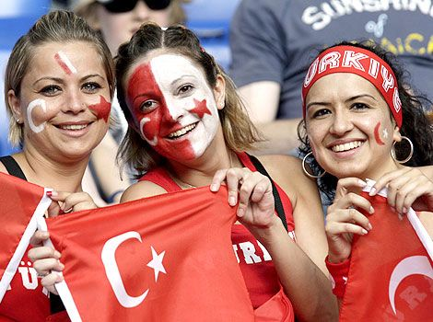
8.Their pride in their country
Turkish people are very proud to be Turkish, and they are enthusiastic when it comes to sharing their history and culture with visitors.

Slide 11
Thank you for listening to us!

