Slide 1
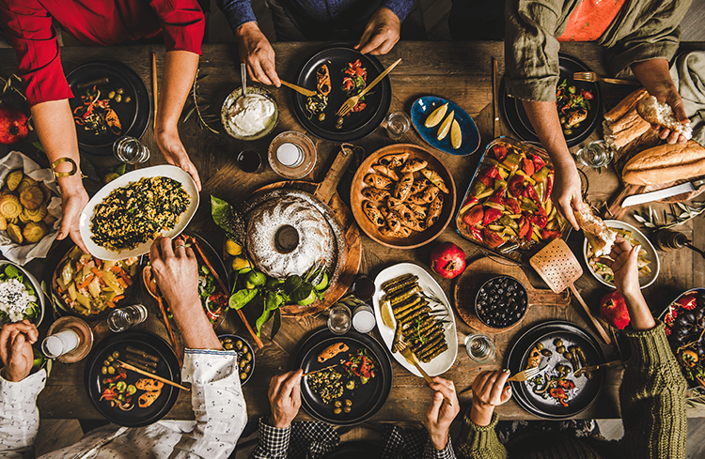
Beauty of Turkish Food
Tastes of a Splendid Heritage

Slide 2
Do not underestimate the dish by calling it just food.
The blessed thing is an entire civilization in itself.
A. Şinasi Hisar( Turkish Novelist)

Slide 3
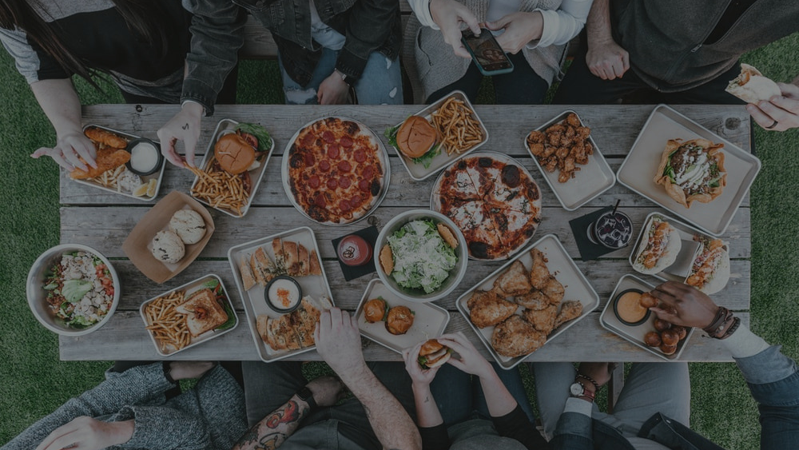
Food connects people.
There is nothing in the world that brings people together like food. Meals become a time for family and friends to come together and share the stories...Food is an emotion and food is medicine...
That is the beauty of food...

Slide 4
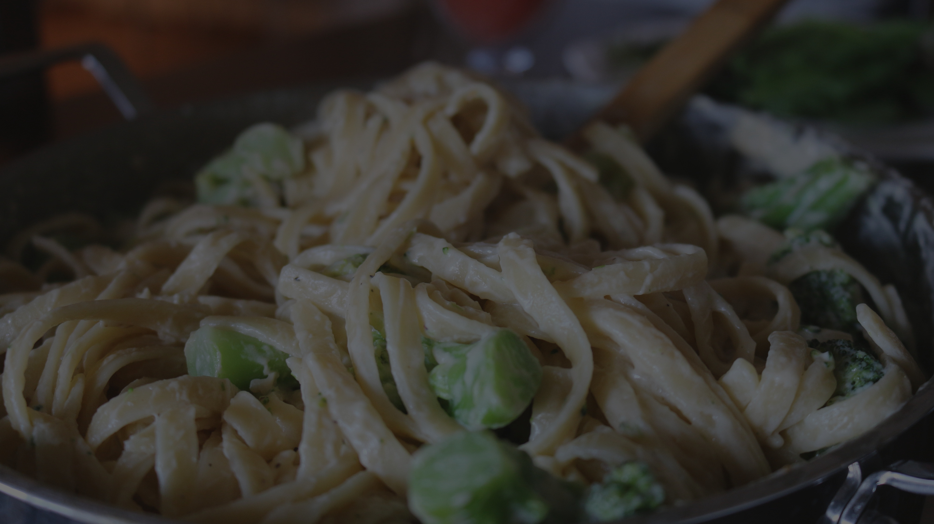
Turkish cuisine is one of the most appetizing and rich cuisines of the world, and Turkish people are known to be quite passionate about food.

Slide 5
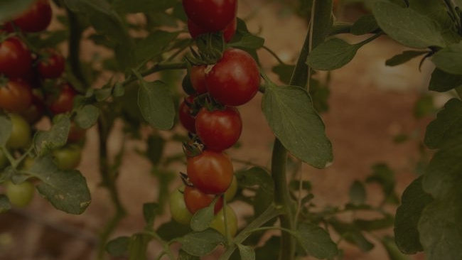
Türkiye is divided into seven regions.Every region has it’s own characteristic soil, climate and of course food.

Slide 6
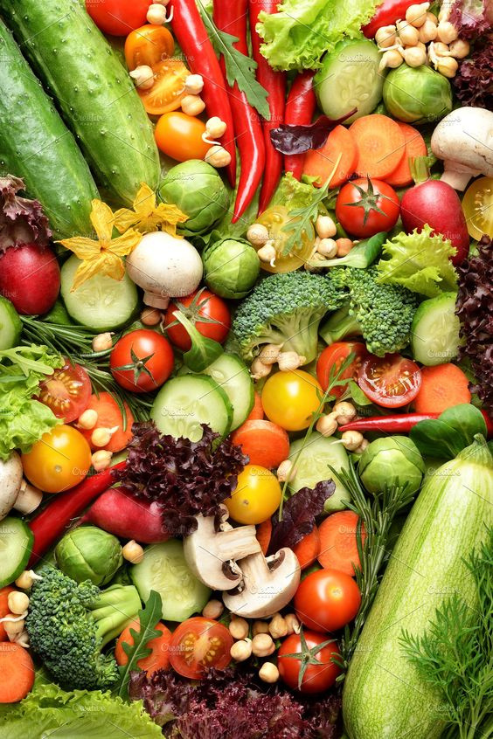
Turkish cuisine uses many vegetables, and some of the most used vegetables are zucchini, tomato, onion, eggplant, cauliflower, green beans, potatoes, spinach, chickpeas, garlic, and lentils.
The most used meat in Türkiye is lamb meat, followed by cattle and chicken meat. Fish is mostly consumed in coastal areas.

Slide 7
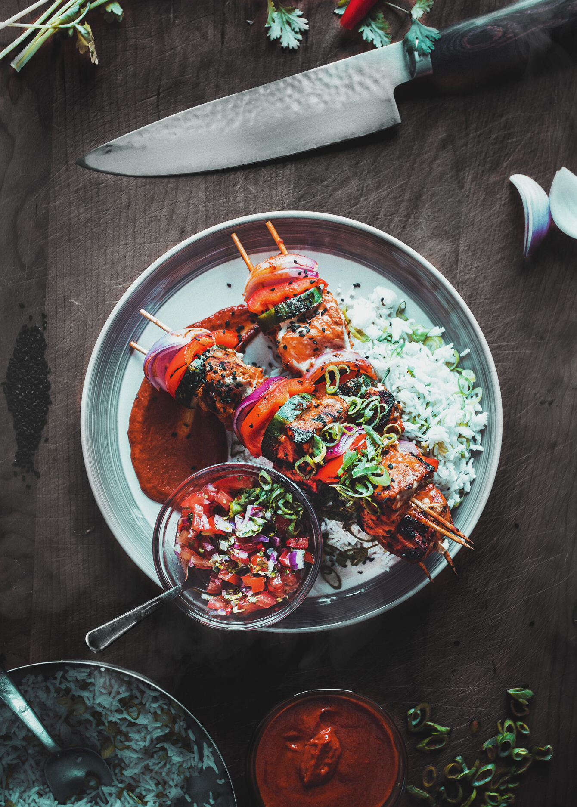
Turkish Eating Habits
Turkish people eat three meals a day.
They usually prefer eating homemade meals at home.
Elder family members start eating first and the younger ones serve meals in a traditional Turkish family.
They like hosting guests and eating together.

Slide 8
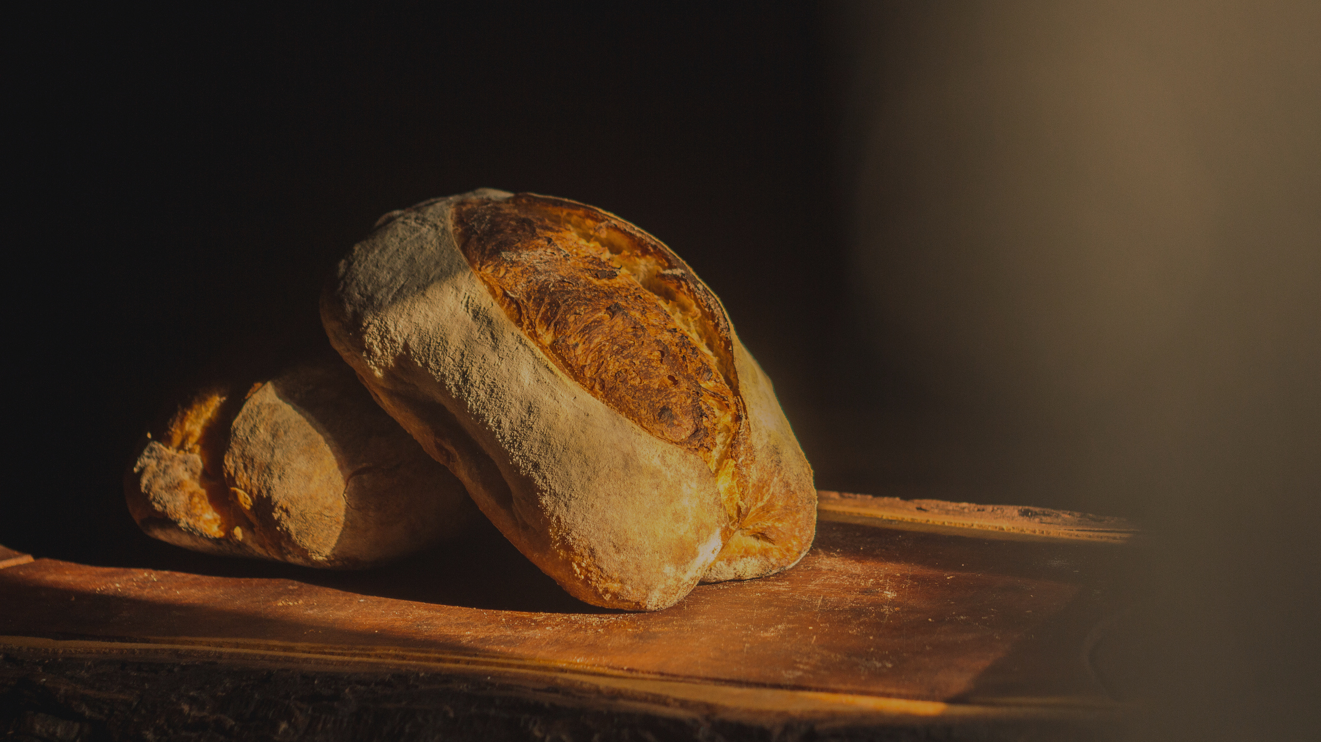
They say "Afiyet Olsun!" before start eating which means that enjoy your meal.
Bread, Bread,Bread:Turks eat bread with everything!
When we finish our meal, we say "elinize sağlık!" to the cook,which means that "good health to your hands
If someone eats loudly, belches, and licks one’s fingers, it is considered rude and shameful.
After eating, our meals, we like drinking Turkish coffee with lokum (Turkish delight) or Turkish tea with a dessert.

Slide 9
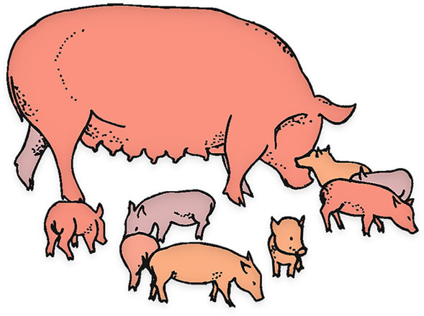
Some animals are not eaten for religious reasons, such as pig, horse, snakes, frogs, mice, scorpions and crows.

Slide 10
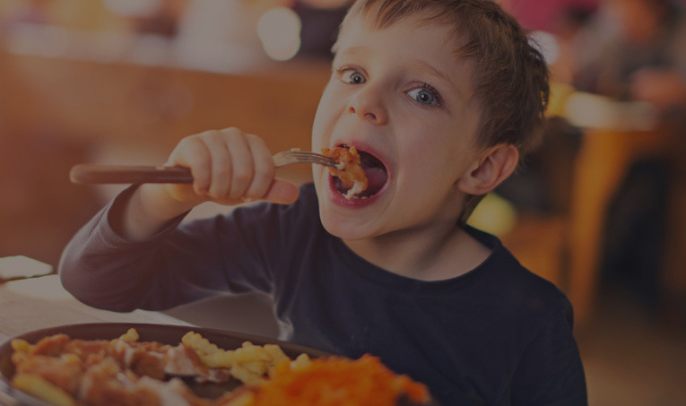
Turks must make sure to eat all the food that is on their plates, and scrape the bottom of the plate. Leaving a portion on the plate is considered a sin; this is based on a religious law regarding avoidance of waste.

Slide 11
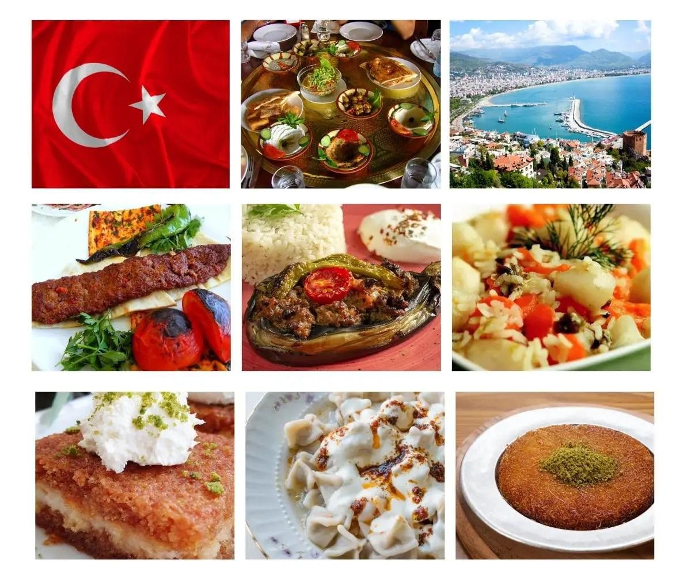
Three Meals of Turkish People

Slide 12
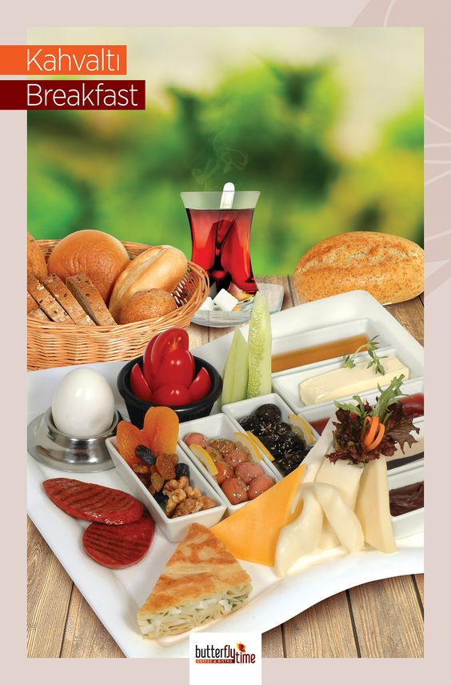
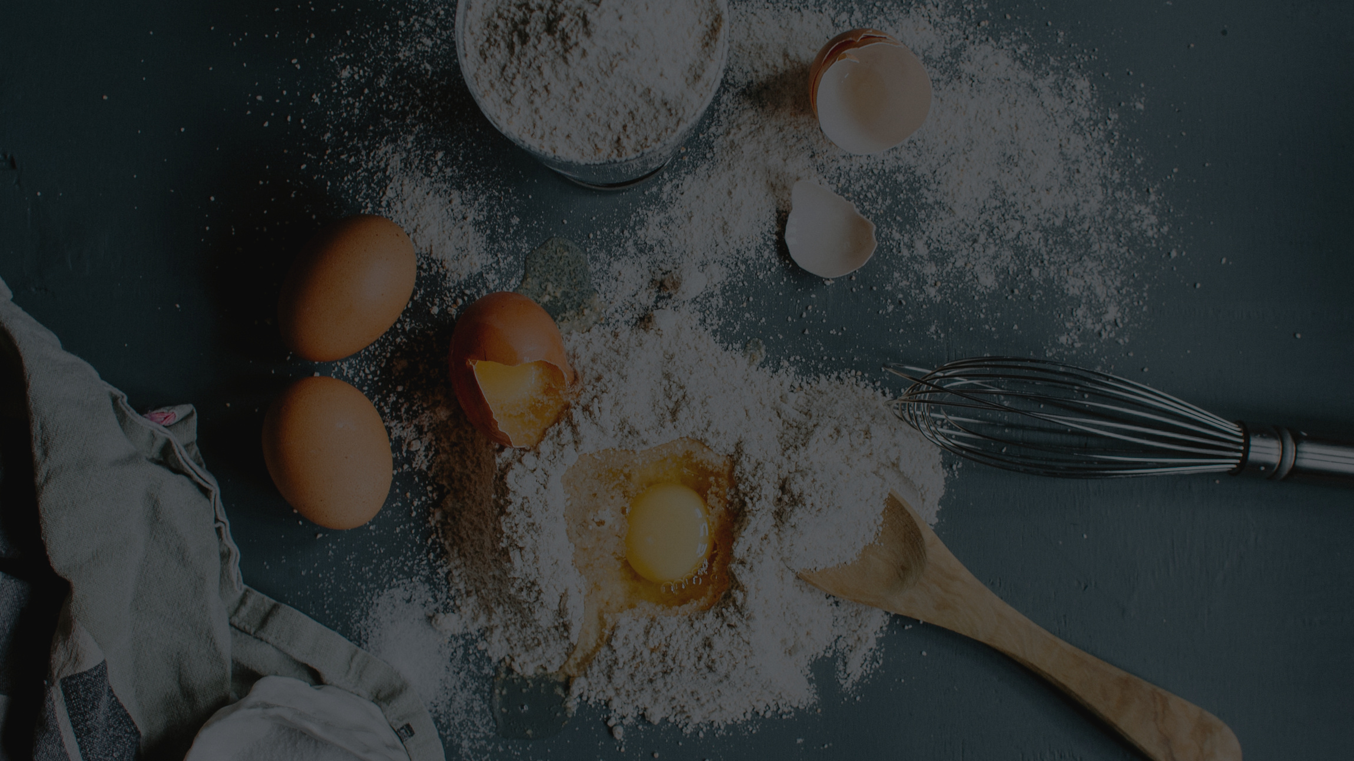
Turkish Breakfast
An average Turkish breakfast is exceptionally rich. In a typical Turkish breakfast, you can find a great variety of cheese, black and green olives, butter, ‘sucuk’ (spicy Turkish sausage), eggs (boiled or fried), tomatoes, cucumbers, bread, honey and jam.

Slide 13
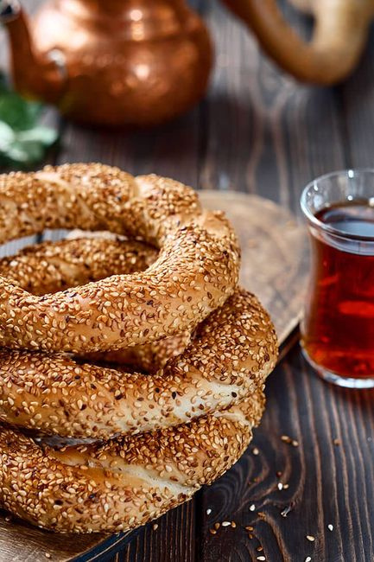
Pastry products such as ‘börek’, ‘poğaça’, and ‘simit’ are also preferred in a rich Turkish breakfast served with, of course, Turkish tea.
Turkish tea is a must in Turkish breakfast.
Turkish coffee is served after breakfast.

Slide 14
01
Turkish Lunch
Turkish people may prefer foods similar to breakfast or dinner. This means that you can find many types of foods like vegetables and meat stews,kebab, pasta, pilav, or simply pastry. The lunch depends on the person, yet there are lots of food varieties to choose from.
Lunch is usually eaten at cafes or local restaurants.

Slide 15
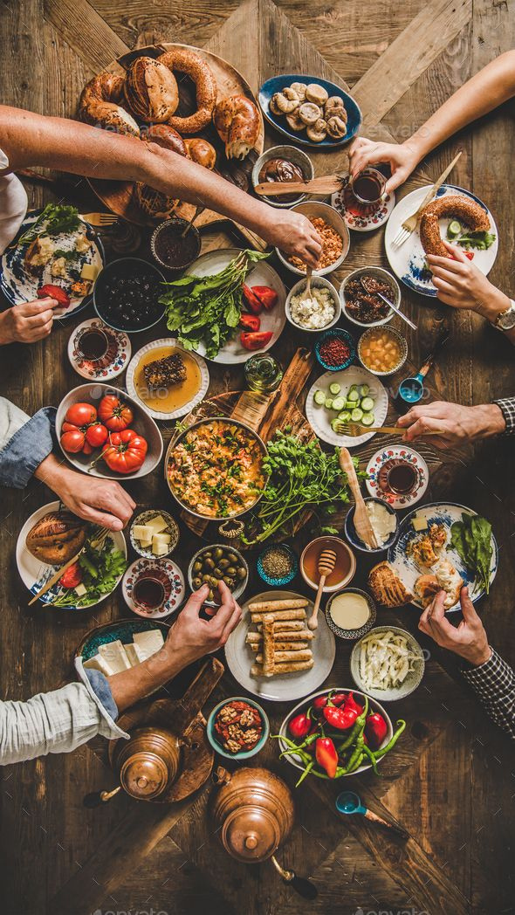
Turkish Dinner
Turkish people prefer to eat their dinner at home, and the tradition is to eat dinner together as a whole family.
A typical Turkish dinner starts with a soup followed by a main course made with vegetables, meat, and legumes.

Slide 16
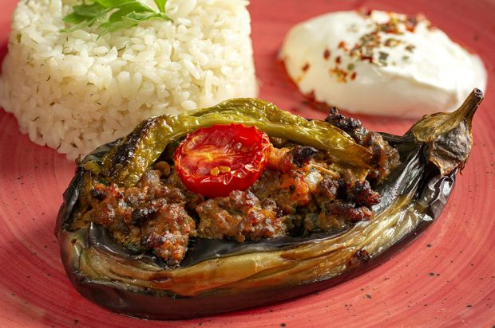
Also, rice and pasta are very common in dinner accompanied by salad, yogurt, ‘ayran’ and ‘cacık.’
Bread is a must at every Turkish dinner table.

Slide 17
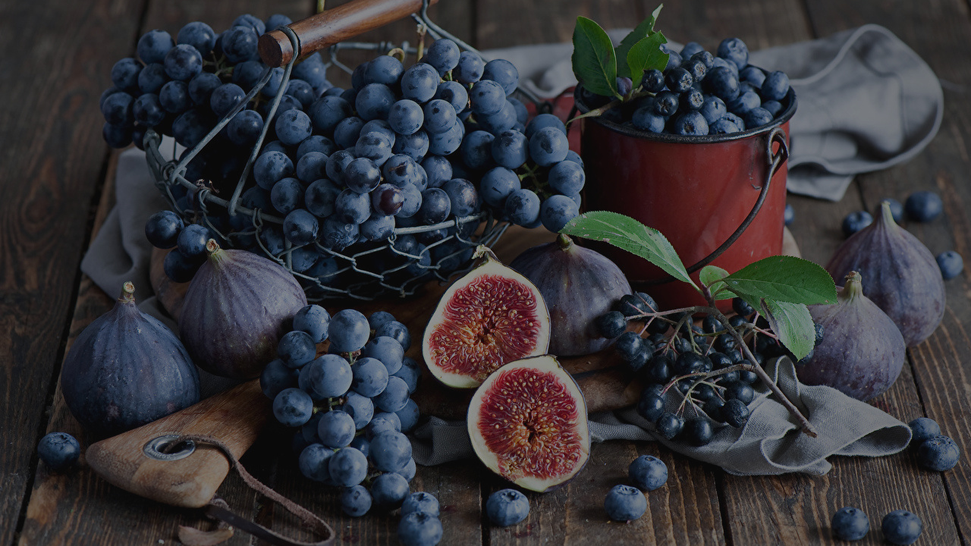
Best Fruits in Türkiye
Turkish Grapes (Sultanas), Turkish Apricots, and Turkish Figs are famous Turkish fruits. Türkiye is the leading producer of apricots, figs, sultanas in the world.

Slide 18
Foods a tourist must taste in Türkiye

Slide 19
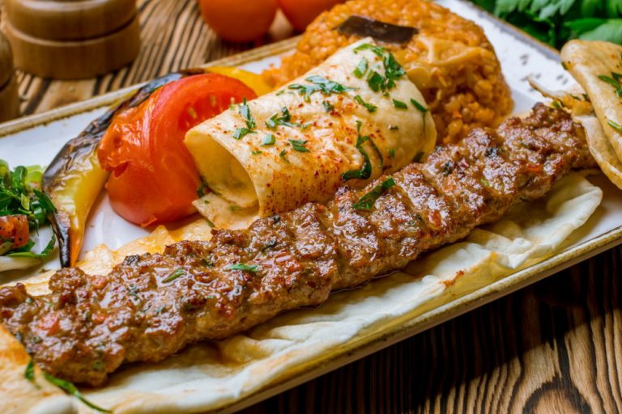
Kebab
It means "grilled or roasted meat"
There are many types of it.

Slide 20
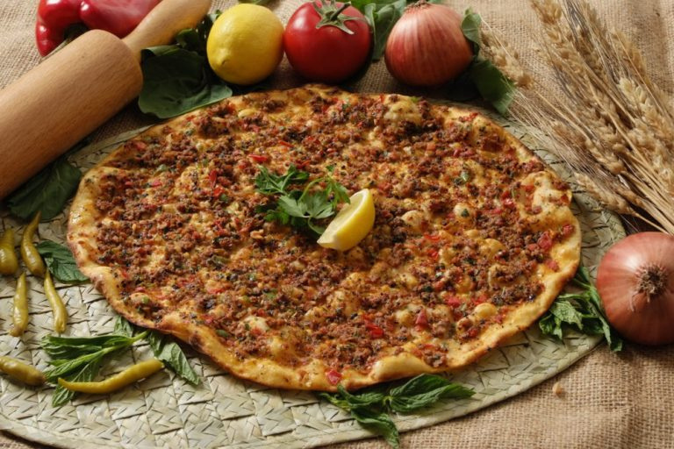
Lahmacun
It isTurkish pizza.

Slide 21
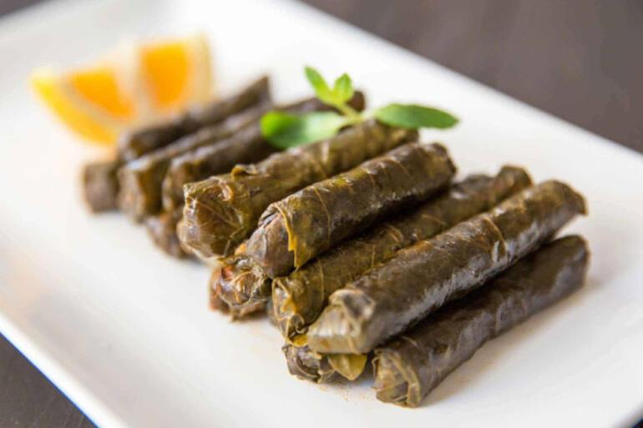
Yaprak sarması
It means "stuffed" in English and describes vegetable or grape leaves filled with rice.

Slide 22
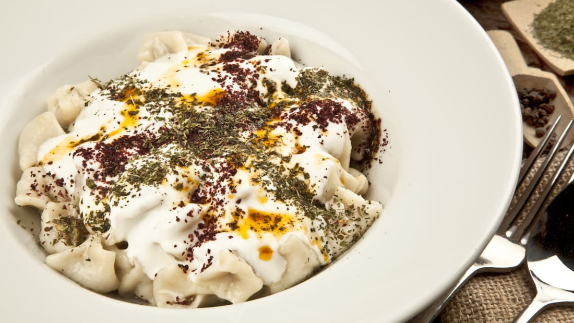
Mantı
‘Mantı’ means dumplings in English. It is served with yogurt and some spices.

Slide 23
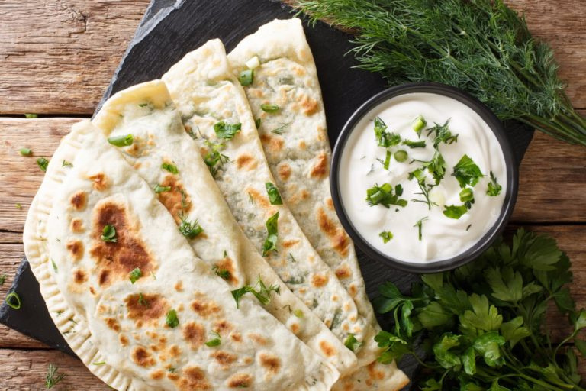
Gözleme
It is thin, mostly spicy filled flat bread. Cheese, spinach and potatoes are very popular fillings.

Slide 24
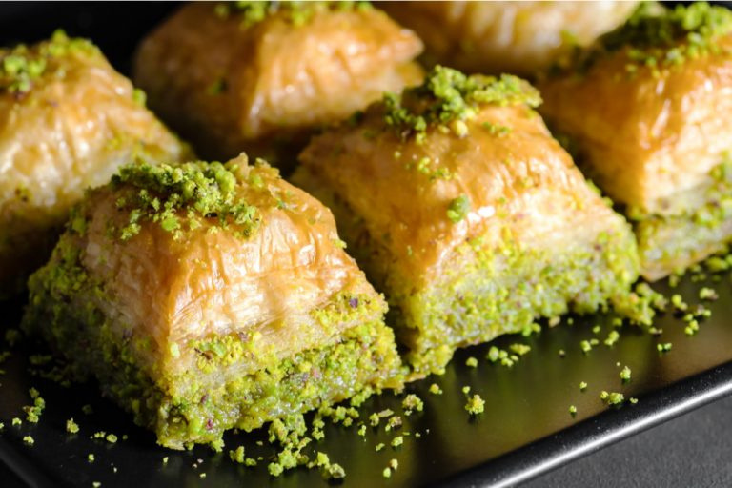
Baklava
Baklava is a sweet treat made of puff pastry covered in honey or sugar syrup and filled with walnuts and pistachios.

Slide 25
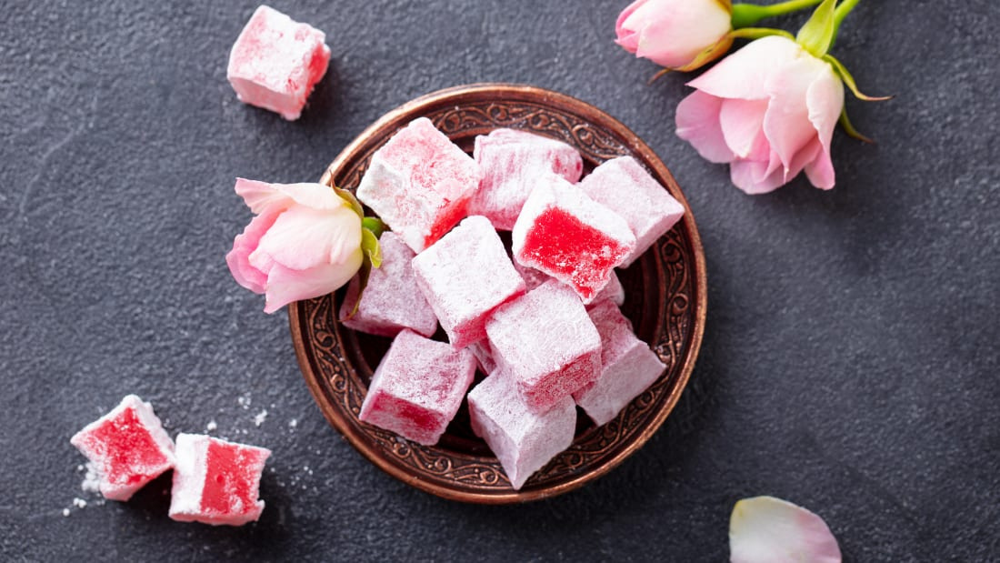
Lokum( Turkish delight)

Slide 26
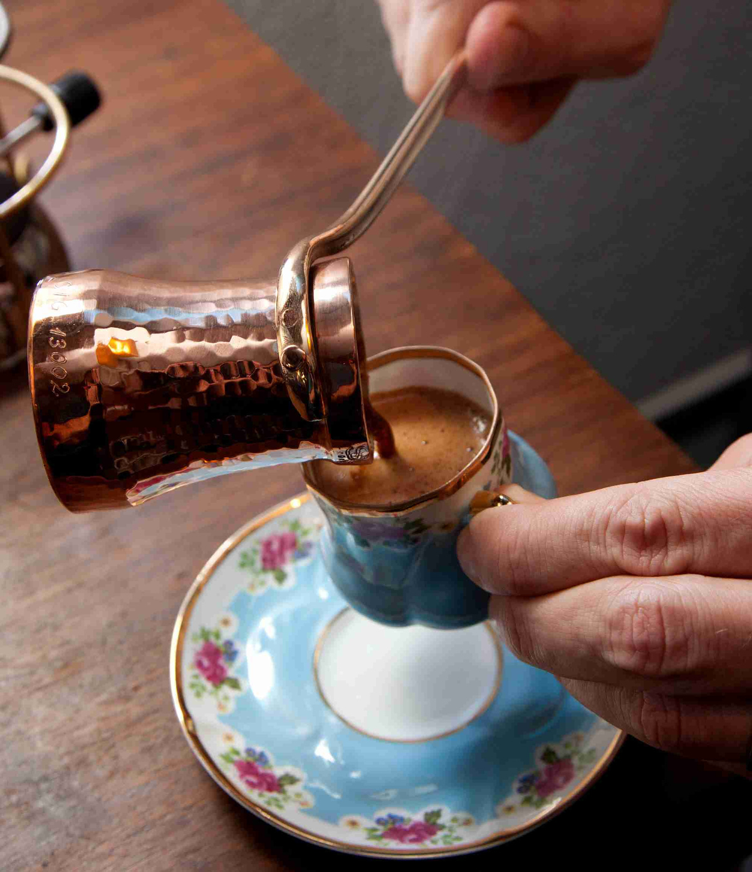
Turkish Coffee
Turkish coffee is a style of coffee prepared in a cezve using very finely ground coffee beans without filtering.

Slide 27
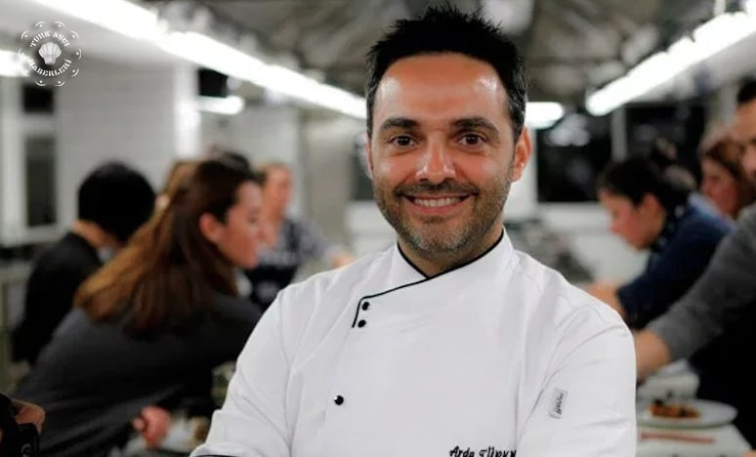
A Turkish Chef-Arda Türkmen
He is one of the very well-known chefs in our country. He does cooking shows on tv.

Slide 28
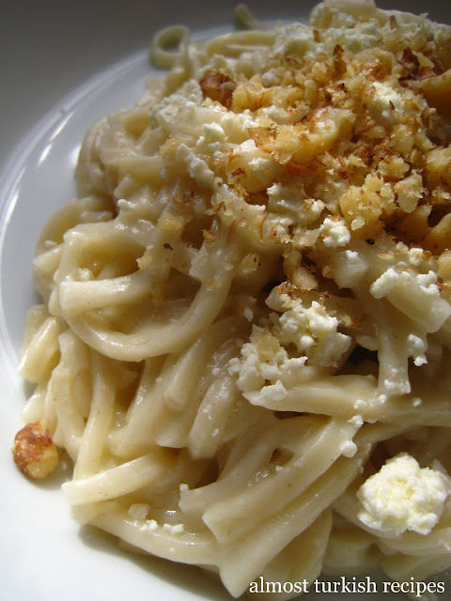
One Recipe from our country
Erişte is home made Turkish pasta. It's generally prepared around September as a winter preparation.

Slide 29
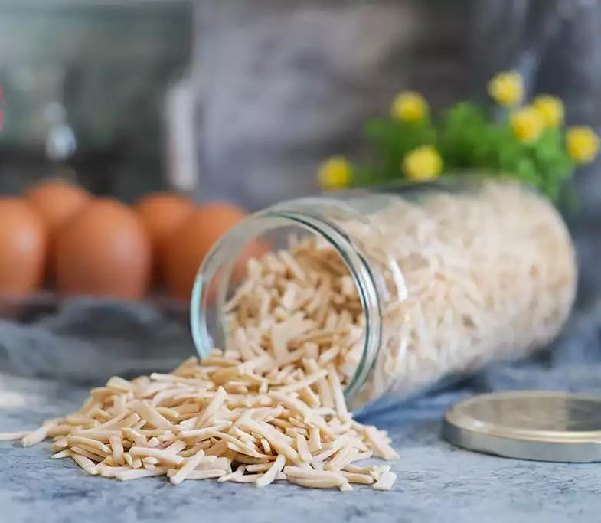
Ingredients
2 cups thinly sliced egg noodles
2tbsp butter
Salt
mozzarella cheese
walnuts
parsley
4 cups of water

Slide 30
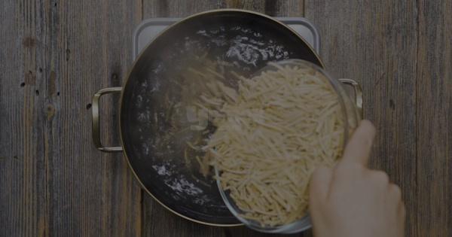
How to make
Step 1
Boil the water and add a pinch of salt.
Step 2
Add the erişte and let cook for 8-10 minutes until just tender.

Slide 31
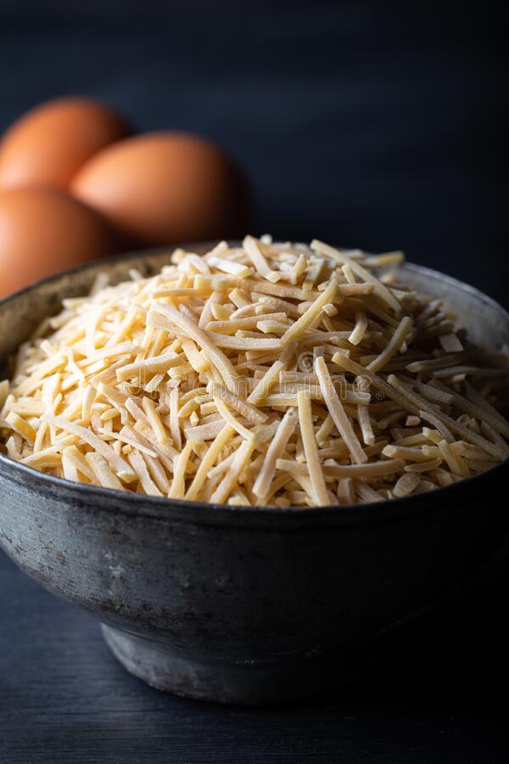
Step 3
Melt the butter in a medium pan.
Step 4
Drain egg noodles and toss in with melted butter.
Step 5
Saute about 3-4 minutes and take over a serving
plate. Garnish with walnuts, cheese and parsley.

Slide 32
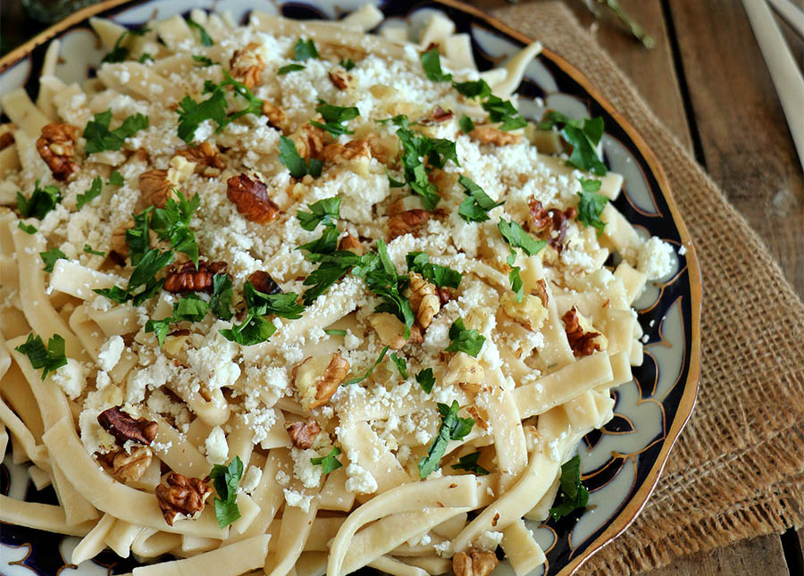
Enjoy!

Slide 33
Thank you for your attention!

