Slide 1
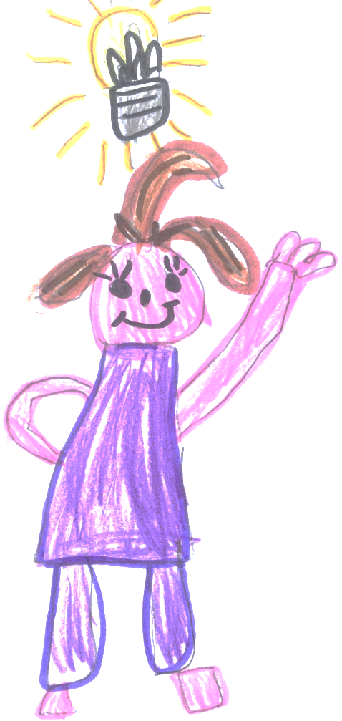
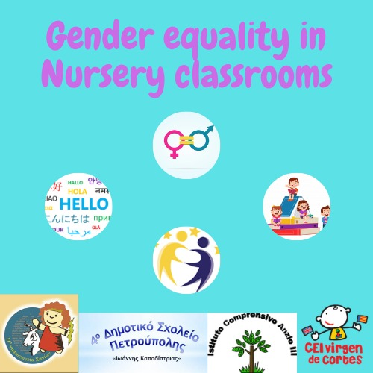
Our school:
Istituto Comprensivo Anzio III

Slide 2
Our city: Anzio
Our school is situated in Lavinio Lido di Enea, a little suburb of Anzio, a touristic and residential town of about 56,000 inhabitants situated on the Tyrrhenian coast of Lazio 50 km far from Rome.

Slide 3
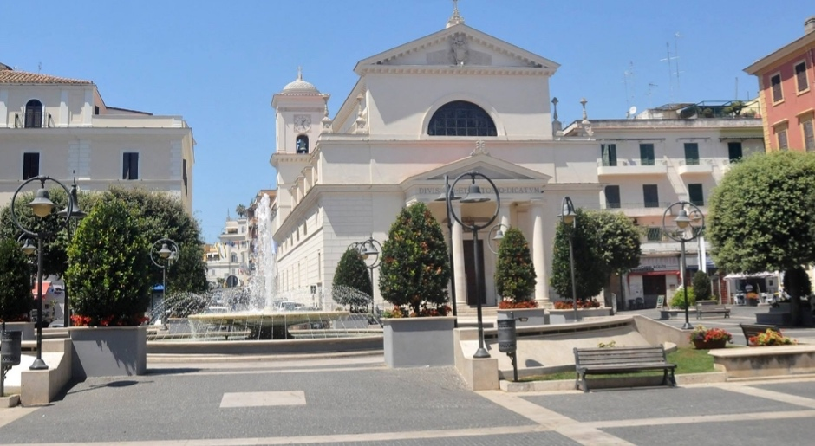
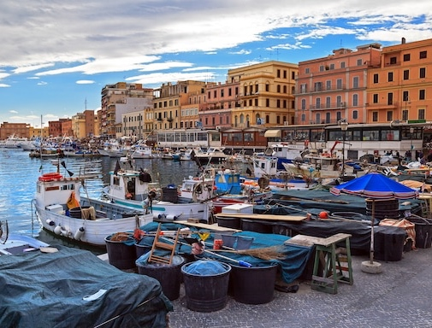
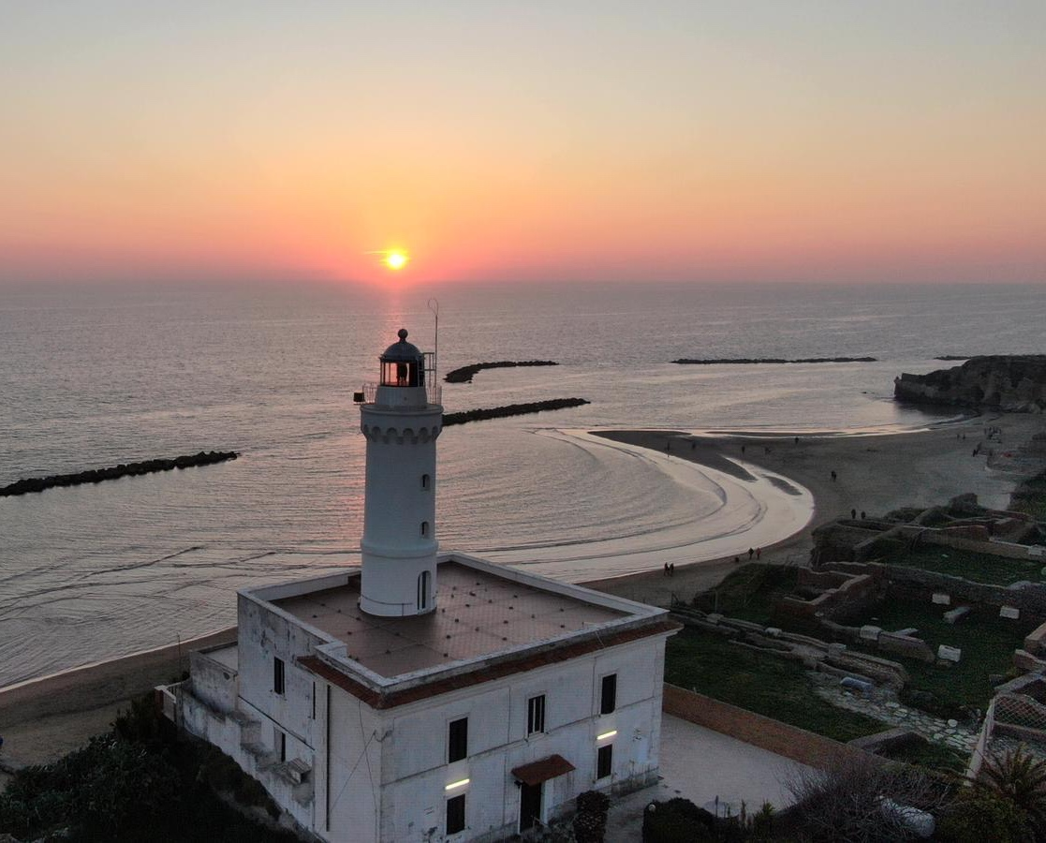
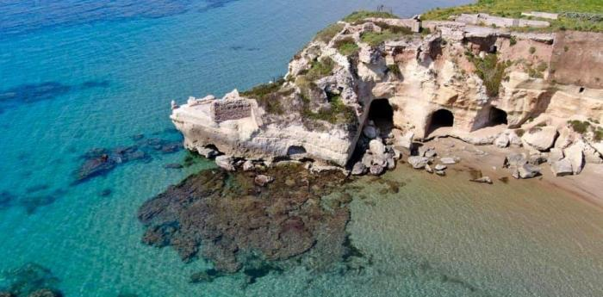

Slide 4
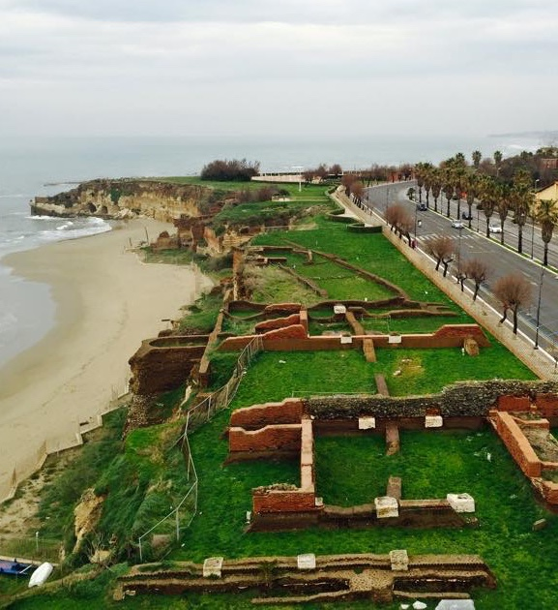
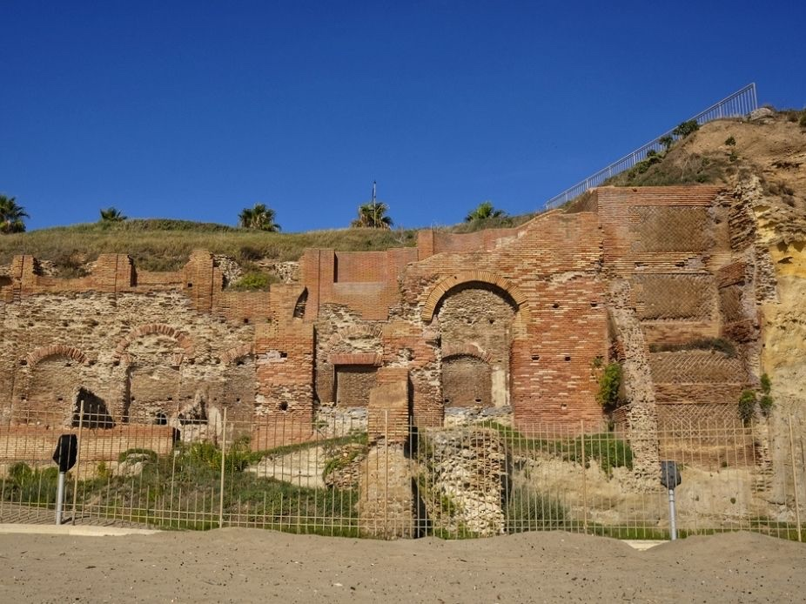
The city of Anzio is well known for the ancient roman ruins (villa, theatre…) and for the landing of troops, named after the city during the Second World War (January, 22nd 1944).

Slide 5
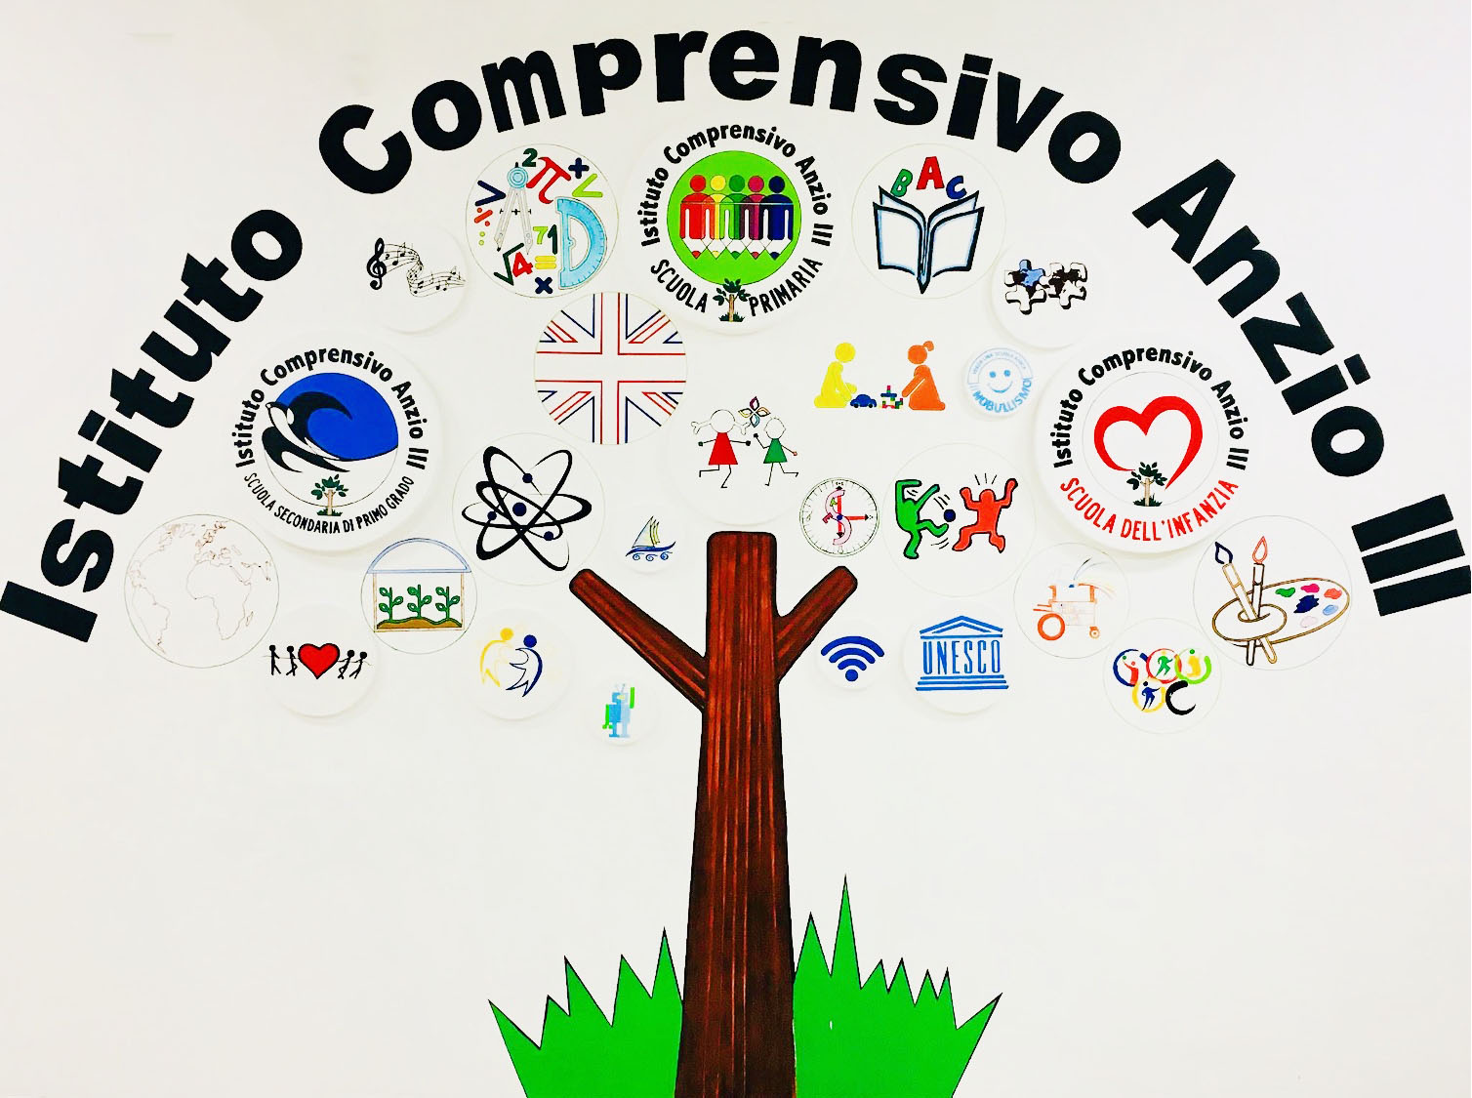
The city of Anzio is well known for the ancient roman ruins (villa, theatre…) and for the landing of troops, named after the city during the Second World War (January, 22th 1944).
Our School

Slide 6
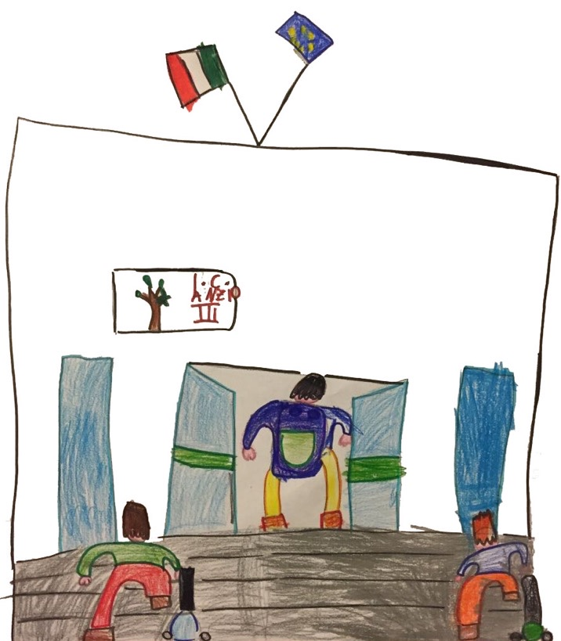
Our school has…
150 teachers on 1300 pupils aged from 3 to 14 years attending kindergarten, primary and secondary school of first grade.
Our school welcomes a large number of students who don’t have Italian origins (37% of them comes from countries belonging to the European community, while 63% from non EU countries).

Slide 7
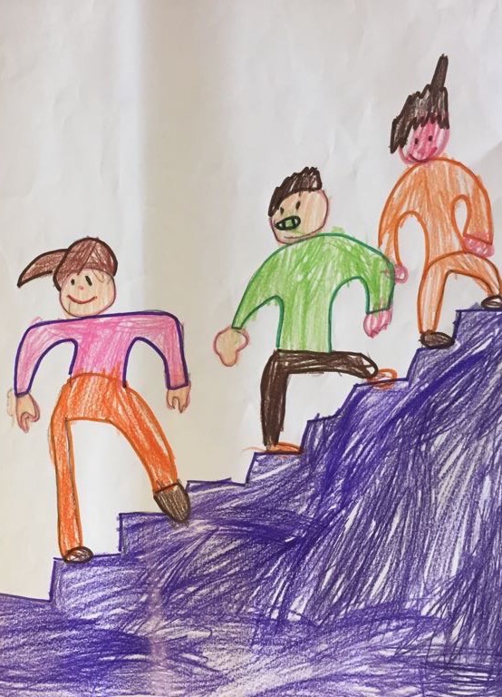
Consists of 3 complexes with classes of:
Kindergarten;
Primary school;
Secondary school of first grade.

Slide 8
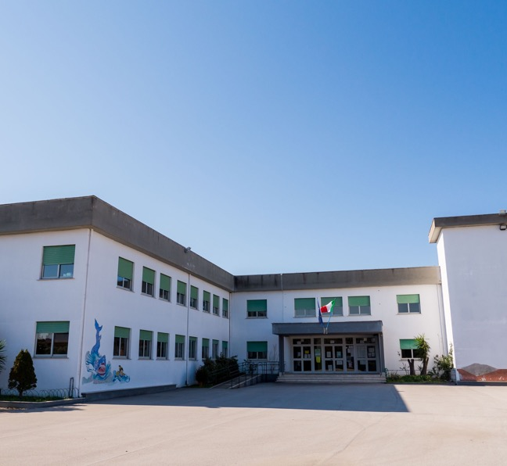
Collodi complex
Primary school
5 first classes;
6 second classes;
5 third classes;
6 fourth classes;
5 fifth classes.
Secondary school of first grade
4 first classes;
2 second classes;
1 third classes;
Benefits: computer lab and gym
In total 34 classes

Slide 9
Collodi complex (Kindergarten)
6 sections work in full time;
5 sections work in normal time.
In total 11 sections

Slide 10
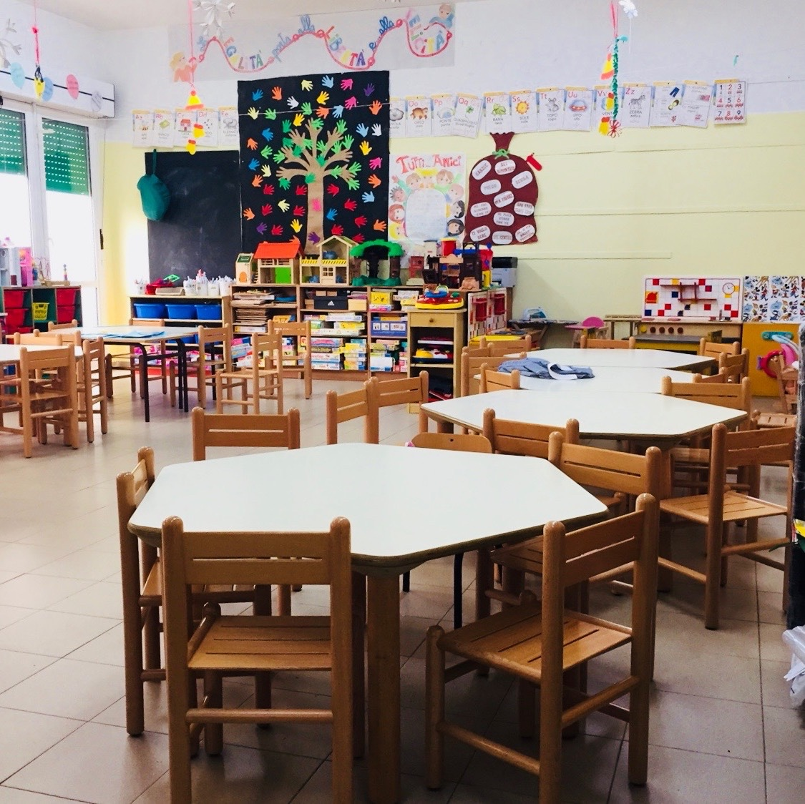
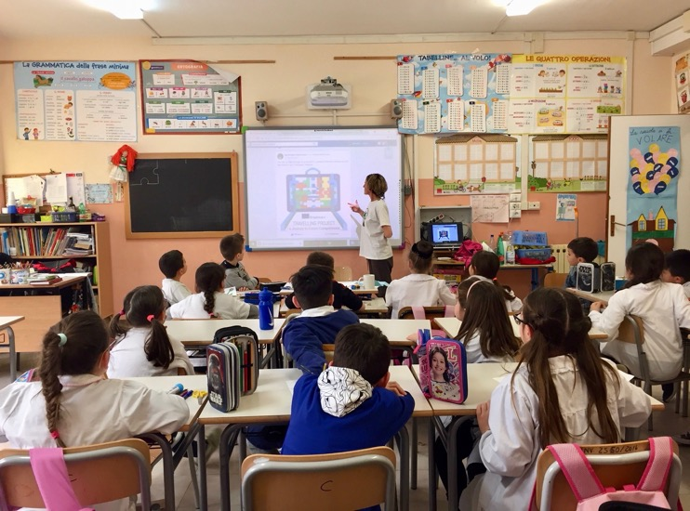
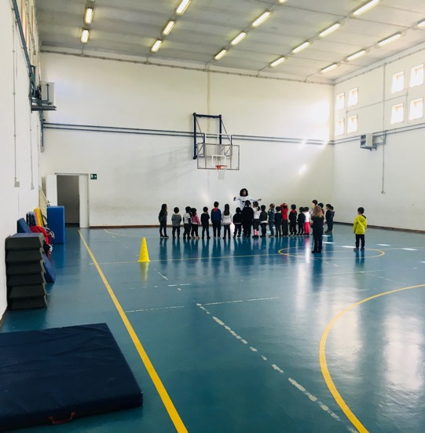

Slide 11
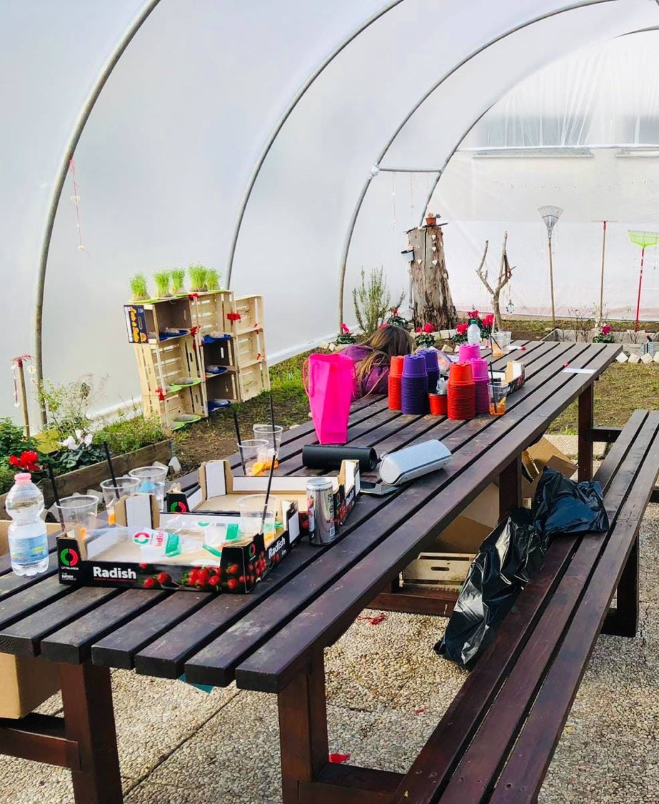
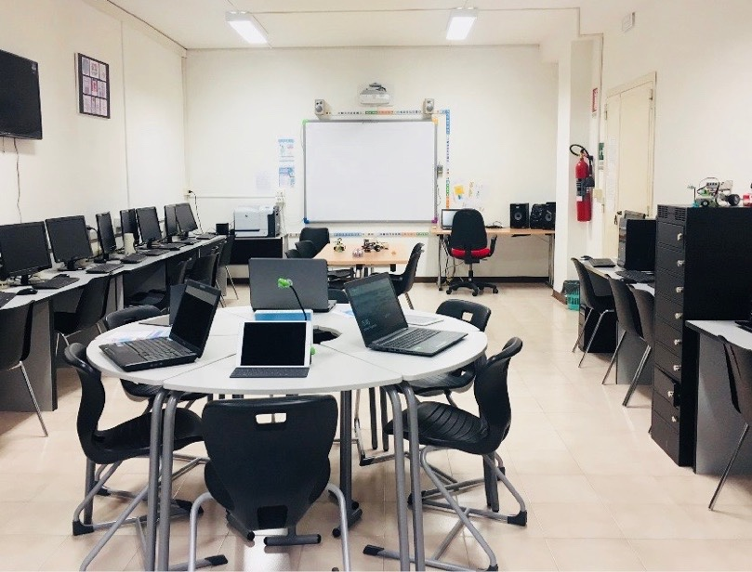
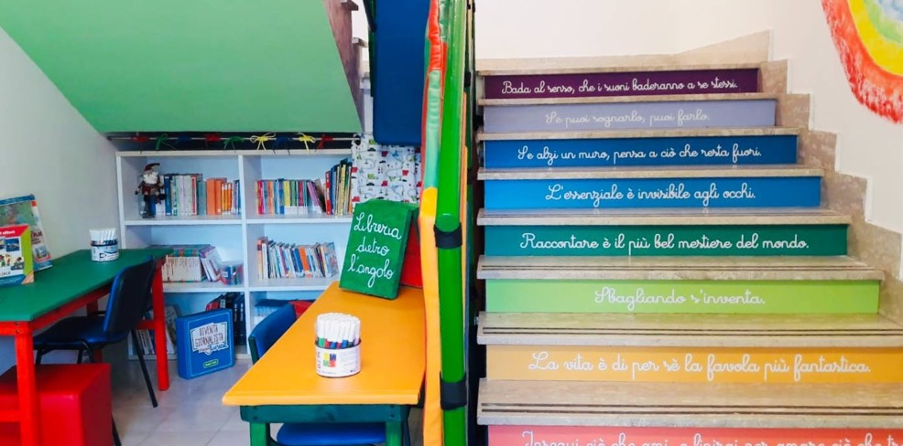

Slide 12
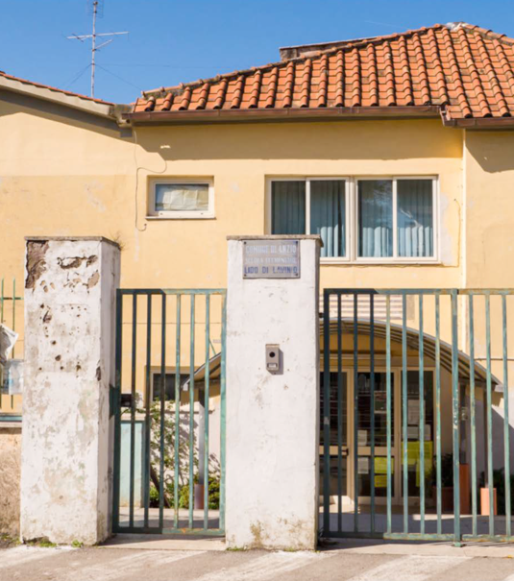
Rodari complex
Primary school
It includes a full course of primary school
Kindergarten
1 section full time
Benefits: science lab,
computer lab, library.
In total 6 classes

Slide 13
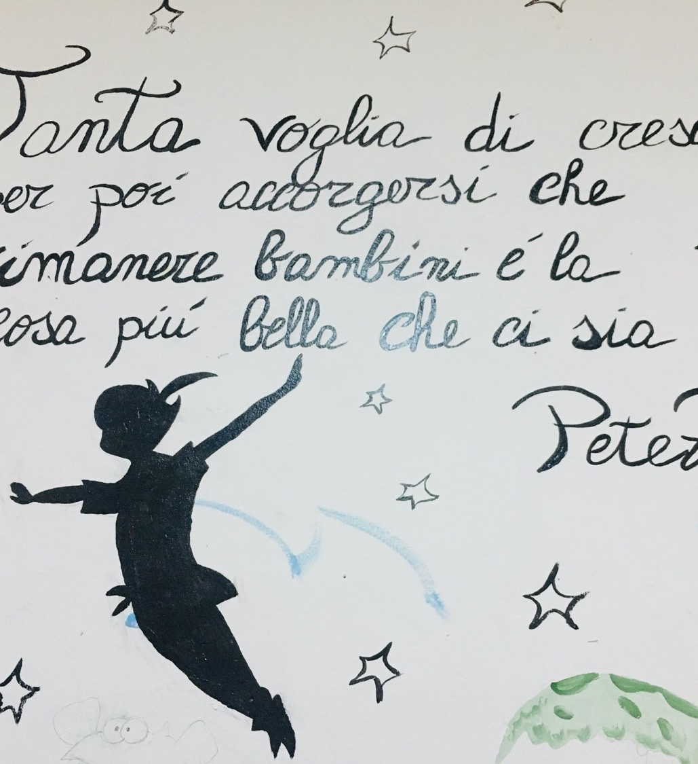
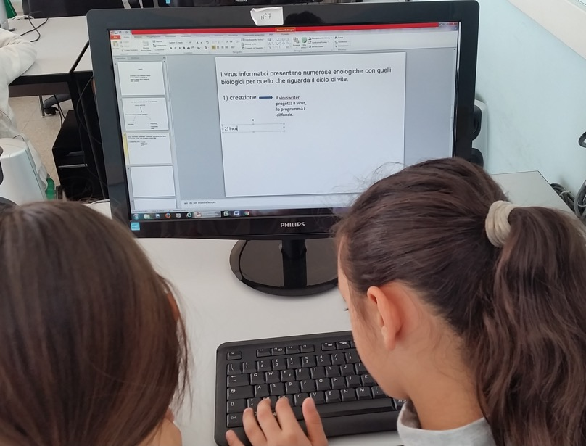

Slide 14
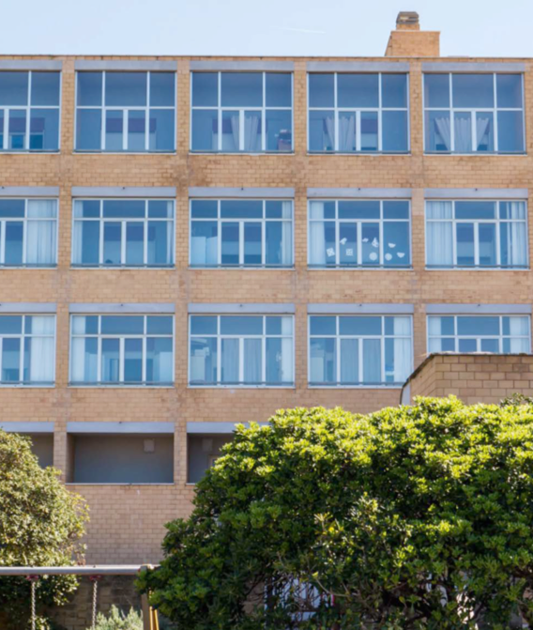
Ex-Anmil complex
Primary school
It includes a full course of primary school.
Benefits: science lab, computer lab, art lab and gym.
In total 5 classes

Slide 15
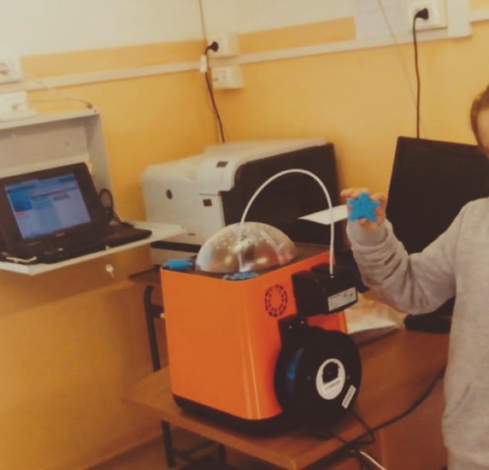
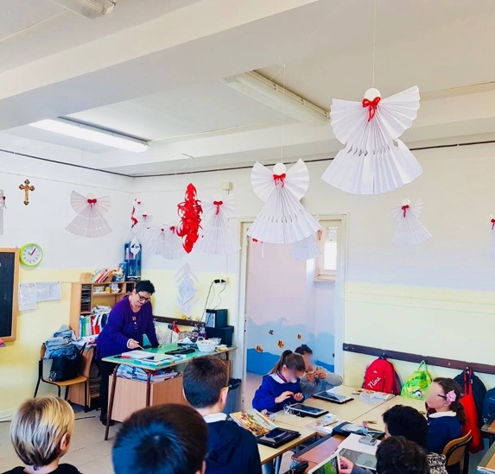

Slide 16
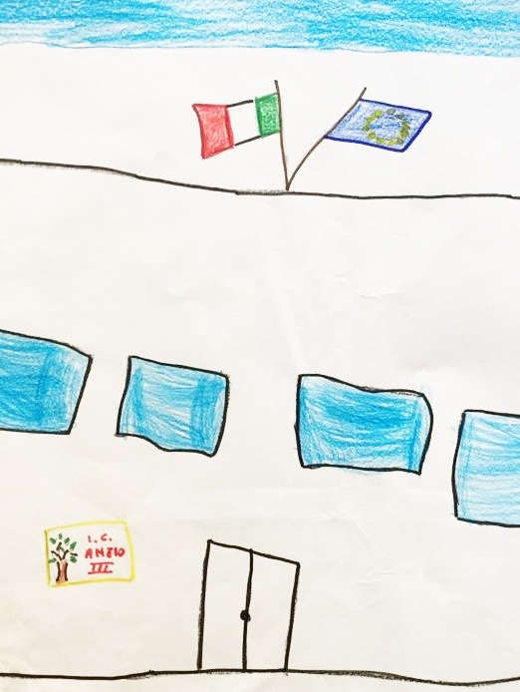
P.T.O.F. (Piano Triennale dell’Offerta Formativa)
Each school prepares the P.T.O.F. (Three-year Plan of the Educational Offer) which defines its objectives in the medium and long term from the analysis of the territory and of its needs. On the basis of P.T.O.F. the class programming is done.

Slide 17
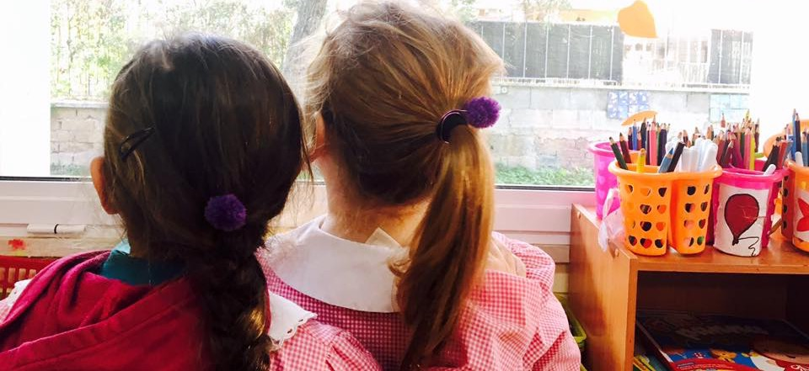
Vision and Mission of our PTOF
"The goal of education must be the formation of individuals who think and act independently, but who see in the community their highest life problem."
(Albert Einstein)

Slide 18
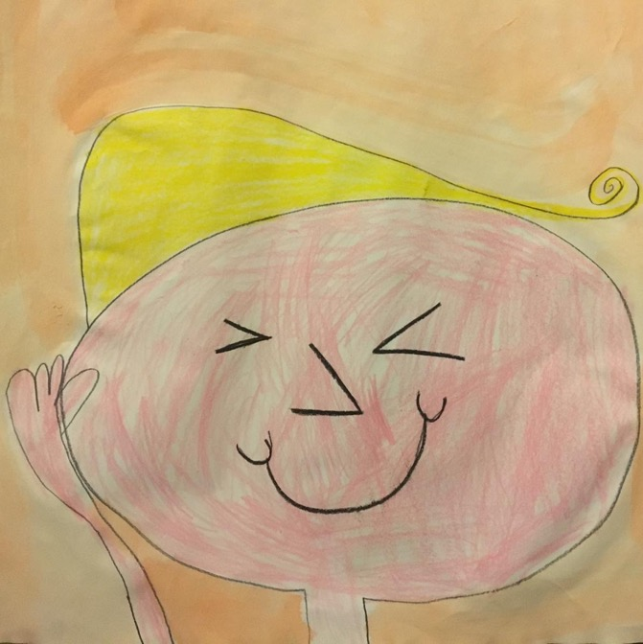
Inclusion: pupils with special needs
In our school there are pupils with disabilities supported by special needs teachers.
Moreover, there are children with specific developmental disorders who are not supported a special needs teacher, but for whom teachers use specific teaching strategies.

Slide 19
Inclusion: pupils from different countries
The growing presence of children of other cultures, pushes our Institute to implement numerous initiatives aimed at reception, intercultural exchange, enhancement and respect for diversity and the meeting between children and families.

Slide 20
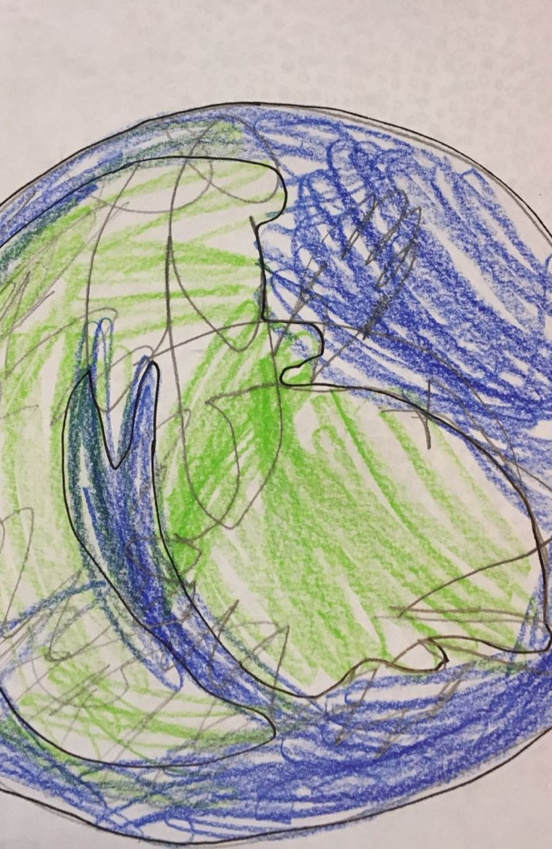
We promote the reciprocal comprehension among different cultures in order to instill in the European citizens of the future what is necessary to recognize and to appreciate the common values, without neglecting the respect for ourselves, for our own and for other countries, the latters considered as parts of a wider whole (Europe as the world as well).

Slide 21
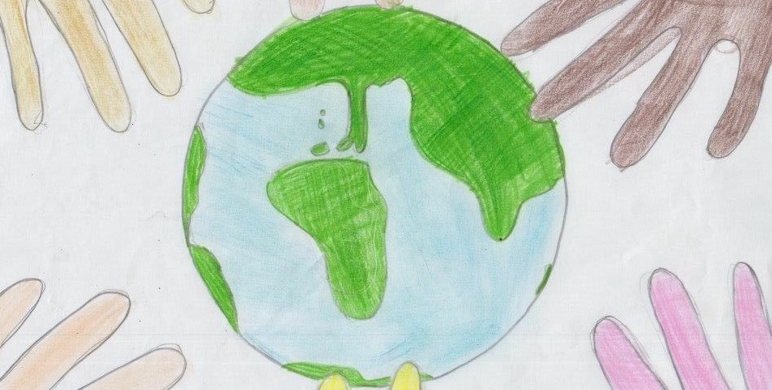
We think that such a way of considering the formative actions may contribute to the formation of future generations that will have the possibility to grow without territorial, cultural and linguistic boundaries

Slide 22
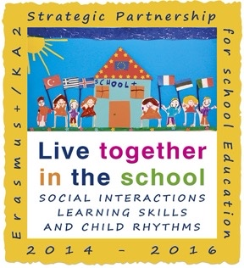
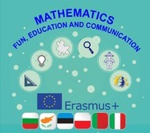
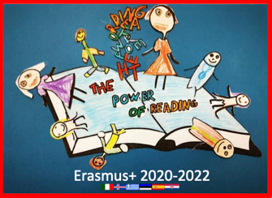
European Project: Comenius and Erasmus
Our school started working on European projects in 2013 (Comenius and Erasmus), especially on projects that focus on sharing tools and the best educative practices, to promote cross skills, on implementing the use of English and ITC and on stimulating the youth’s participation to the democratic life.

Slide 23
These projects helped our teachers to improve their skills in English, methods and teaching practices and use of ITC, whereas the use new technologies was useful to implementing the development of logical and mathematical thinking.

Slide 24
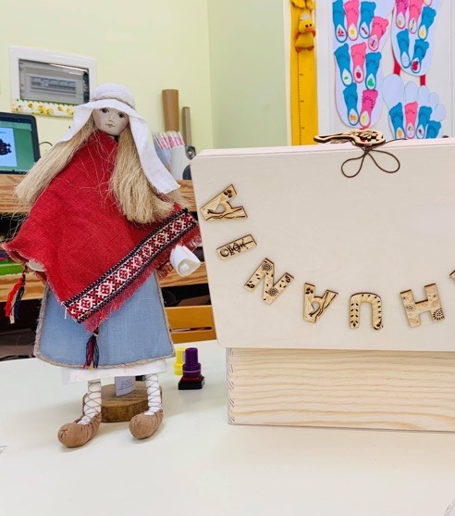
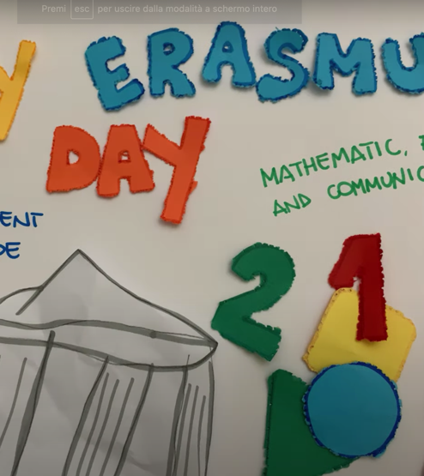
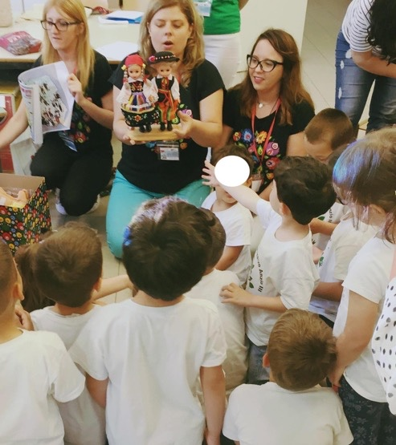
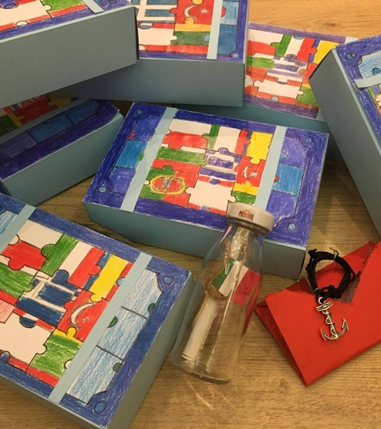
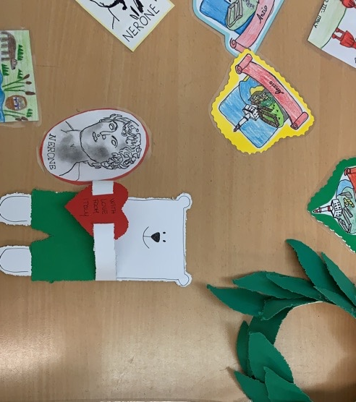

Slide 25
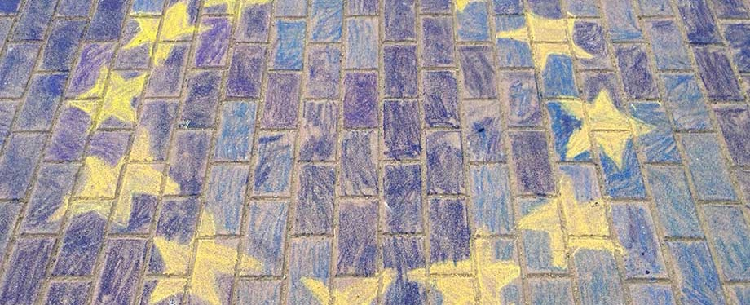
We currently have three new Erasmus projects:
On the traces of the @ncient Europe (Austria, Greece, Czech Republic, Croatia, Italy);
Mathematics - fun, education and communication (Poland, Bulgaria, Cyprus, Italy, Portugal);
The Power of Reading (Spain, Iceland, Greece, Estonia, Croazia, Cyprus).

Slide 26
European Project: eTwinning
Our school also received twice the eTwinning School Label and won eTwinning prizes with two projects.

Slide 27
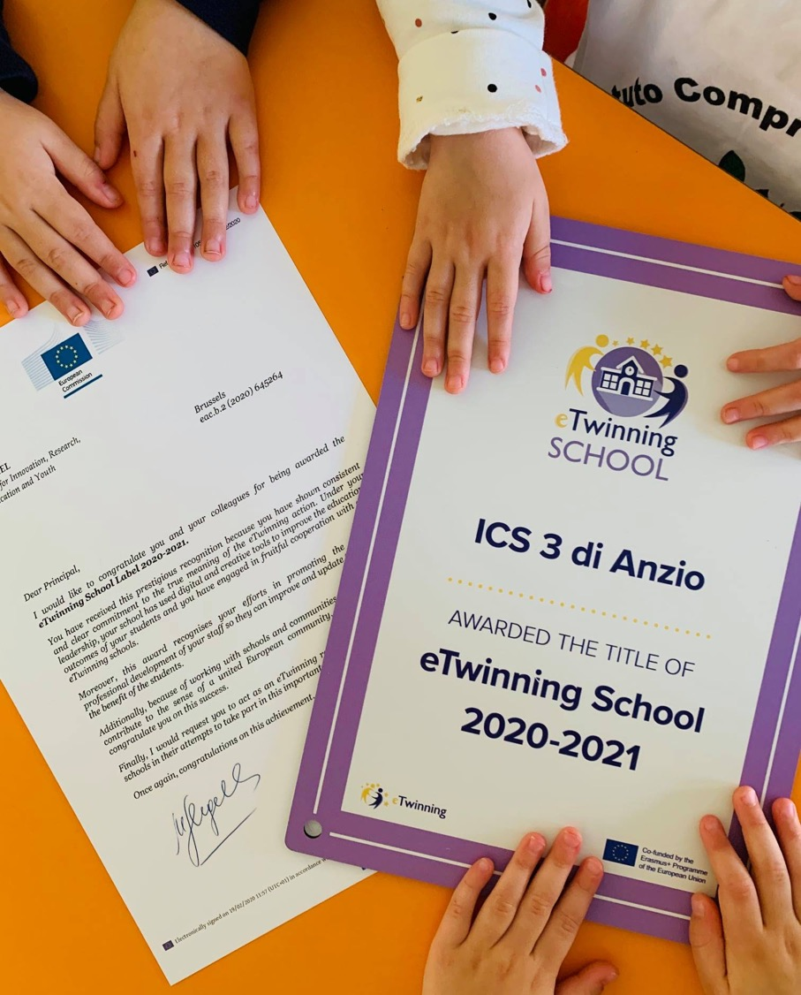
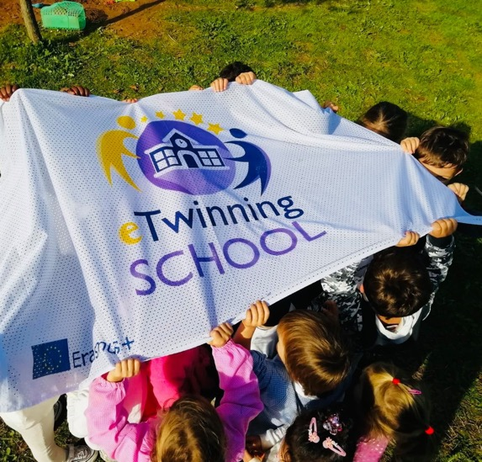
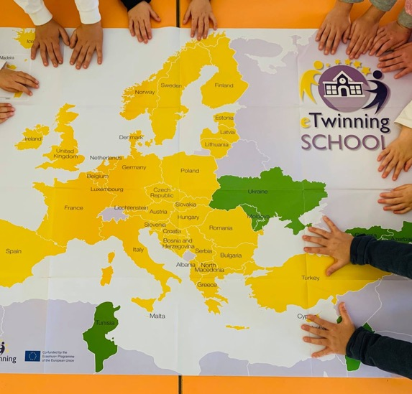

Slide 28
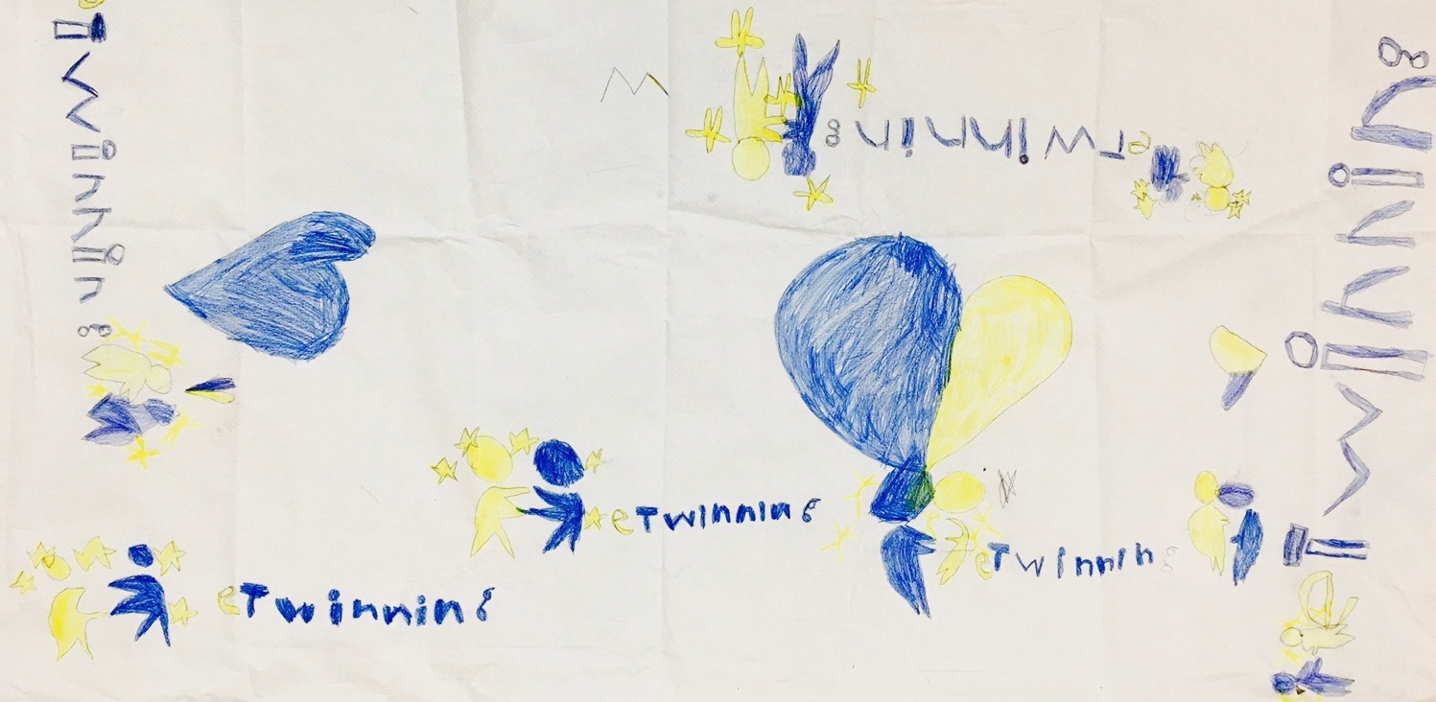
We are currently working on several eTwinining projects :
Dis.Co.Codi. (Discovering Collaborative Coding) Greece and Italy;
Gender equality in Nursery classrooms Italy, Spain, Greece;
and many others…

Slide 29
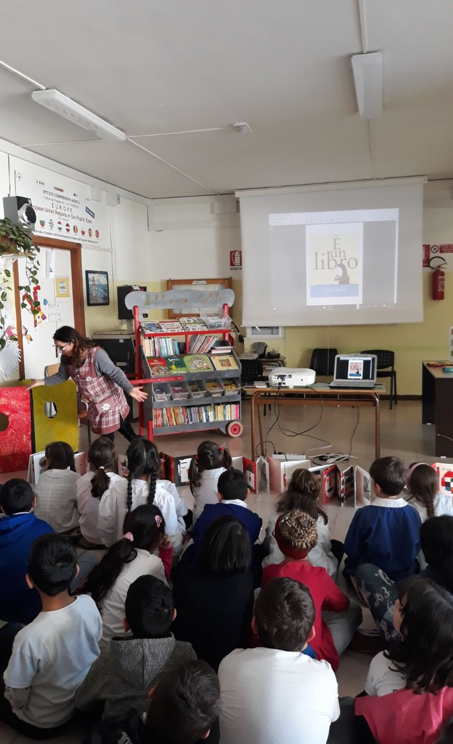
Mobile Library and Books Festival
Our School promotes projects related to the pleasure of reading with the aim of developing curiosity, desire and the pleasure of reading.
The initiatives include moments of collaboration and involvement and exchange between different educational agencies.

Slide 30
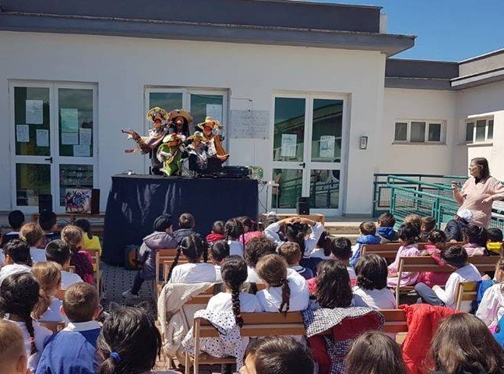
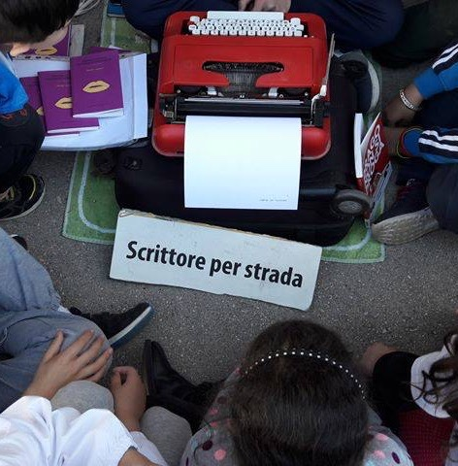

Slide 31
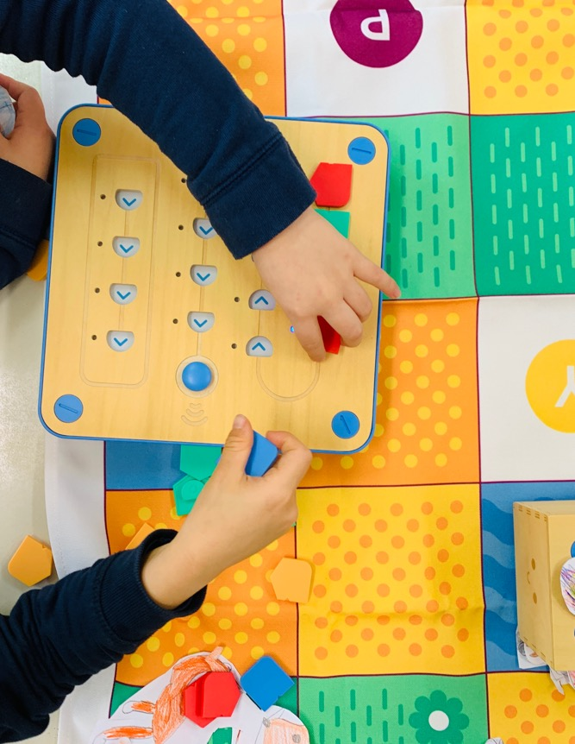
Digital technologies
We largely use the new digital technologies for educative purposes.
Several teachers have skills and competencies in digital practice, eSafety, robotics, coding, creative and innovative approaches to pedagogy

Slide 32
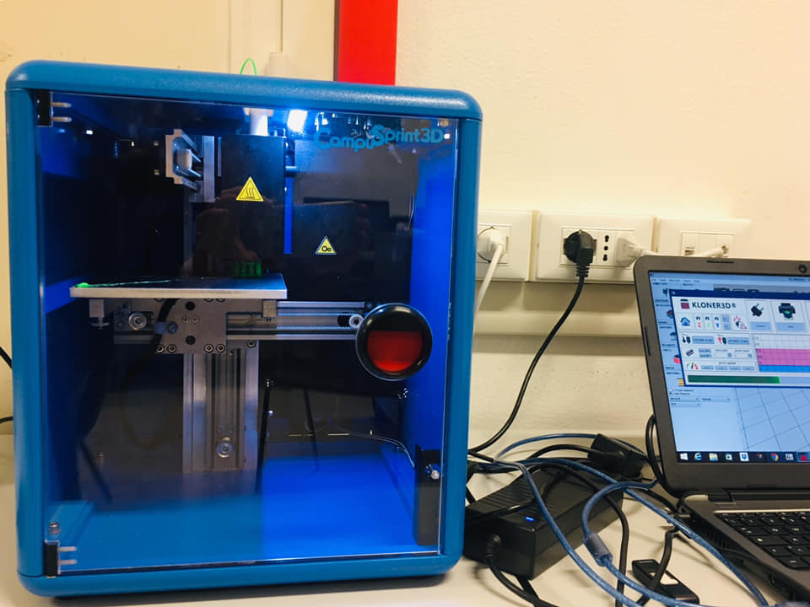
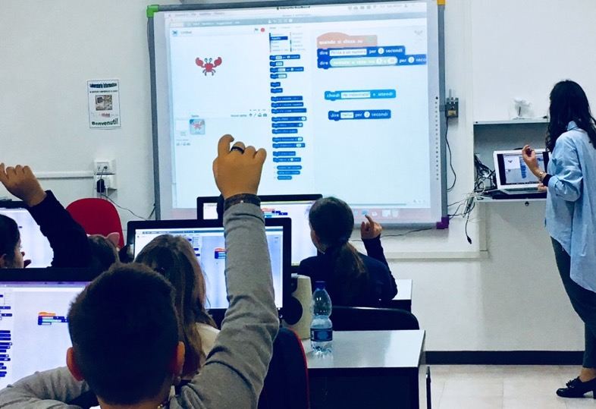
These aspects respond exactly to the demands of a constantly evolving society that sees in the School a place to develop skills to become future citizens of the world: people with communicative, collaborative, entrepreneurial skills, able to learn throughout life and ready to face the "challenges" of tomorrow.

Slide 33
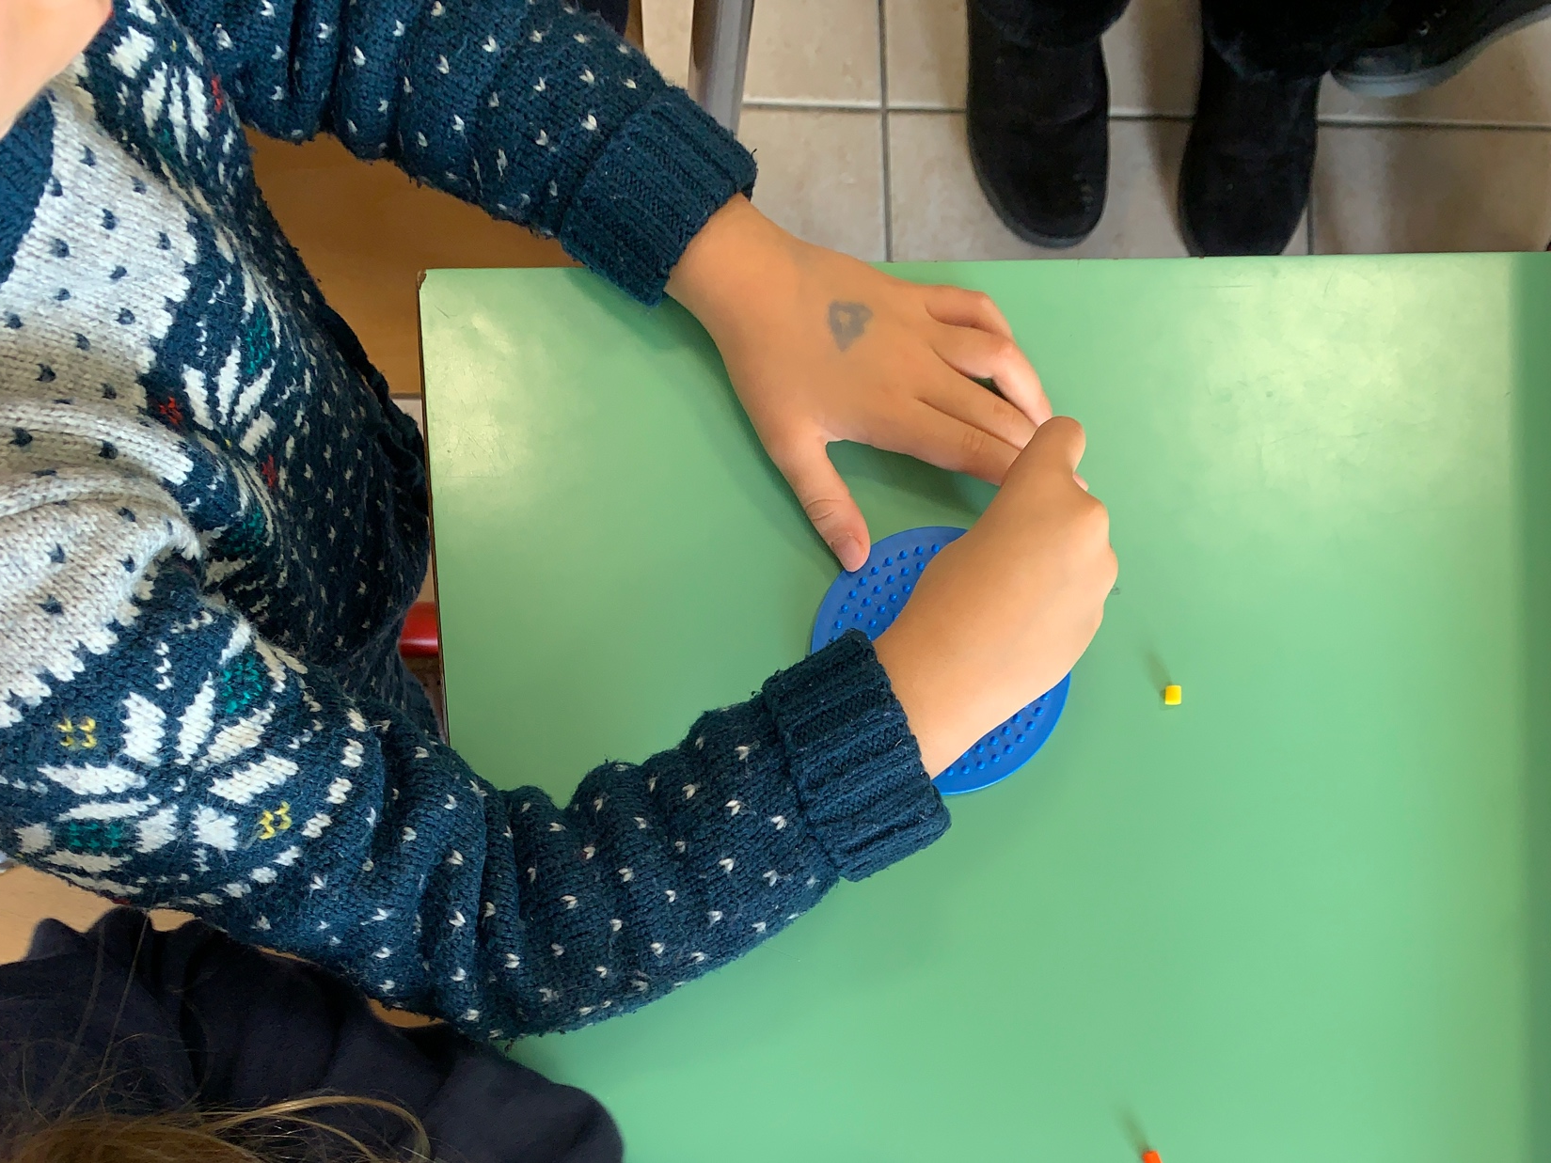
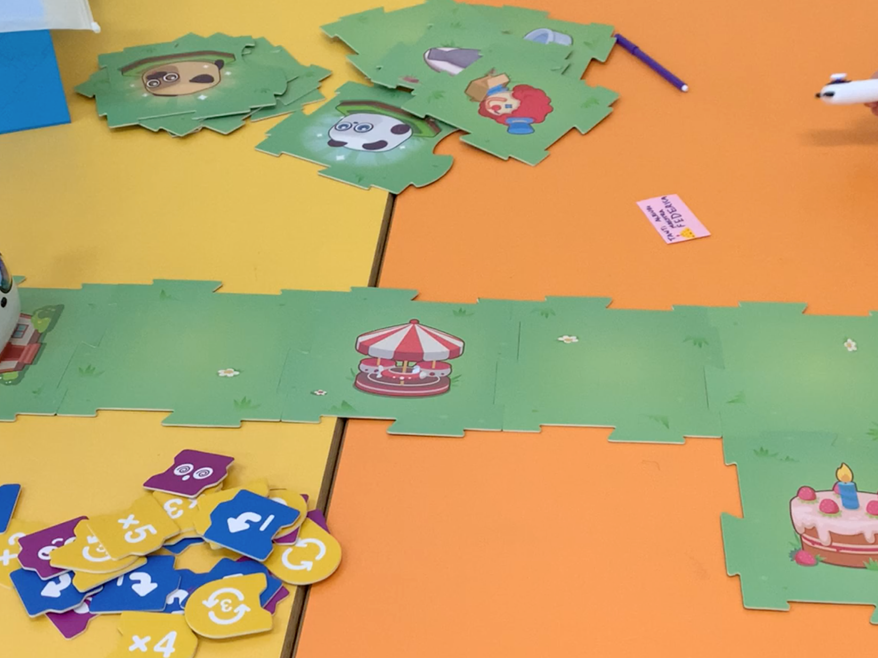
since kindergarten

Slide 36
Thanks for your attention

