Slide 1
Latvia

Slide 2
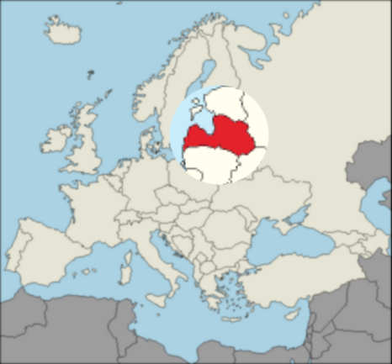
Latvia
Independent from 1920 to 1940 and has regained it since 1990.
The very term Latvian was coined by the patriotic movement in the early 20th century
Located between Baltic sea and Russia. The Middle of Baltic states. Geographic hotspot of north for many centuries.

Slide 3
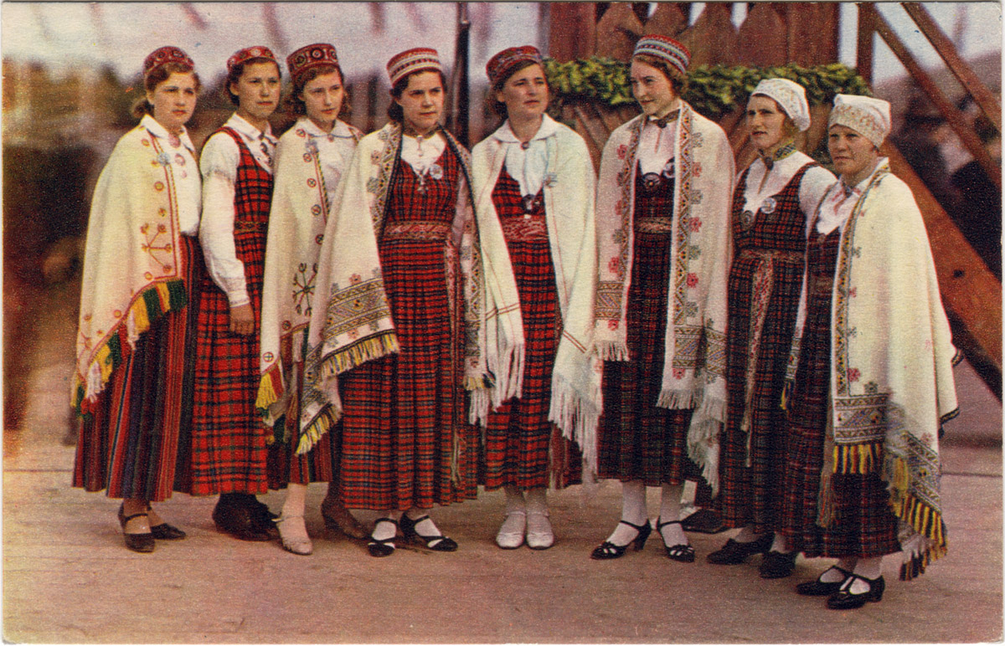
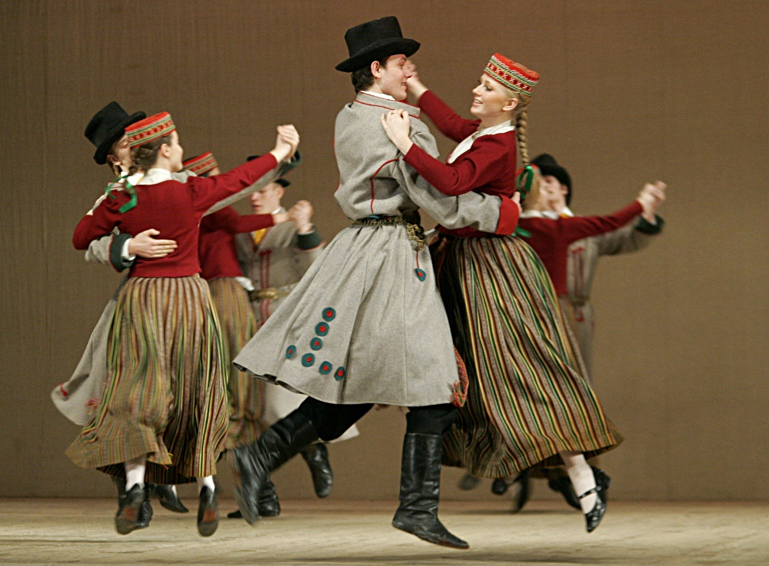
Culture of Latvia
Latvian culture is made from many ancient latvian tribe traditions
Summer soltices- biggest celebration
Singing and dancing is a major part of culture

Slide 4
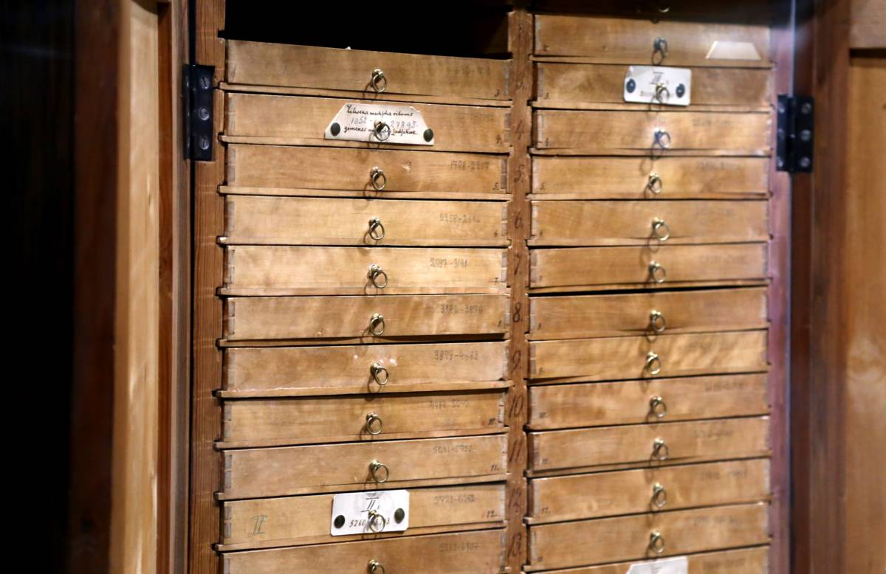
Dainu skapis
Made by latvian writer Krisjanis Barons
Contains latvian folklore
70 drawers with 20 tiles each

Slide 5
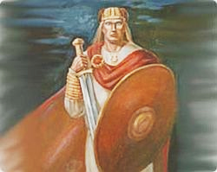
Lāčplesis
Iconic hero of Latvian folklore
Originated from old Latvian legends
Super-human strength from his bear ears

Slide 6
The Baltic Way
Peaceful protest against the Soviet unions occupation
2 million people joined their hands to form 675.5 km long line
Demonstrating a popular desire for independence for each country in Baltic States

Slide 7
Carmine red with white stripe in the middle
Reconstructed from an ancient latvian «letgallu» tribe depiction
One of the oldest flags in the world (as early as 1100s)
Was forbidden in time of USSR occupation and became a symbol of independence

Slide 8
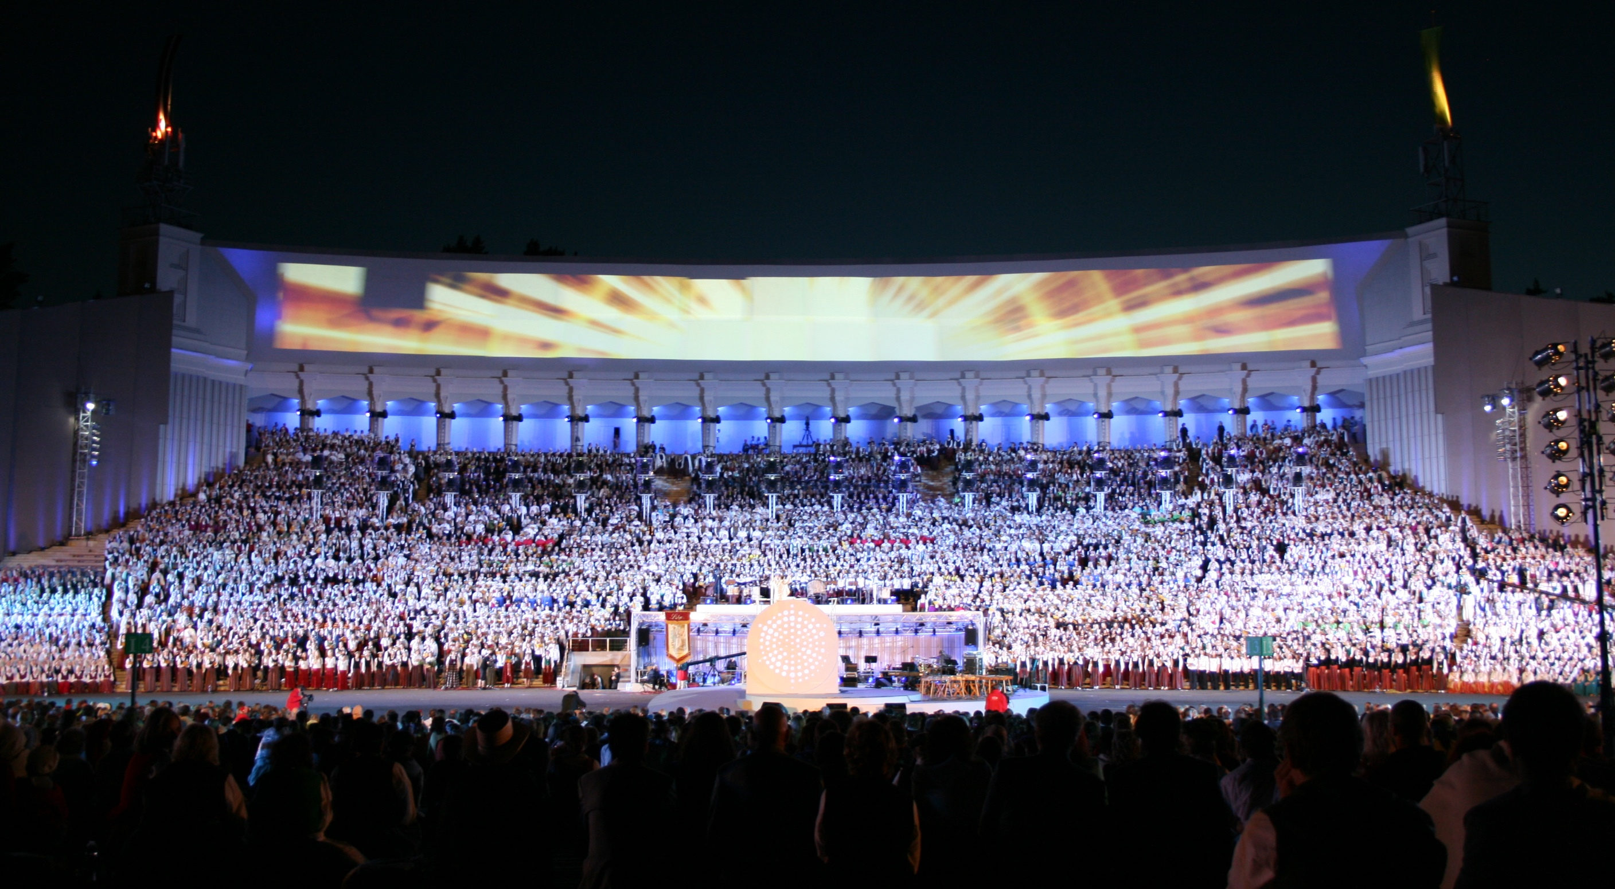
Latvian Song and Dance Festival

Slide 9
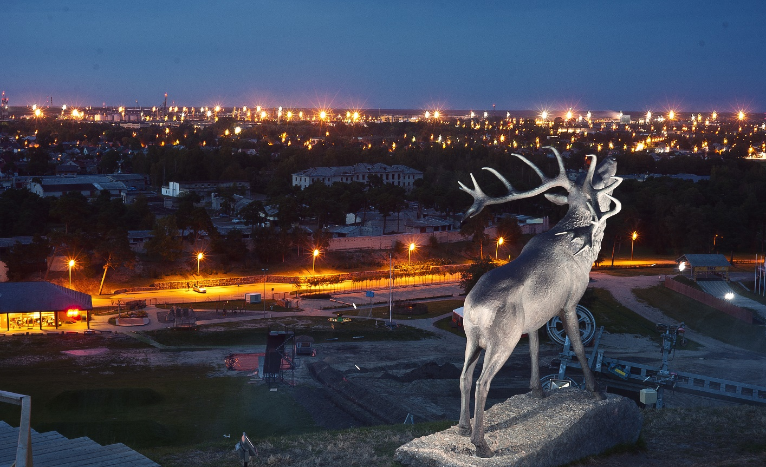
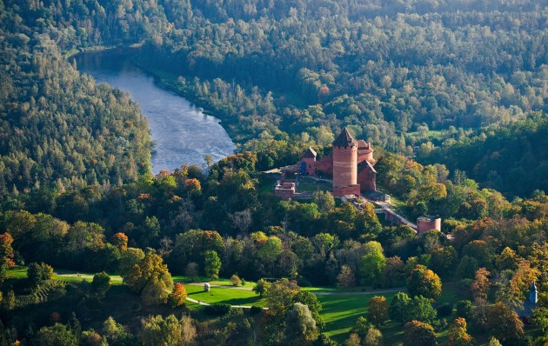
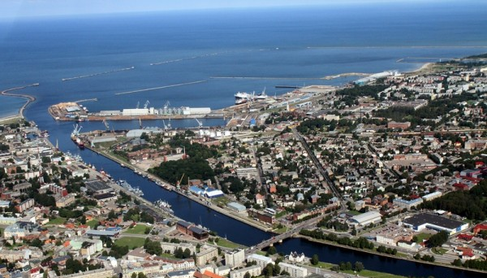
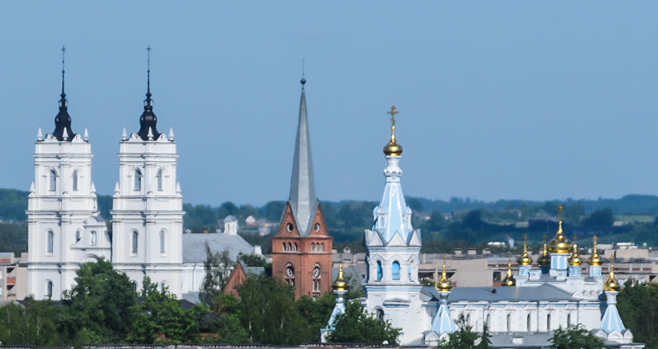
Four corners of Latvia

Slide 10
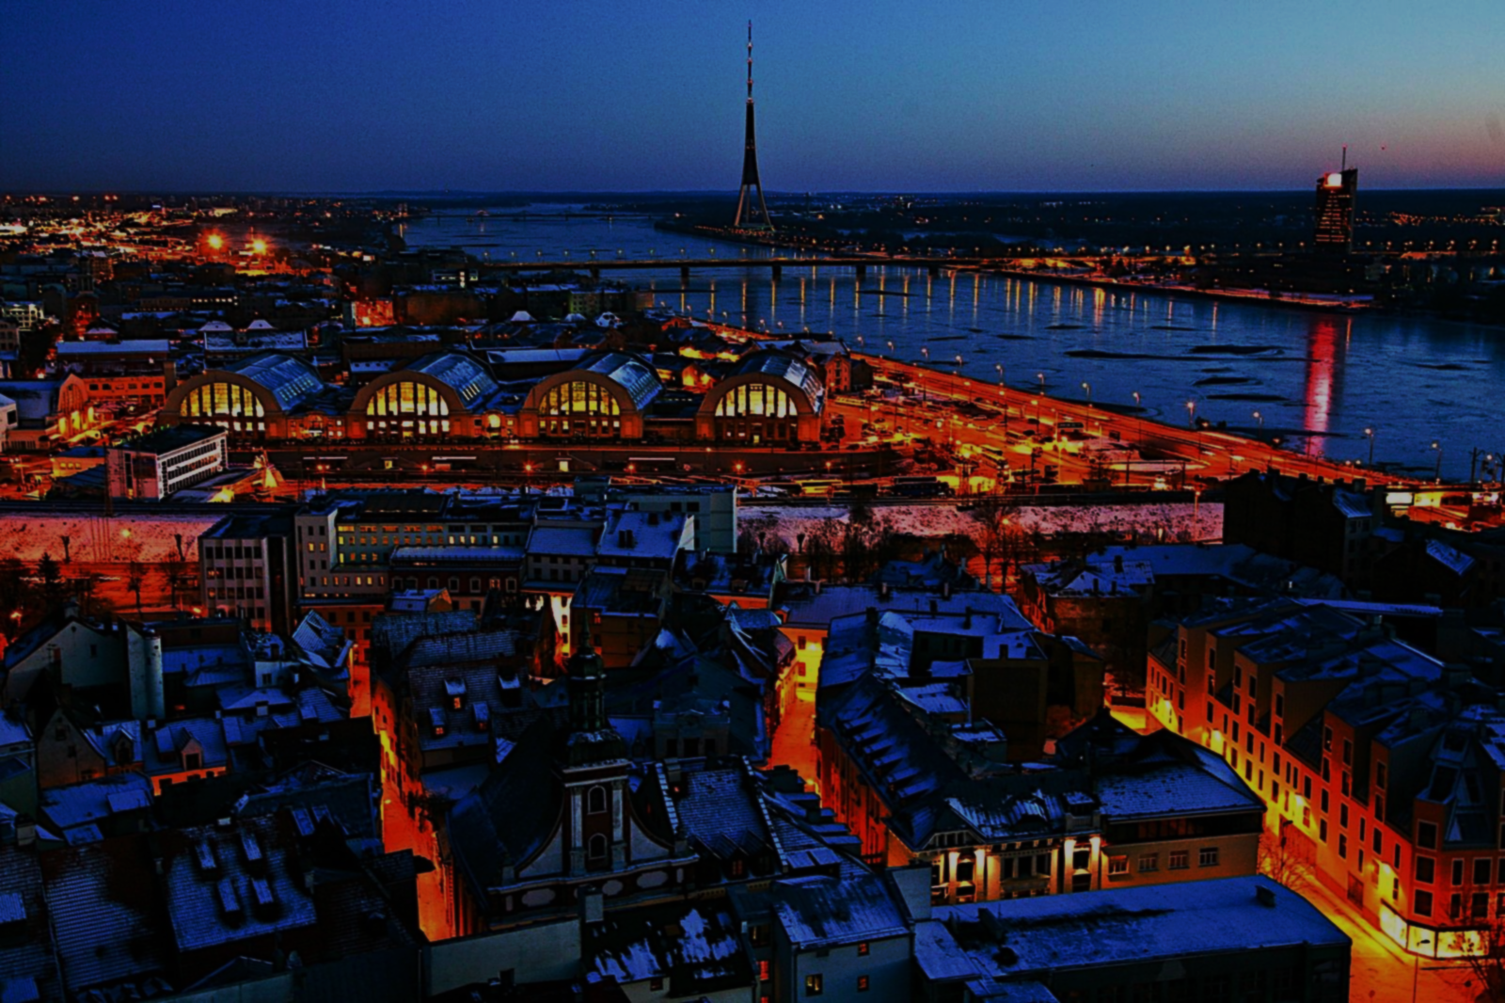
RIGA
Capital city of Latvia

Slide 11
Capital City Riga
Biggest city in the Baltic, with large transit port and the biggest airport in Baltic
Historical centre is included amongst UNESCO World Heritage, noted for its Art Nouveau/Jugendstil architecture
Former member of the Hanseatic League

Slide 12
Siguldas golden autumn
Golden autumn Of Sigulda

Slide 13
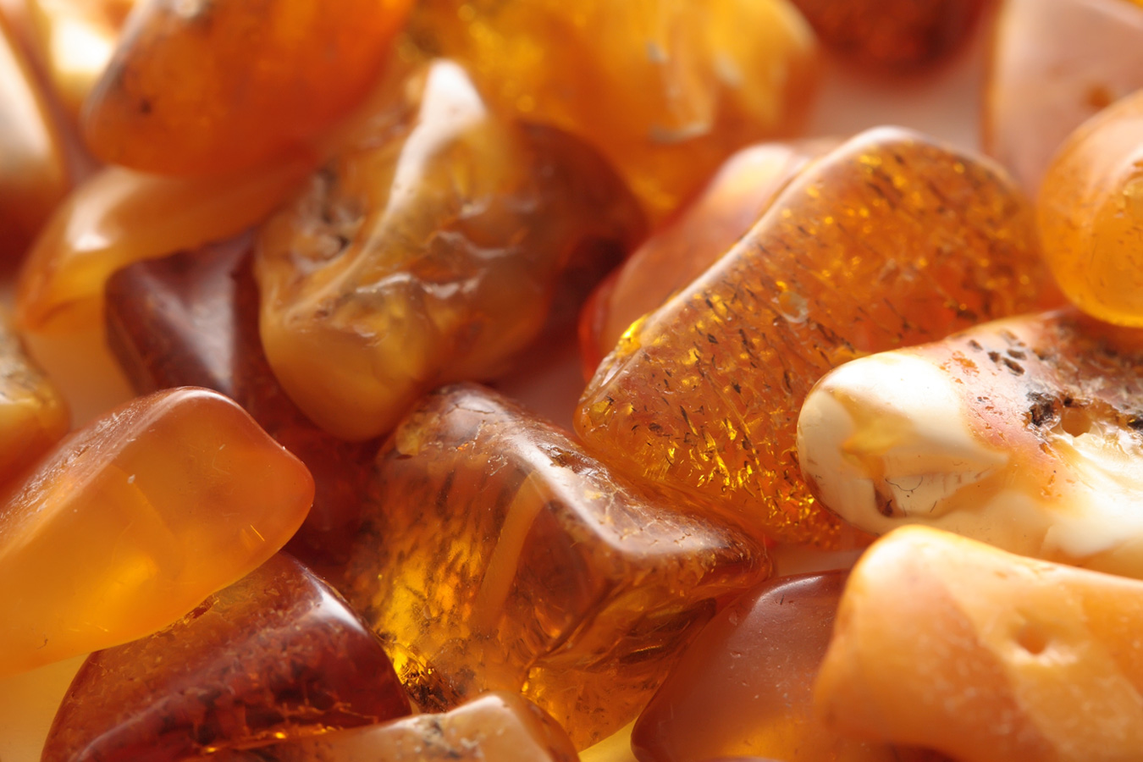
Latvian Gem

Slide 14
Amber forms from fossilized tree resin for which is appreciated for its color and natural beauty.
Ancient tribes used it for jewelry, medicine and rituals.
With invasion of Crusaders in Baltics guilds mostly dealt with making of praying beads

Slide 15
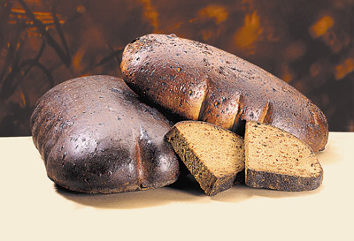
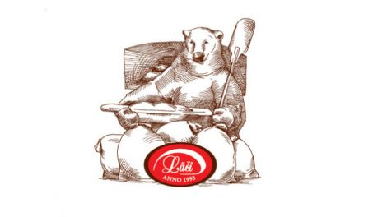
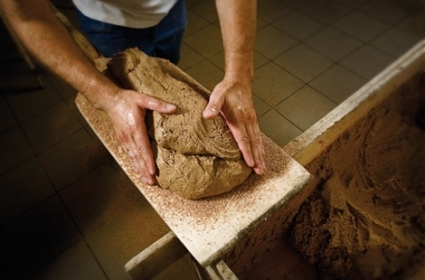
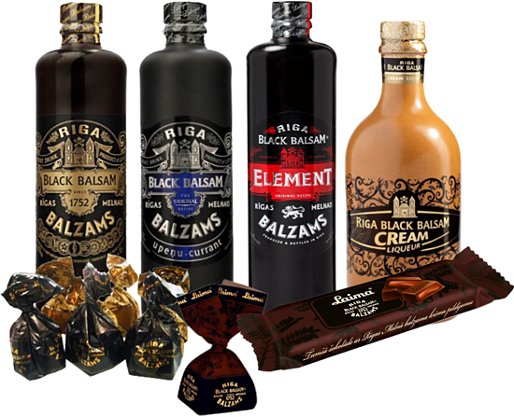
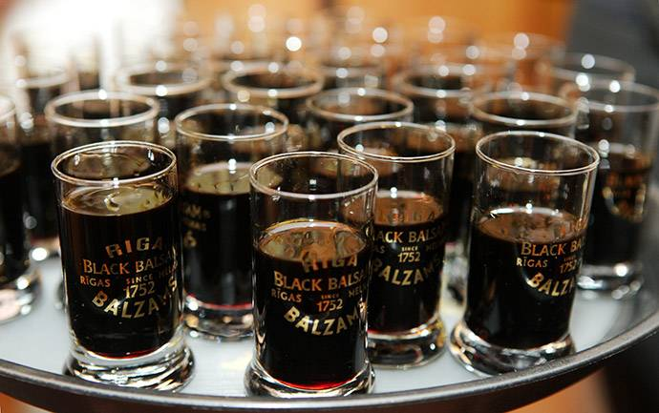
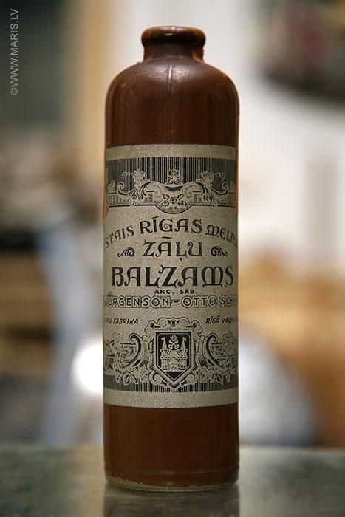
Renown foods and drinks
Bear’s bakery’s rye bread (latv. Lāčmaize)
Riga’s black balsam (latv. Rīgas melnais balzāms)

Slide 16
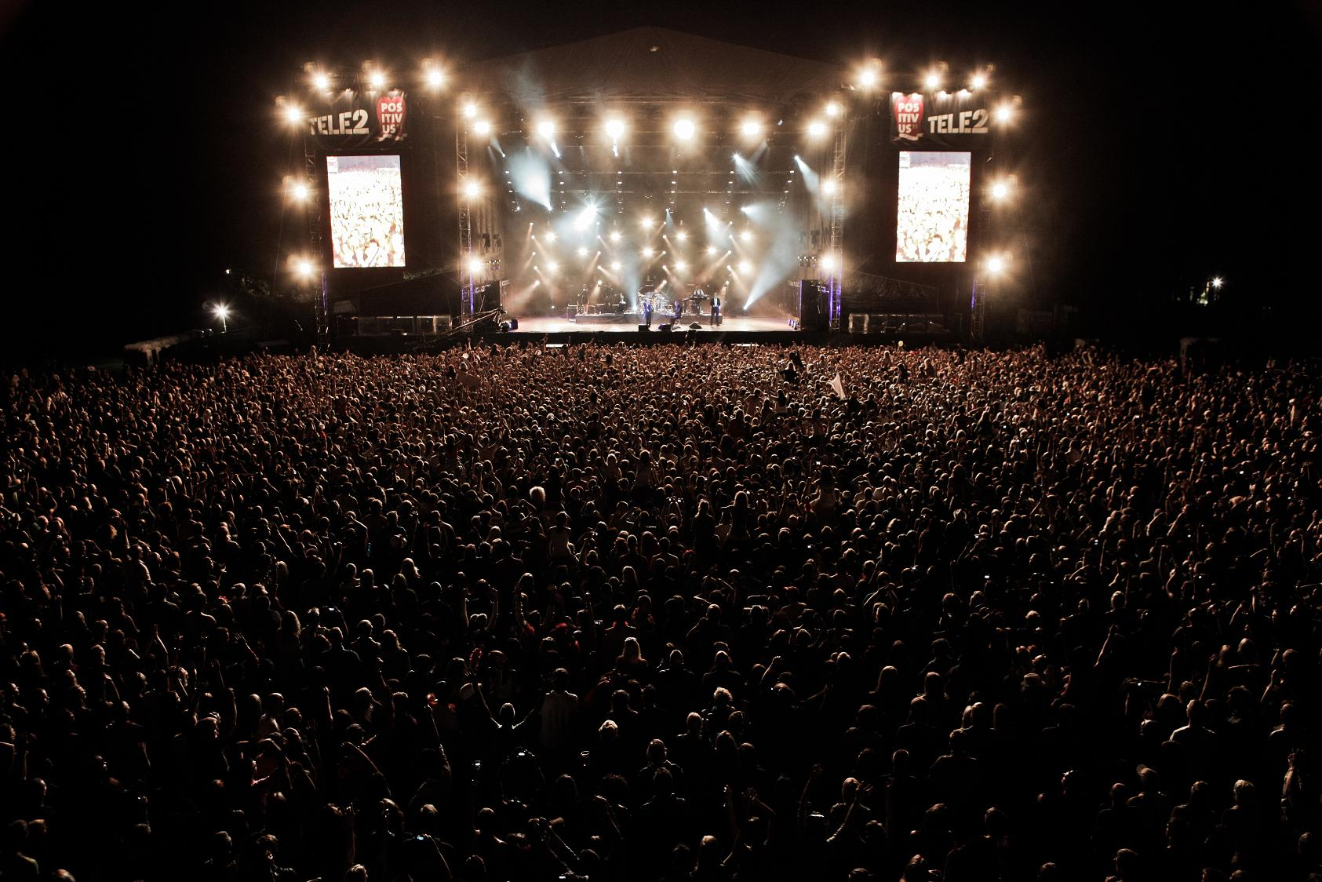
Positivus

Slide 17
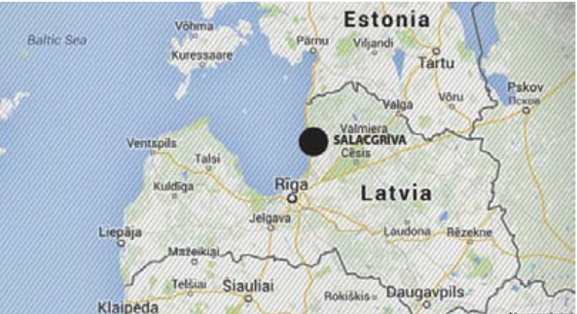
An annual three-day music festival has been taking place in Latvia, Salacgrīva since 2007
Offers a wide array of amazing performers, plentiful entertainment options and a lively atmosphere
mid-sized European festival with 35,000
annual visitors and 6 stages.

Slide 18
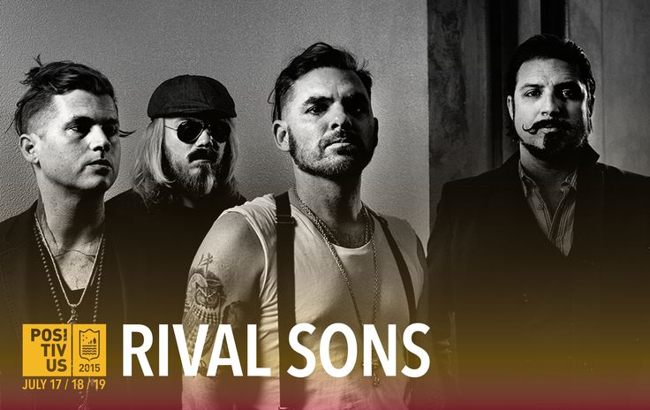
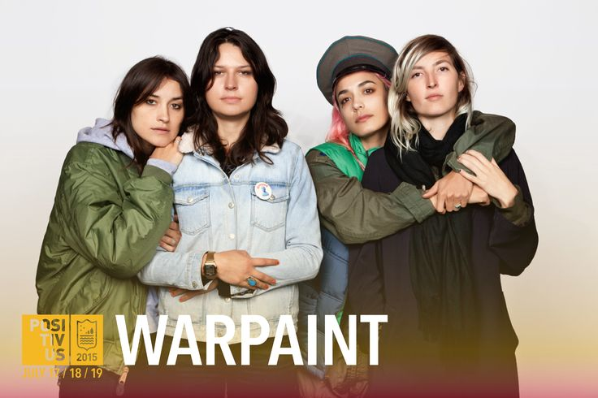
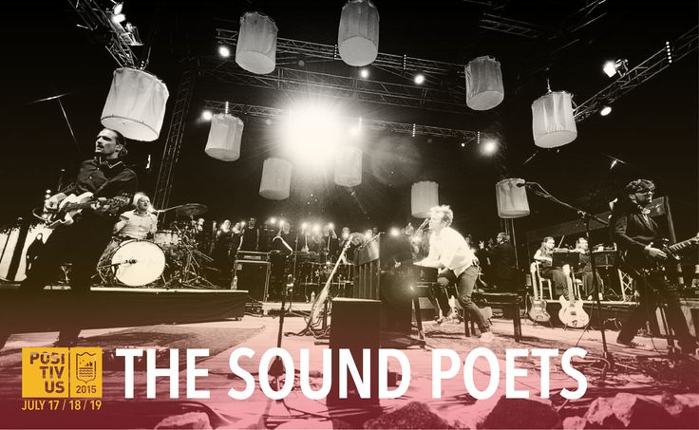
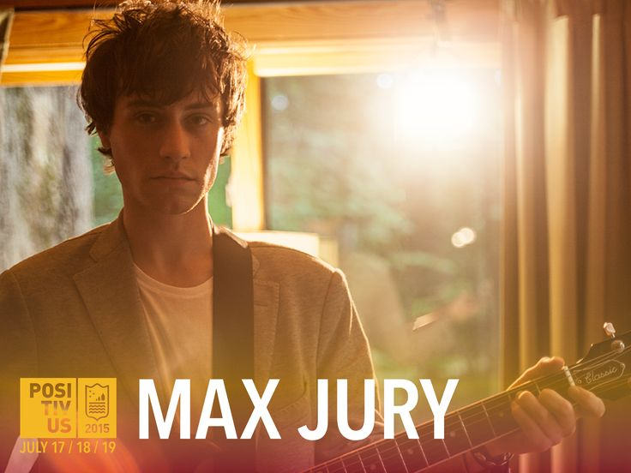
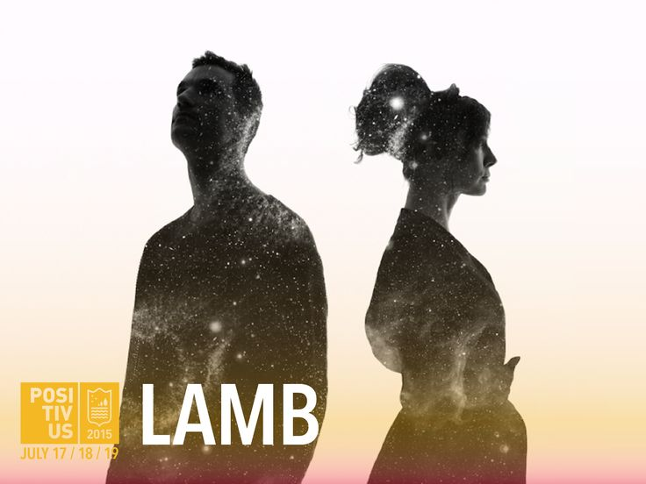
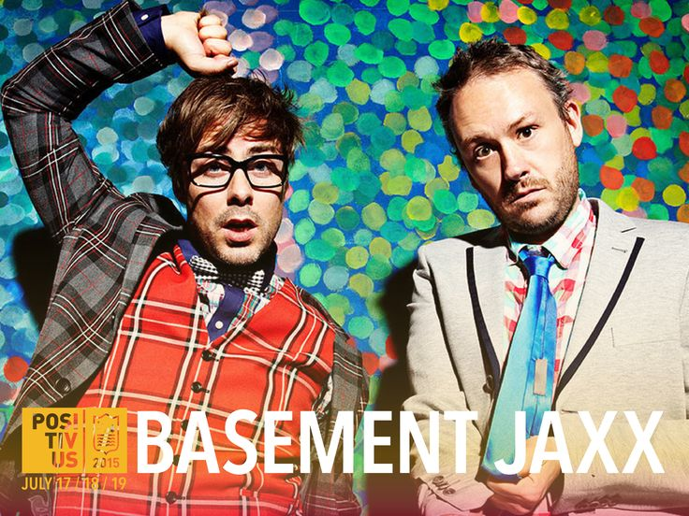

Slide 19
Thank you for attention !

