Slide 2
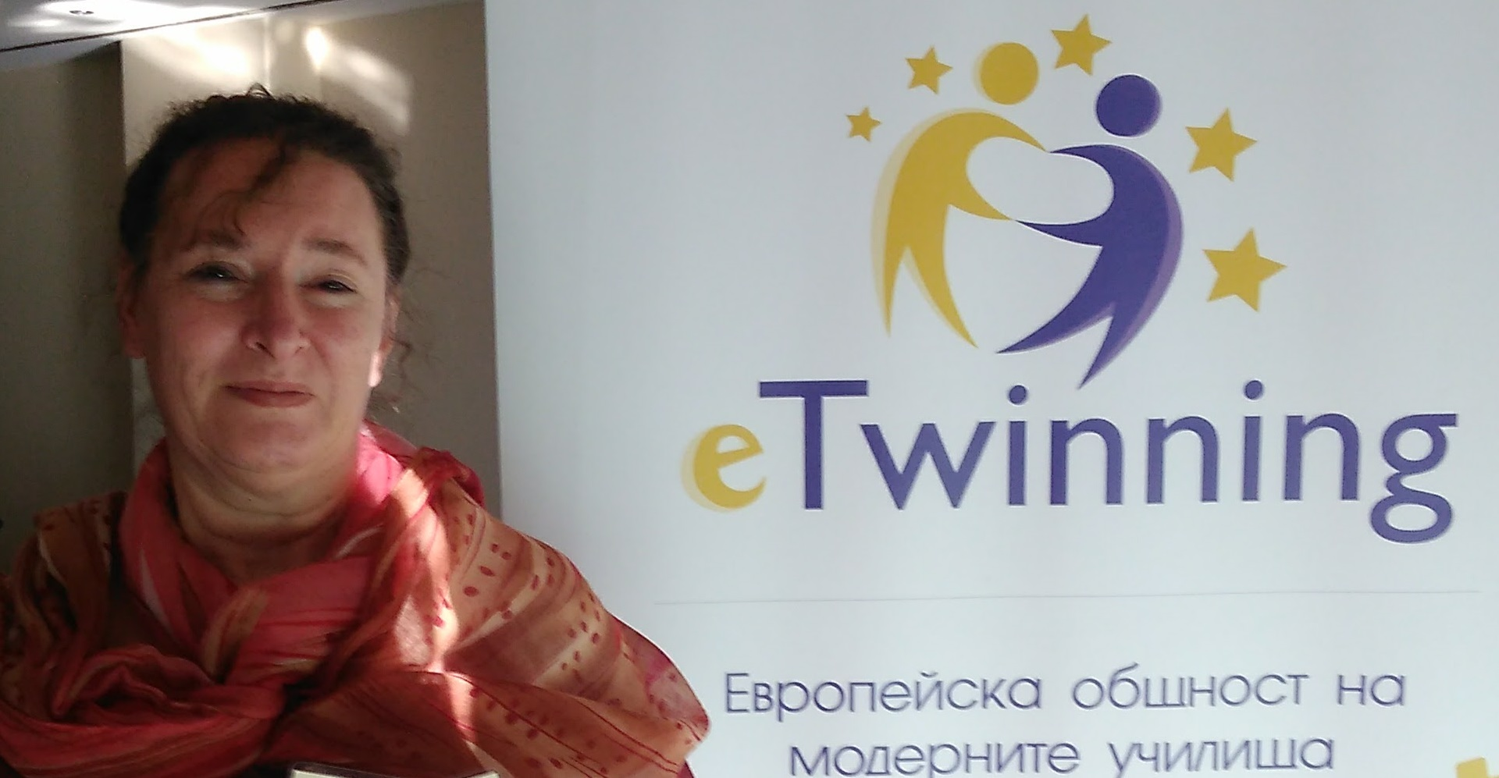
Maya Kyulevchieva
eTwinning Ambassador
English teacher
Ivan Vazov Language school
Plovdiv

Slide 3
Digital games as learning tools in
eTwinning projects
Maya Kyulevchieva
eTwinning Ambassador

Slide 5
Game-Based Learning
Repetition
Failures and winning
Goals to achieve
Levels to master the skills
Improved knowledge in specific area

Slide 6
Purpose of games
- To provide fun
- To check some knowledge through fun
To practice some knowledge or skills
To summarize knowledge on a topic
To assess some knowledge or skills on a topic

Slide 7
The next level –
self-created games
- Demonstrates high and solid level of knowledge
- Going deeper to outline specific details
Building up ability to “lay traps” for the other players
Increases self-esteem of the creator

Slide 8
Ready-made vs self-created games
Specially designed
Concentrated on a specific topic/unit/lesson
No ‘surprises’ for the students
Banks /libraries of ready-made games
Save time of the teacher
Teachers can edit to suit their goal

Slide 9
Ordinary games
vs
Formative assessment games
- To practice a grammar unit
- To practice a vocabulary topic
- To develop specific skills
- To demonstrate knowledge on a specific topic
All of them through FUN!!!
- To assess some knowledge
- To provide feedback
- To increase specific knowledge
- To save Teacher’s time for checking the results
All of them through FUN!

Slide 10
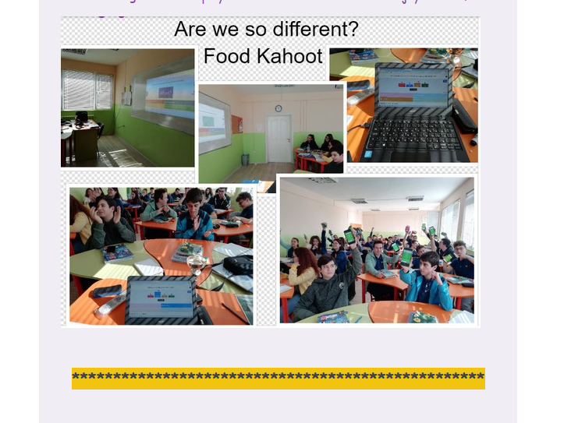
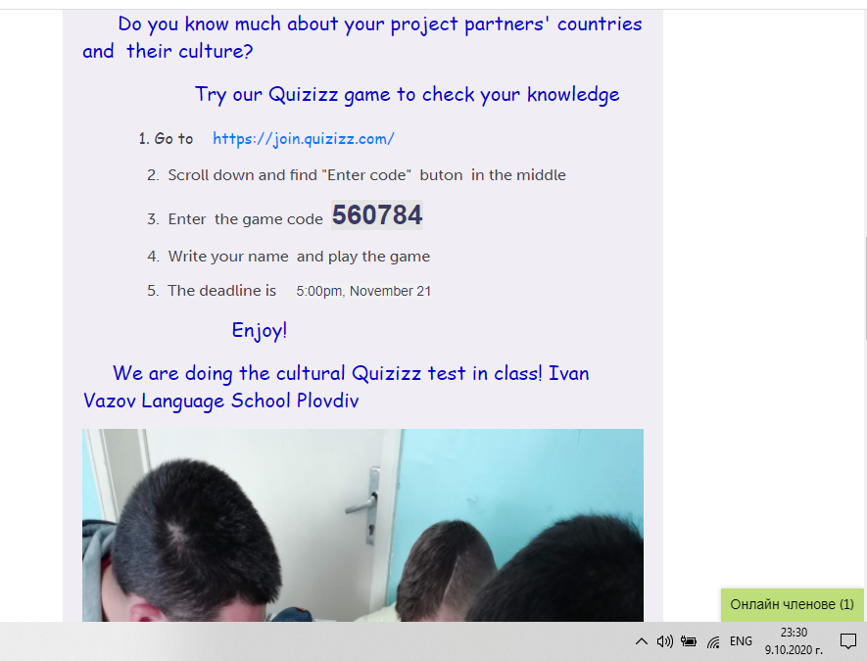
Games in eTwinning projects
http://kahoot.com
http://quizizz.com
Summarizing an eTwinning topic and having fun
Are we so different?
Different languages, new and old friends

Slide 11
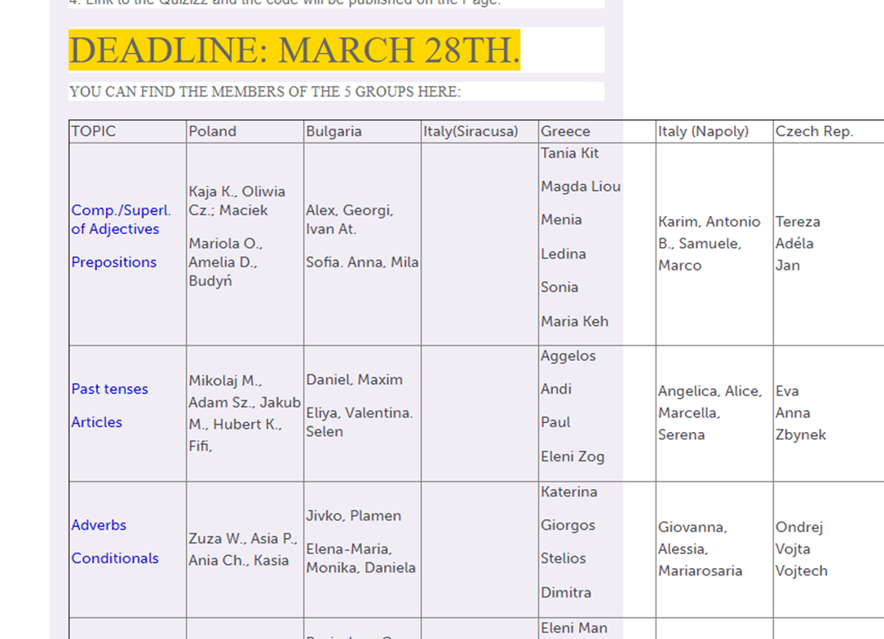
Games in eTwinning projects
Self-created Quizizz games
CLICK – Creative Learning
in a Computer Kingdom

Slide 12
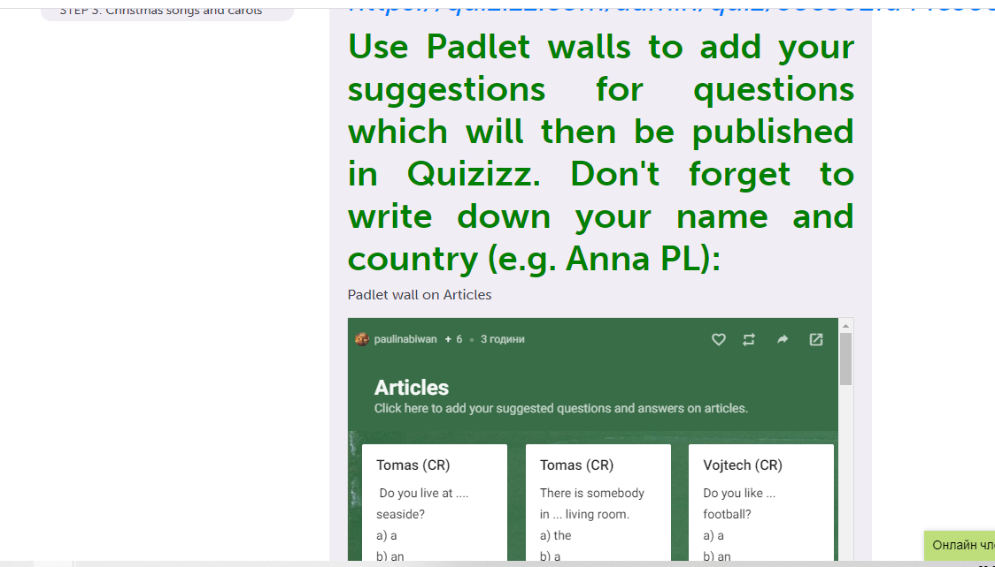
Games in eTwinning projects
Self-created Quizizz games
CLICK – Creative Learning
in a Computer Kingdom

Slide 13
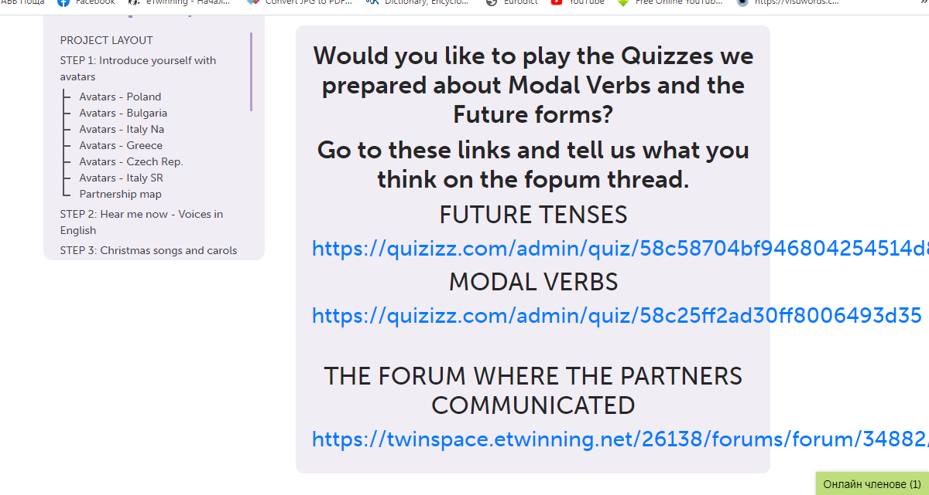
Games in eTwinning projects
Self-created Quizizz games
CLICK – Creative Learning
in a Computer Kingdom

Slide 14
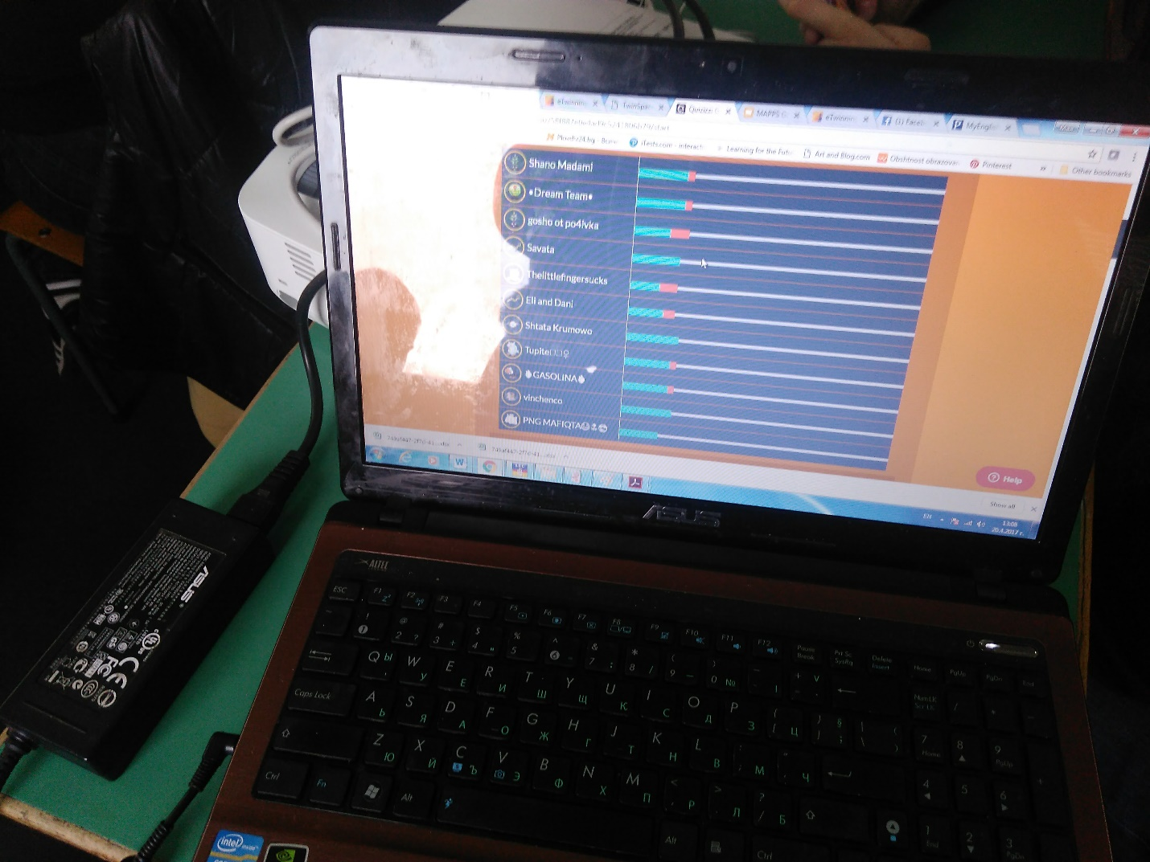
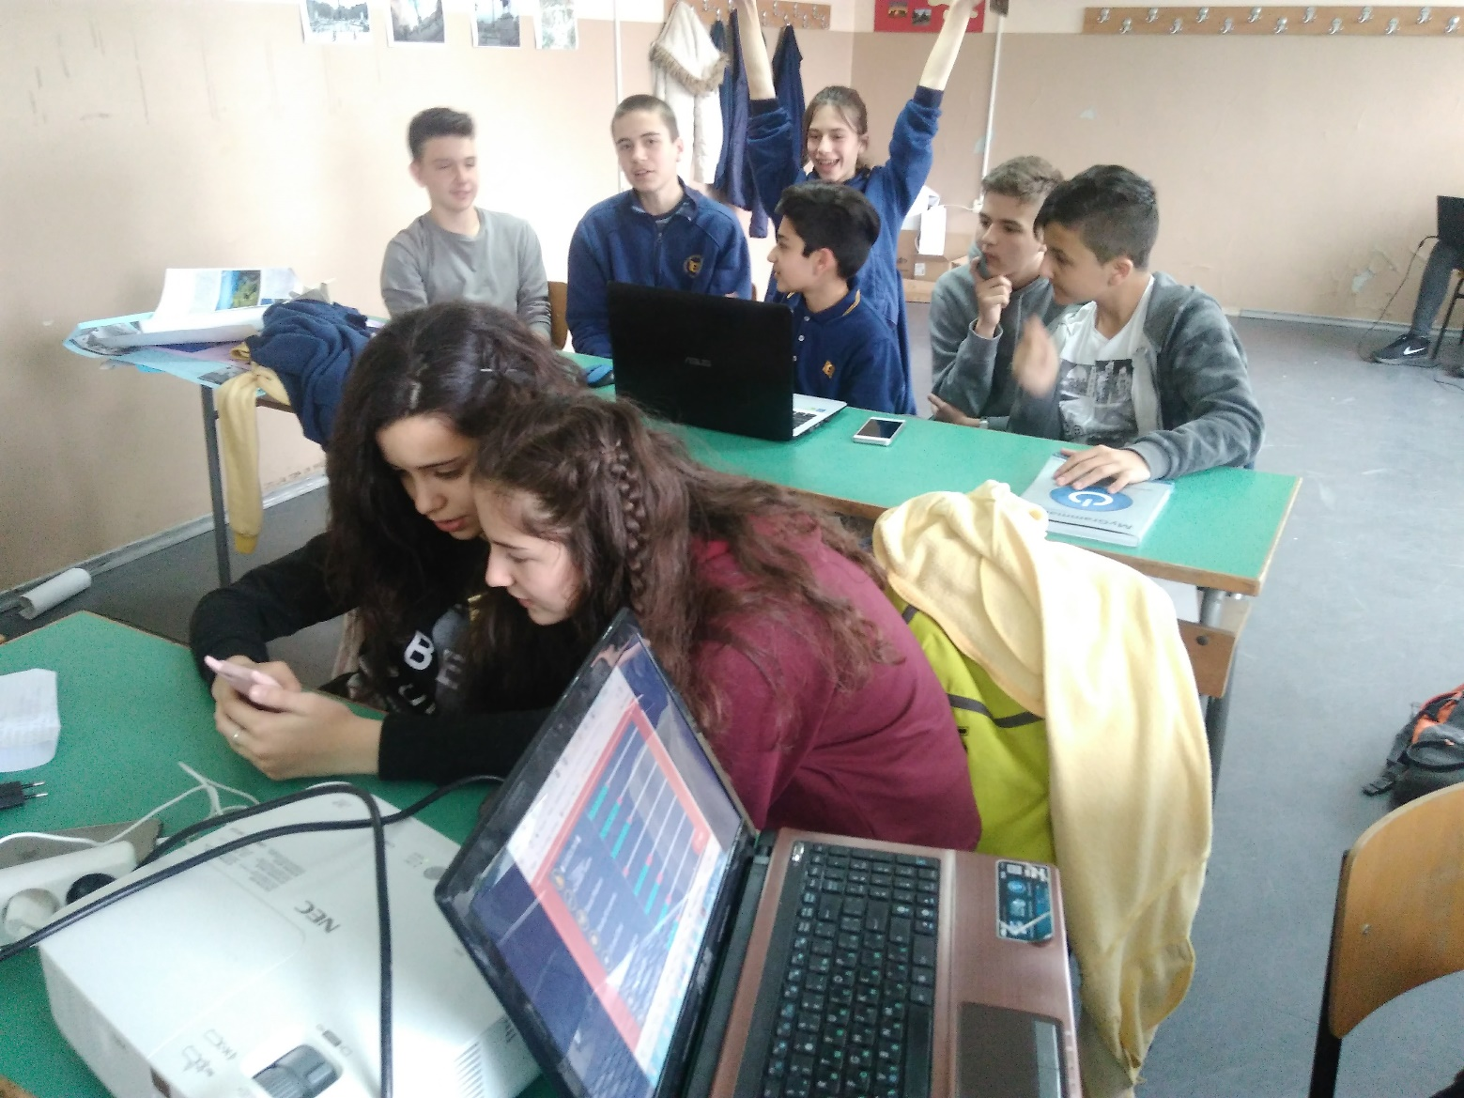
Games in eTwinning projects
Self-created Quizizz games
CLICK – Creative Learning in a Computer Kingdom

Slide 15
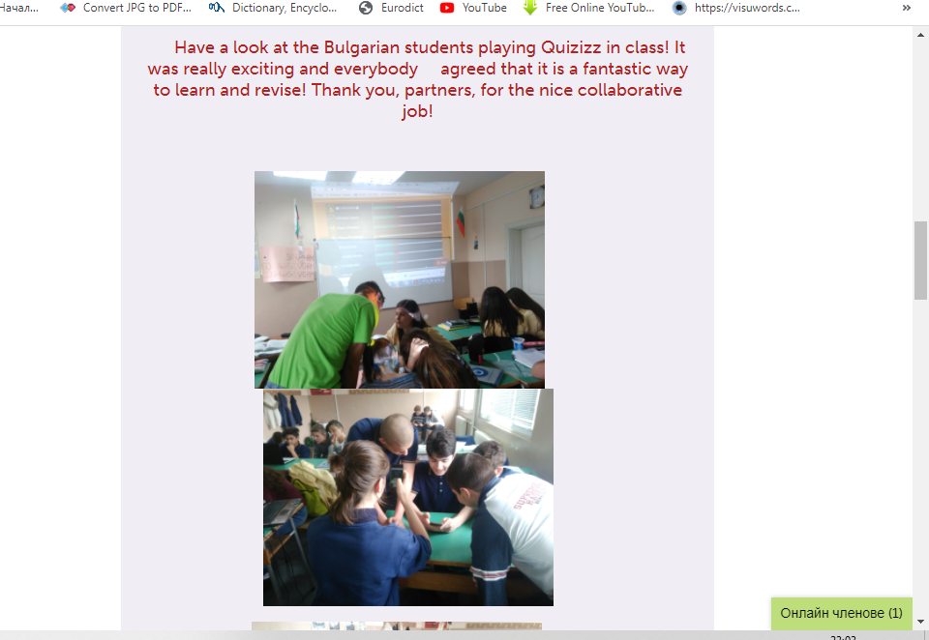
Games in eTwinning projects
Self-created Quizizz games
CLICK – Creative Learning in
a Computer Kingdom

Slide 16
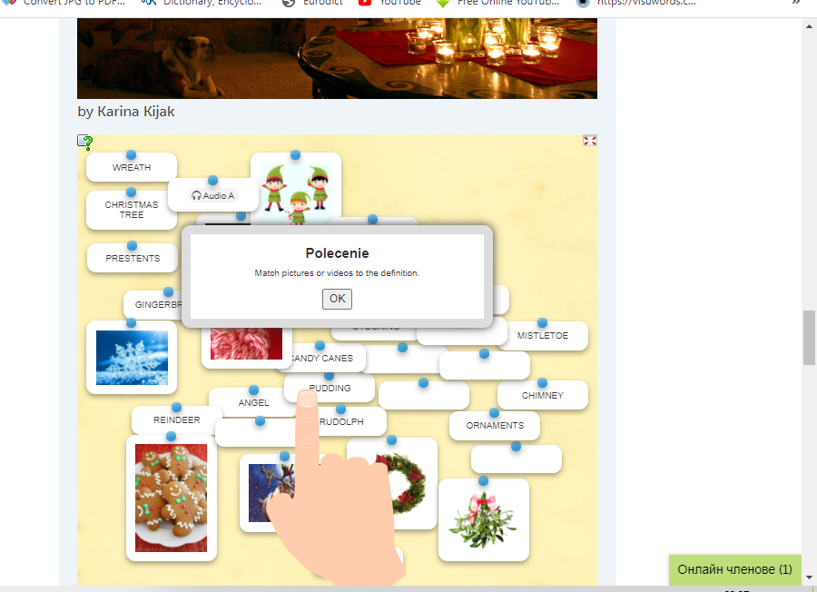
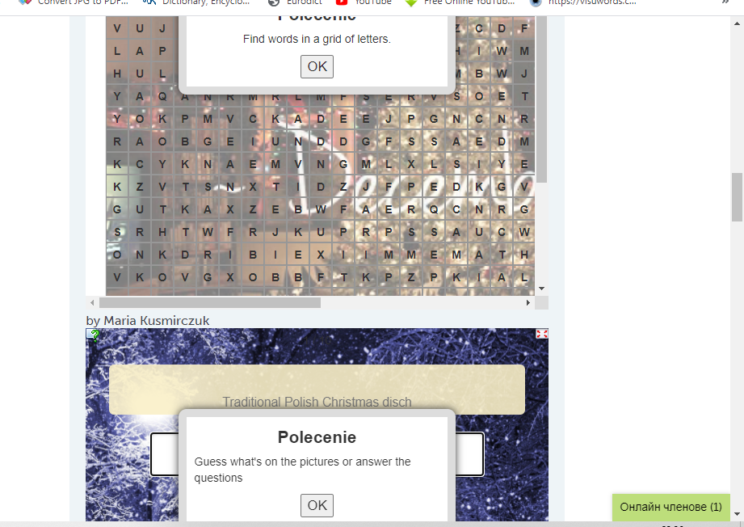
Games in eTwinning projects
https://learningapps.org/
Food Globalization – EXPO 2015

Slide 17
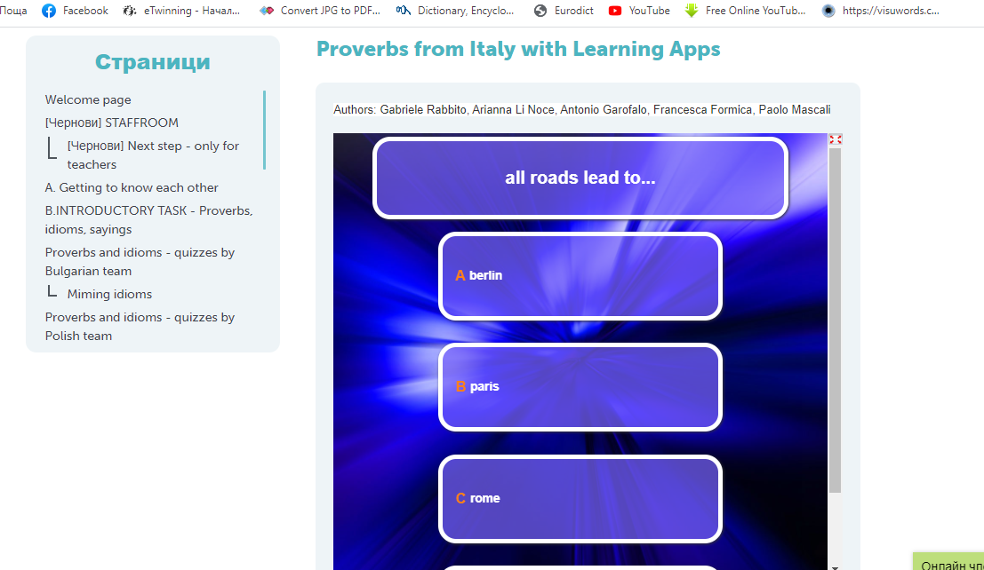
Games in eTwinning projects
https://learningapps.org/
A proverb a
day keeps the
boredom away

Slide 18
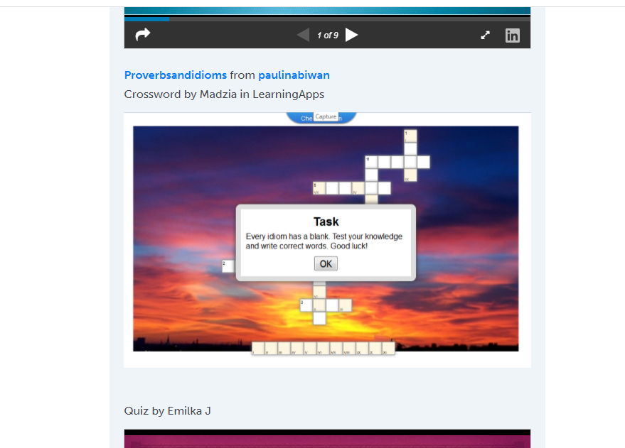
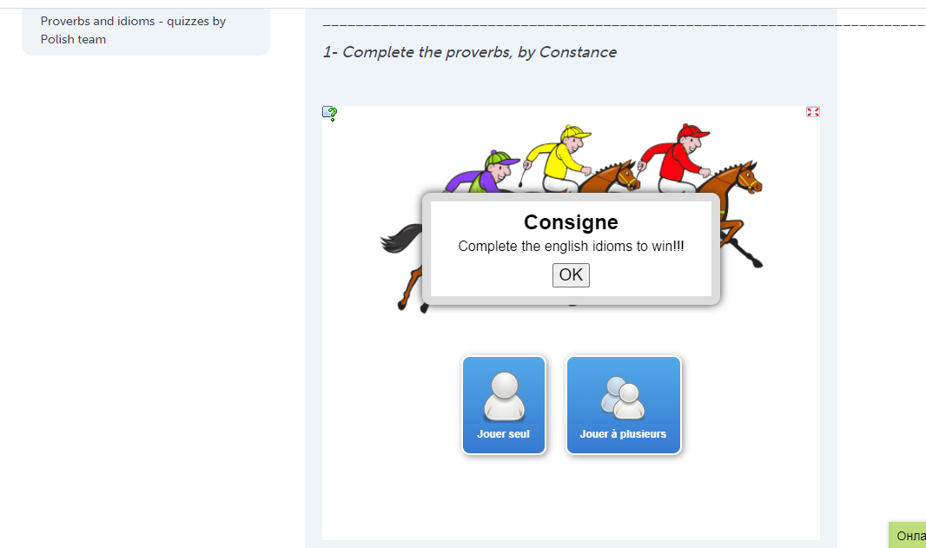
Games in eTwinning projects
https://learningapps.org/
A proverb a
day keeps the
boredom away

Slide 19
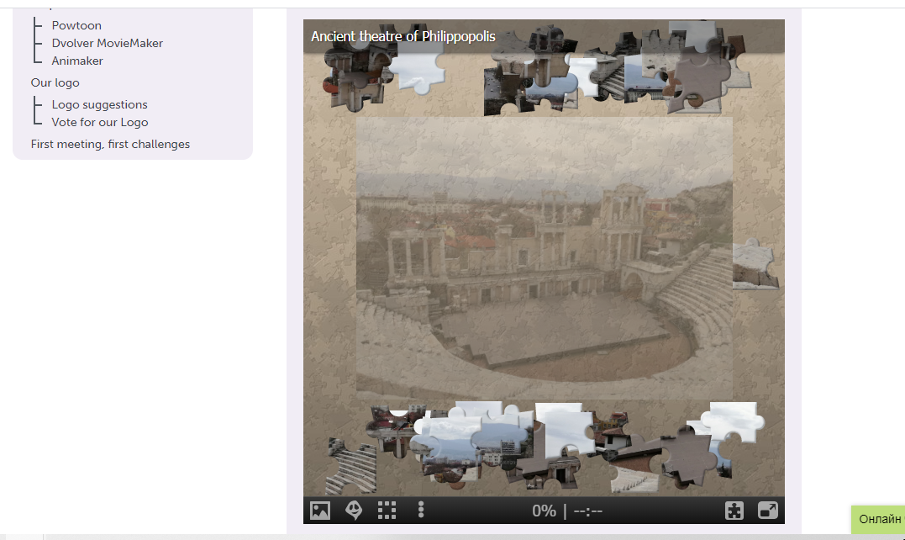
Games in eTwinning projects
https://www.jigsawplanet.com/
When two cities mean Europe

Slide 20
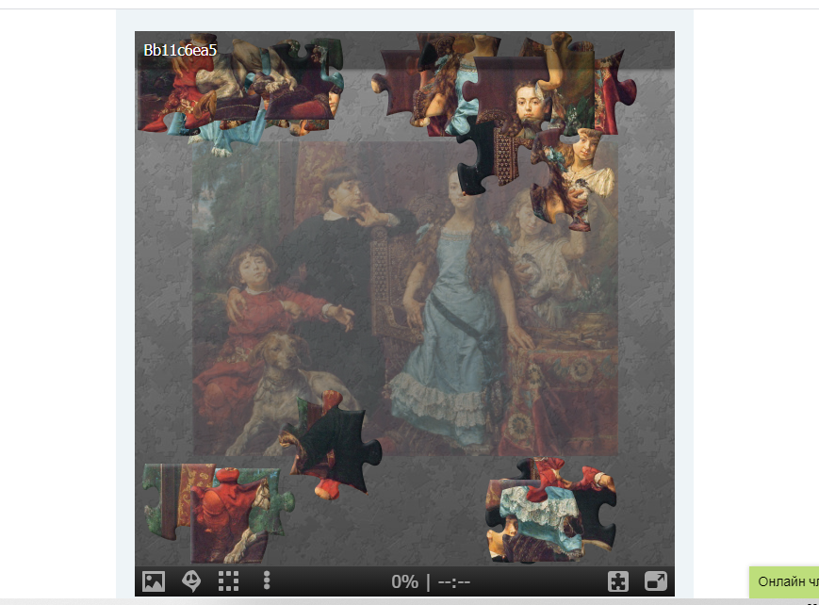
Games in eTwinning projects
https://www.jigsawplanet.com/
Art, English and … mannequin challenge

Slide 21
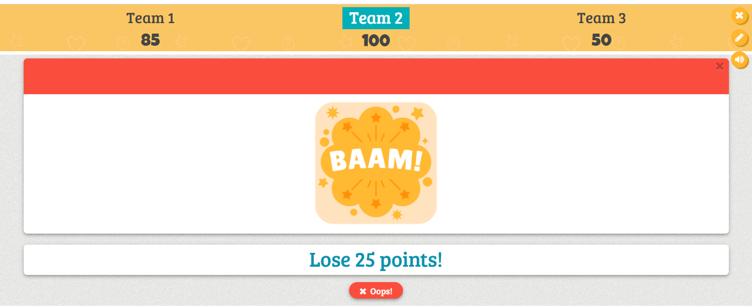
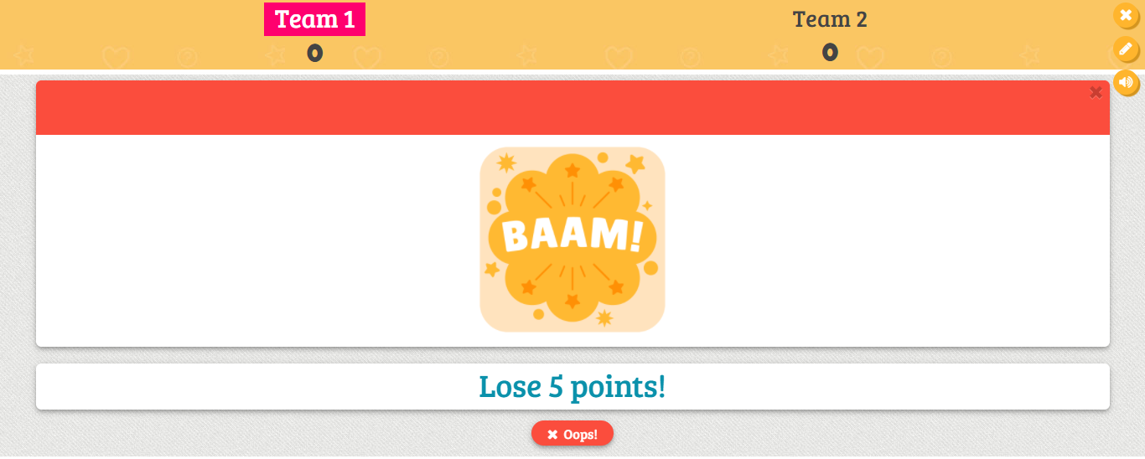
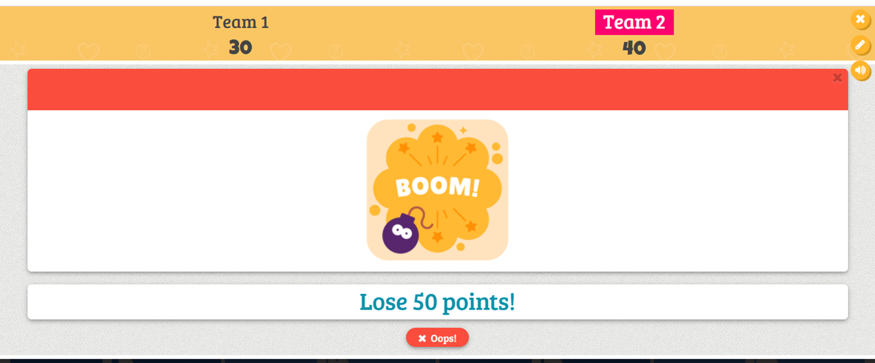
Games in eTwinning projects
https://www.baamboozle.com/

Slide 22
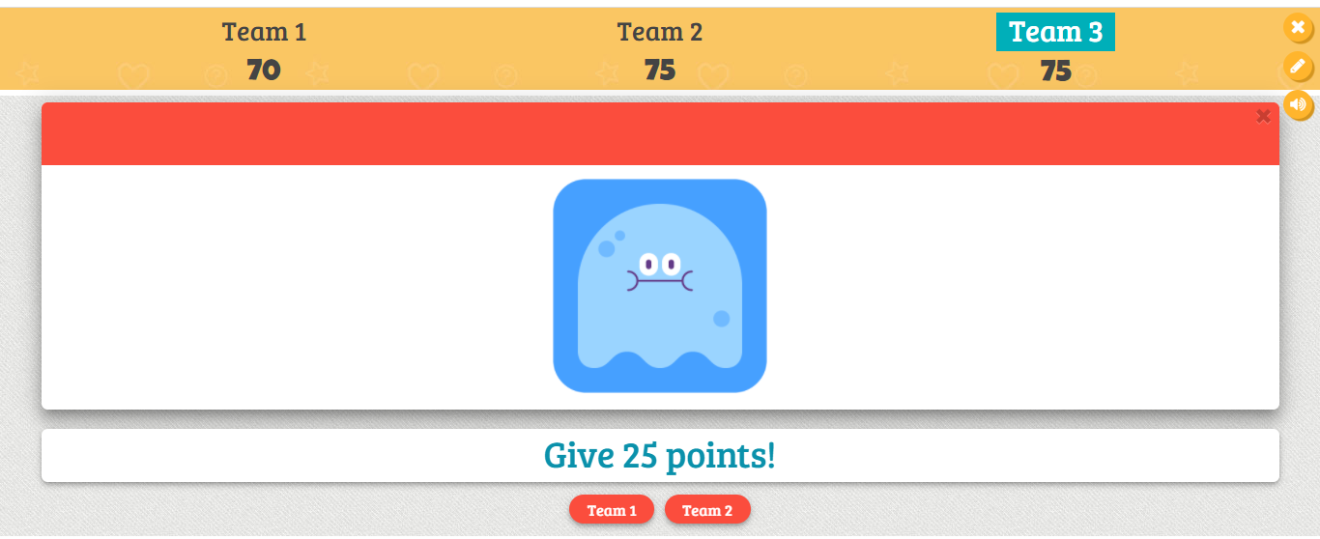
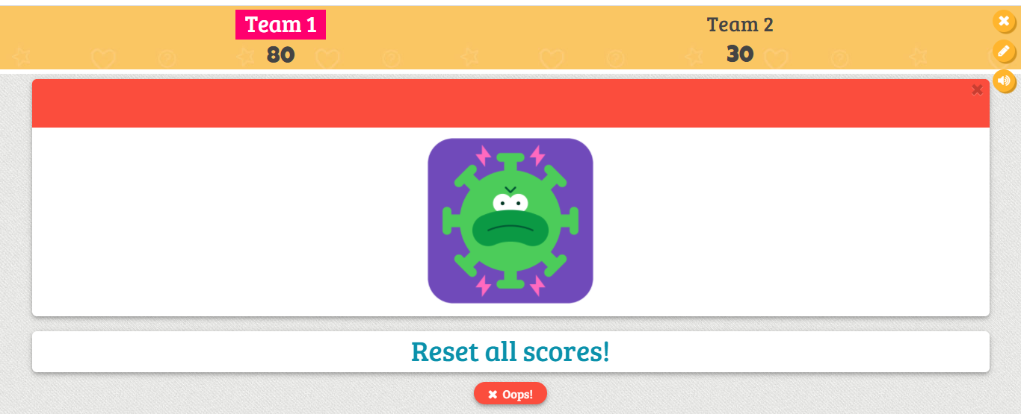
Games in eTwinning projects
https://www.baamboozle.com/

Slide 23
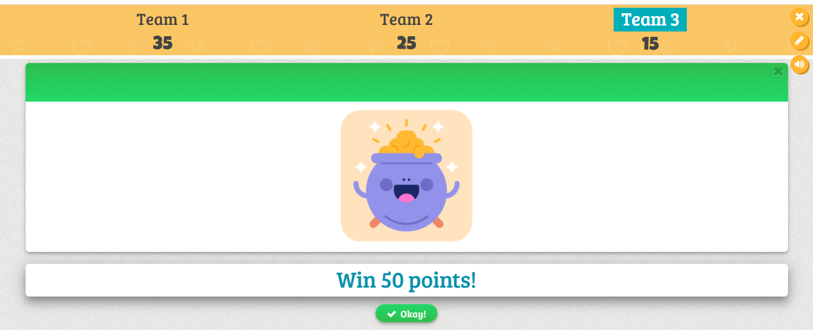
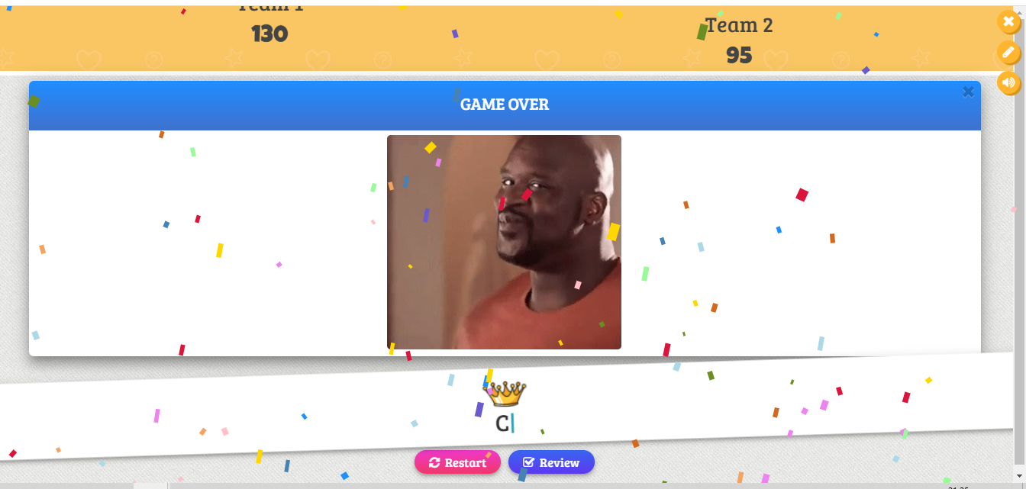
Games in eTwinning projects
https://www.baamboozle.com/

Slide 24
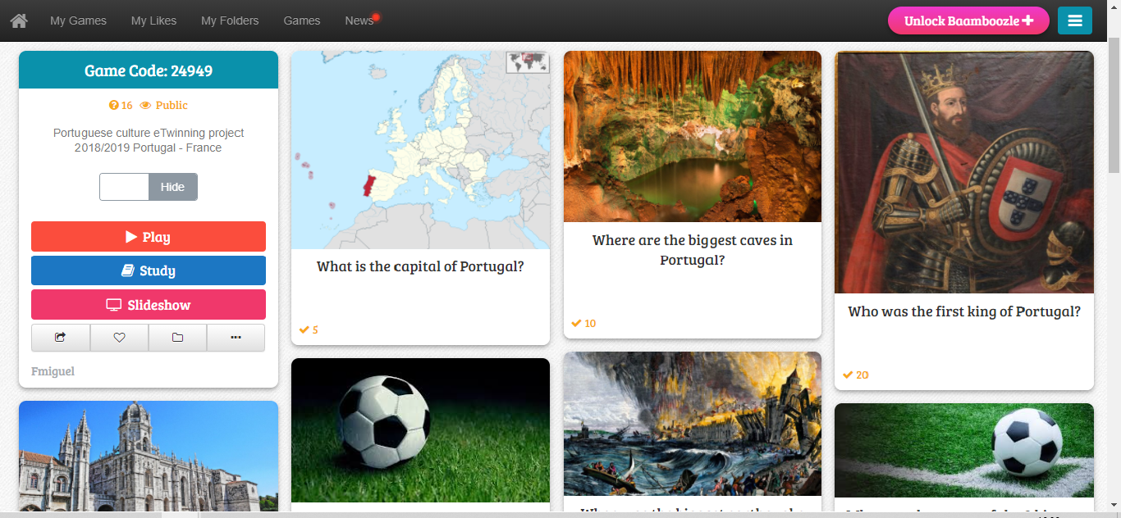
Games in eTwinning projects
https://www.baamboozle.com/

Slide 25
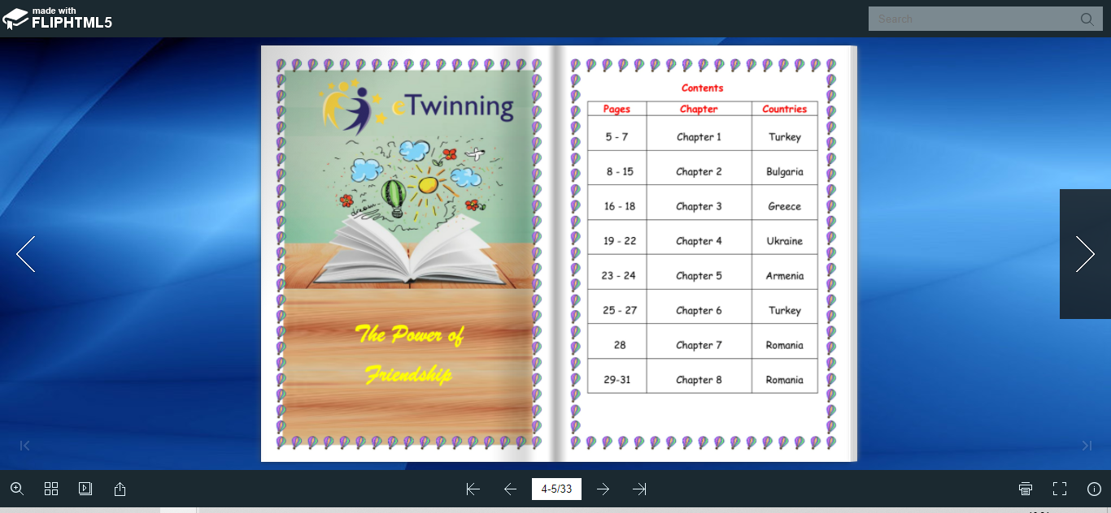
Games in eTwinning projects
Storytelling as a game
Are we so different?

Slide 26
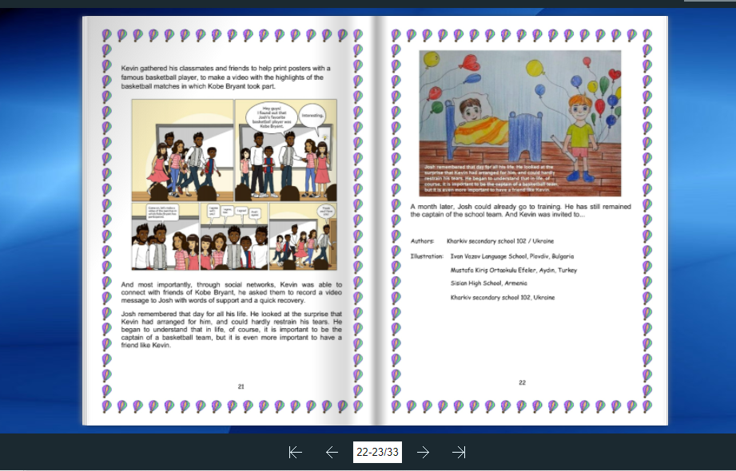
Games in eTwinning projects
Storytelling as a game
Are we so different?

Slide 27
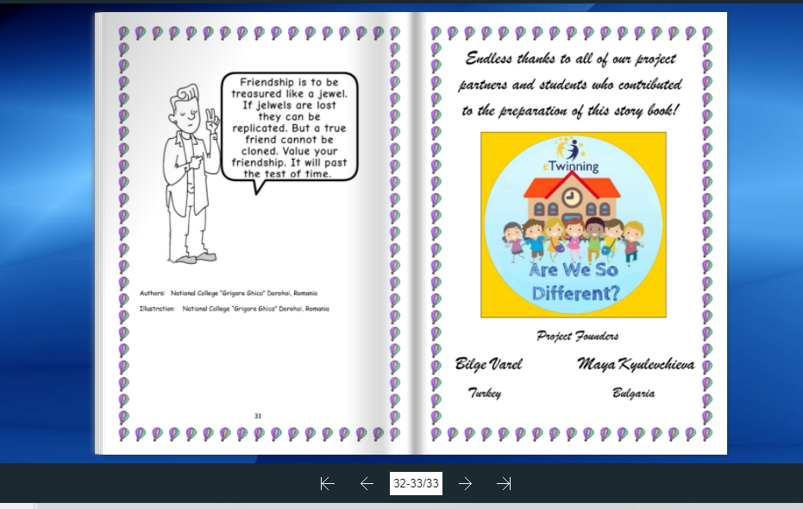
Games in eTwinning projects
Storytelling as a game
Are we so different?

Slide 28
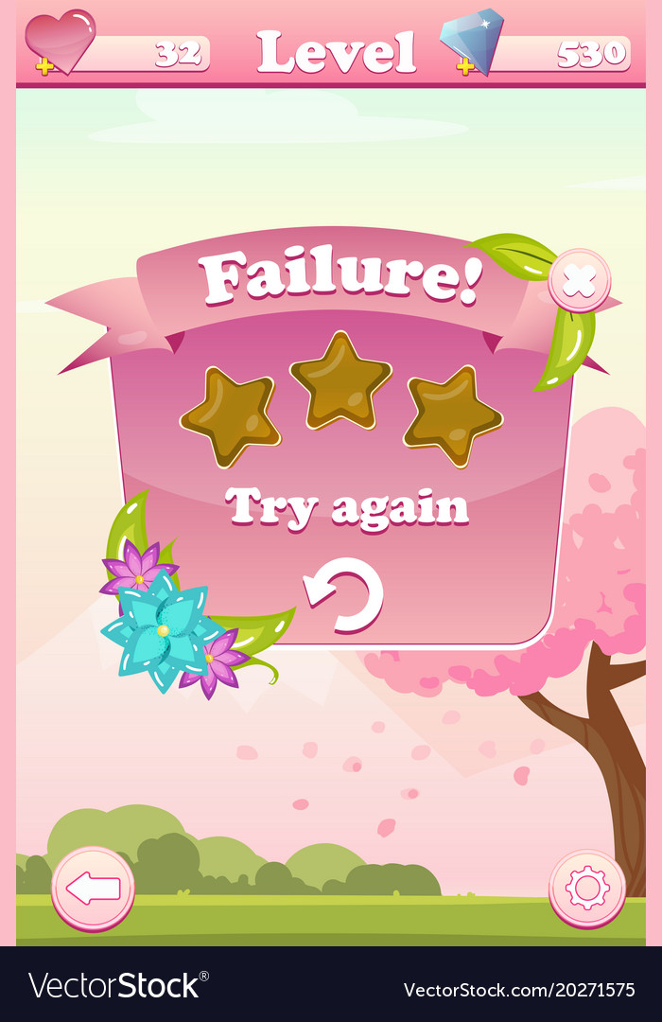

Slide 29
Thank you
for
your attention
Maya Kyulevchieva
eTwinning Ambassador
mayakyul@abv.bg
Template - Eli Maksova

