Slide 1
Hello!
My name is Katarina, and my surname is Ninić. I’m thirteen years old. I’m from Šibenik, a small but beautiful city in Croatia. I go to school in Šibenik.

Slide 2
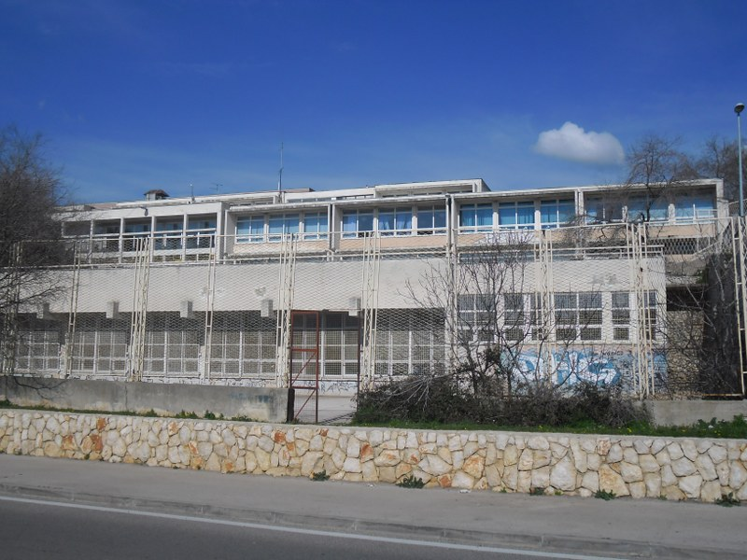
ABOUT MY SCHOOL.
I go to elementary school Juraj Šižgorić. The building is old, but I love it. It has great teachers and studnets. I have a lot of friends in school.

Slide 3
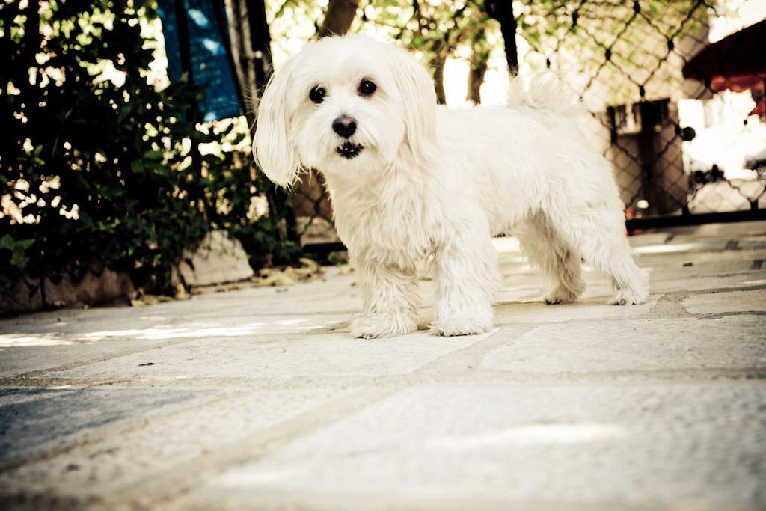
About my family.
I have two older sisters, they go to college in Zagreb (capital of Croatia). I live with my parents, and my dog Bubby, it’s maltese. I really love dogs, I think they’re so cute.

Slide 4
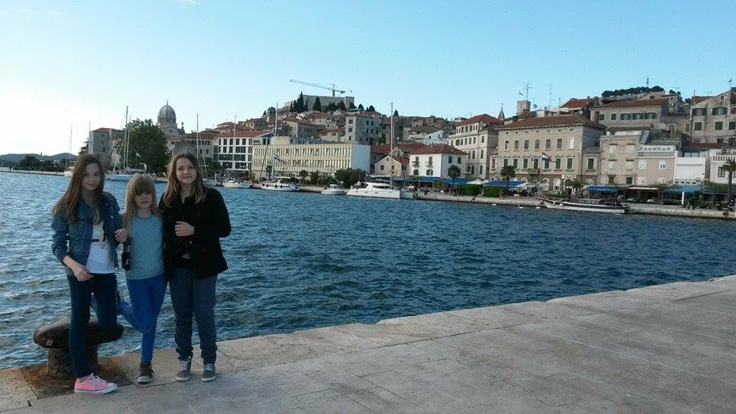
ABOUT MY FRIENDS.
I have two best friends, Anđela & Tina. We are in the same class. I love to spend time with them and hang around with them. They’re so funny and always there for me. That’s why I love them.
Friends forever.

Slide 5
MY HOBBIES.
My biggest hobby is singing. I attend music school and I play piano. I can’t imagine my life without music. I also love to draw & dance.

Slide 6
The end.
Hope you like it. Greetings, Katarina.

