Slide 1
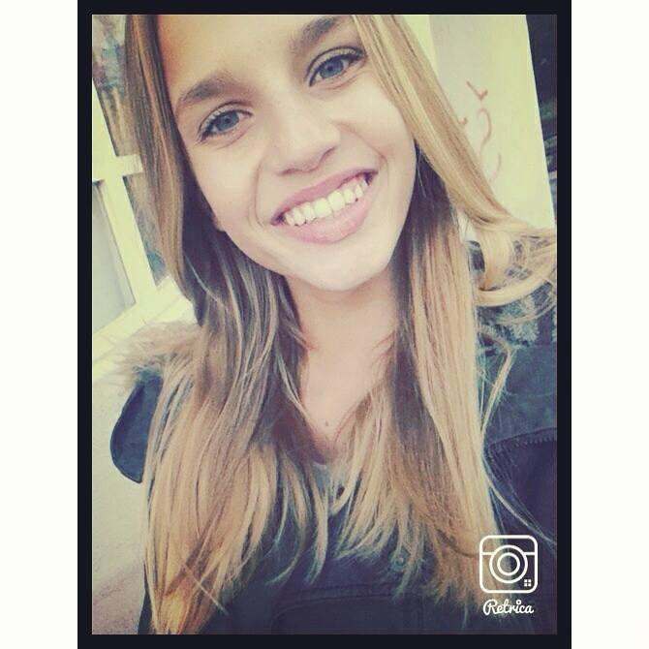

Slide 2
Hi,my name is Mia Kitarović. I’m thirteen years old.I’m in the 7th grade.
My hobby is karate. I practice it for like 5 years, we go on tournaments in other cities and we have a lot of fun.My free time I spend with my friends and family, I go in the nature with my mom and sister, or I go out with my friends. My sister doesn’t spend much time with me and my mom cause she is 17 and she thinks that we’re boring. My favorite band is Simple Plan, i just love them .My favorite youtuber is Pewdiepie, he is very funny and he always makes me smile. I don’t like school very much, I mean who does, but I like some subjects like english,chemistry...

