Slide 1
MY LIFE
Tina Grubišić-Čabo

Slide 2
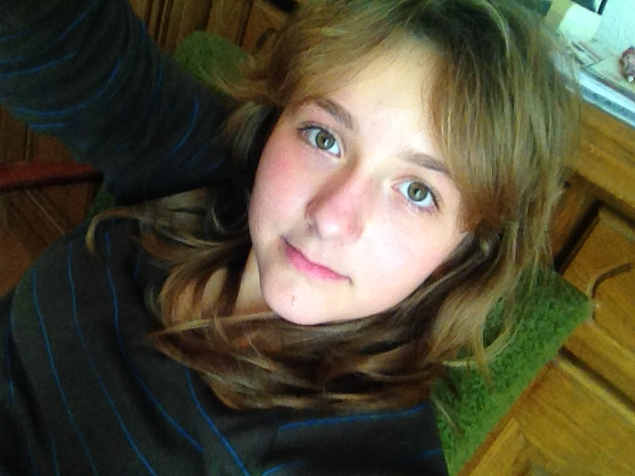
General
My name is Tina Grubišić-Čabo.I am 13 years old and I live in Šibenik , Croatia with my family . I am in the 7th grade and my best friend’s name is Anđela.

Slide 3
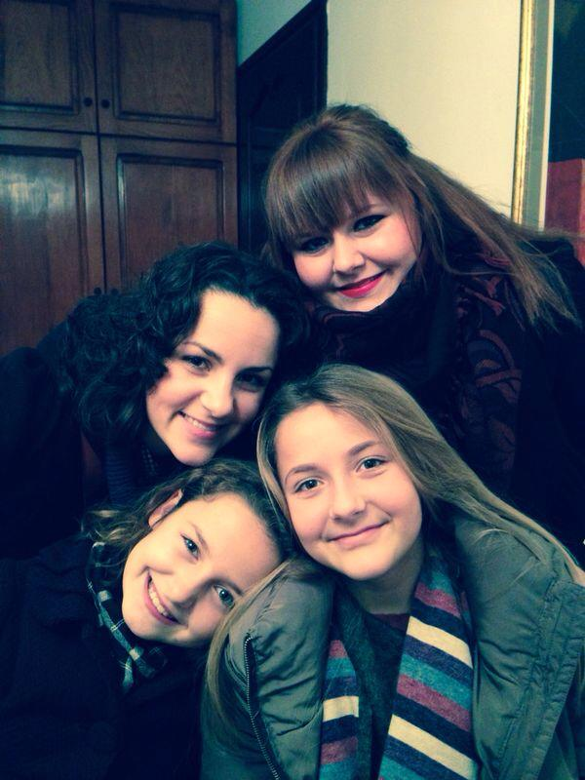
Family
I have 3 sisters: Barbara , Nikolina and Ana. My dad’s name is Robert and he is doctor . My mom’s name is Tatjana and she is a doctor too. My sisters Barbara and Nikolina are on college in Zagreb and my sister Ana goes to the 5th grade.Barbara is 23 years old , Nikolina 21 and Ana 11.We are very happy together.

Slide 4
School
I am going to the primary school Juraj Šižgorić.I am a great student and my best friend is too. My favourite subjects are Geography, History and Chemistry. When I grow up I want to be a lawyer.

Slide 5
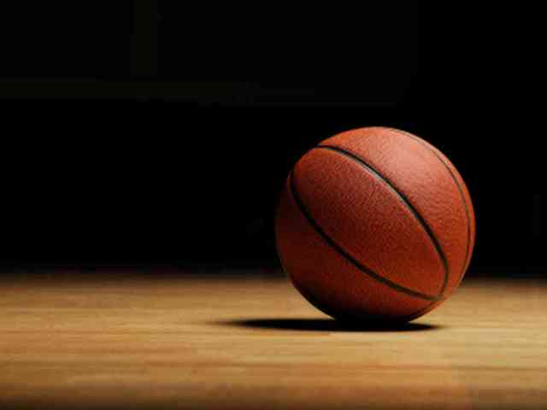
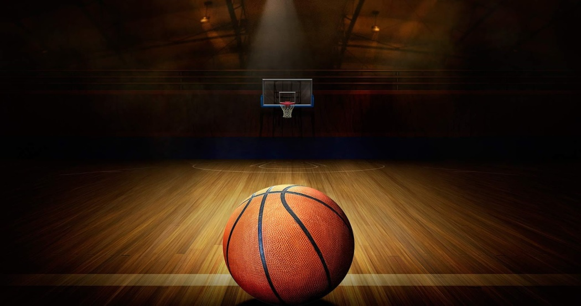
Hobbies
I practice basketball in the club Šibenik. I am learning French and I always go out with my friends. I love watching movies and listening to music.

Slide 6
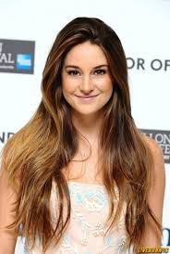
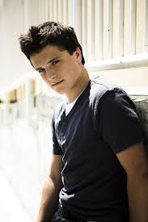
MOVIES, SERIES
My favourite movies are The Fault In Our Stars and The Hunger Games .
My favourite actor is Josh Hutcherson and my favourite actress is Shailene Woodley.
My favourite series are The Big Bang Theory and Two and a half men

Slide 7
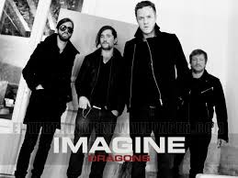
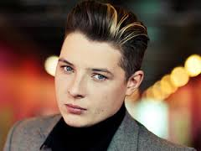
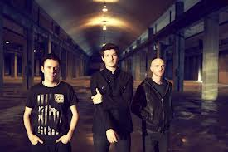
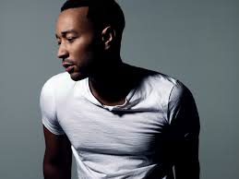
MUSIC
My favourite singers are John Legend and John Newman
My favourite songs are All of me , Rude , I see fire and Amnesia.
My favourite bands are 5 Seconds of Summer,The Script and Imagine Dragons.

Slide 8
So this is all about me . ☺
Tina Grubišić Čabo

