Slide 1
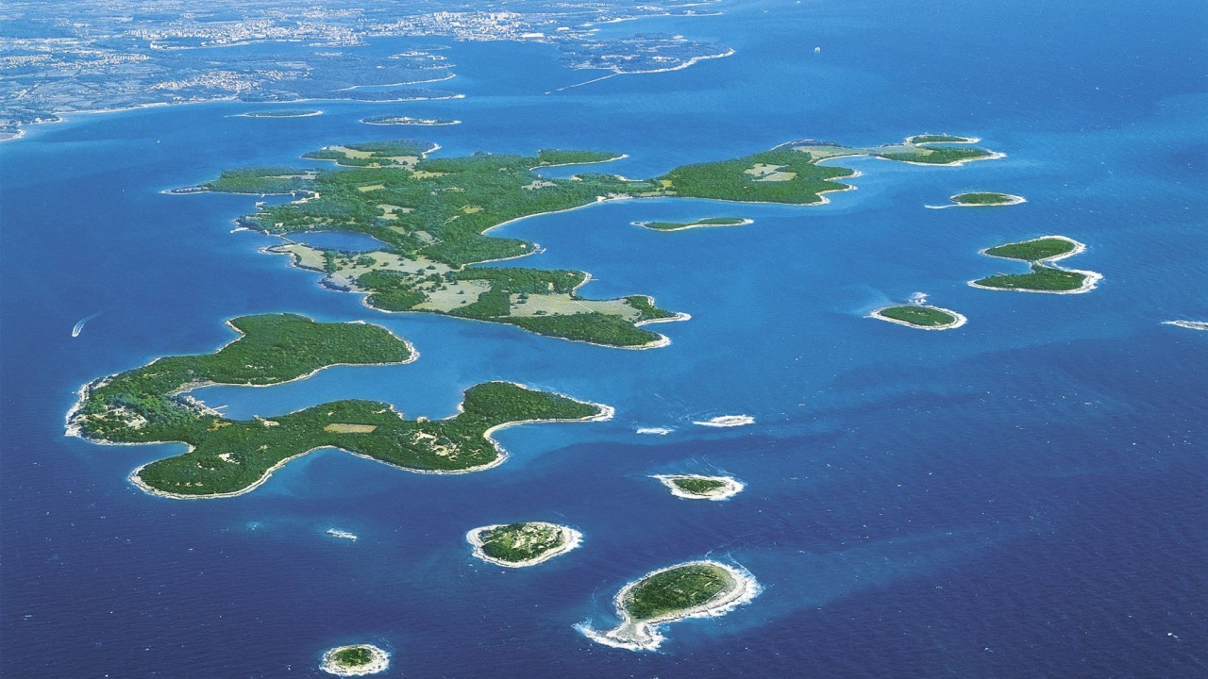
National park Brijuni islands

Slide 2
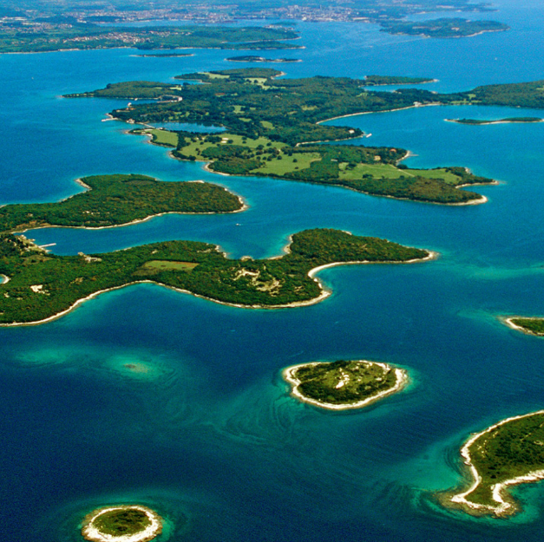
Generalities
National park
27 October 1983
3 islands i 11 isles
Surface 33,9 km²
Istria county
Veliki Brijun and Mali Brijun
Sveti Marko, Gaz, Okrugljak, Galija...

Slide 3
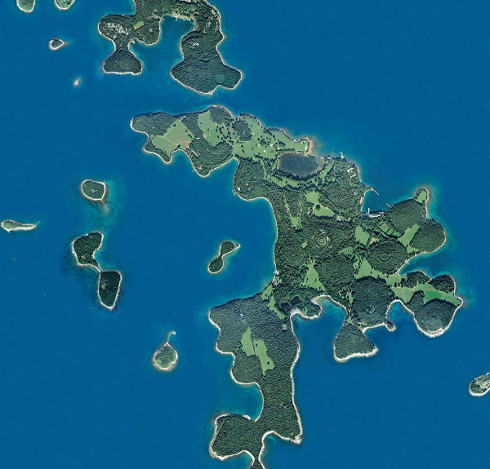
Climate
mild, Mediterranean with lots of sun and warmth
the mean annual temperature is 13.9°C
Average annual rainfall 817 mm

Slide 4
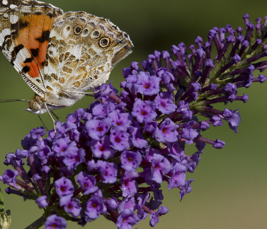
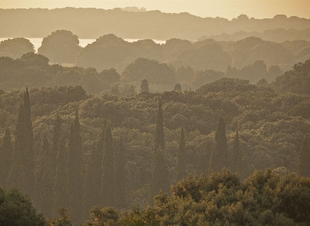
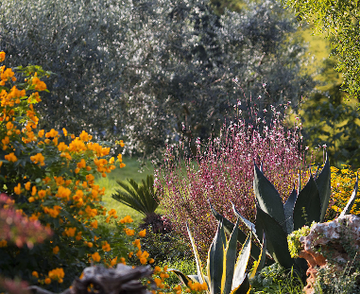
Vegetation
maquis
lawns
holm oak forests
holm oak and laurel forests
coniferous crops
coastal poppy, various types of orchids, various salt marsh plants, some types of grass, etc.
primorska makovica, razne vrste orhideja, razne biljke slanuše, neke vrste trava i dr.

Slide 5
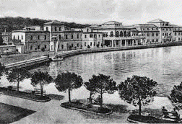
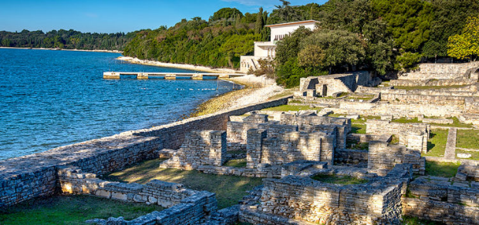
History
Illyrian tribe Histri
Josip Broz Tito’s residence
president dr. Franjo Tuđman held numerous meetings (Brijuni meeting)

Slide 6
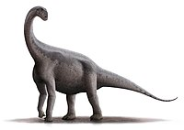
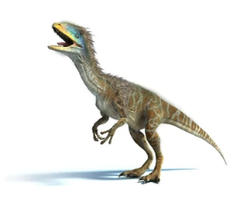
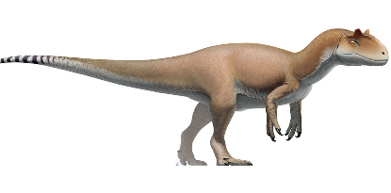
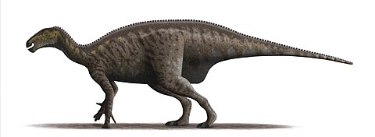
Dinosaurs
Found more than 200 footprints
Teropodi
Coelurosauria
Sauropodi
iguanodoni

Slide 7
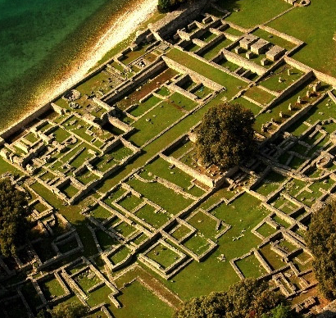
Byzantine castrum
archeological site on Veliki Brijun
the decay of the Roman villa gradually transformed into a series of smaller living quarters
St. Mary’s Basilica
in the narthex of the basilica and around it was an early Christian cemetery
Church of St. Peter

Slide 8
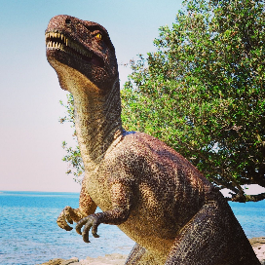
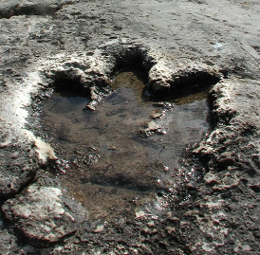
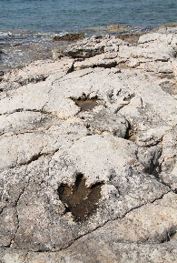
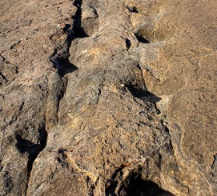
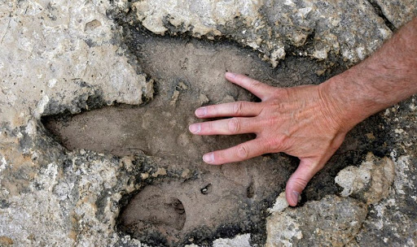
THE END

