Slide 1
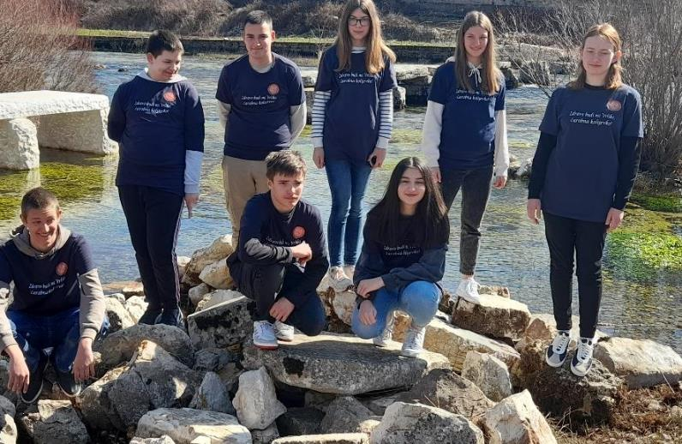
Welcome to my...place - Vrlika, National Park Brijuni and National Park Plitvice Lakes

Slide 2
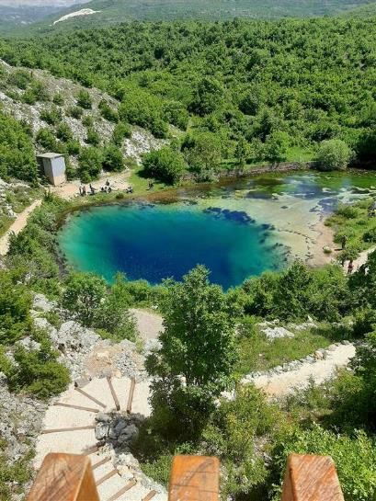
The source of the Cetina River
This beautiful nature’s blue eye is the source of the Cetina river. Rising from a spring at Milasevo near a small village called Cetina, 7 kilometres north of Vrlika, it flows 101 kilometres to the Adriatic Sea.
This karst spring of the Cetina river is more than 150 meters (490 feet) deep.

Slide 3
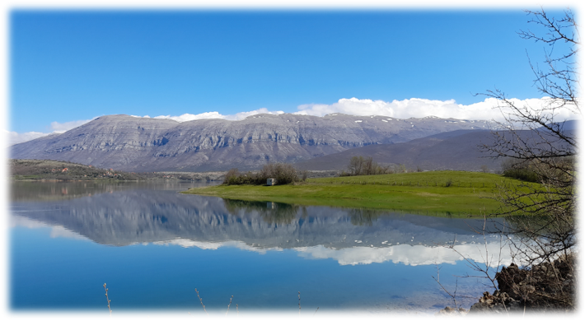
Nature Park Dinara Mountain

Slide 4
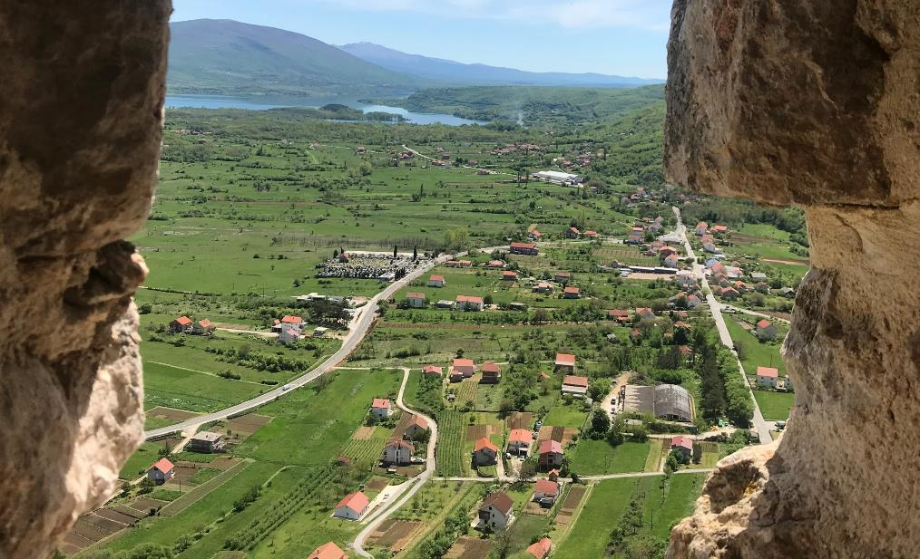
Prozor Fortress

Slide 5
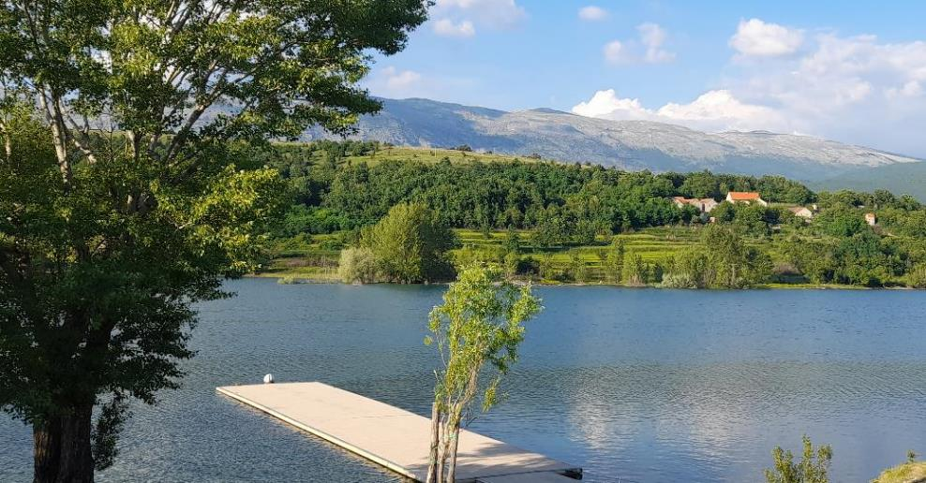
Peruča Lake

Slide 6
Please, open this link and watch the whole presentation of our hometown Vrlika.
https://sway.office.com/cGyrVcvzT8P9OR2B?ref=Link&loc=play
Let’s move to two other beautiful places in Croatia, both National Parks – first the Brijuni Islands and then the Plitvice Lakes.

