Slide 1
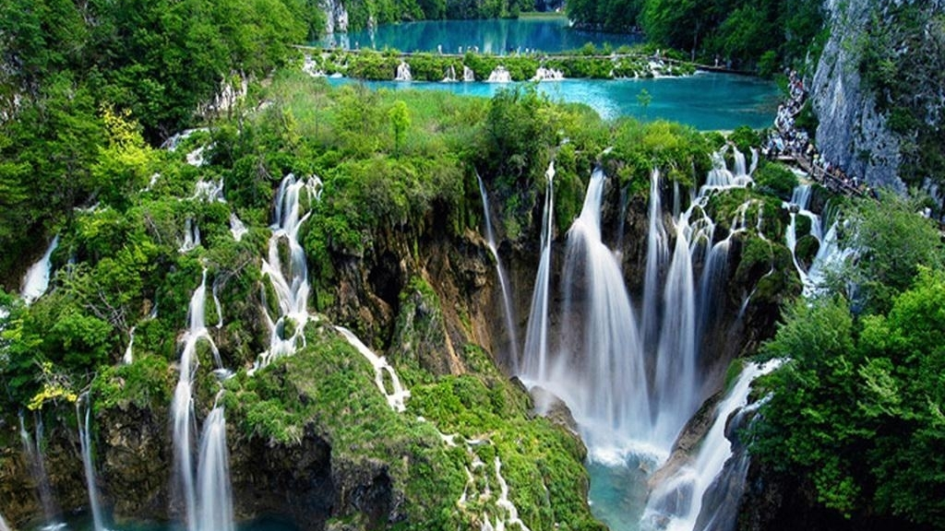
The Plitvice Lakes National Park

Slide 2
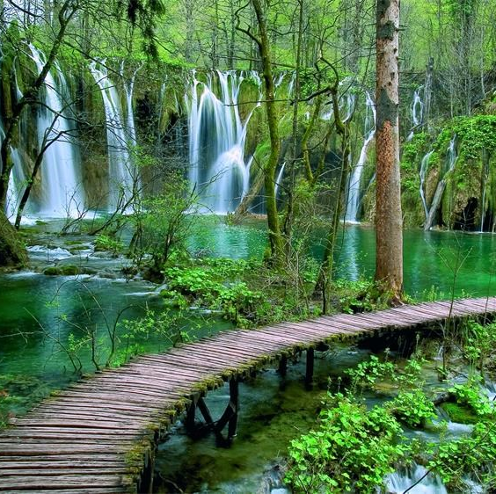
Generalities
Plitvice Lakes were declared a national park on April 8, 1949
The largest, oldest and most visited Croatian national park
There are 16 lakes of different sizes
Tufa on Plitvice

Slide 3
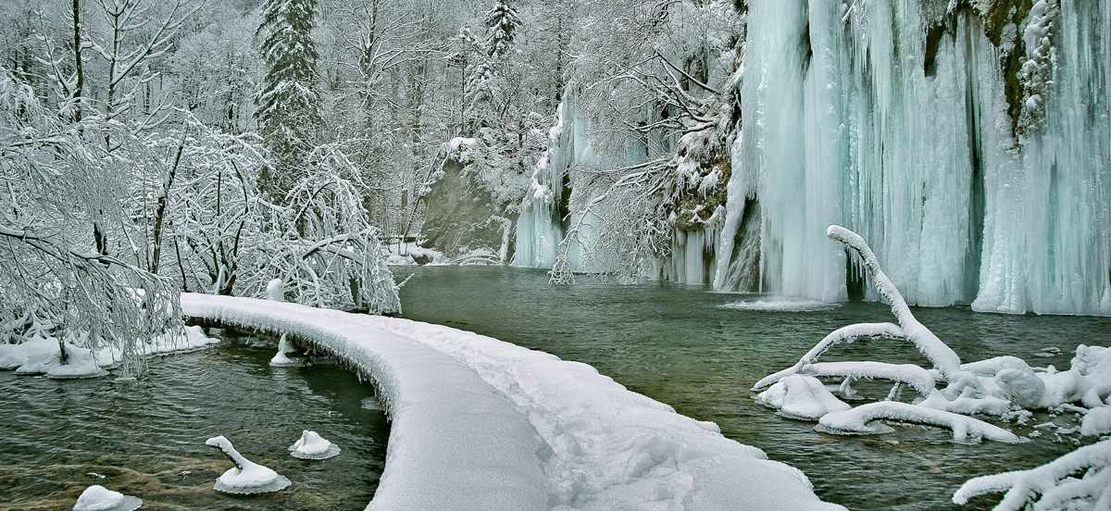
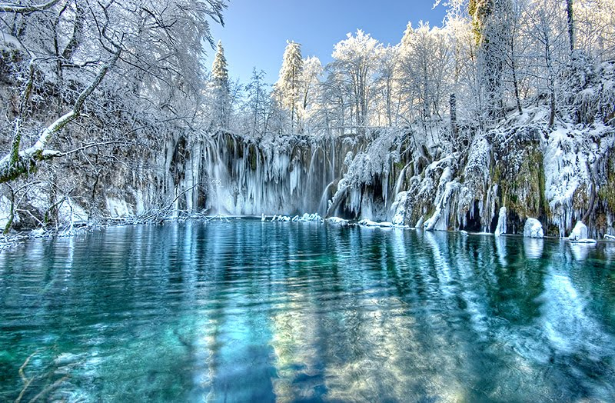
Position and climate
In January, the average temperature is 2.2 ° C
During the summer months, the temperature rises to 17.4 ° C
Lakes are usually frozen during December and January

Slide 4
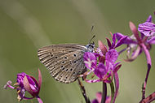
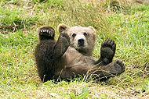
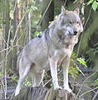
Animals
There is a great biodiversity and many different habitats for animals in the Park area
321 species of butterflies, 157 species of birds and 20 species of bats were found in the Park
Gray falcons nest on the rocks
The brown bear is a resident and symbol of Plitvice Lakes

Slide 5
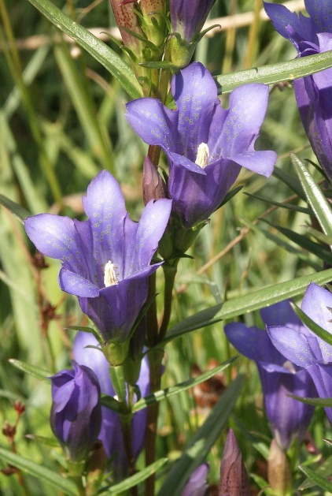
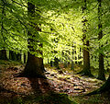
Plants
About 2/3 of the National Park is covered with forest
The most common type of tree is beech and fir
As many as 1267 different plant species were found in the Park, of which as many as 50 species of orchids
Crveni repuh
Plućna širištara
Zlatna jezičnica
Beech
Brdski različak
Medenika

Slide 6
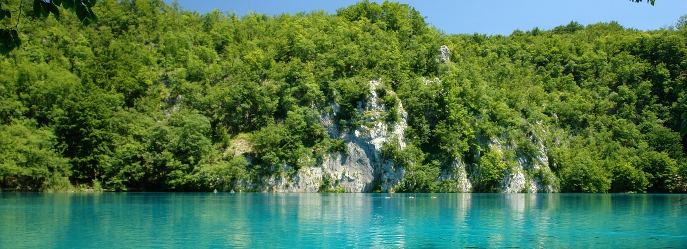
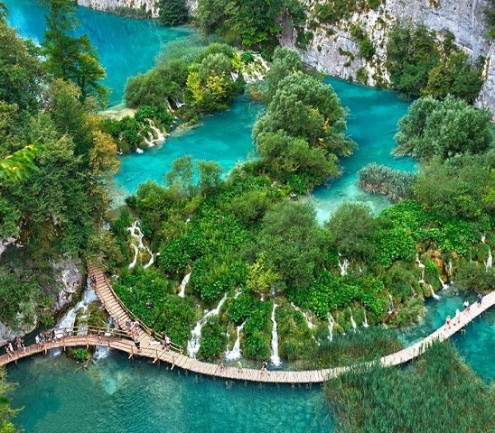
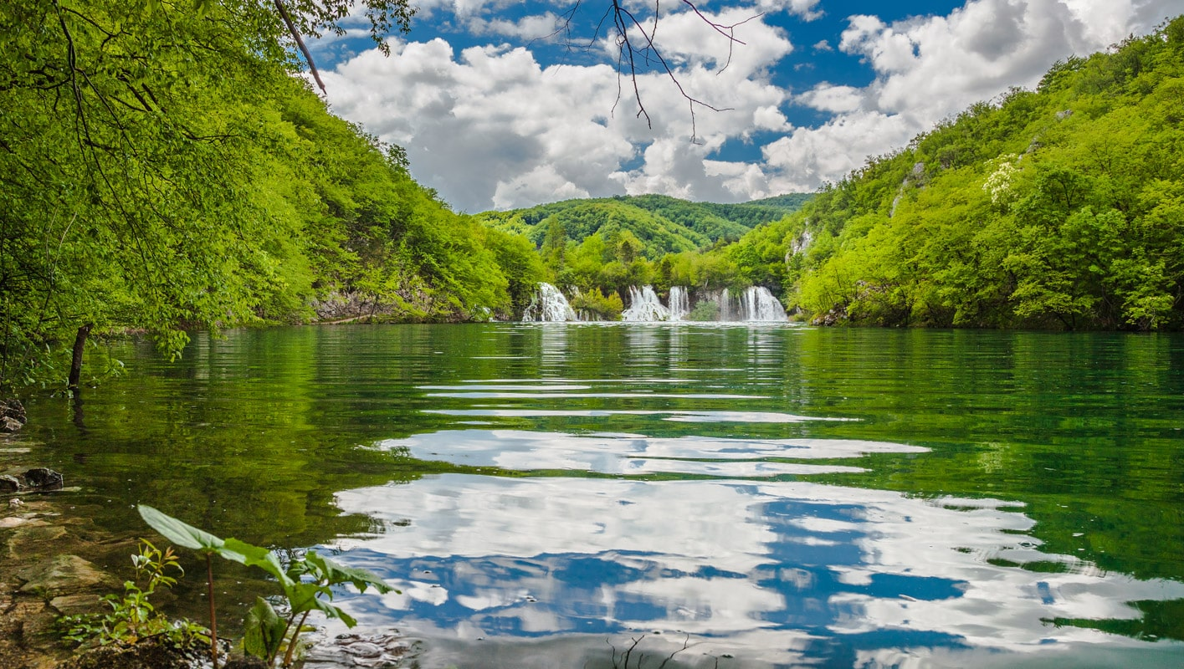
History
People have inhabited the Plitvice Lakes area for thousands of years
In the 7th century, Croats settled permanently in this area
According to the legend, the Black Queen created the Plitvice Lakes for the people due to the great drought

Slide 7
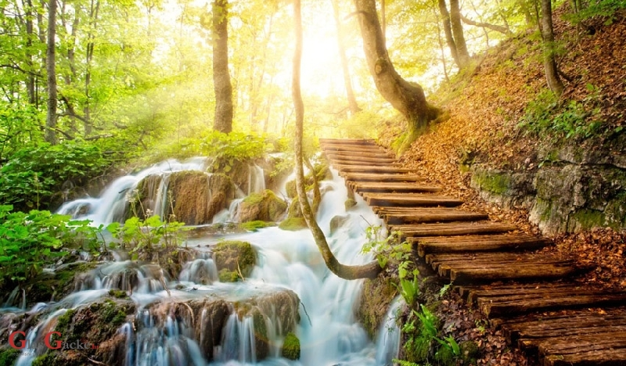
The End

