Slide 1
How to use Storyjumper
Created by Giedre

Slide 2
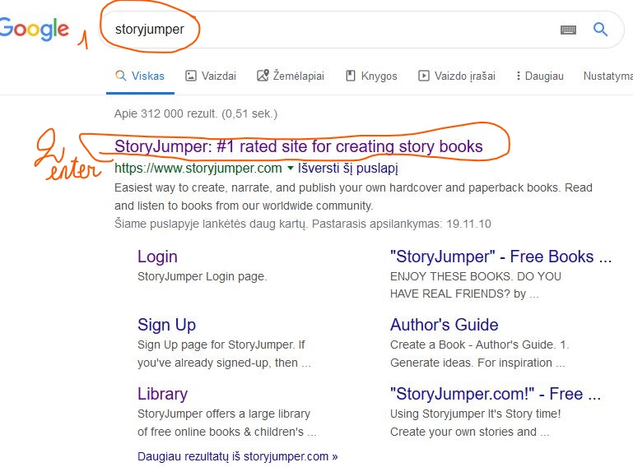
Registration

Slide 3
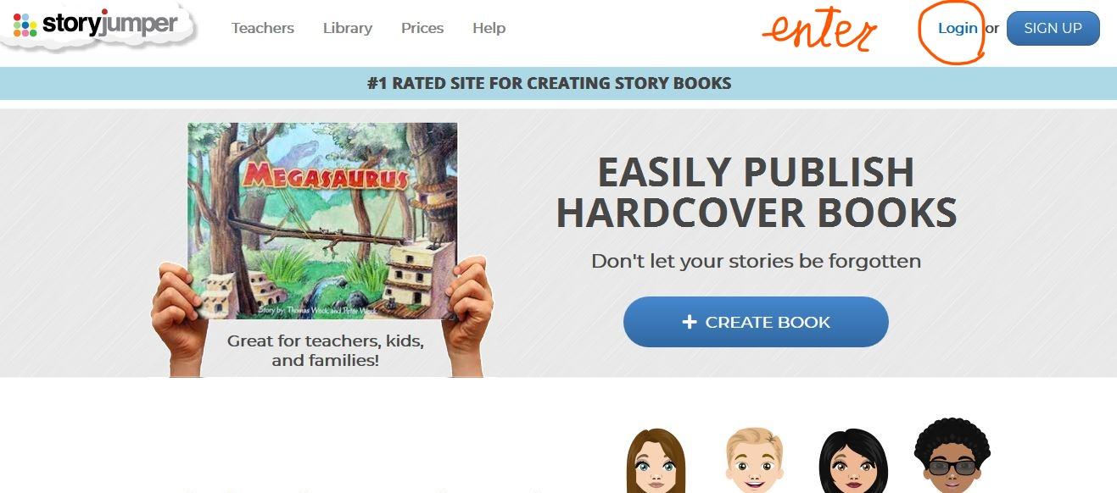
Registration

Slide 4
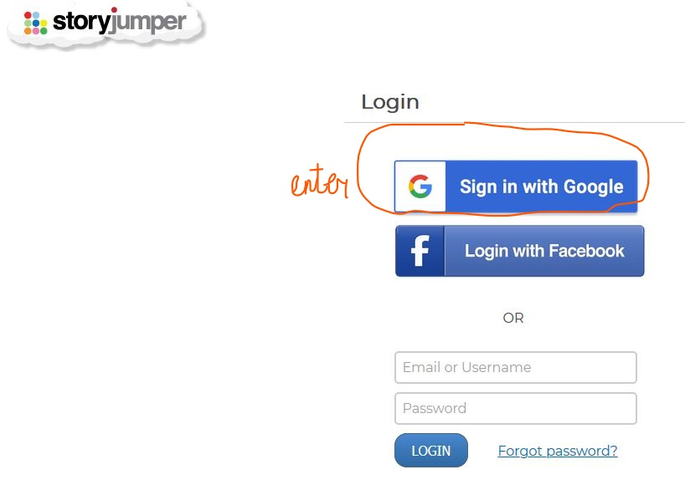
Registration

Slide 5

Book Creation

Slide 6
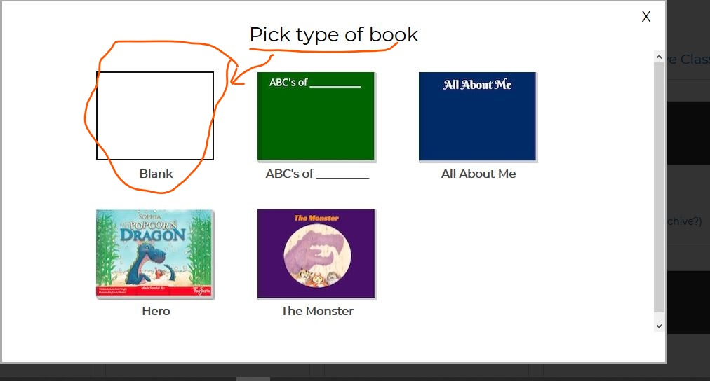
Type of Book

Slide 7
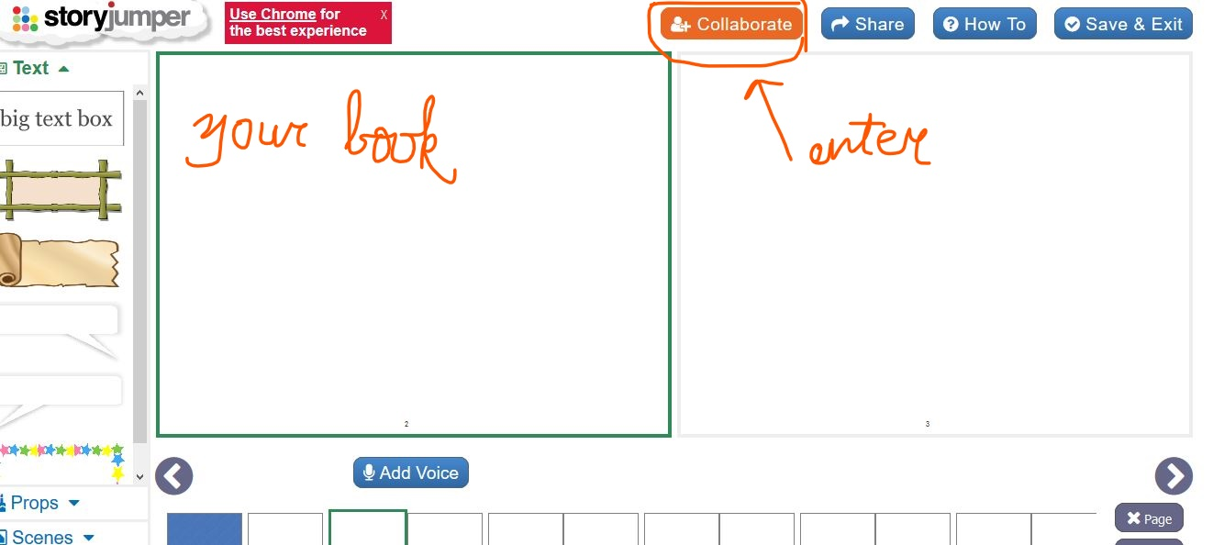
Collaboration

Slide 8
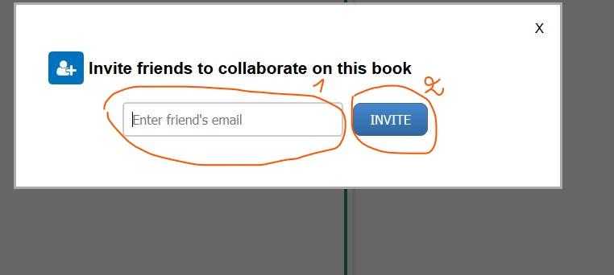
Collaboration by email

Slide 9
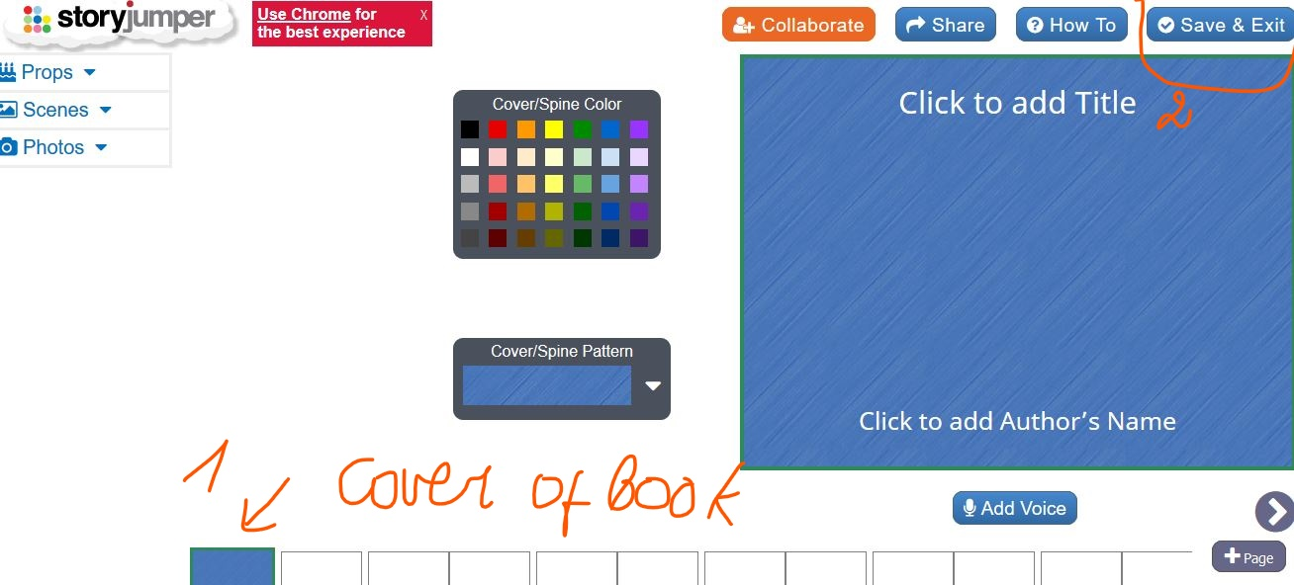
Cover of the Book
Saving

Slide 10
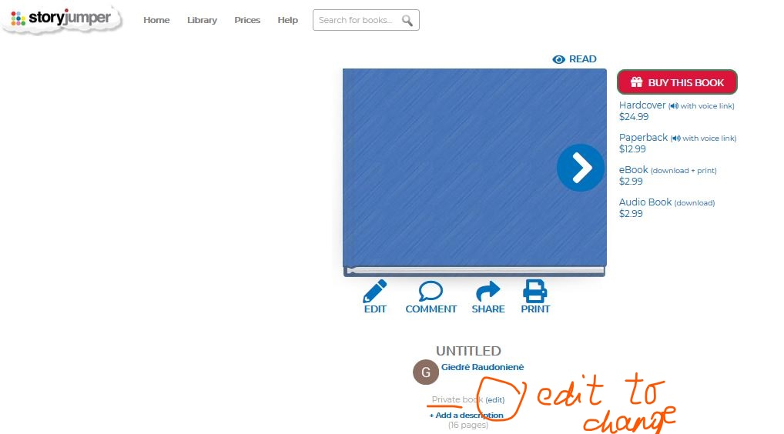
Change Private to Public

Slide 11
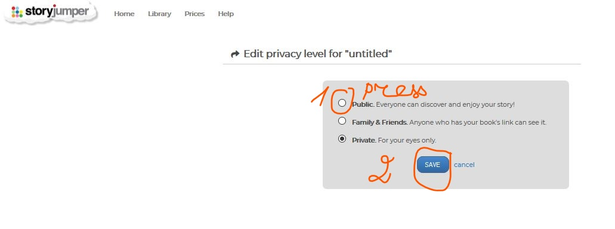
Change Private to Public

Slide 12
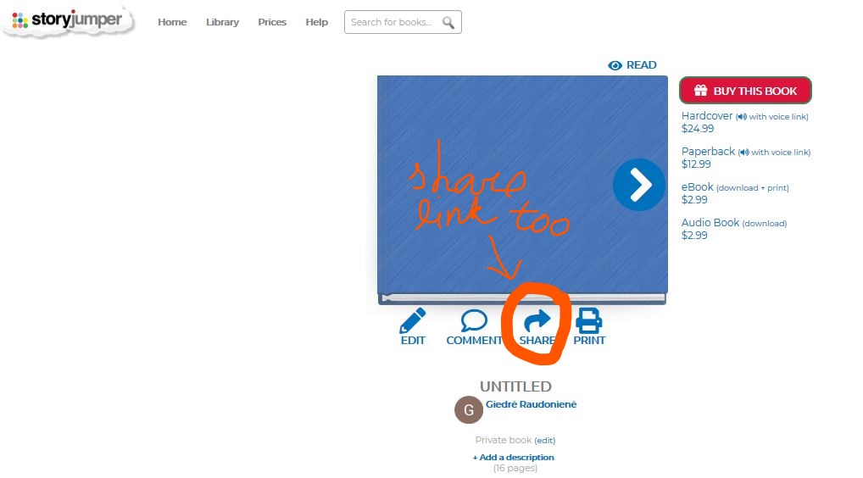
Sharing

