Slide 1
How to use „Canva“?
by Giedre

Slide 2
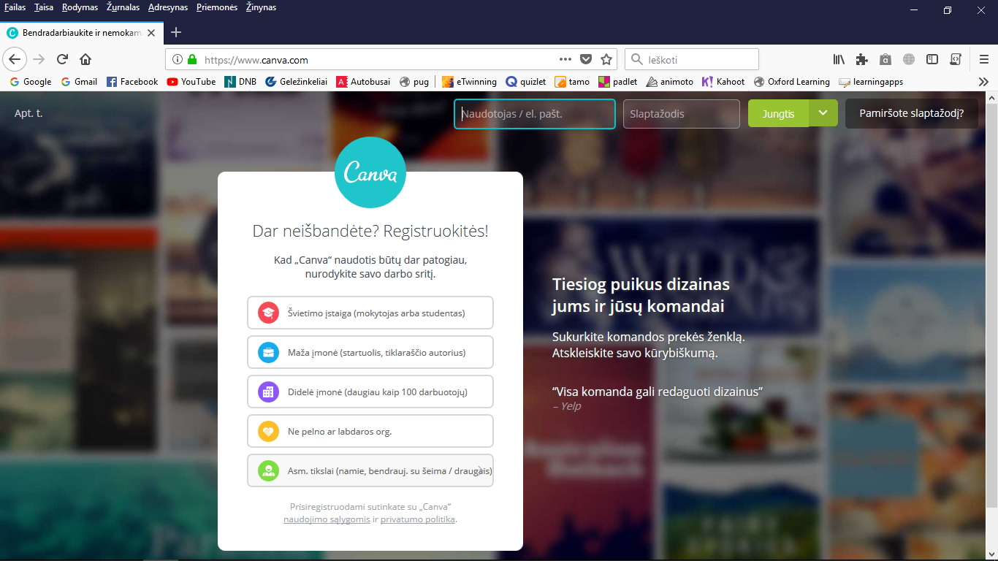
Registration
www.canva.com

Slide 3
Create an account
Registration
Write name
Create e-mail
repeat e-mail
Write password
Tick (to identify if you aren‘t a robbot)
Press registration

Slide 4
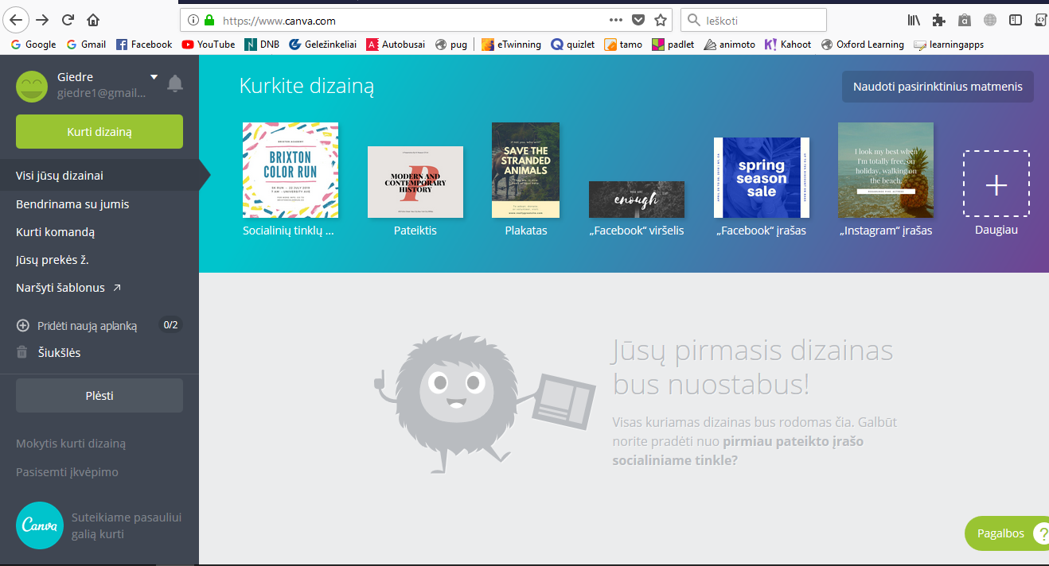
Now you are in
Patterns/templates

Slide 5
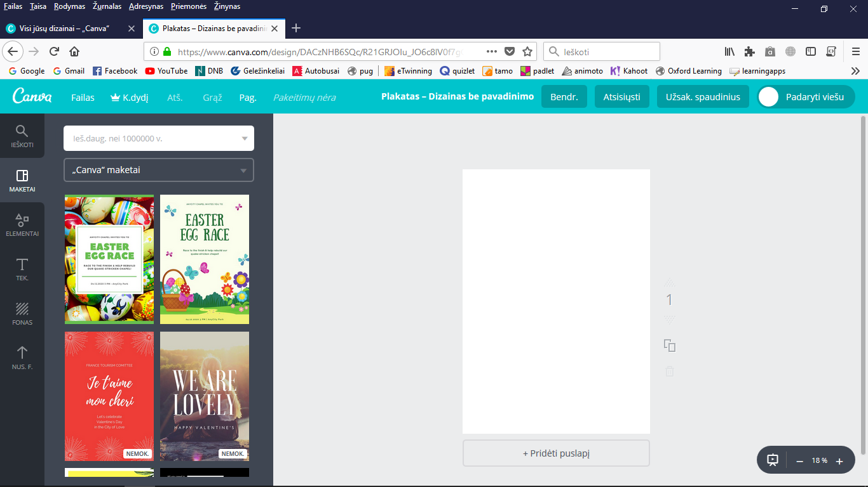
How create a poster

Slide 6
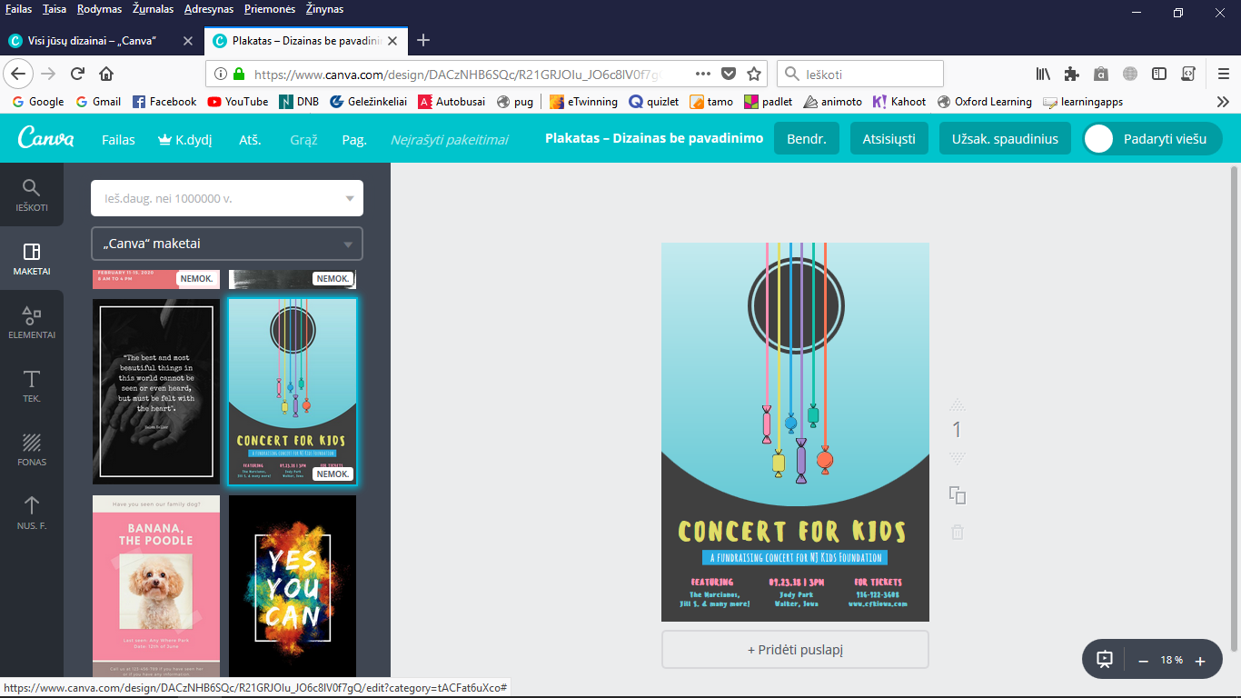

Slide 7
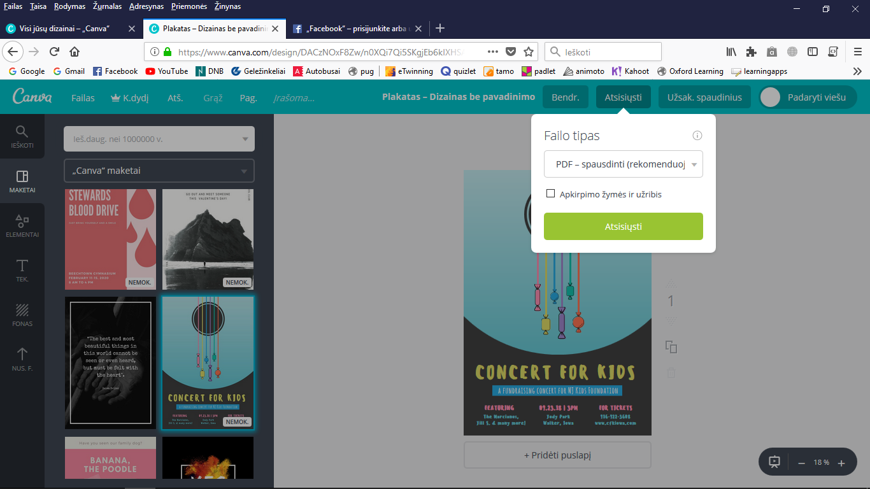
To save on your computer
download

Slide 8
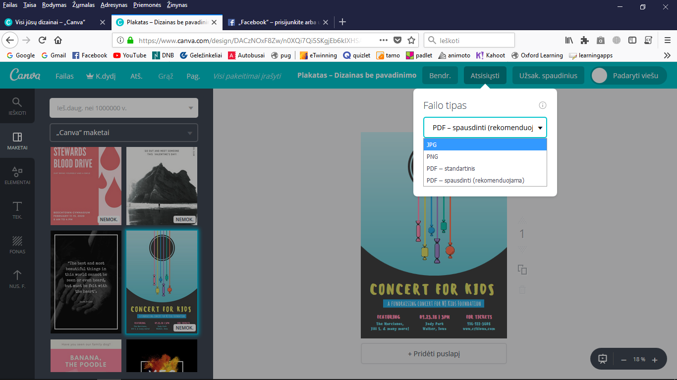

Slide 9
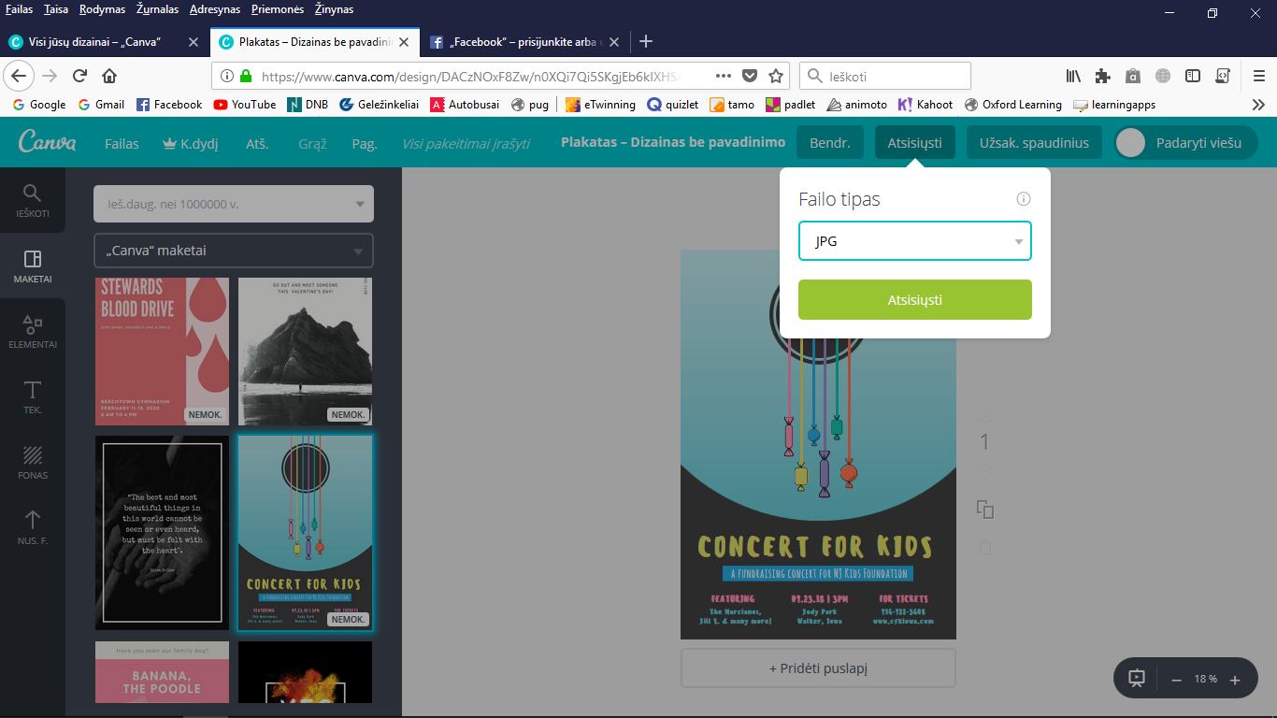
Start downloading

