Slide 1
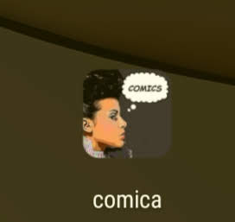
How to use Comica app

Slide 2
Download Comica to phone or tablet

Slide 3
Beginning
From gallery
Take photo
Make collage

Slide 4
When you choose the photo, start creating comics
This is how visualize photo

Slide 5
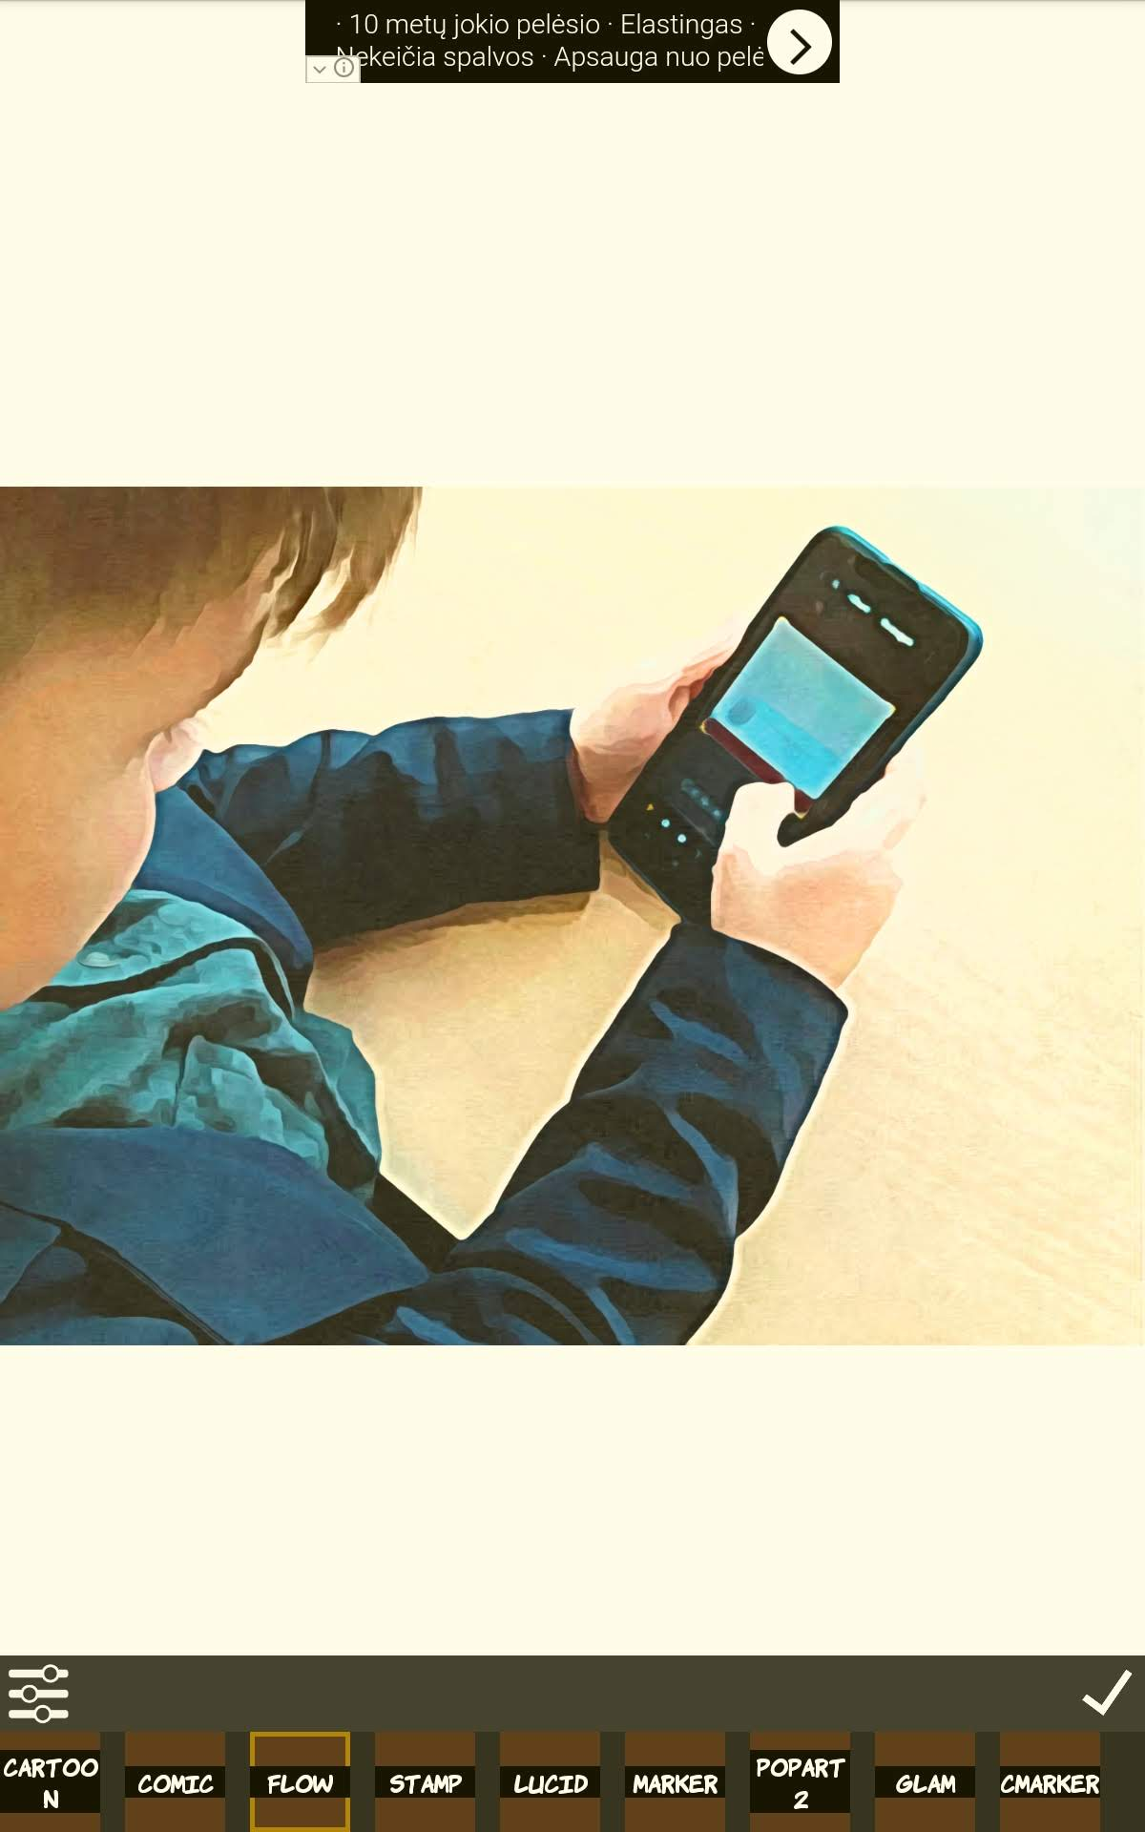
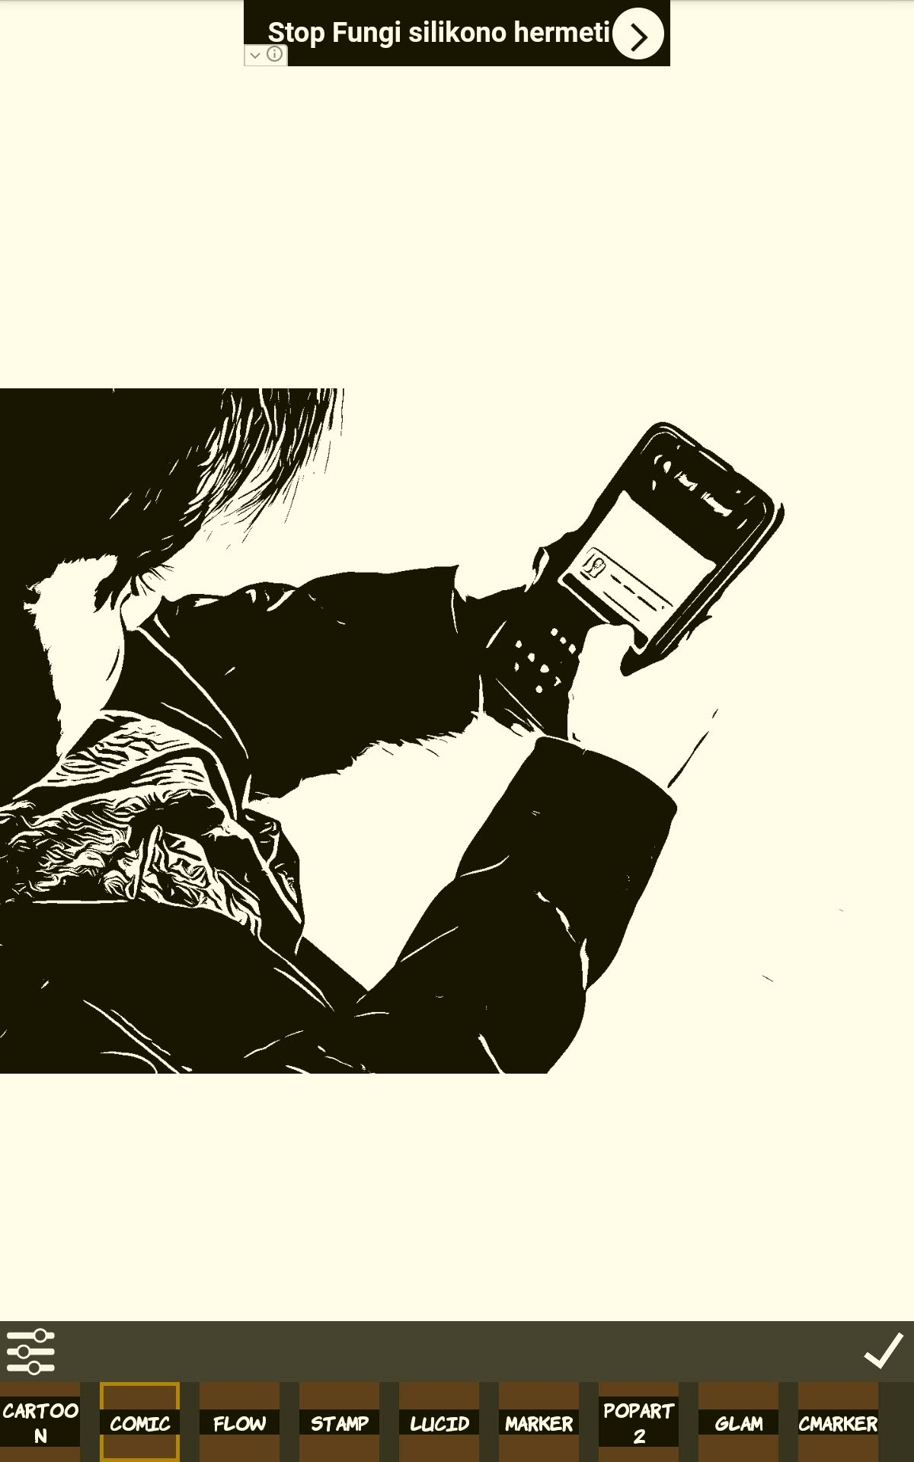

Slide 6
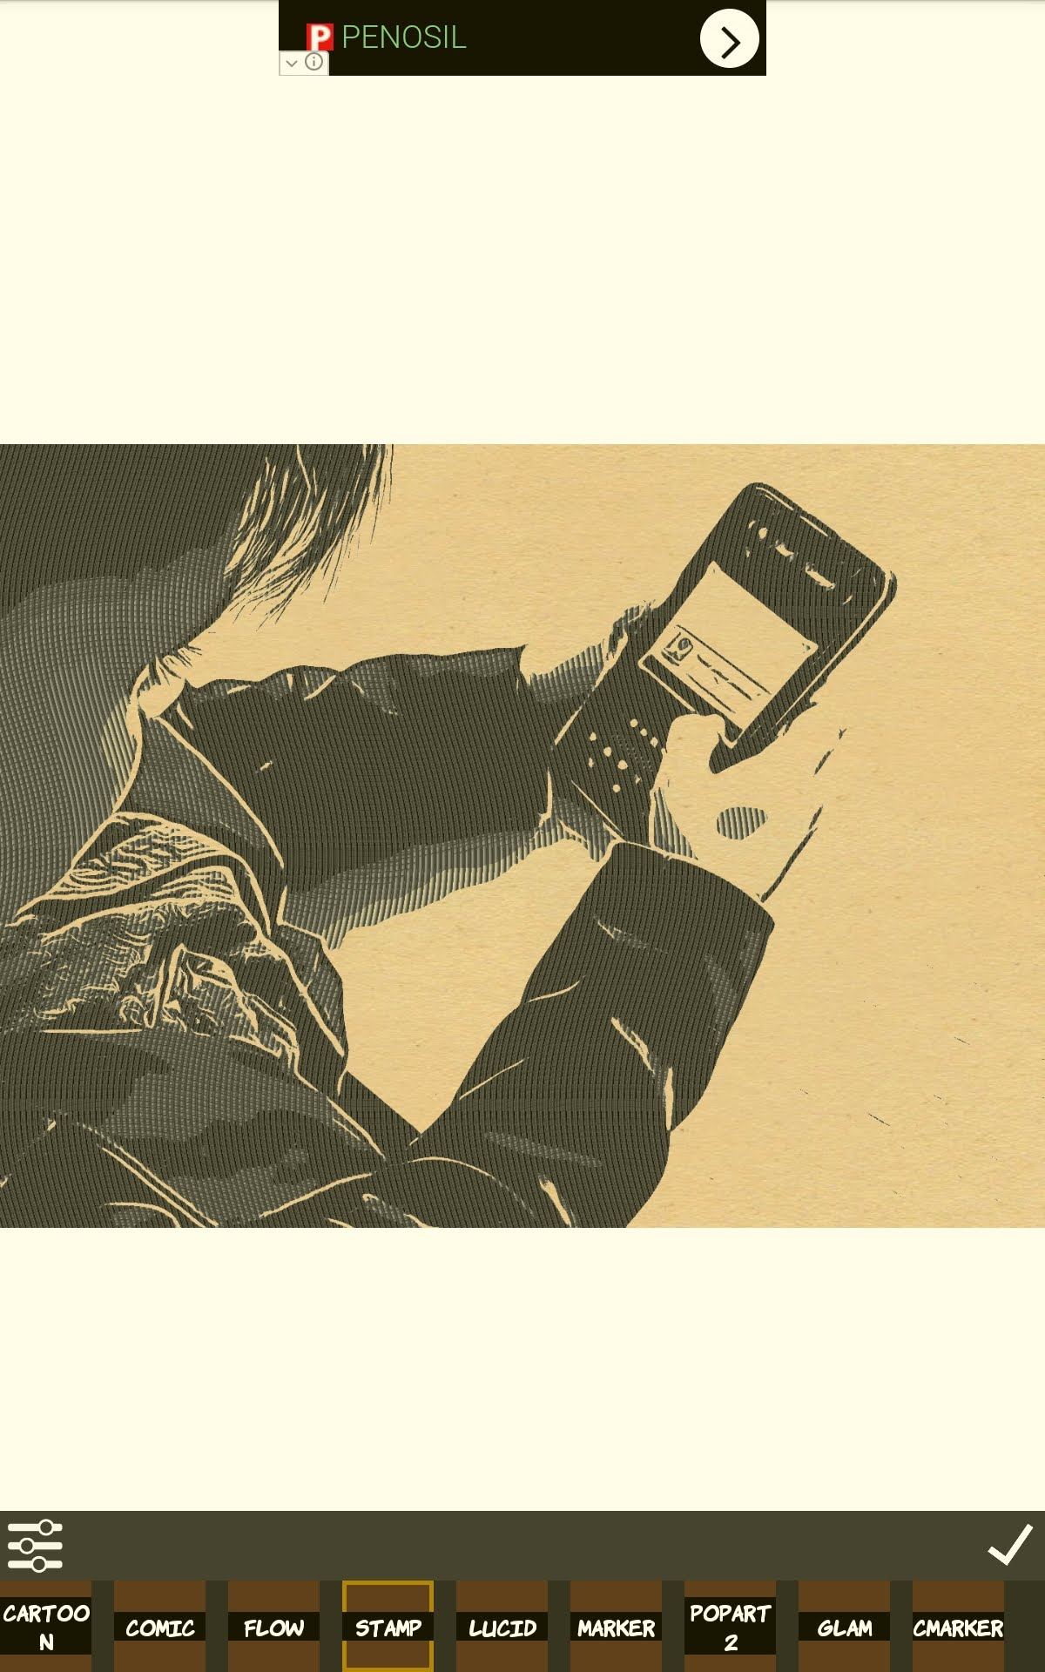
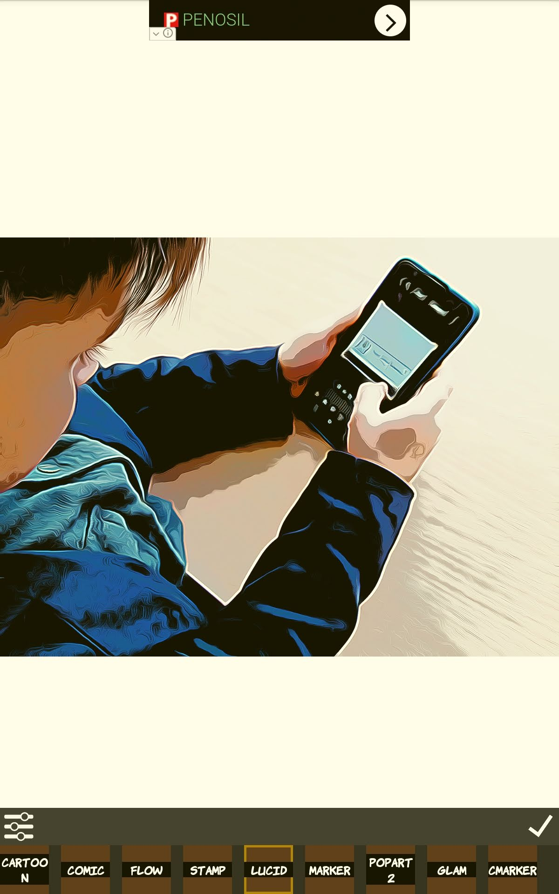

Slide 7
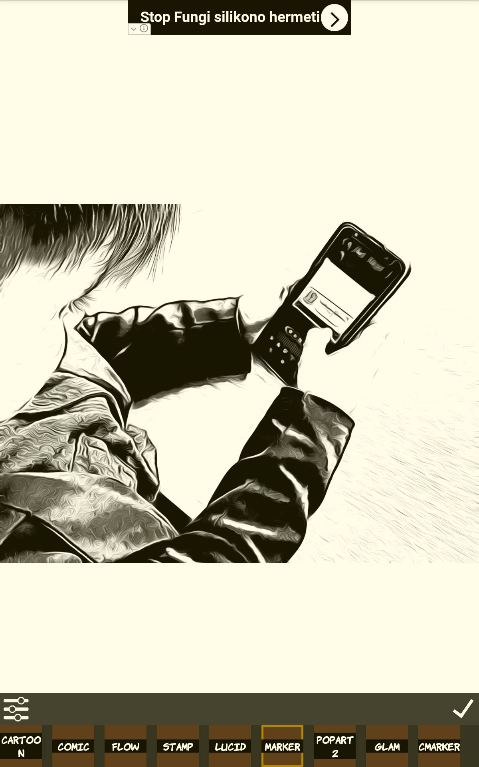
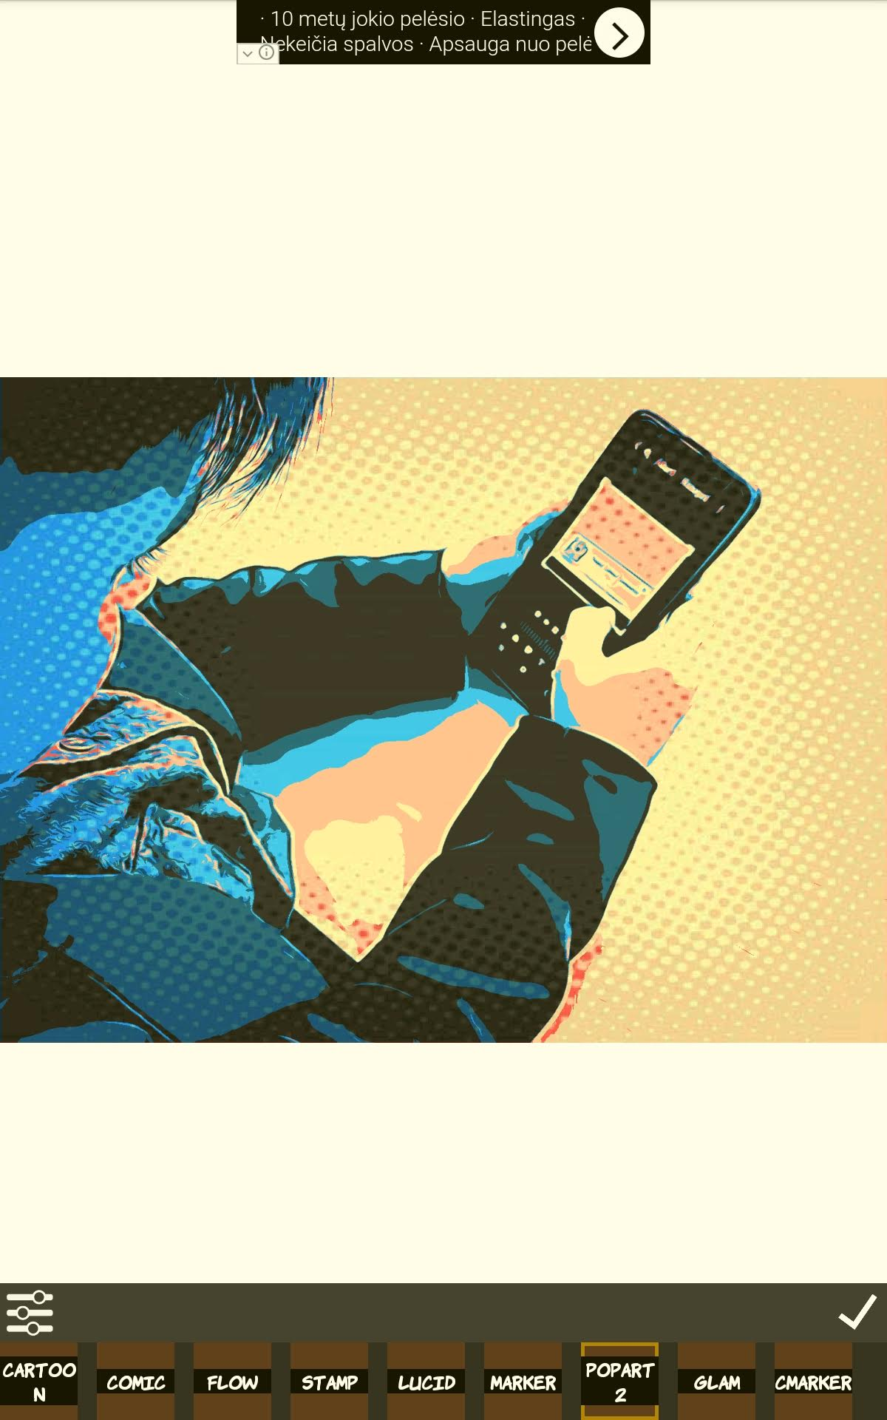

Slide 8
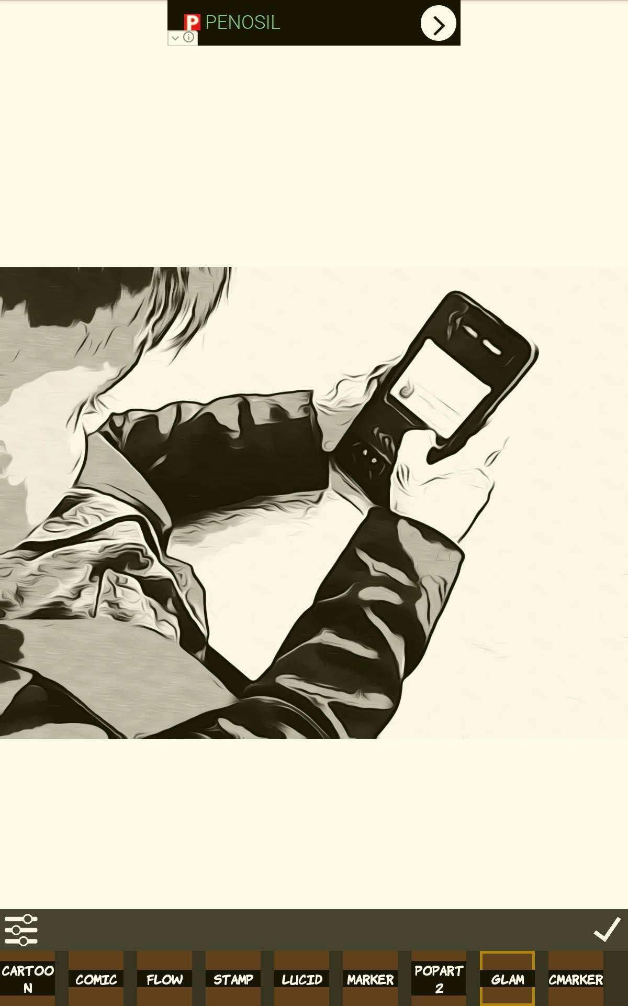
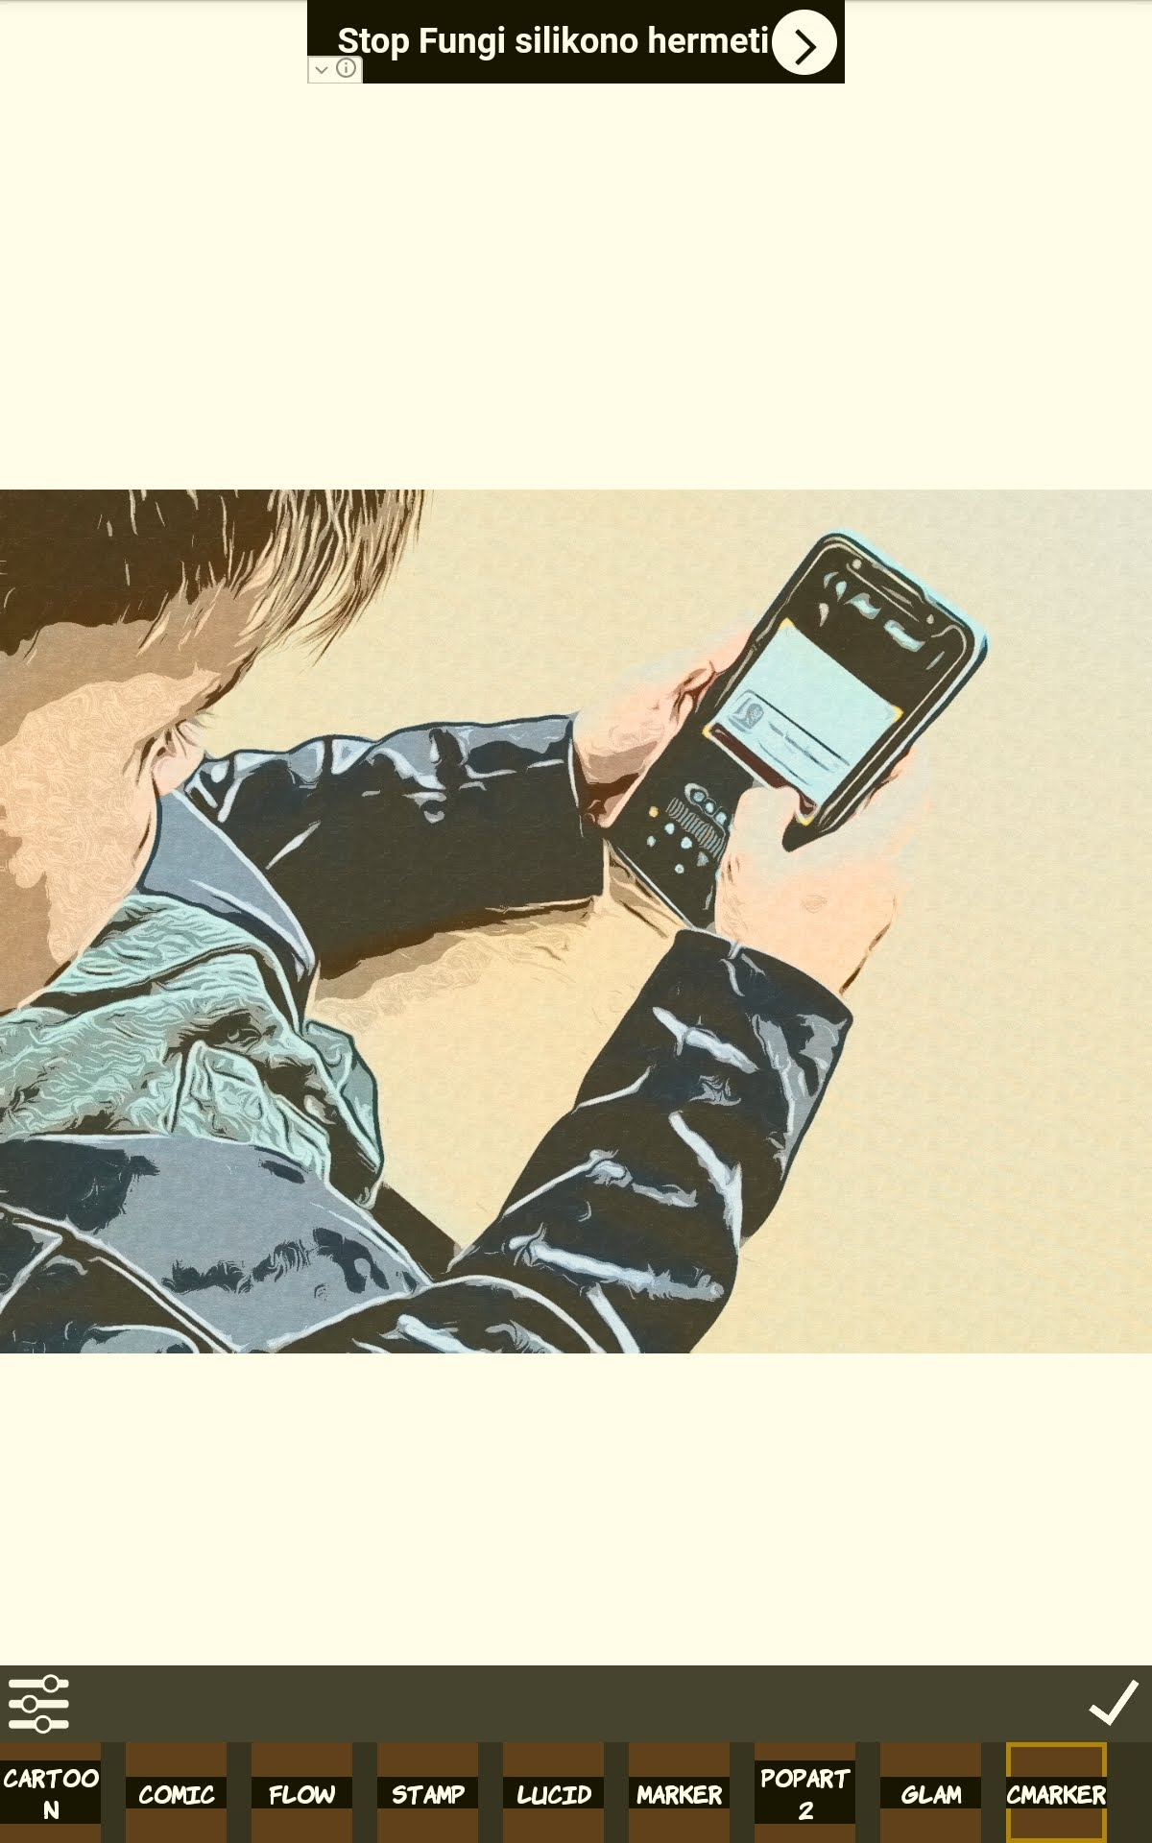

Slide 9
When you choose right photo visualization
apply

Slide 10
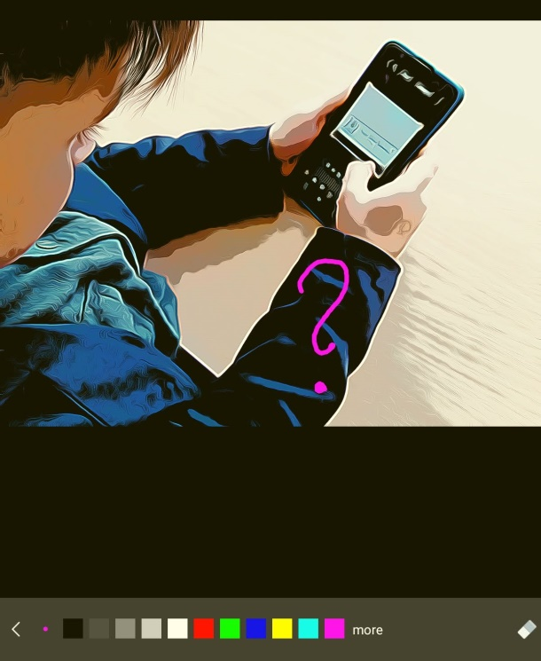
Create comics
Write by hand

Slide 11
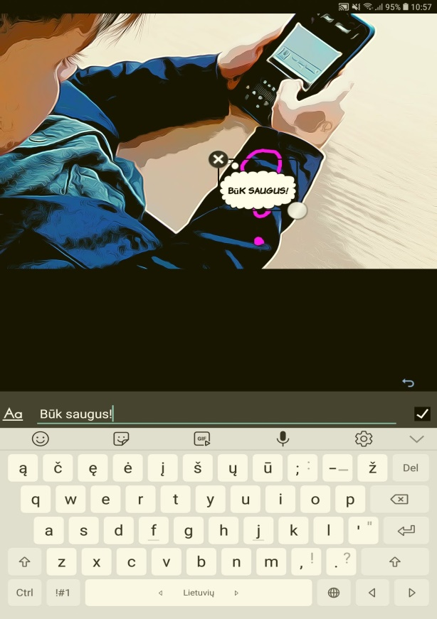
Text writing
text

Slide 12
Crop photo if need

Slide 13
Use stickers

Slide 14
To create collage use Multi

Slide 15
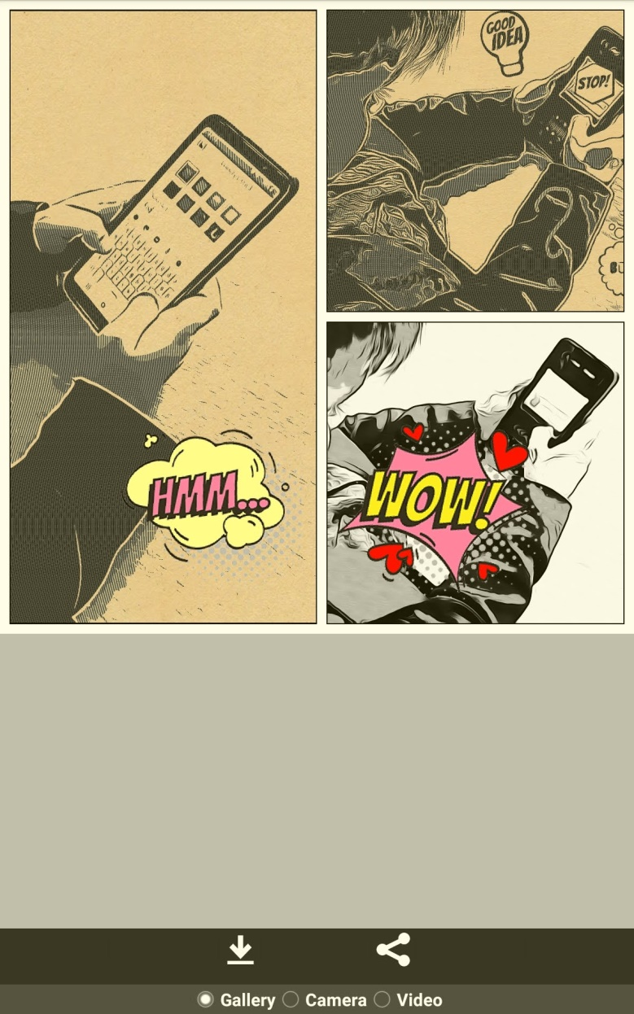
create different comics in each picture
save

