Slide 1
How to use WordArt
Created by Giedre

Slide 2
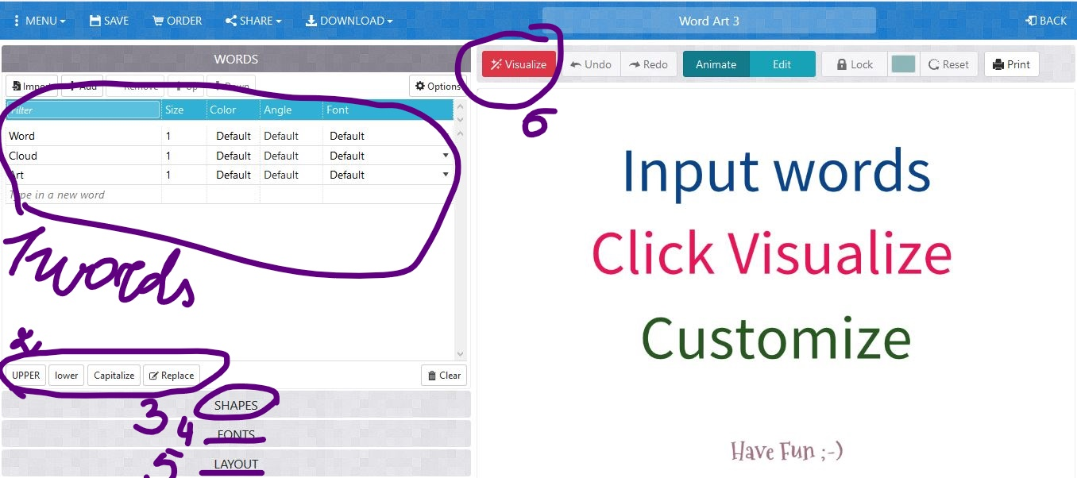
Beginning

Slide 3
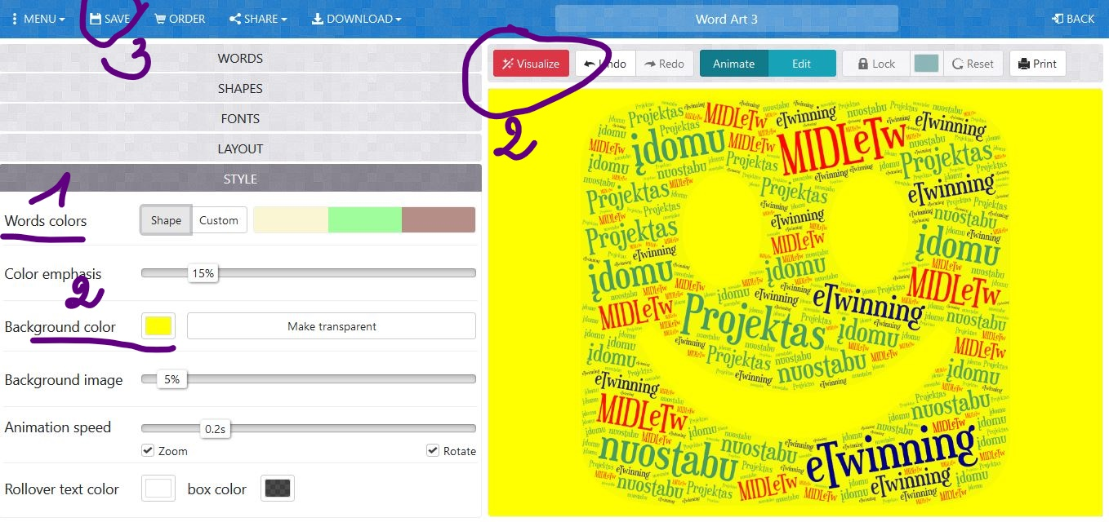
Visualize and make the best

Slide 4
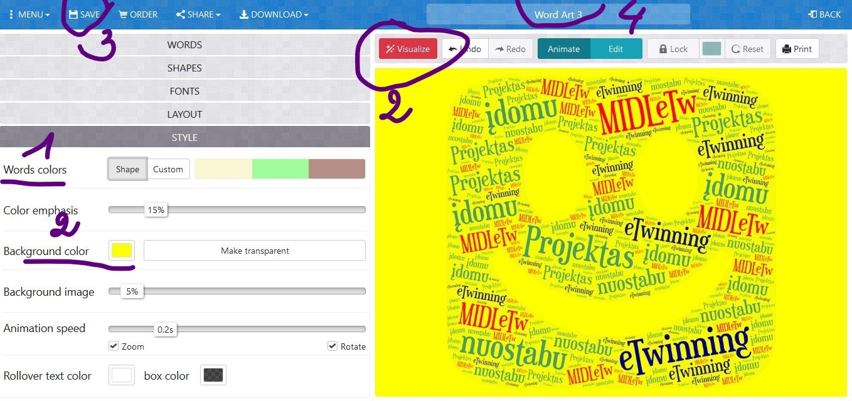
Save (3) and write title (4)

Slide 5

Final result

