Slide 1
SHIPPING OF GOODS BEYOND THE EU BORDERS Carriage of cargo Ukraine - neutral goods - dangerous goods -animals

Slide 2
DOCUMENTS FOR TRANSPORT ·license for pursue an international transport are released by Main Inspectorate of Road Transport · Bi-lateral permit"short", general, transit, third-country permits, (PL - UA) Permits are released by Office of International Transport.

Slide 3
DOCUMENT FOR NEUTRAL GOODS ·CMR consignment note ·Invoice ·EX-1 - export declaration · Customs Transit (Сarnet TIR, financial guarantees. PP,PD,EA ) ·Specification of loads ·Certificate of origin and other certificates (sender makes them in suitable offices).

Slide 4
CMR consignment note
The CMR consignment note is considered as a proof of the contract of carriage but the absence, irregularity or loss of the consignment note does not affect the existence or the validity of the contract of carriage, which shall remain subject to the provisions of the CMR Convention (Article 4).
The CMR consignment note serves also as proof of the reception of the goods by the carrier.
How to fill in CMR consignment note
https://www.iru.org/sites/default/files/2017-01/how-to-fill-cmr-model-iru-2007-en.pdf

Slide 5
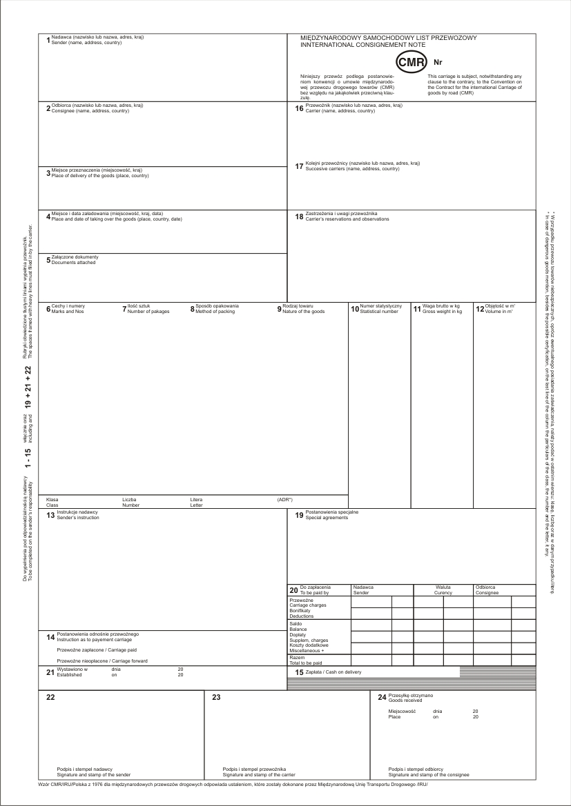

Slide 6
Customs transit
transit is a customs procedure used to move goods
betweeCustoms n two points of a customs territory, via another customs territory; or
between two or more different customs territories.
Using the Customs Transit procedure allows for the temporary suspension of duties, taxes and commercial policy measures that are applicable at import. As such, it allows customs clearance formalities to take place at the point destination rather than at the point of entry into the customs territory.
Customs transit is particularly relevant where a single customs territory is combined with multiple fiscal territories: it allows the movement of goods under transit from their point of entry into the Union to their point of clearance, where both the customs and national fiscal obligations will then be taken care of.

Slide 7
TIR CARNET
The TIR Convention establishes an international customs transit system with maximum facility to move goods:
- in sealed vehicles; - from a customs office of departure in one country to a customs office of destination in another country; - without requiring extensive and time-consuming border checks at intermediate borders; - while, at the same time, providing customs authorities with the required security and guarantees. How to fill in Carnet TIR https://www.iru.org/sites/default/files/2017-03/How_to_fill_in_a_TIR_Carnet_EN_2.pdf

Slide 8
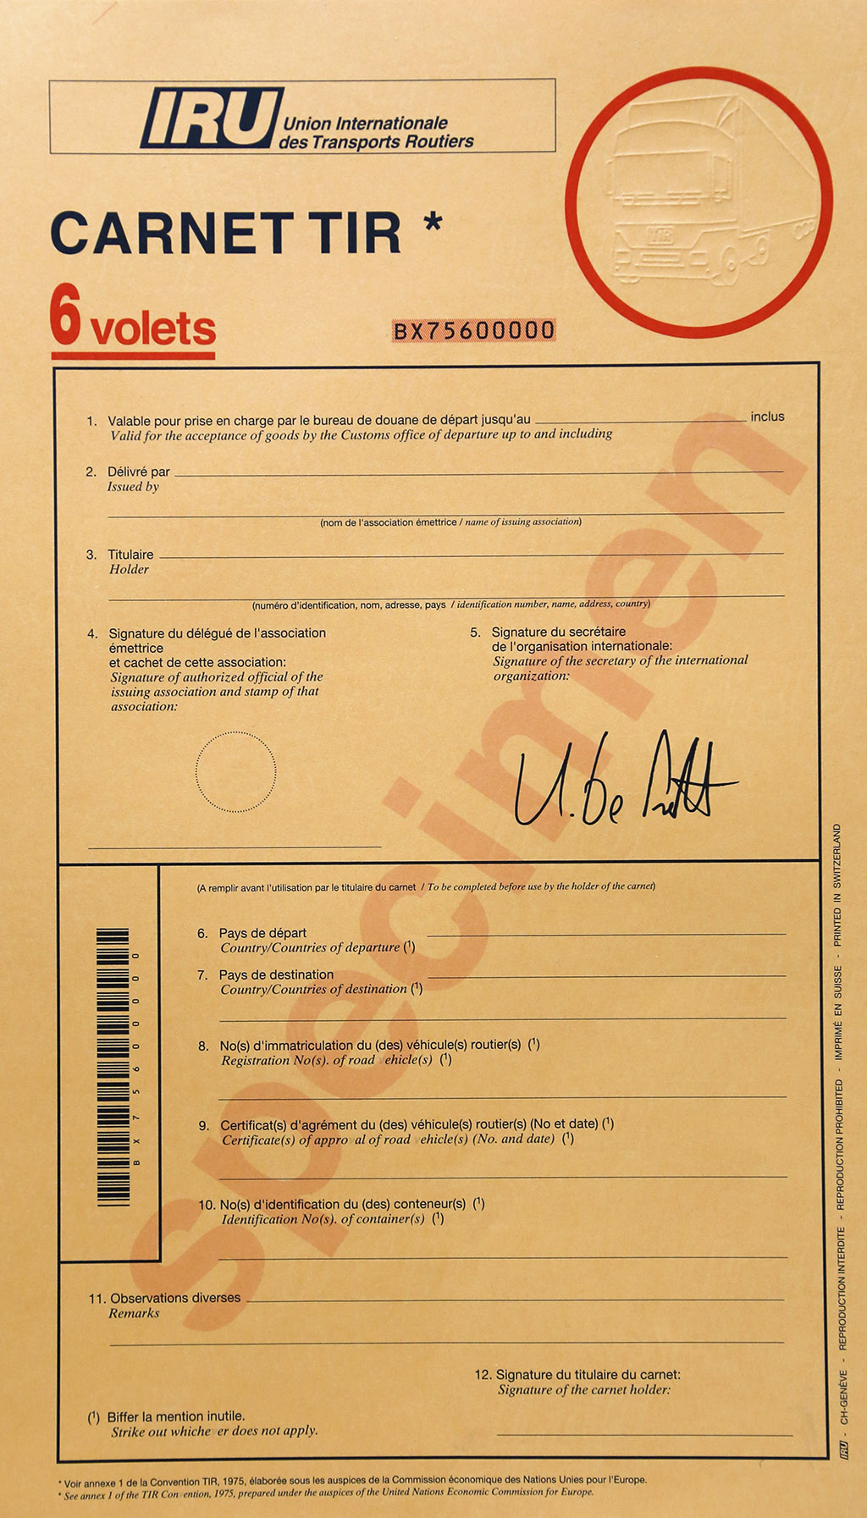

Slide 9
PP, PD, EA
Preliminary Customs Confirmation (PP – „pepeszka”) - Consignee inform a customs about import the goods from EU
Preliminary Customs Declaration (PD – „pdeszka”) – Consignee inform a customs and have to provide security and guarantees that duties, taxes will be paid
Preliminary Customs Declaration type EA - Customs clearance provide on the border
All documents issued by the customs office where the consignee is accredited) to be sent by e-mail to the releasing customs office.
Number PP, PD or EA should be notice in CMR

Slide 10
DOCUMENTS FOR TRANSPORT DANGEROUS LOADS ·CMR ·Invoice ·EX-1 ·Specification (MSDS) ·Certificate of provenance and others certifications (sender makes them in adequates offices) ·TIR, financial guarantee, PP,PD,EA + list of documents for DG

Slide 11
ADDITIONAL NECESSARY DOCUMENTS FOR TRANSPORT OF DANGEROUS LOADS:
The transport document must be provided by the Consignor, and must be set out and contain the following information for each dangerous substance, material or article carried;
the UN number preceded by the letters "UN";
the proper shipping name supplemented, when applicable with the technical name in brackets;
the hazard label model numbers given in Column (5) of Table A in ADR Chapter 3.2 or when more than one hazard label model numbers are given, the numbers following the first one shall be given in brackets;
where assigned, the packing group for the substance which may be preceded by the letters "PG" (e.g. "PG II");
the number and a description of the packages when applicable. UN packaging codes may only be used to supplement the description of the kind of package (e.g. one box (4G);

Slide 12
(f) the name and address of the consignor;
(g) the name and address of the consignee(s). With the agreement of the competent authorities of the countries concerned by the carriage, when dangerous goods are carried to be delivered to multiple consignees who cannot be identified at the start of the carriage, the words "Delivery Sale" may be given instead
a declaration as required by the terms of any special agreement;
where assigned, the tunnel restriction code given in Column (15) of Table A of ADR Chapter 3.2, in capitals within parenthesis. The tunnel restriction code need not be added in the transport document where the carriage is known beforehand not to pass through a tunnel with restrictions for carriage of dangerous goods (See also Section 13.4)
Examples of such permitted dangerous goods descriptions are:
"UN 1098 ALLYL ALCOHOL, 6.1 (3), I, (C/D)" or
"UN 1098, ALLYL ALCOHOL, 6.1 (3), PG I, (C/D)" *
* https://consultation.hsa.ie/general-applications/Carriage-of-Dangerous-Goods-by-Road/adrguideforbusiness.dft.05jul2012.pdf

Slide 13
ADR Transport Document
ADR TRANSPORT DOCUMENT Consignor: Company XYZ Address: a road, town, country Date: dd/mm/yy
Dangerous goods description: | No. Of packages / type | Total quantity
UN1134, chlorobenzene, 3, PGIII, (D/E) | 20 x 200L drums | 2000L
UN1760, corrosive liquid, N.O.S. (contains sodium hydoxide),8, PGIII, (E) | 10 x 10L drums | 100L
Consignee (s): Company ABC Address: a road, town, county

Slide 14
DOCUMENTS FOR TRANSPORT ANIMALS ·CMR ·Ex-1 ·Invoice ·Specification ·TIR, financial guarantee, PP, PD, EA ·Vet certificate (made by sender) ·Passport for animals (made by sender, SEPARATE PASSPORT FOR EVERY ANIMAL) ·Permission for import into receiver country Check-in animals is available only after receiving by importer a permission from Department of Vet of Ministry of Agriculture and Food.

Slide 15
Literature/bibliography: Literature/bibliography: 1. Transport i Spedycja międzynarodowa w handlu zagranicznym, Andrzej Sikorski, Oddk Gdańsk 2013 2. Transport i Spedycja Cz2, Radosław Kacperczyk, Difin 2010 Spedycja, Eugenisz Januła, Teresa Truś, Żaneta Gutowska, Difin 2013 3. http://www.zmpd.pl 4. https://www.iru.org/innovation/e-cmr 5. http://www.tks.ru 6. http://www.prawoprzewoznika.pl/jak-czytac-list-przewozowy-cmr 7.https://www.unece.org/fileadmin/DAM/trans/danger/publi/adr/adr2011/English/Part3.pdf 8. http://tbncom.com/forum/247-1619-1 9. https://trademaster.ua/zakon/1510

