Slide 1
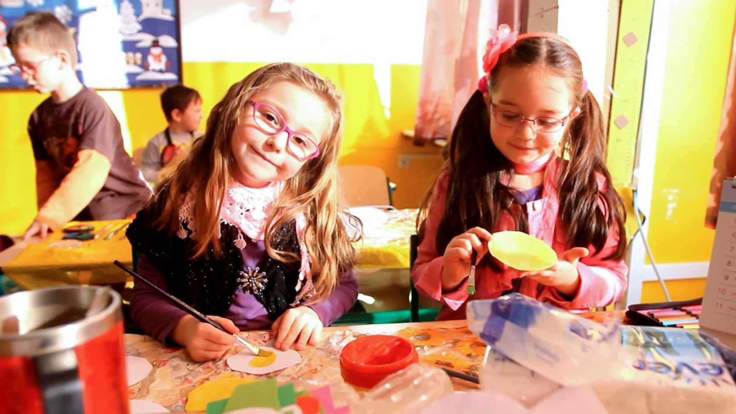
Základná škola Škultétyho, Nitra

Slide 2
About the school
Number of pupils: 430
Primary education, age: 6 -10
Lower secondary education, age: 11 – 15
Scool club, age: 6 – 12 (205 children), before and after lessons from 6 a.m. to 5. p.m.
Center of leisure time activities: (105 children)
Music and singing
Dancing
Cooking
Sports

Slide 4
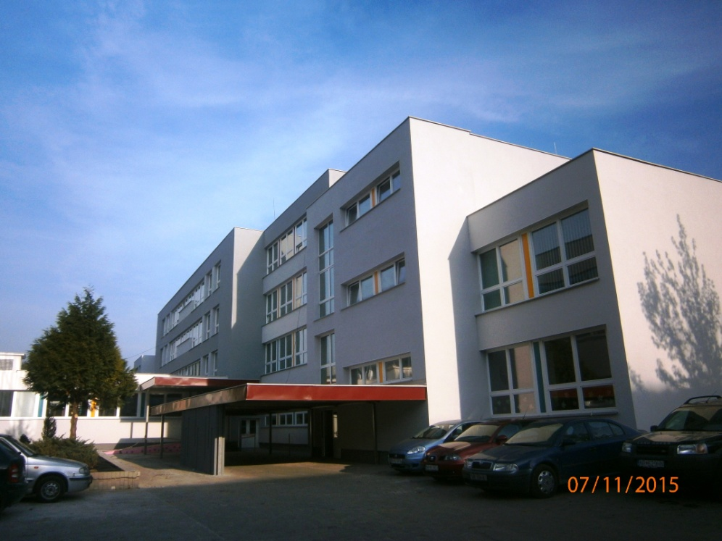
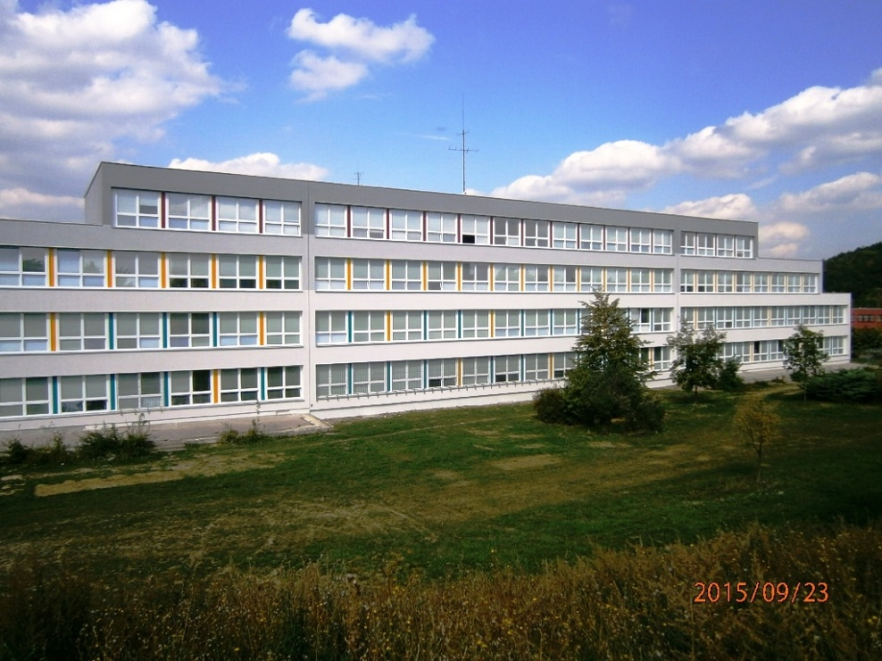
Our school building

Slide 5
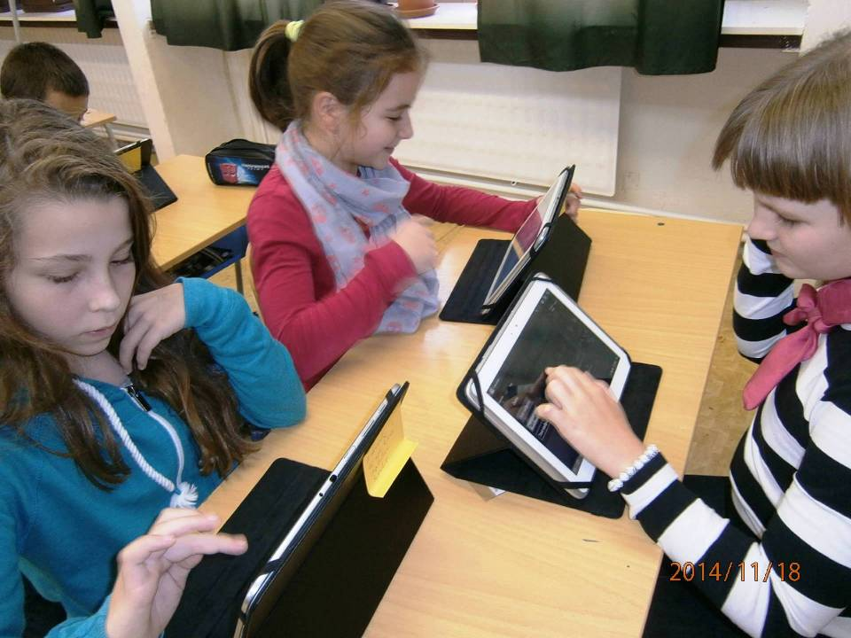
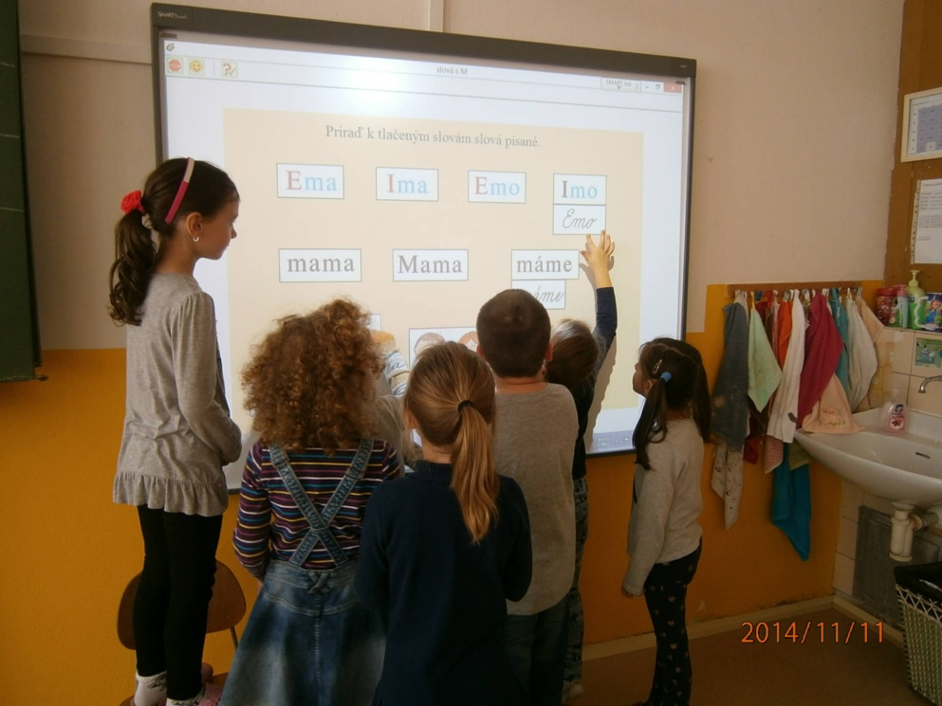
We are learning

Slide 6
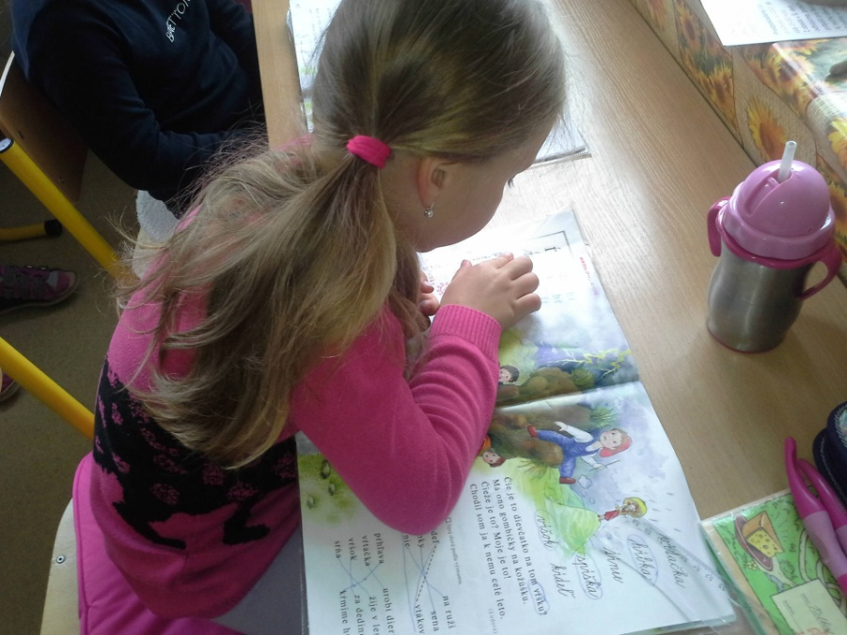
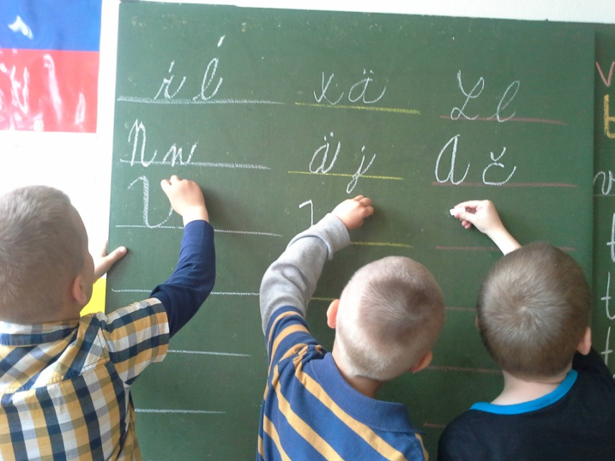
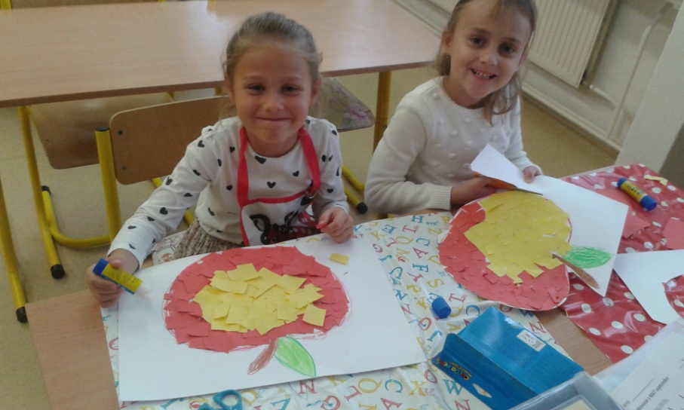
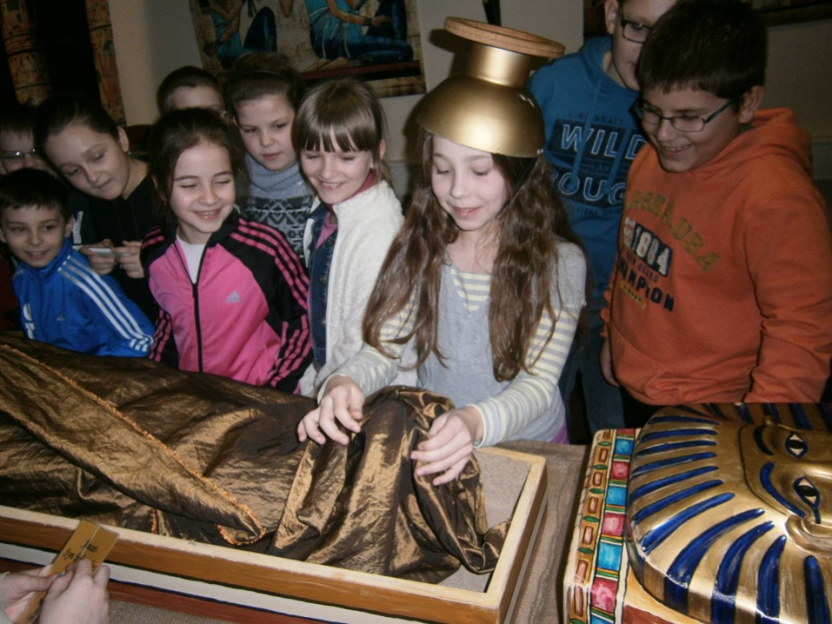
to write
to read
to create
to discover

Slide 7
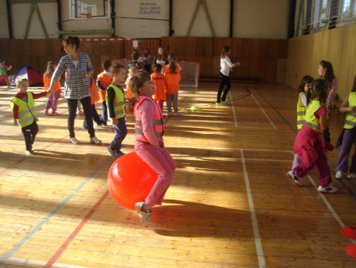
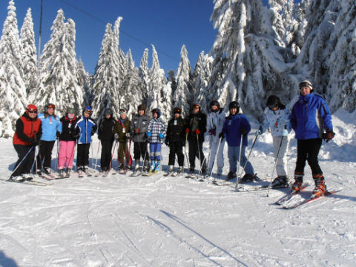
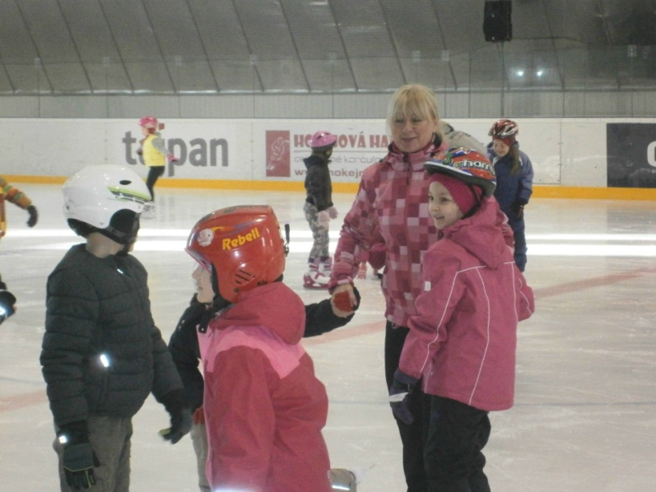
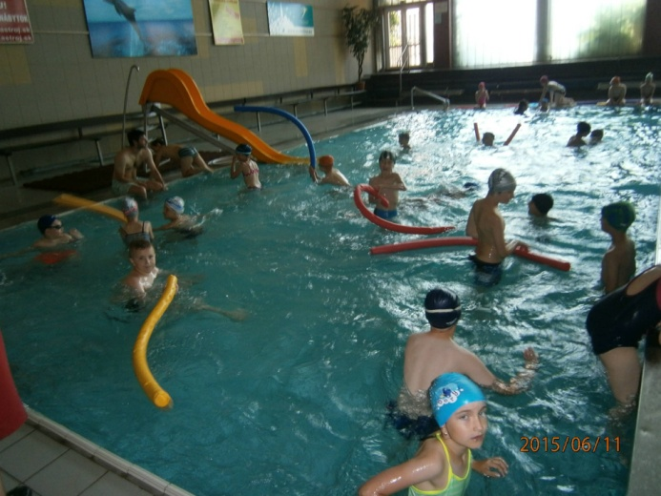
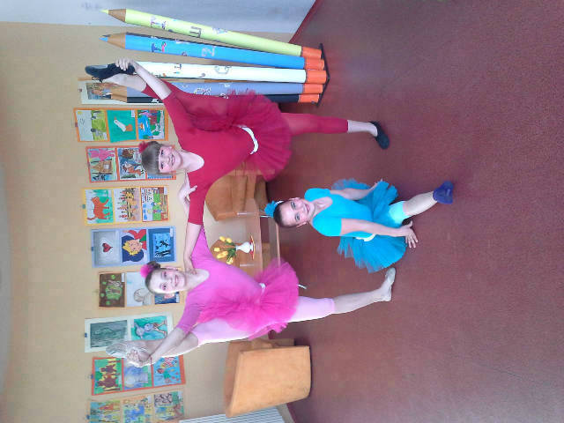
We love sports

Slide 8
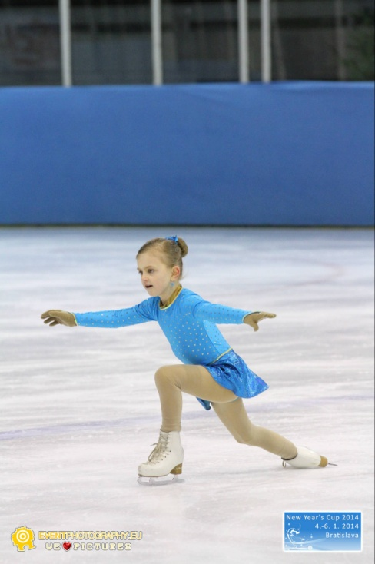
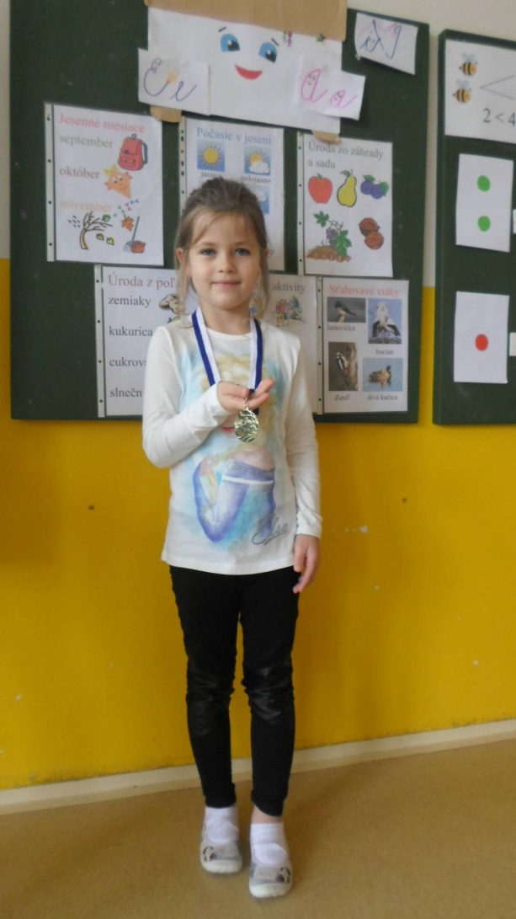
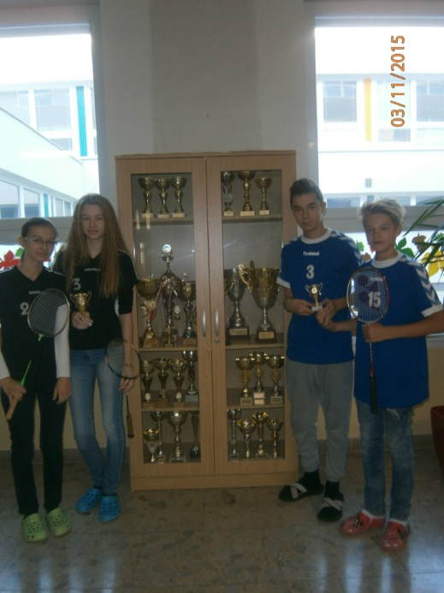
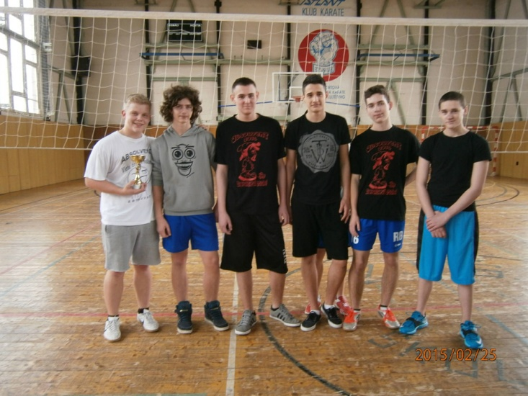
Champions
Figure skating
Badminton
Synchronized swimming
Volleyball

Slide 9
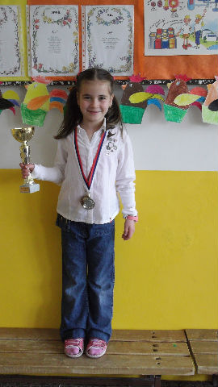
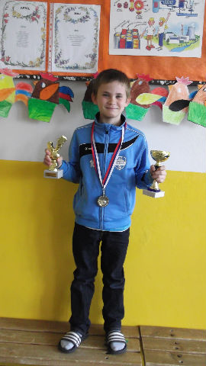
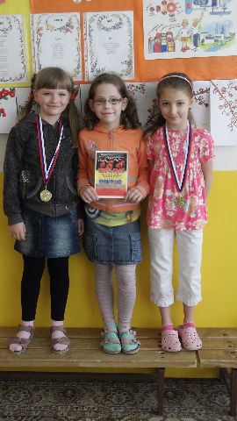
Champions in gymnastics, football and scenic dance

Slide 10
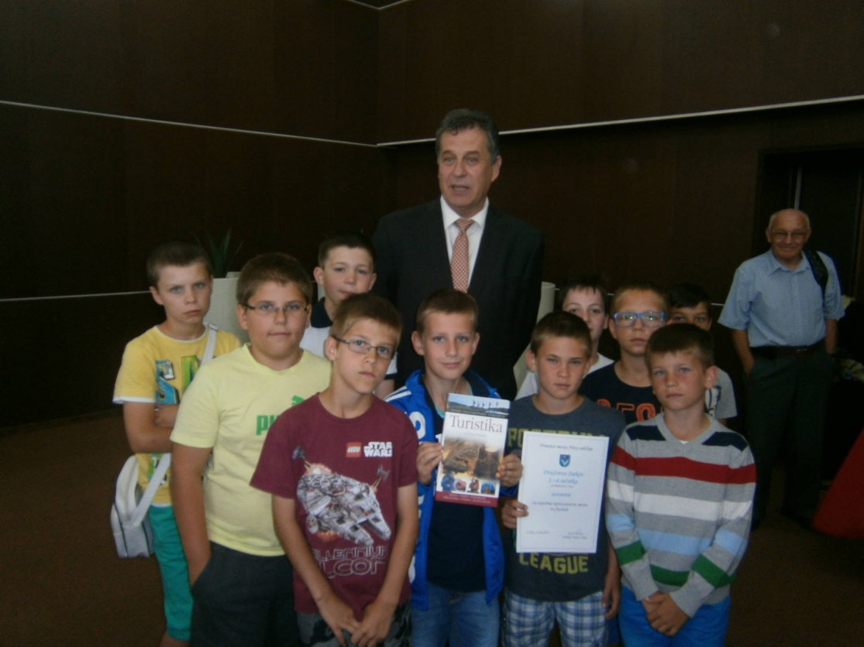
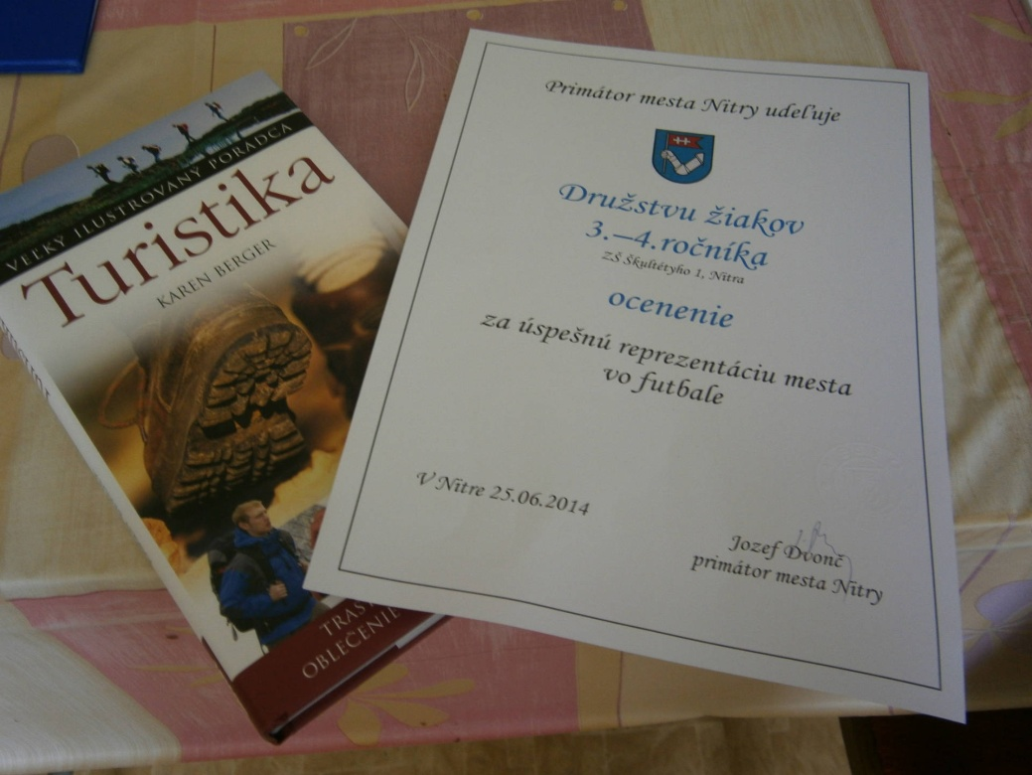
Young footballers – Champions of Slovakia
Awarded by the Mayor of our City

Slide 11
Environment
In 2014 we started to participate in an international programme Eco school, which helps naturally transform theoretical knowledge into responsible and protective attitude to the environment in everyday life.
We separete waste, collect batteries, protect small birds, insect, we plant trees and flowers etc.

Slide 12
Our International Project Erasmus+: The ICT ROAD TO STEM THROUGH TCC Six schools work in „“the cloud“ creating virtual classrooms fo European cooperation and learning. The project aim is to develop skills in STEM, ICT and TCC, transnational collaboration and communication between teachers and pupils by means of different ICT tools.

Slide 13
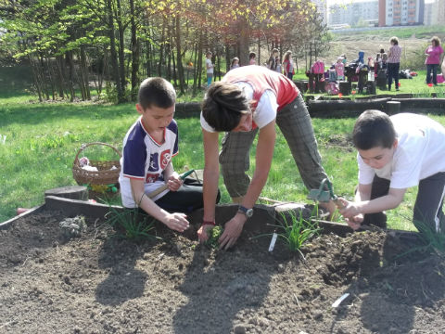
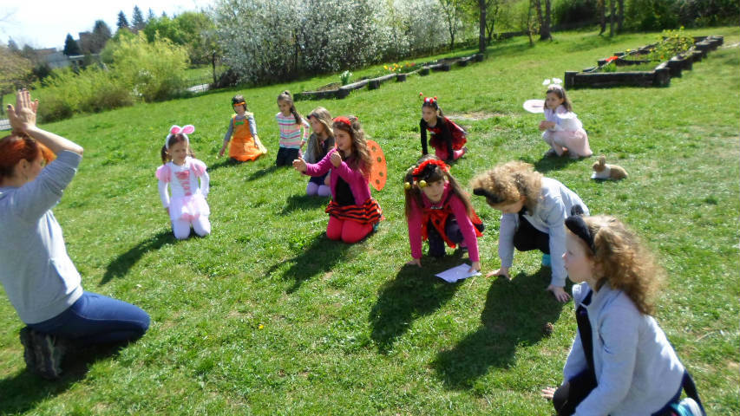
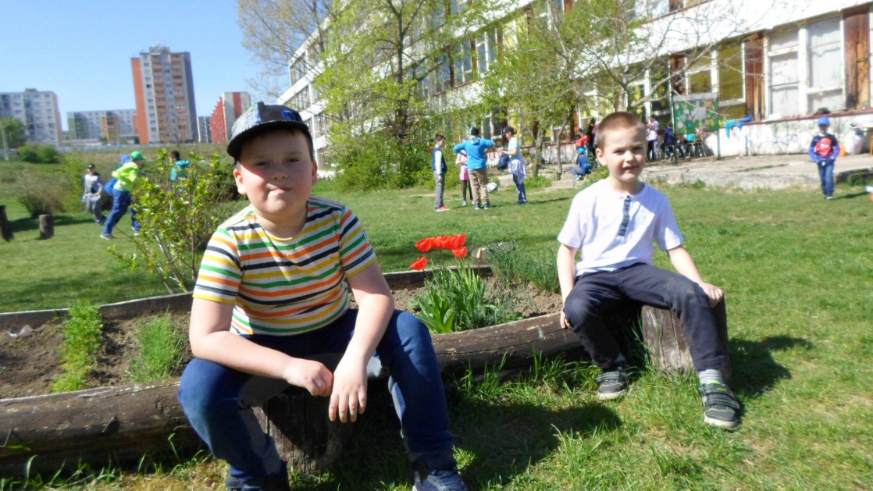
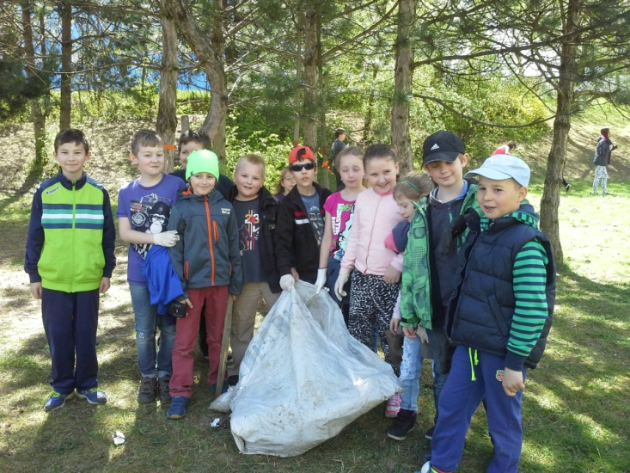
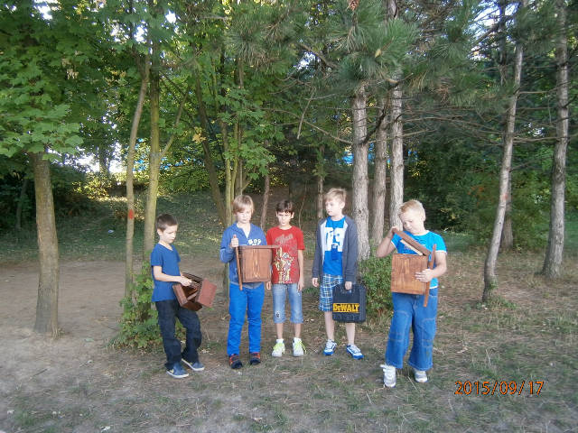
Earth Day

Slide 14
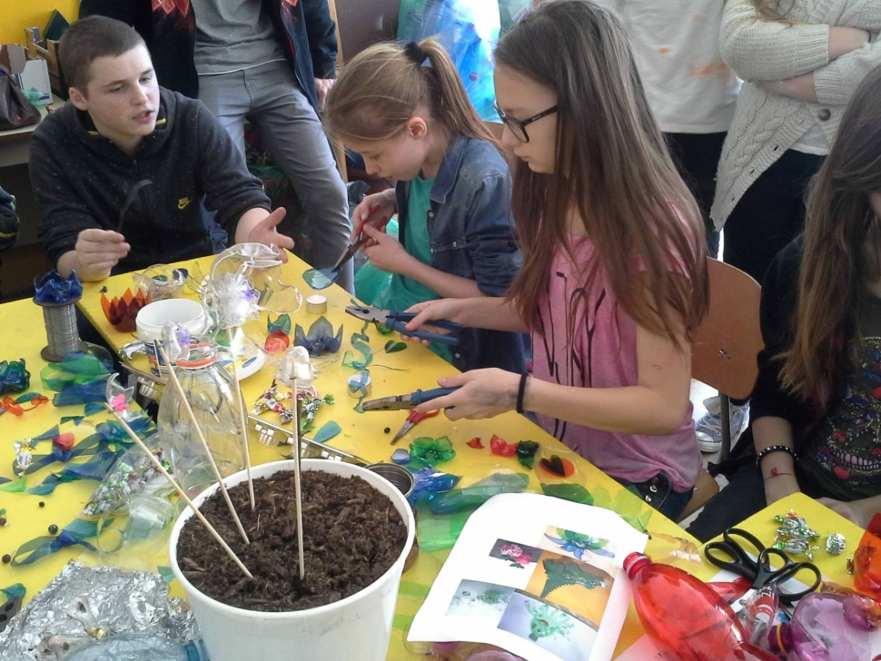
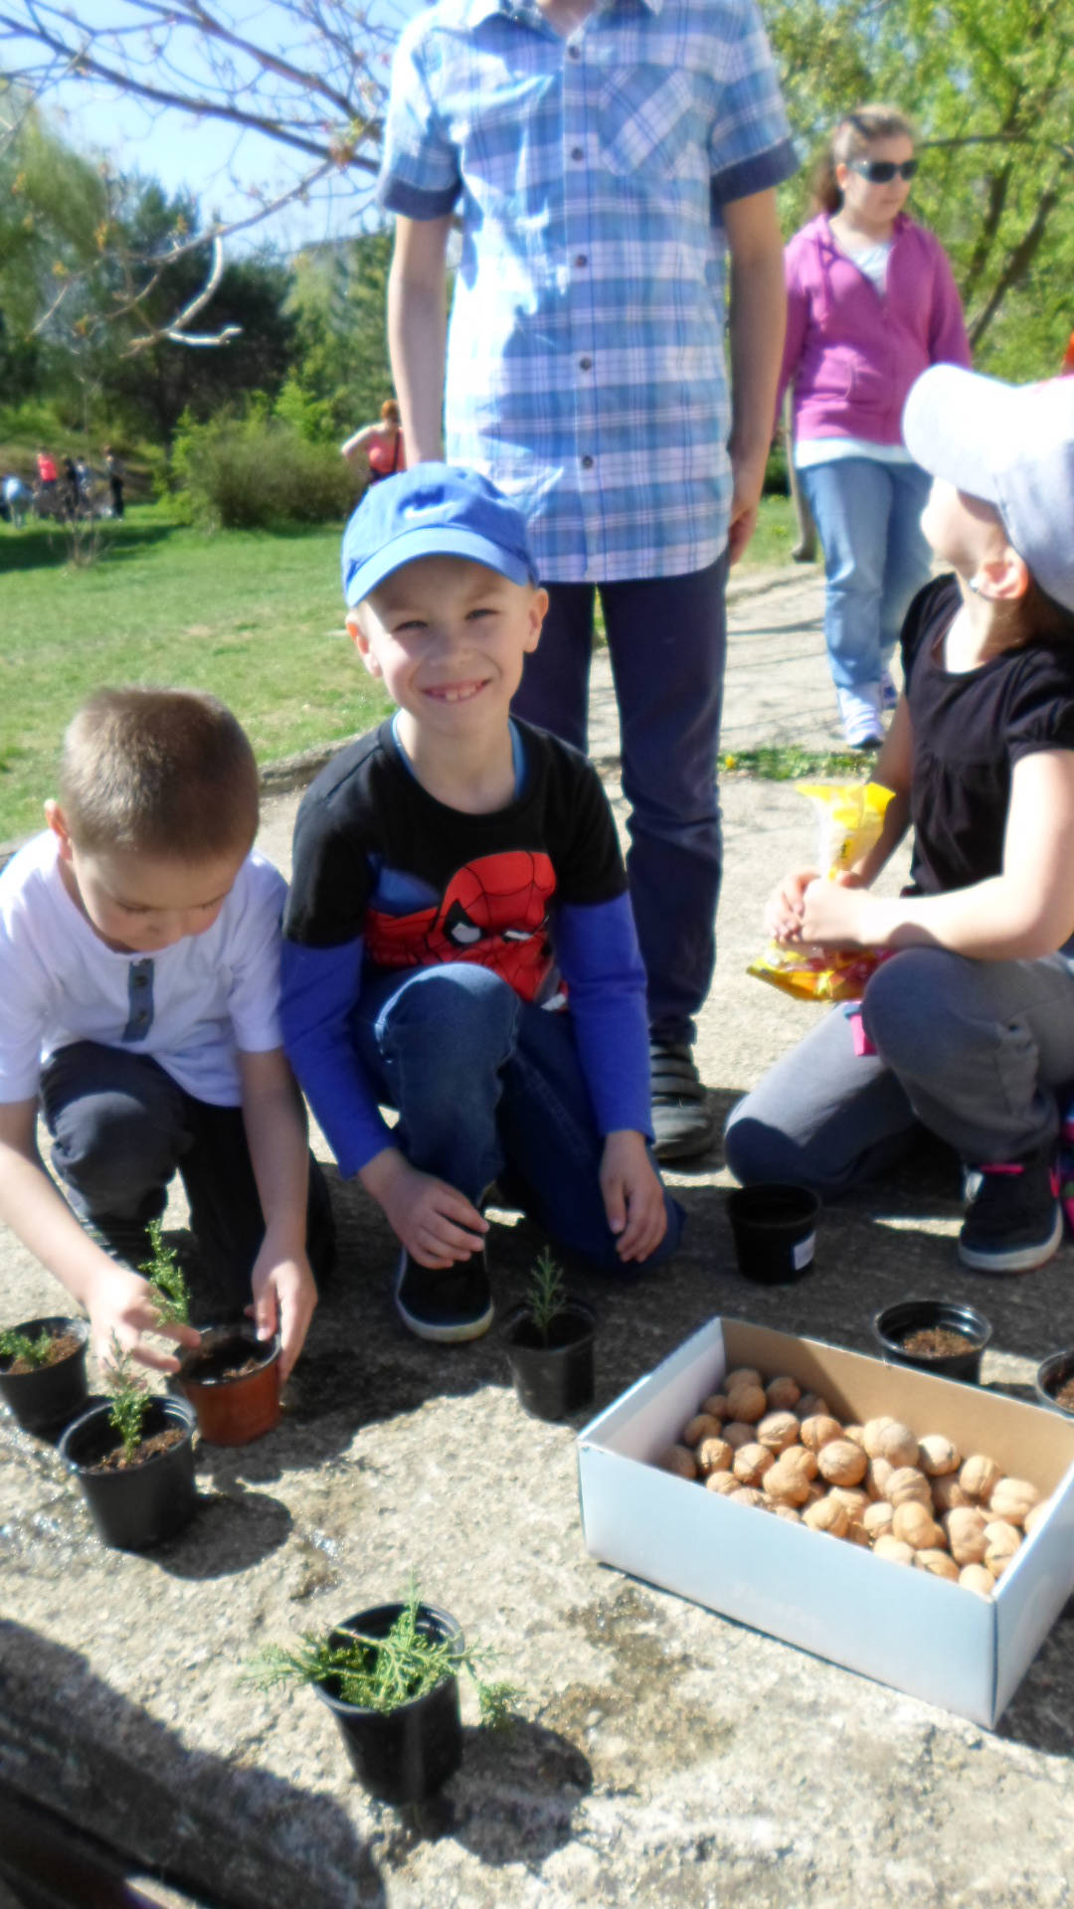
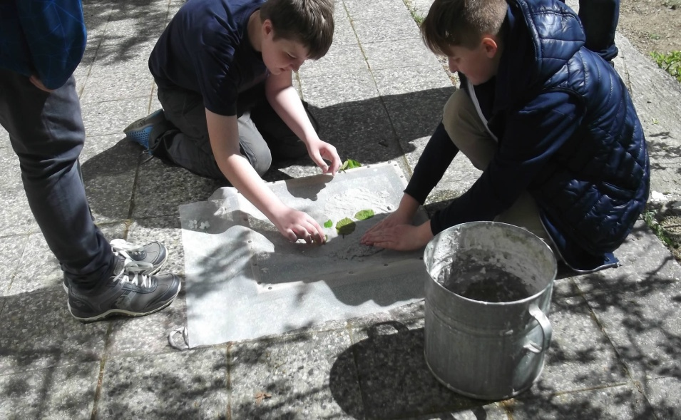
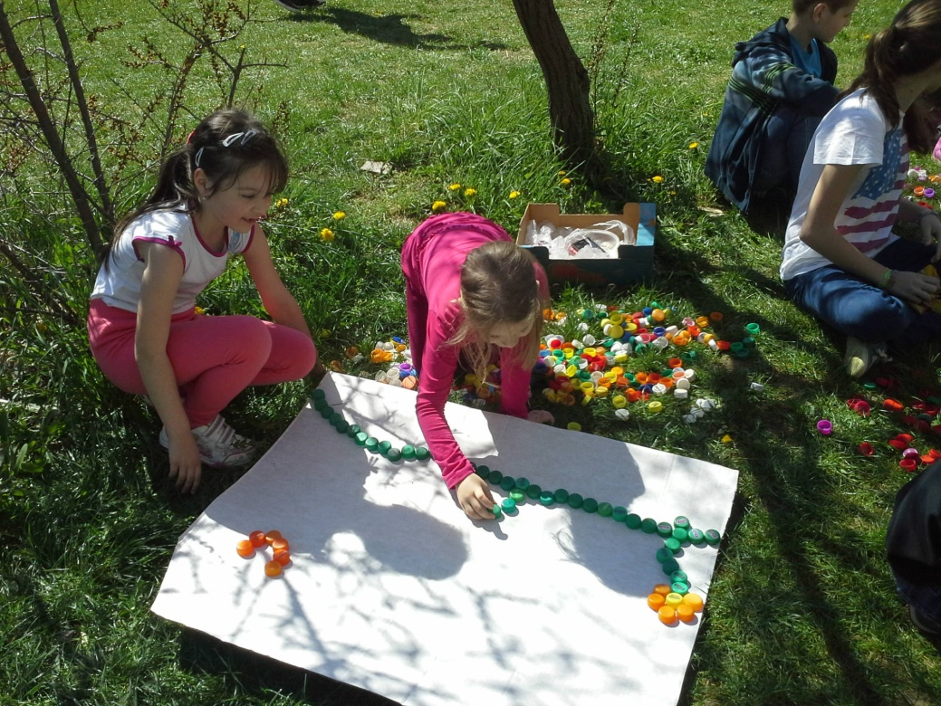
We use waste for creating new things

Slide 15
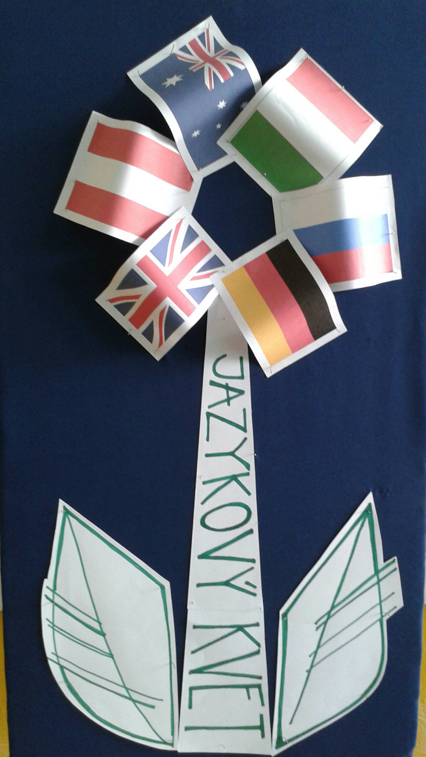
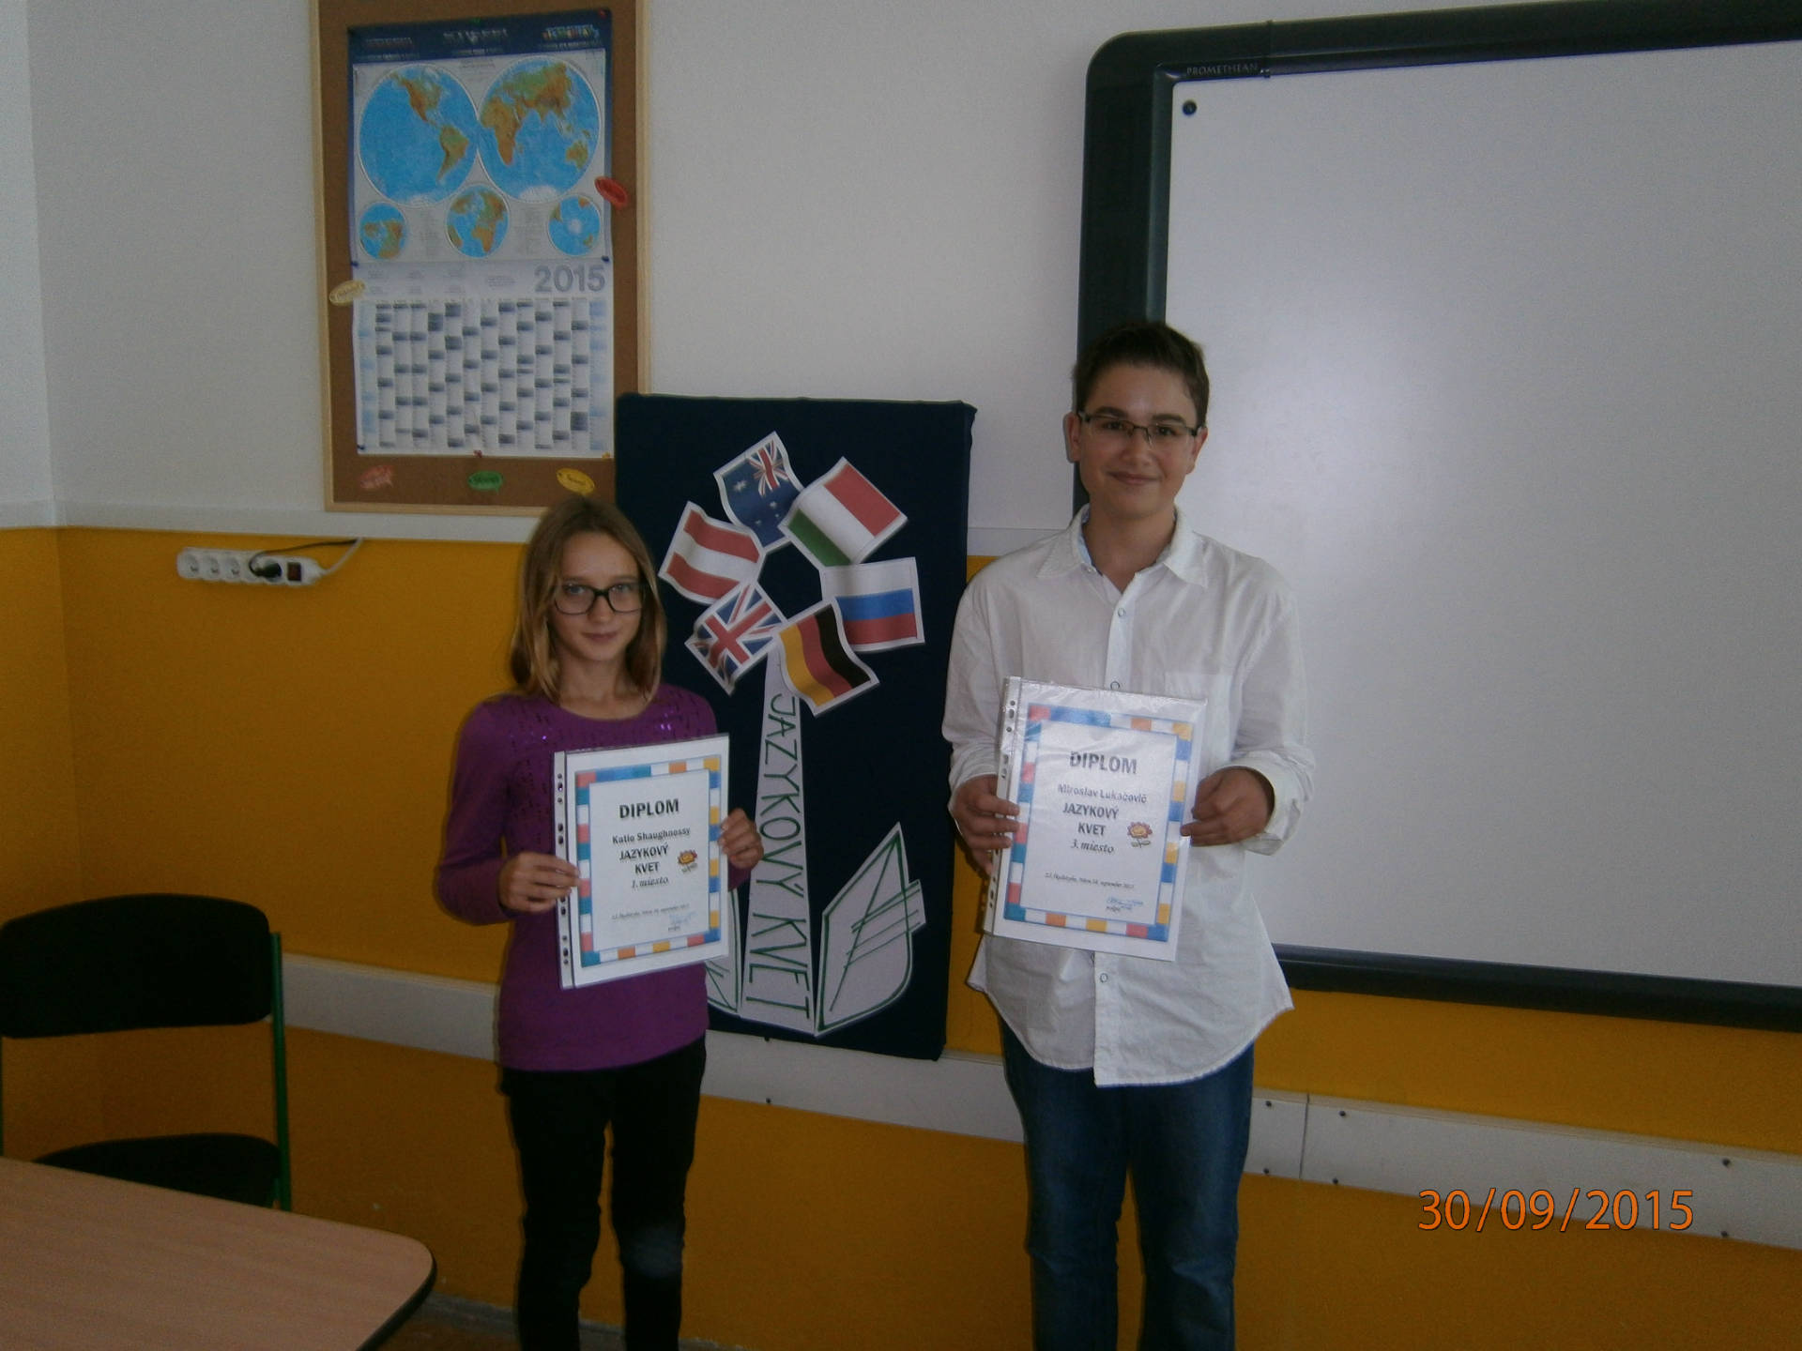
Competition “Language flower“
Champions

Slide 16
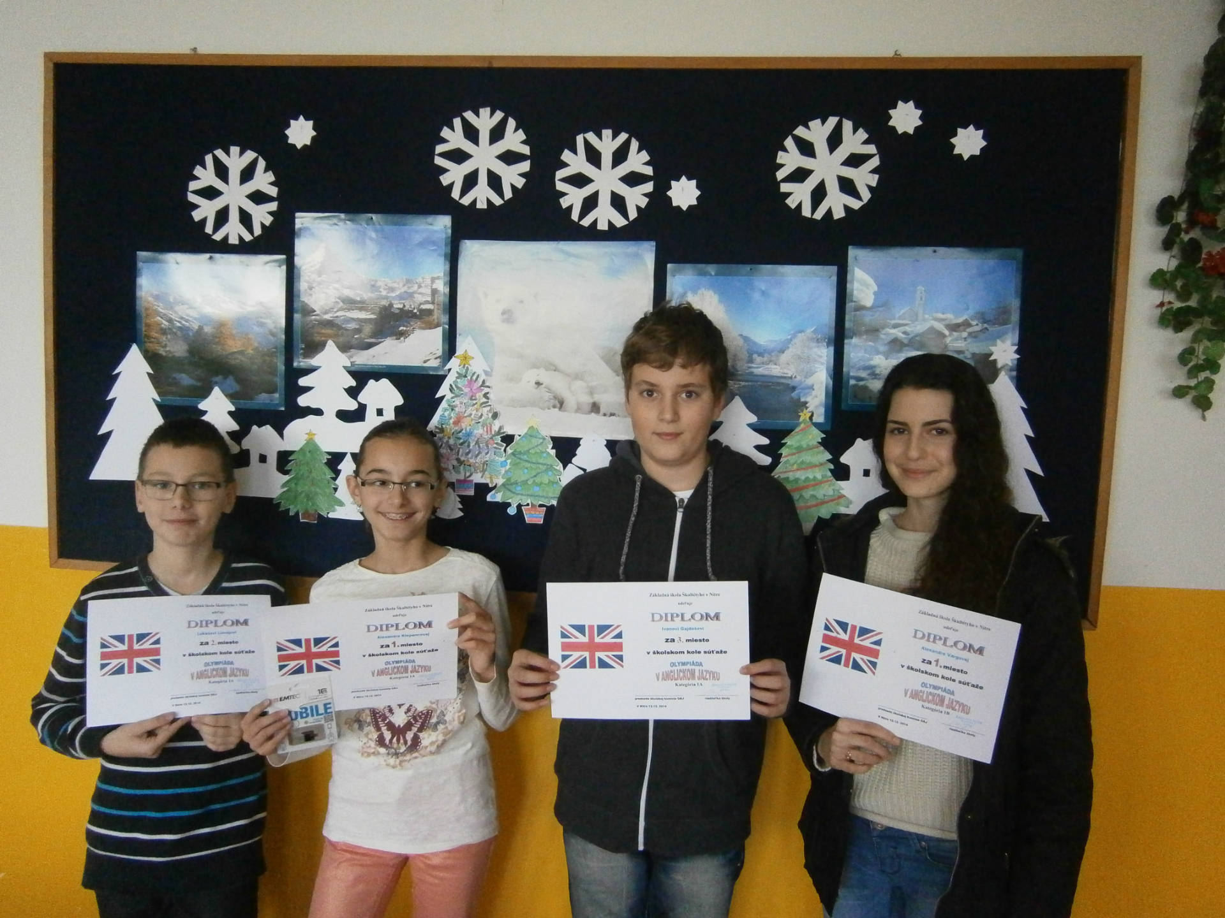
Olympic games in English

Slide 17
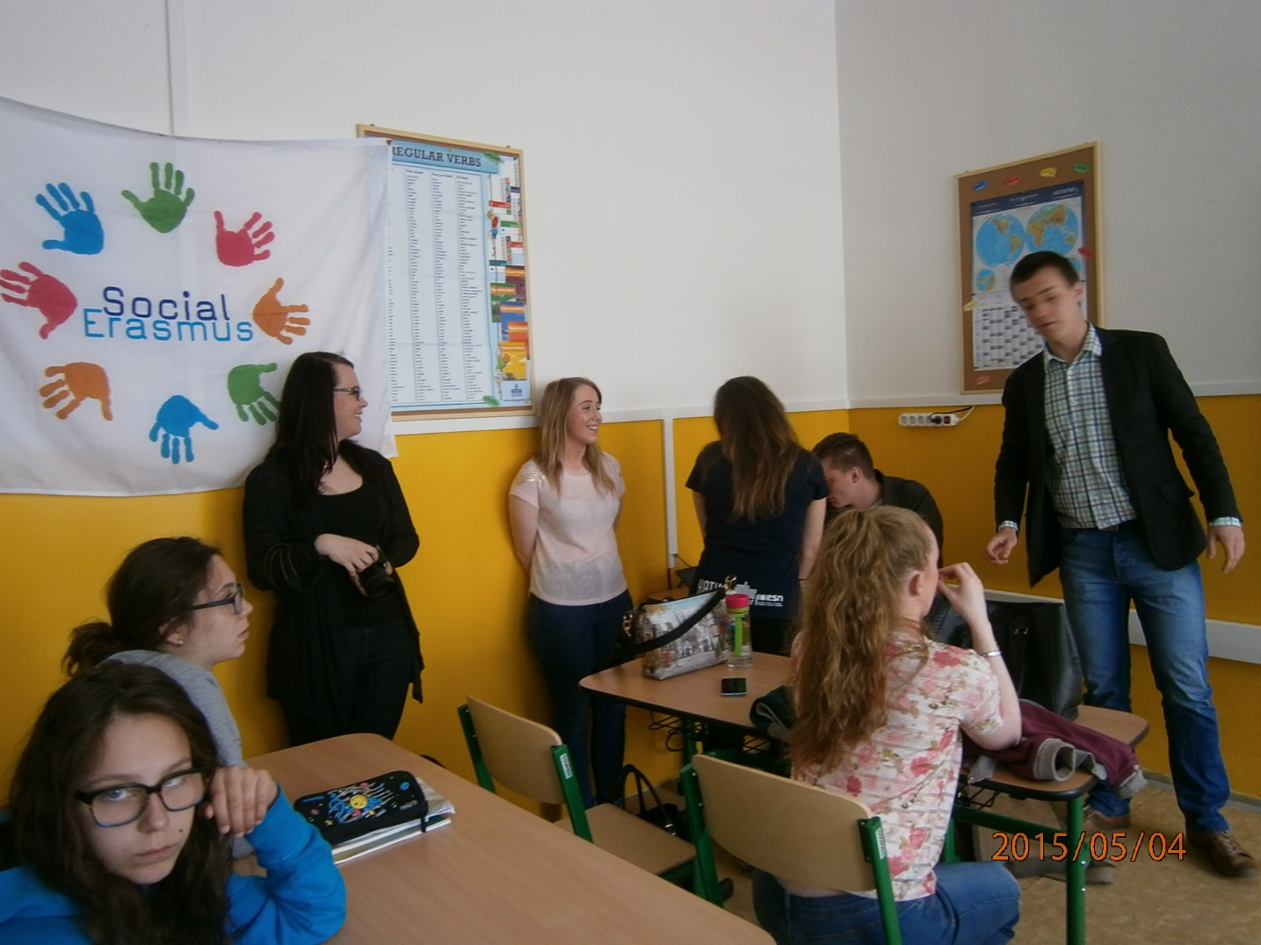
Project “Educate Slovakia“ with internatinal AISEC students

Slide 18
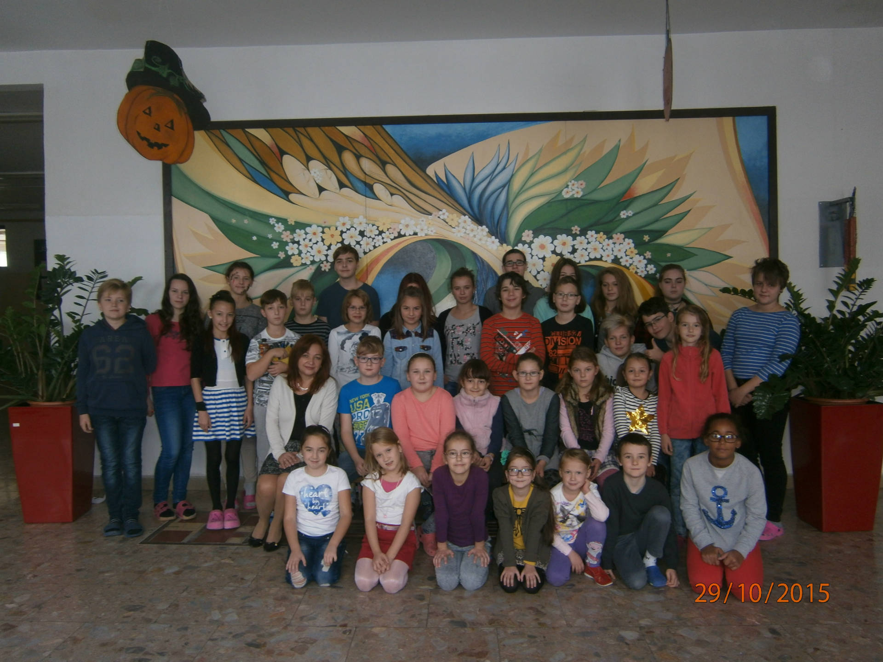
School Parliament

Slide 19
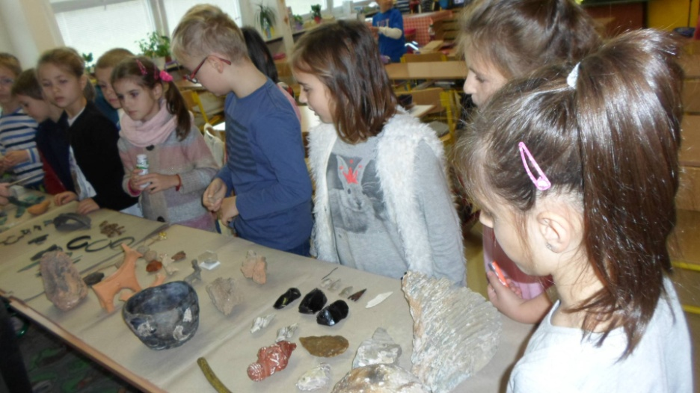
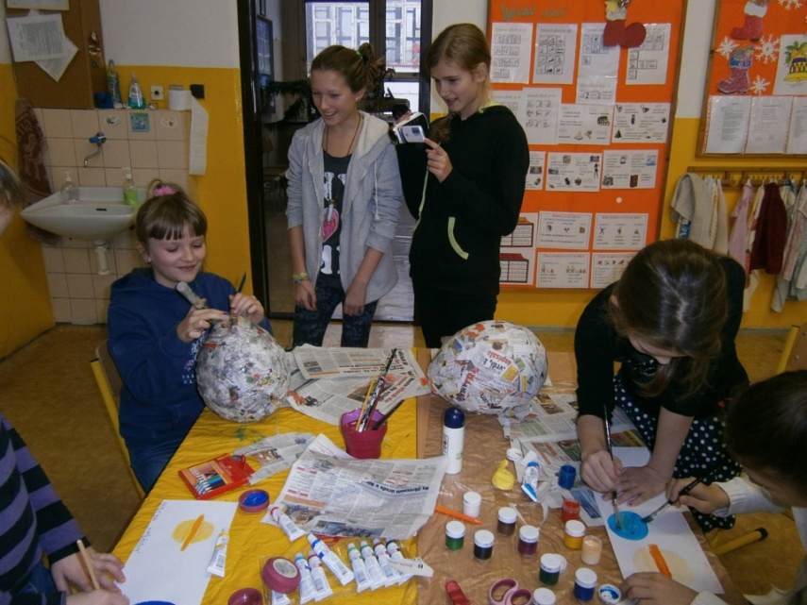
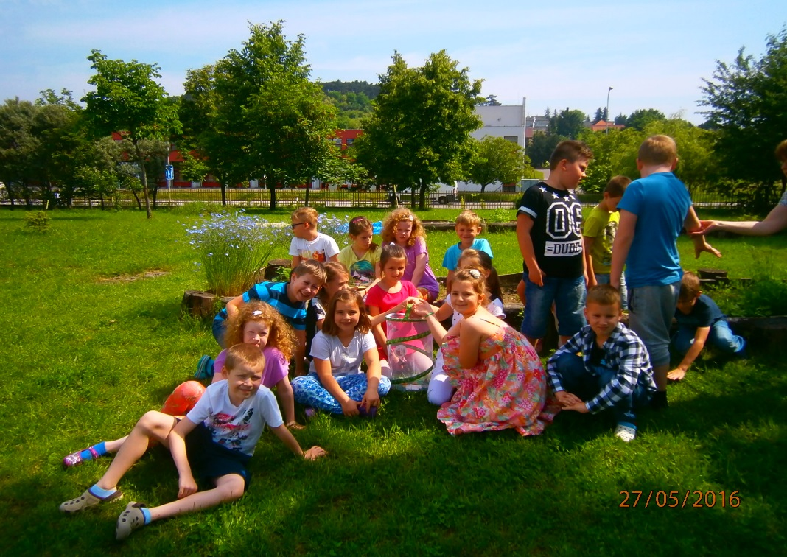
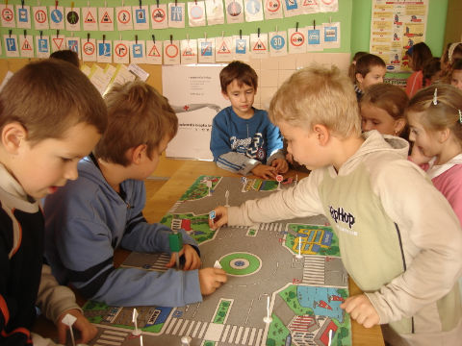
Creative learning

Slide 20
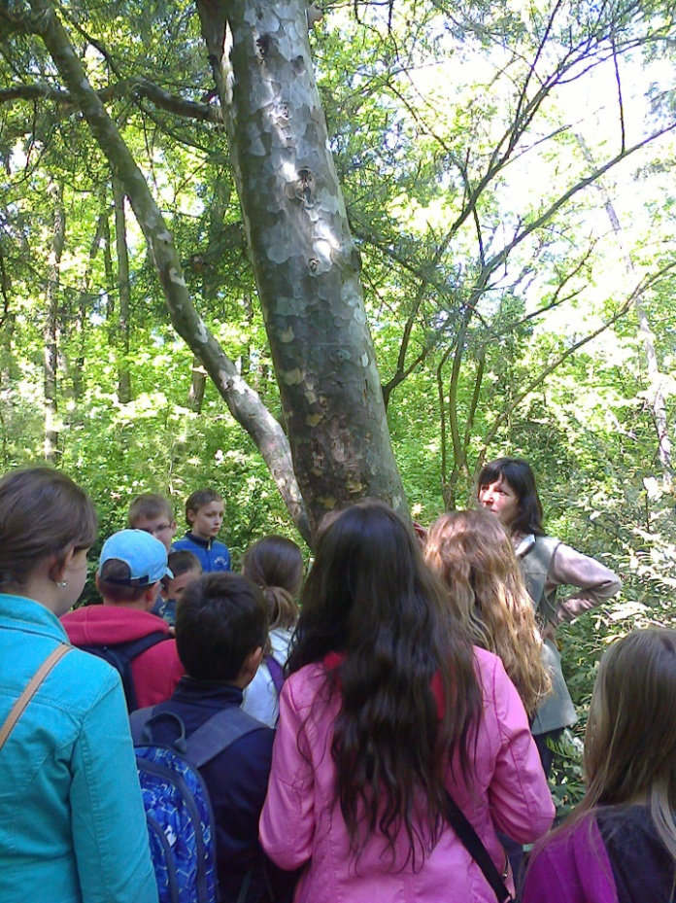
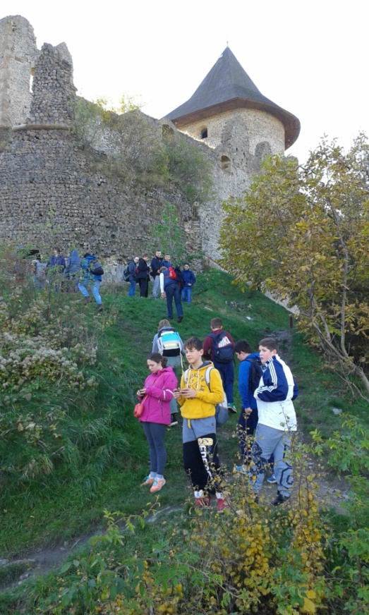
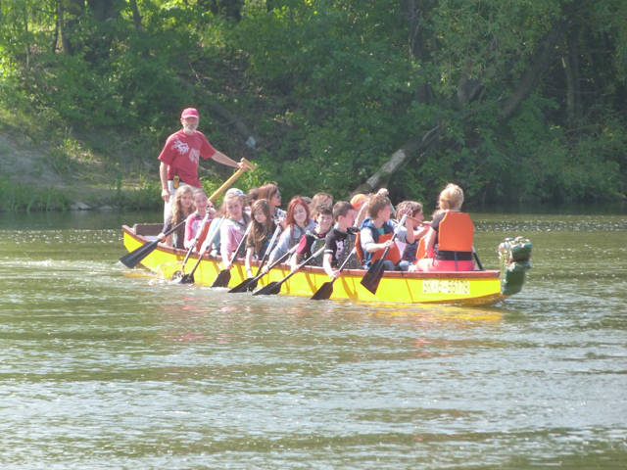
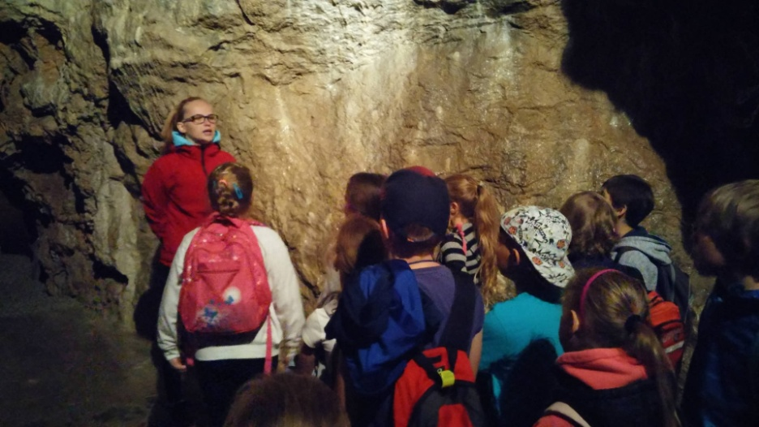
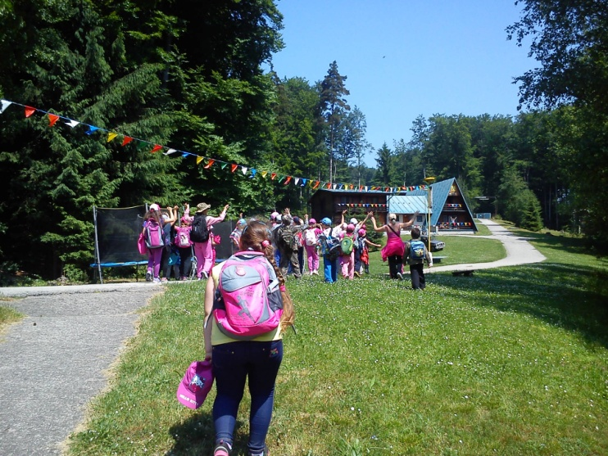
We discover natural and historical beauties

Slide 21
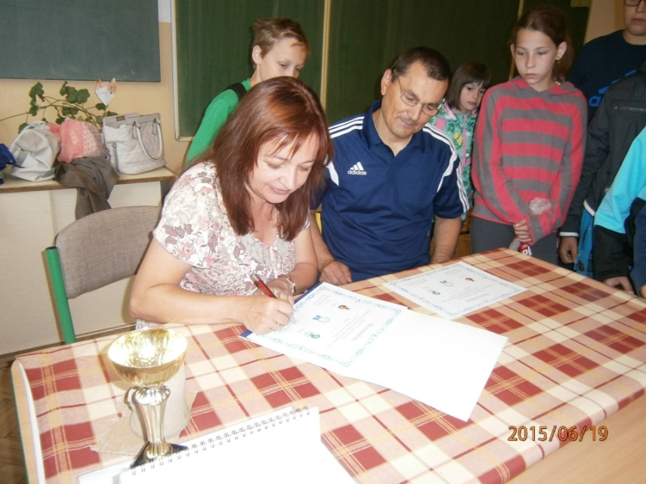
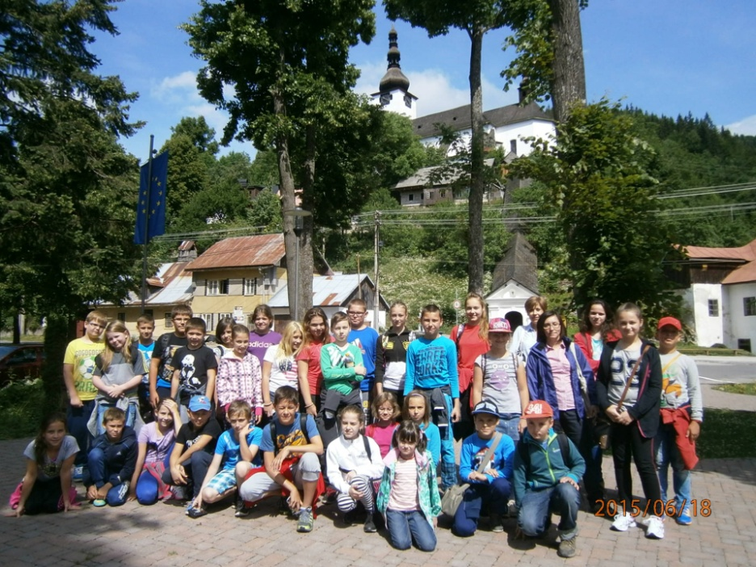
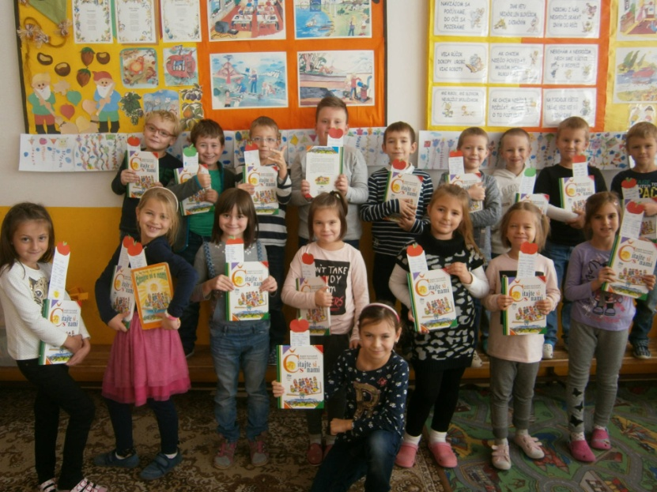
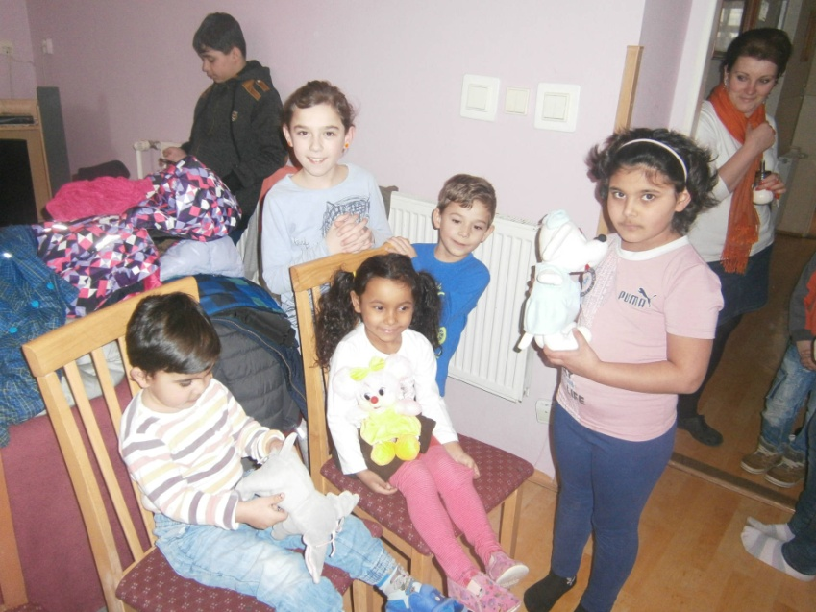
Our partners
Partner school in Hruštín
Libochovice
Friends from foster home in Kolíňany

Slide 22
International Day of Libraries
Apple Day

Slide 23
Partying
Halloween
Carnival
Christmas party
Flying kites

Slide 24
Thank you for your attention

