Slide 1
The Amazing World of Plants Flower Structure
Agrupamento de Escolas de Marco de Canaveses
2018

Slide 2
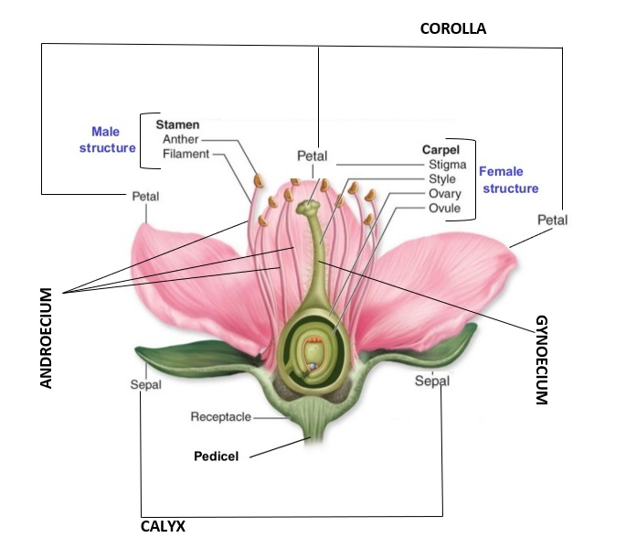
Observe and identify the different parts of a flower in your carnation. Stick and label them on your notebook.

