Slide 1
The Amazing World of Plants Classification
Agrupamento de Escolas de Marco de Canaveses
2018

Slide 2
Parts of a plant with flowers
Plants have three main parts: roots, stem and leaves

Slide 3
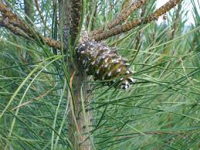
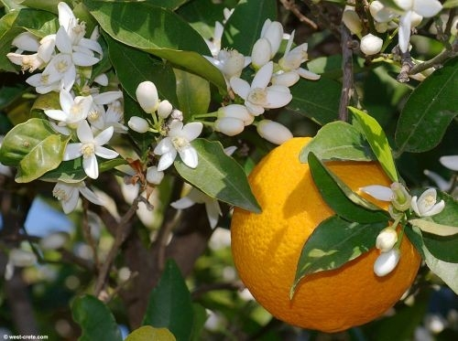
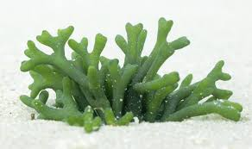
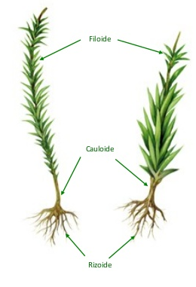
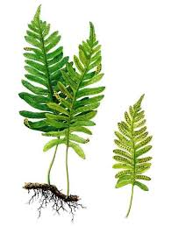
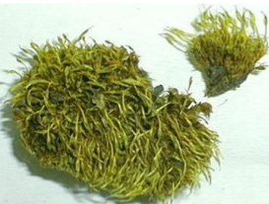
Classification
Plants
Spore-bearing
Has no true roots, stems or leaves
Has roots, stems and leaves
Seed-bearing
Without flowers
Has no true roots, stems or leaves structure
Has some true roots, stems or leaves structure
MOSSES
ALGAE
FERNS
With flowers
Gymnosperms
Angiosperms

Slide 4
Complete the diagram
PLANTS
Spore-bearing
Has no true roots, stems or leaves
Has roots, stems or leaves
Seed-bearing
Without flowers
With flowers

Slide 5
Complete the diagram
PLANTS
Spore-bearing
Has no true roots, stems or leaves
Has roots, stems or leaves
Seed-bearing
Without flowers
With flowers
ALGAE
MOSSES
FERNS
GYMNOSPERMS
ANGIOSPERMS

Slide 6
Read and match
What are the groups of plants? •
What are the plants with spores? •
What are the plants without flowers? •
What are the plants with flowers? •
What do plants take through their roots? • What is the smallest group of plants? •
• Gymnosperms.
• They take water and mineral salts.
• Spore-bearing and seed-bearing plants.
• Algae, mosses and ferns.
• Spore-bearing.
• Angiosperms.

Slide 7
Read and match
What are the groups of plants? •
What are the plants with spores? •
What are the plants with naked seeds? •
What are the plants with flowers? •
What do plants take through their roots? • What is the smallest group of plants? •
• Gymnosperms.
• They take water and mineral salts.
• Spore-bearing and seed-bearing plants.
• Algae, mosses and ferns.
• Spore-bearing.
• Angiosperms.

