Slide 1
Learning Event
The use of Webquests
in CLIL learning settings
04th February 2019
Helena Serdoura | AEMarcoCanaveses, Portugal
Notes:
Welcome to The use of Webquests in CLIL learning settings, part I of the Blended Learning Mobility of School Learners that will ta

Slide 2
WHAT IS A WEBQUEST
Dodge (1995). “An inquiry-oriented activity in which some or all of the information that learners interact with comes from resources on the internet, optionally supplemented with videoconferencing”.
March (2007). “It is a scaffolded learning structure that uses links to essential resources on the World Wide Web and an authentic task to motivate students’ investigation of an open-ended question, development of individual expertise, and participation in a group process that transforms newly acquired information into a more sophisticated understanding”.

Slide 3
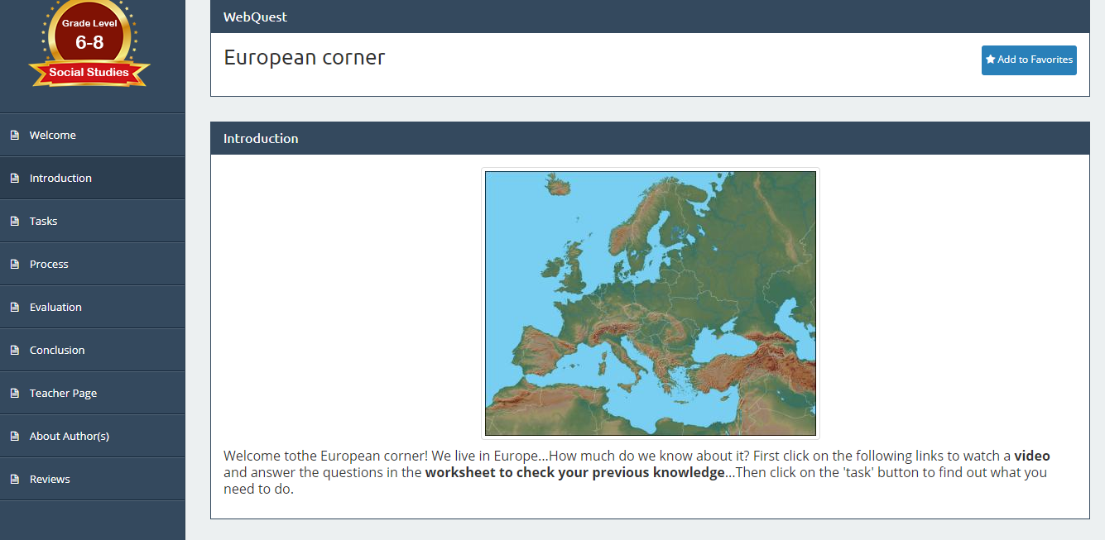
COMPONENTS OF A WEBQUEST
INTRODUCTION
Sets the stage and provides some background information.

Slide 4
COMPONENTS OF A WEBQUEST
TASK
Description of what the learner will have done at the end of the WebQuest.

Slide 5
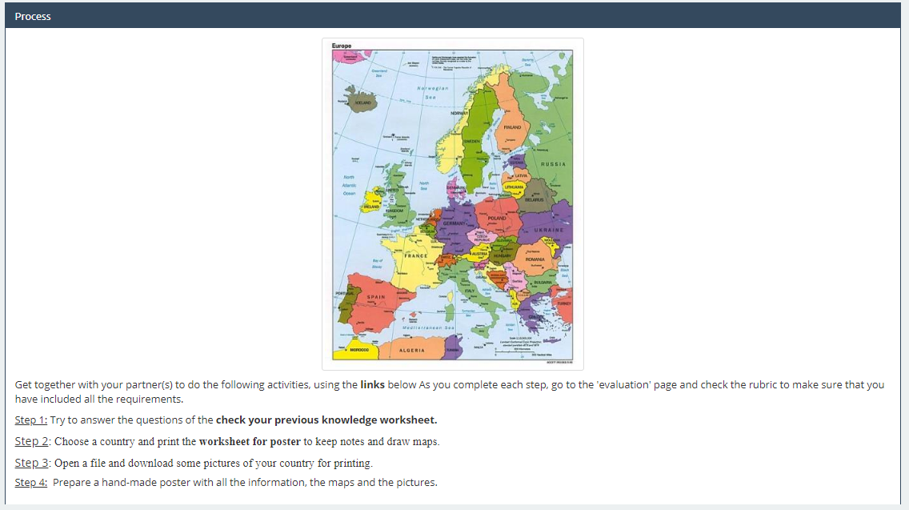
COMPONENTS OF A WEBQUEST
PROCESS
Steps the learners should go through in accomplishing the task.

Slide 6
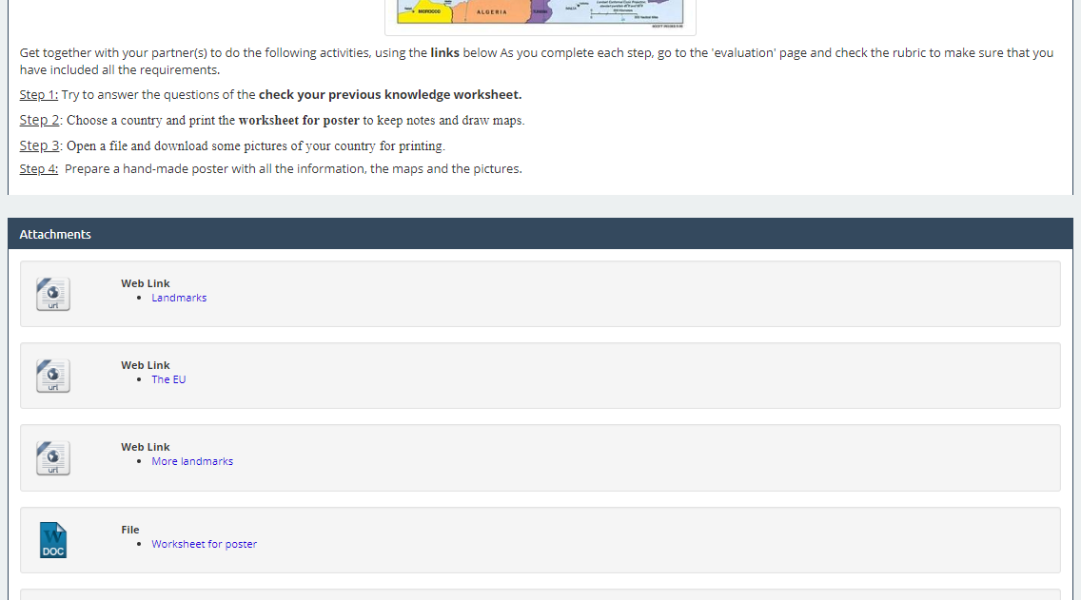
COMPONENTS OF A WEBQUEST
RESOURCES
List of information sources.

Slide 7
COMPONENTS OF A WEBQUEST
EVALUATION
Rubrics or criteria to evaluate students .

Slide 8
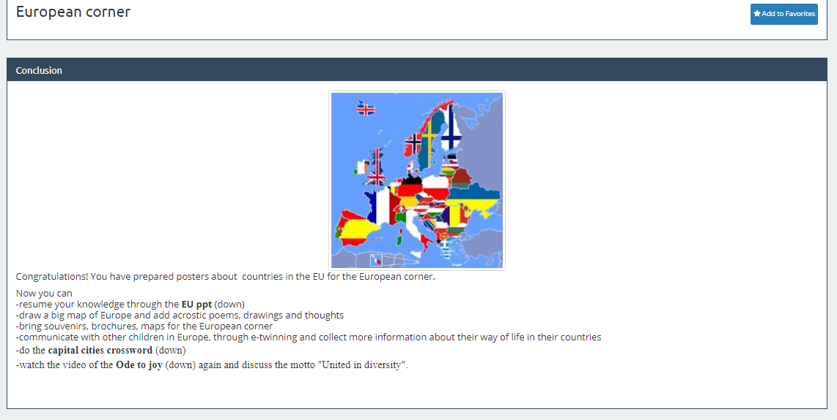
COMPONENTS OF A WEBQUEST
CONCLUSION
Summarizes what has been learned and encourages further learning.

Slide 9
WHY TO USE WEBQUESTS IN CLIL?
CONSTRUCTIVIST PERSPECTIVE

Slide 10
WHY TO USE WEBQUESTS IN CLIL?
CONSTRUCTIVIST PERSPECTIVE

Slide 11
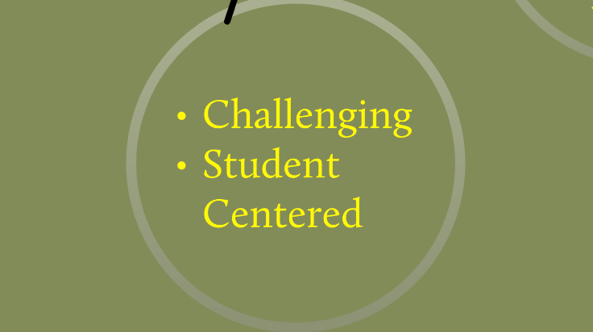
WHY TO USE WEBQUESTS IN CLIL?
COMMUNICATION

Slide 12
WHY TO USE WEBQUESTS IN CLIL?
COMMUNICATION

Slide 13
WHY TO USE WEBQUESTS IN CLIL?
COMMUNICATION

Slide 14
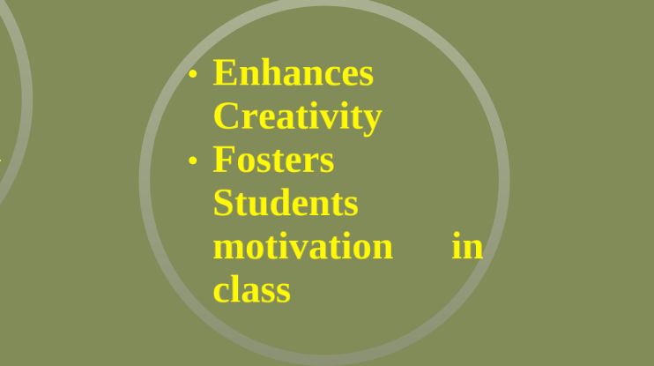
WHY TO USE WEBQUESTS IN CLIL?
AUTHENTICITY

Slide 15
HOW TO USE WEBQUESTS IN CLIL
WHERE TO START
Read about what webquests are
Analyse and use webquests created by other teachers
Choose a topic you would like your students to work on and find web resources (images, videos, texts) about it
Determine the kind of task you want your students to do
Write an outline for your webquest

Slide 16
HOW TO USE WEBQUESTS IN CLIL
WHERE TO START
Design your webquests. You can use:
www.zunal.com
www.webquestcreator.carm.es
Type clear, concise and engaging activities for all the components
Establish criteria / rubrics to evaluate the task

Slide 17
TASKS
Explore 2 WebQuests
Learn how to create a WebQuest
Plan a WebQuest that can be used in a Hands On CLIL class in a topic of your choice
By the end of this workshop, you will create an engaging WebQuest to post in the project’s Website and eTwinning TwinSpace, use with your students and share with your partners in the Blended Mobility of School Learners, in Portugal.

Slide 18
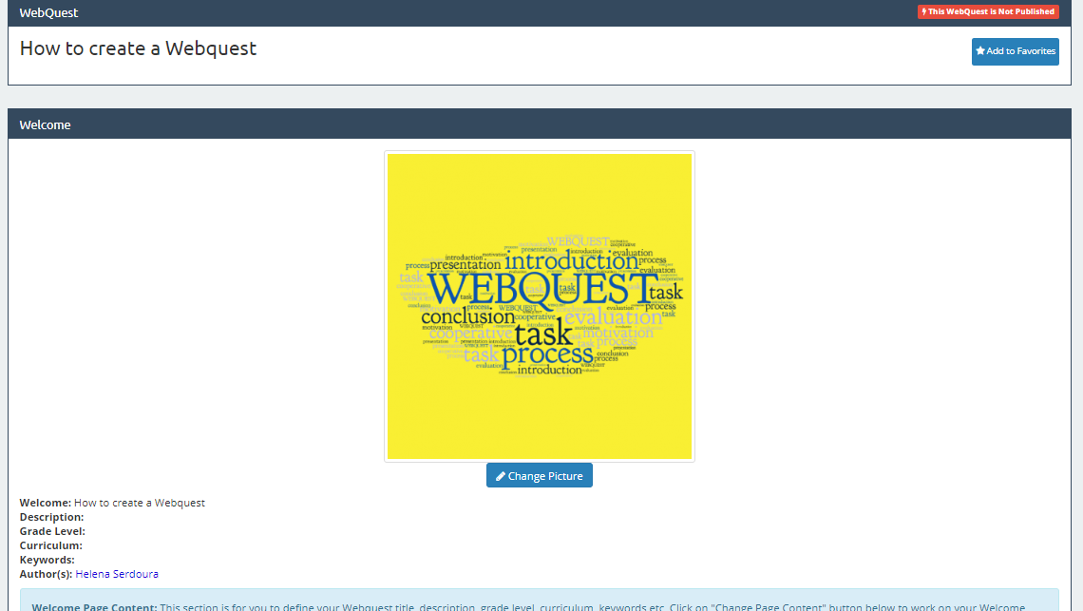
TASK
Please follow the WebQuest link to accomplish your tasks:
http://zunal.com/webquest.php?w=400000

Slide 19
http://zunal.com/process.php?w=268014
http://zunal.com/process.php?w=268014
http://zunal.com/process.php?w=268014
BIBLIOGRAPHY
Adapted from https://prezi.com/mtpqbfbfh2gx/the-use-of-web-quests-in-clil-settings/
https://www.slideserve.com/hoai/a-webquest-about-webquests#
https://www.slideserve.com/embed/1130108
https://list.ly/list/26yt-webquests-pbl-for-the-timid
https://mrscienceut.net/WebQuest.html
http://www.onestopenglish.com/teenagers/topic-based-materials/webquests/
http://zunal.com/process.php?w=268014
https://www.teachingenglish.org.uk/article/webquests

Slide 20
Thank you!
See you in Marco de Canaveses!

