Slide 1
History of Ostrava
Teaching: An effective key to self-lerning
This project is funded by European Union.

Slide 2
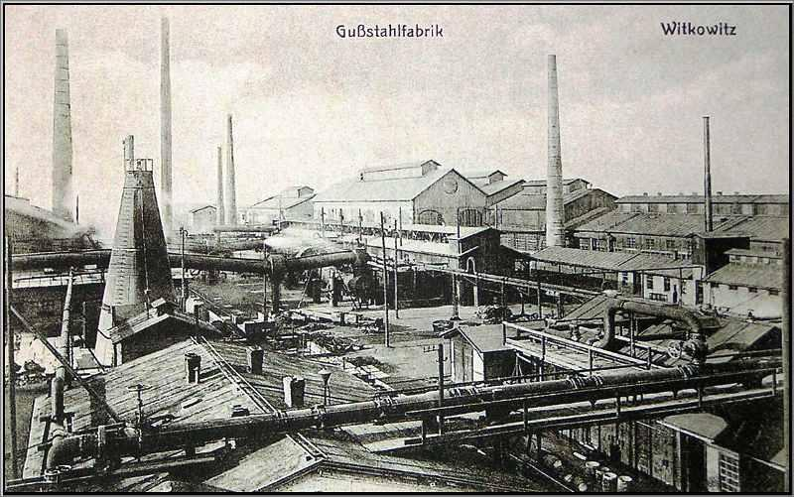
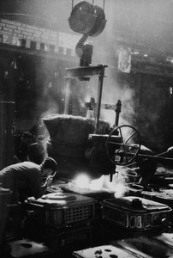
Development of Ostrava
The first written record about Ostrava is from 1267. However, the development of Ostrava started in 1763 when the black coal was discovered near Landek museum.
In 1828 the first foundry was built in Vitkovice.
In 1951, the New Foundry in Kunčice was opened. Nowadays, all mines in Ostrava are closed and the foundries in Vitkovice stopped producing iron.

Slide 3
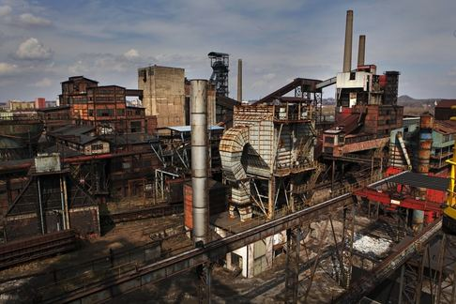
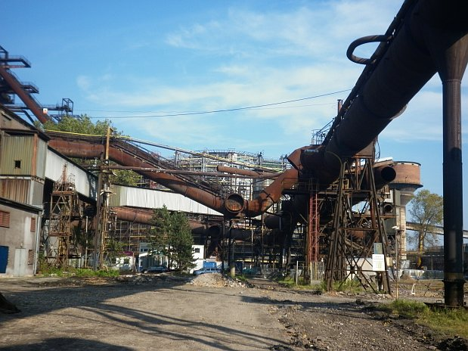
Ostrava ironworks
Ostrava became famous for its production of coal, iron, steel and various steel products made in Vitkovice and Mittal iron works.
Today it‘s not Mittal but Lower Vitkovice

Slide 4
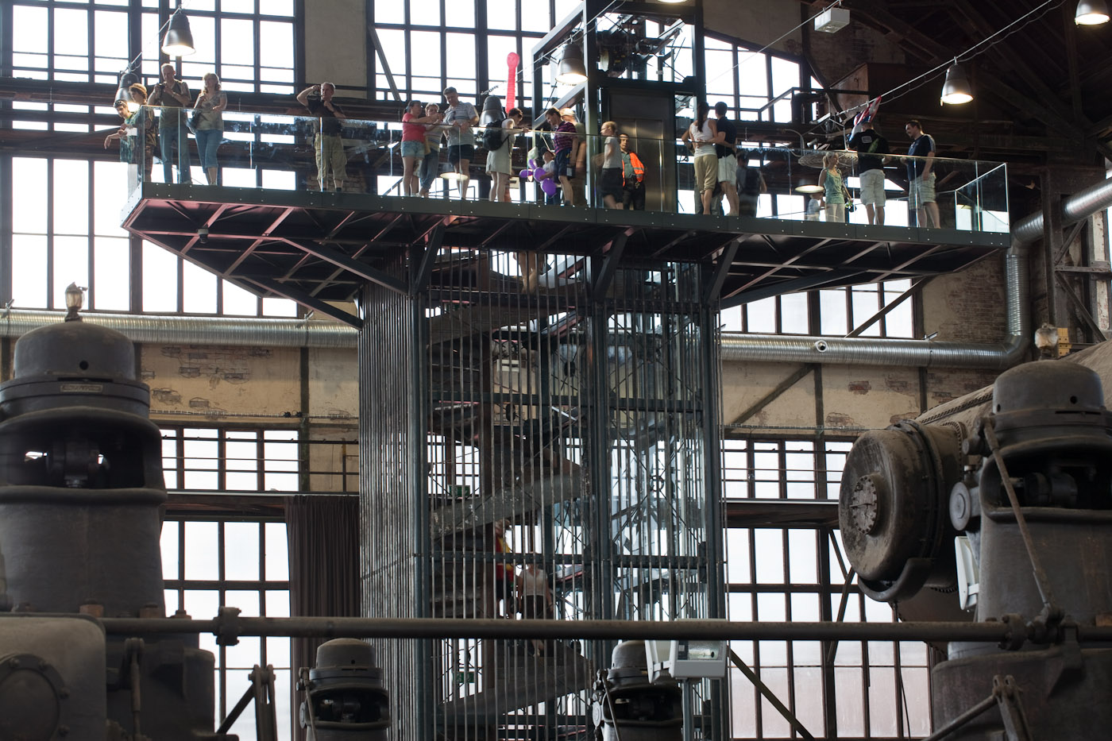
Rozložení s nadpisem a obsahem (se seznamem)
Industrial museum
The area of the old factories in Vitkovice became one of the largest preserved technical monuments. Tourists come and admire the old factory buildings in this unique industrial museum.

Slide 5
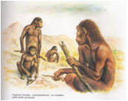
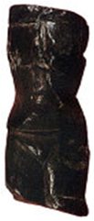
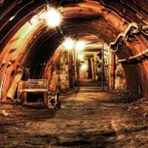
Rozložení se dvěma obsahy (s obrázkem SmartArt)
Another great museum is Landek
1) Landek is a little hill on the outskirt of Ostrava near the river Odra.
2) It is also one of the most important archaeological places in Europe.
Bones of mammoths and primeval people were found there.
Discovery of a small stone woman made Landek famous.
3) The museum is located in an old coal mine. Tourists can go underground in a real mine lift and admire the mining exhibits in work.
4) A unique geological place is nearby - the coal seam coming on the surface.
5) For fun, tourists can visit the new rope centre, play tennis or borrow a boat.

