Slide 1
Project meeting in Ostrava
25 – 31 January 2015
Czech Republic
This project is funded by European Union.

Slide 2
Wednesday
8 – 9:00 Breakfast in hotel
9:15 – 10 Journey to the Lower part of Vítkovice
10 – 11 STEM – technical museum U6 – GUESTS
Science museum – pupils from 7. A, 8.
11 – 12 Lunch – GUESTS
Educational film – pupils from 7. A, 8.
12 - 16 Science museum
All pupils work in international teams
16 – 18 Free time
18 – 21 Disco with Czech pupils from grade 8 + 9

Slide 3
Technical museum called U6

Slide 4
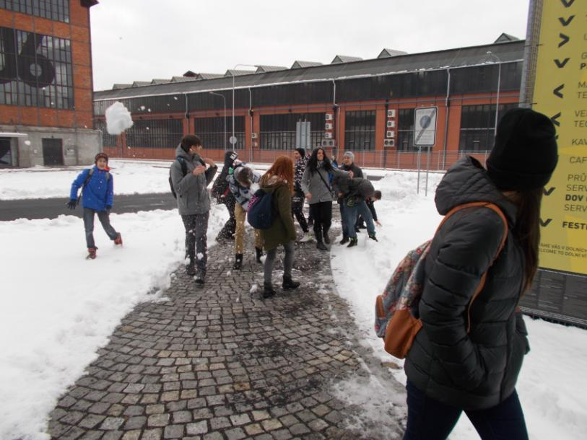
Technical museum U6 Museum is located in the Lower part of Vítkovice in a former factory building. It is closed in January and due to the maintenance of the exhibits. They opened it for our guests from European countries. Czech pupils from grade 8 and 7. A will visit it in February. They went to the other museum only.

Slide 5
Museum U6 from above

Slide 6
First activity – hamster wheel

Slide 7
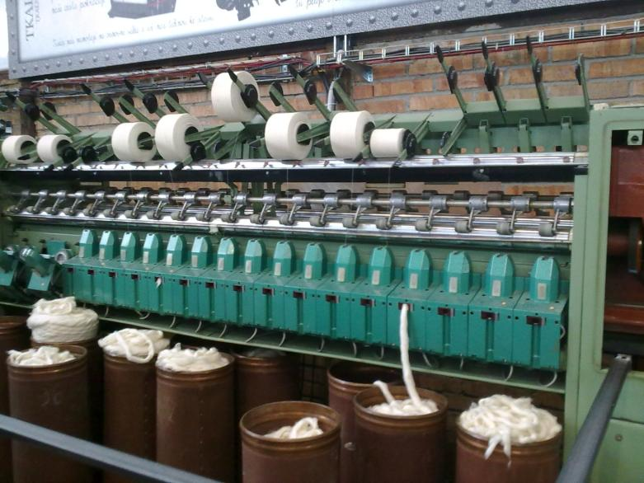
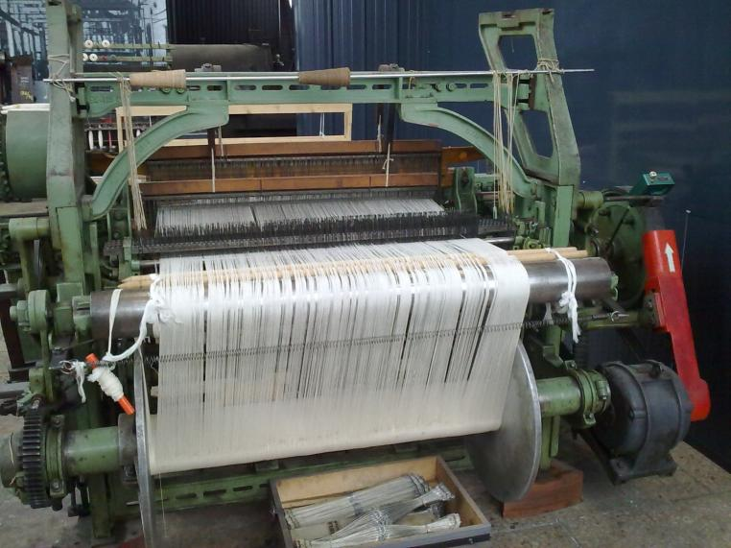
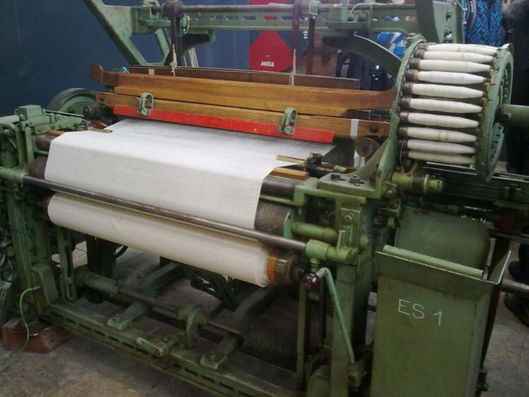
Looms
Czech Republic has a long tradition of textile production and Czech engineers developed the first water-jet-loom. You can also see the cotton loom, shuttle less loom, power loom, gripper shuttle loom etc.

Slide 8
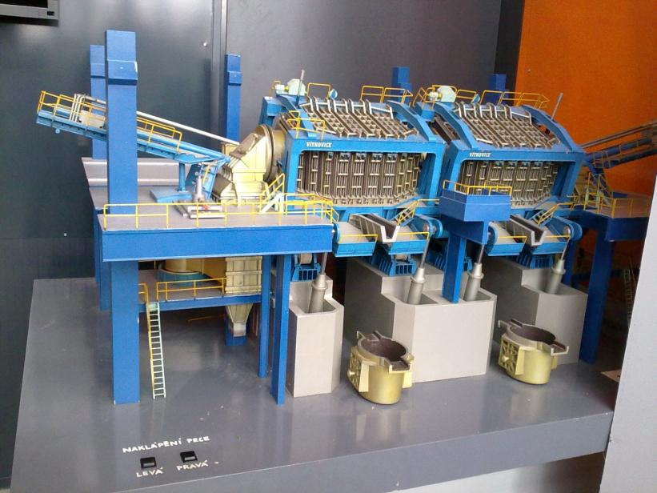
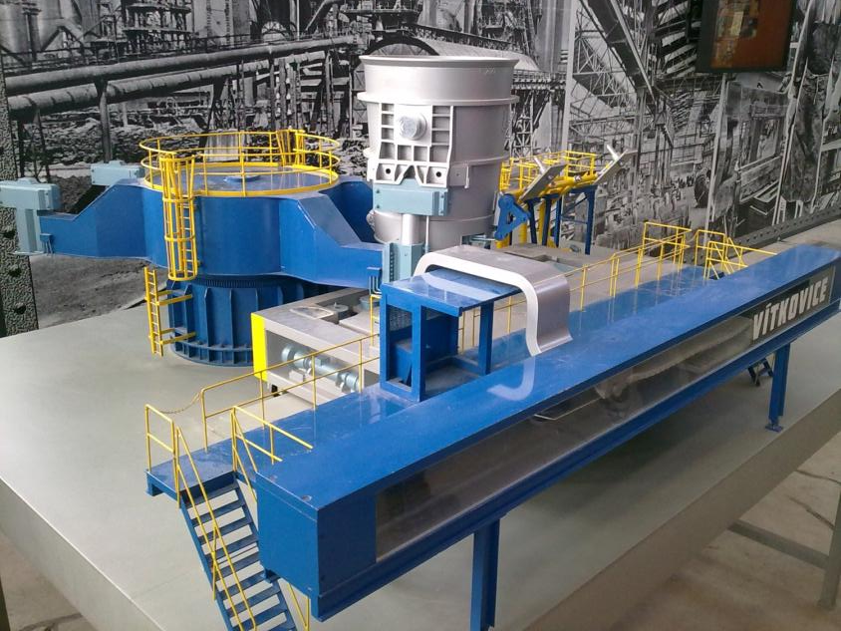
Models of Vítkovice steel factories

Slide 9
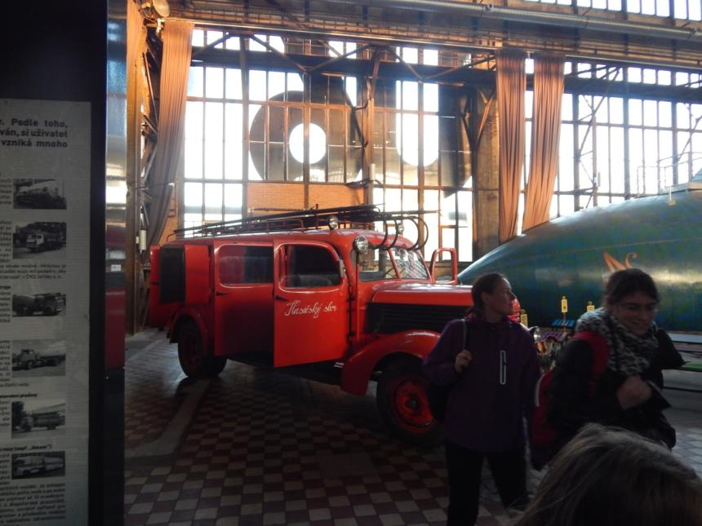
Atmosphere of the factory building turned into the museum

Slide 10
Visitors can try some occupations

Slide 11
First cars used steam for their engine

Slide 12
Try to produce enough electricity to turn on a radio and play a song

Slide 13
Sound changes into colours

Slide 14
Science Museum Ostrava
In the large glass front side of the museum building you can see like in a mirror the panorama of lower Vítkovice areal and museum U6.

Slide 15
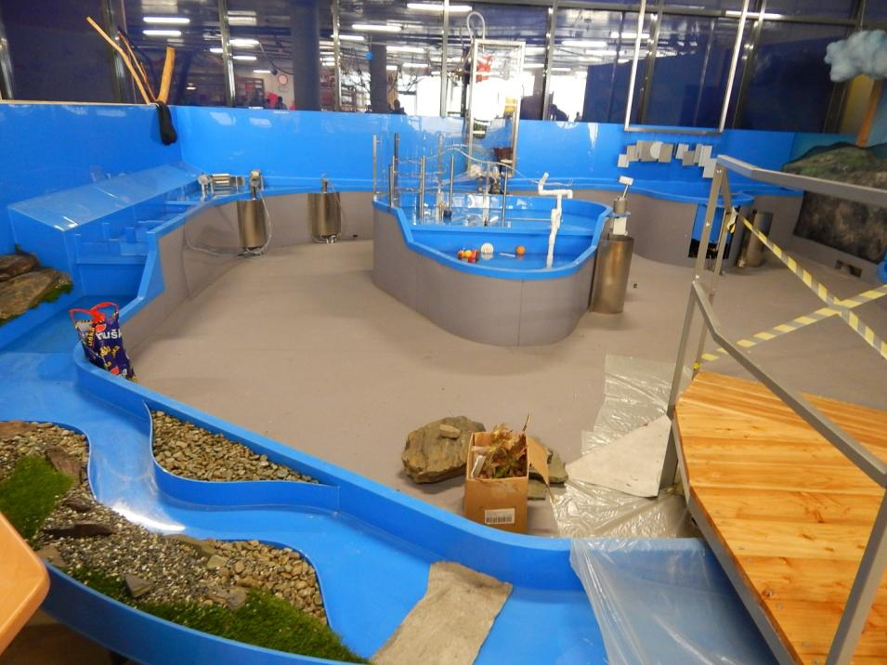
WATER WORLD is part of the CHILDREN´S WORLD exhibition
Water is life. The Water World, where something is flowing, dripping, splashing and plopping everywhere, is a limitless well of ideas and inspiration for children.
http://www.svet-techniky-ostrava.cz/web/guest/detsky-svet
A system of canals and waterways can be used by children to watch the water cycle in the nature. Other exhibits are used for water pumping, construction of obstacles in the way of water and to use its power as an energy source for other moving attractions. Or you can watch the boats flowing through the channel.

Slide 16
WORLD OF CIVILIZATION
The motto of the exhibition is the phrase "The World and You".
It is about the relationship of humans - each of us - and the world around us, and its previous and future development. How our life and environment are affected by our inventions and technologies and, vice versa, how we can actively contribute to the positive and negative direction of the civilization? The exhibition does not provide clear answers, what our relationship to the world should be like, but it offers information that can be useful when we decide about our behaviour to the world. The basic idea is that anyone who wants to change the world must begin with himself/ herself.
What can we see in this exhibition?
You can experience one of your normal days in the World of Civilisation. In the morning, you get up, wash yourself, get dressed, go to school or work, go for lunch, and spend some time with your hobbies, family and friends. What we take for granted here, however, may not be normal in other parts of the world. Through interactive exhibits you can experience your common day in a completely different way. The exhibition moves you to the third world countries, where even drinking water is scarce, it will take a look behind the scenes of the world cuisines and show you the tools that are used by children at schools in other parts of the world and you will see why lifelong learning is so important.
http://www.svet-techniky-ostrava.cz/web/guest/svet-civilizace

Slide 17
WORLD OF SCIENCE AND DISCOVERIES
The World of Science highlights the structures of the world around us and the technologies with which we explain and experience it in five sub areas. In ‘Mathematics', visitors approach mathematical proofs, systems, and phenomena playfully – suddenly math isn't so frightening anymore. ‘Physics' shows waves in all their forms and relationships. The area ‘Nano and Micro' invites visitors on a journey into the smallest dimensions of our environment. ‘Medical Technologies' gives visitors samples of how modern technology prolongs and supports their lives and what prostheses make our everyday lives easier. The area on ‘New Materials' looks into the future and introduces visitors to technologies like 3D printers or nano materials that in the next few years they will meet a lot more commonly than today.
http://www.svet-techniky-ostrava.cz/web/guest/svet-vedy-a-objevu

Slide 18
WORLD OF NATURE
In World of Nature and its eleven different areas, visitors learn to understand the world around them better. From the ‘Oasis of Iron', presenting Ostrava's history of a heavy metal industry city and its huge ironworks, to ‘Fauna', ‘Tree', ‘Man', ‘Space' up to ‘Energy', ‘Light', and ‘Electricity': Phenomena which we regularly meet in our daily life, here we can learn to understand how the world around us works with our hands-on exhibits and media stations.
Visitors can climb a giant tree, hunt fish with sonar just like dolphins, find out where the energy they use daily comes from. They learn about the life cycle of stars just as well as about the cycle of water on our planet, make the sparks fly with a Wimshurst machine and let planes circle with light energy. The experience from the experiments helps to understand these phenomena better. A 2,000 square metre garden invites visitors to a learn in "real" nature.
http://www.svet-techniky-ostrava.cz/web/guest/svet-prirody

Slide 19
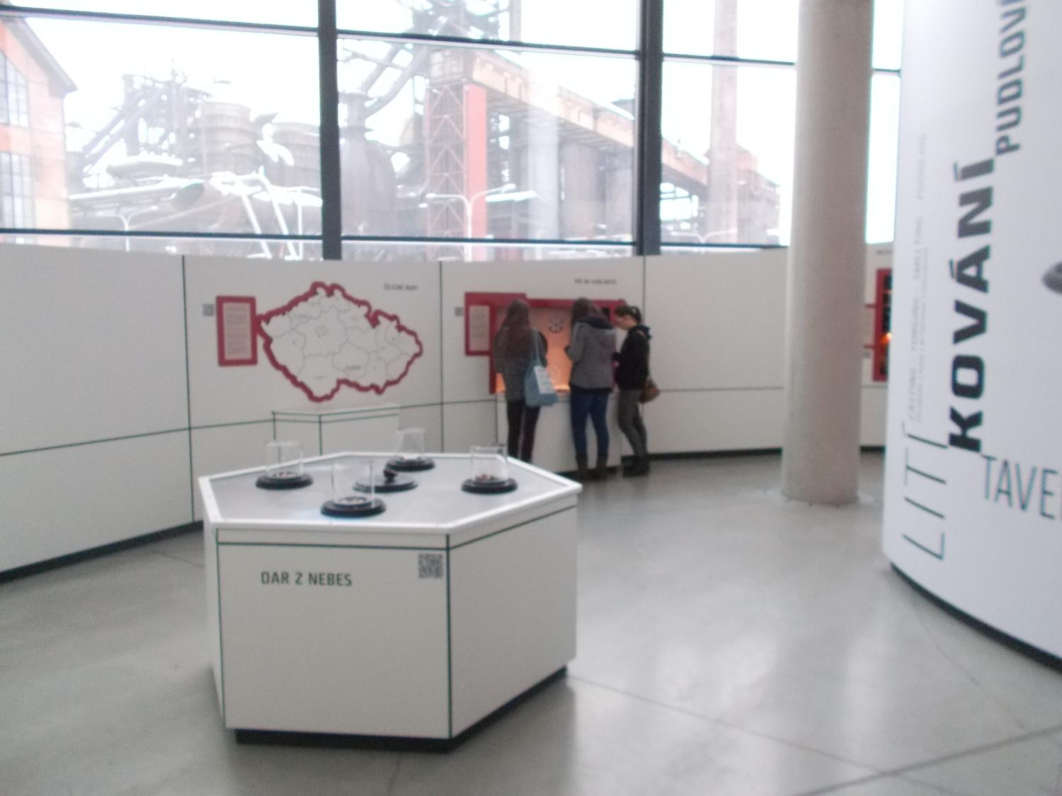
Science Museum Ostrava
view from the window in the world of nature

Slide 20
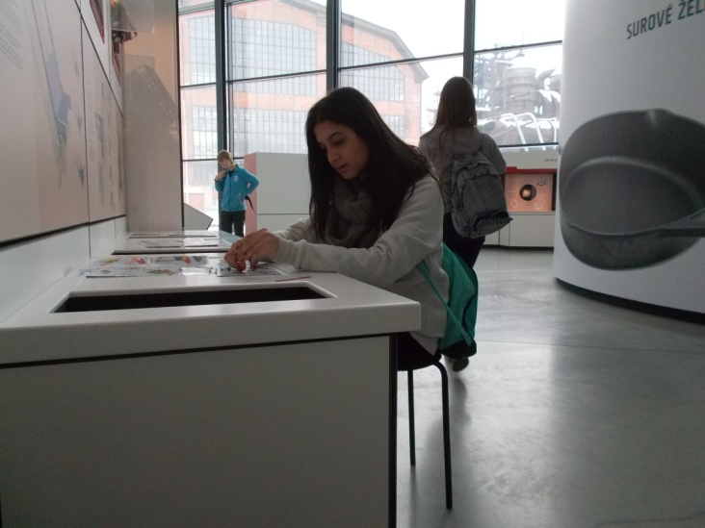
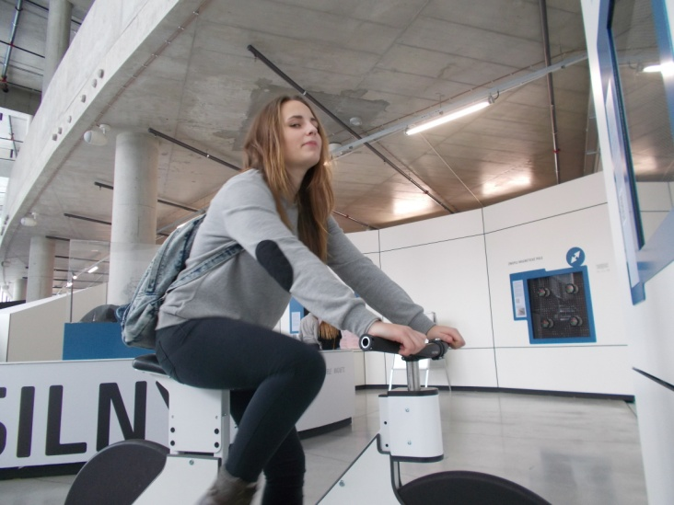
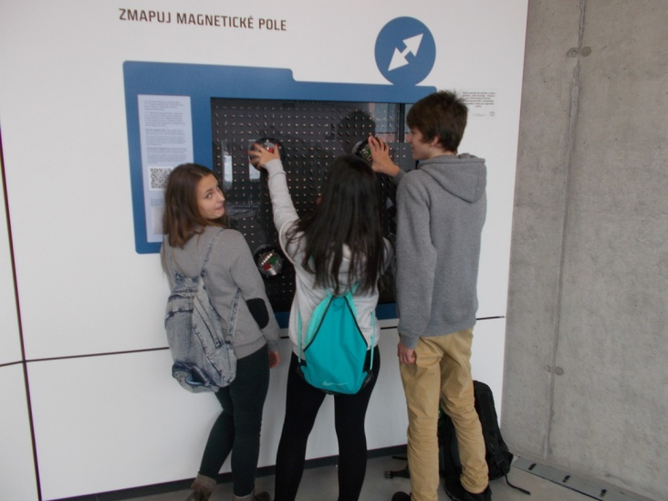

Slide 21
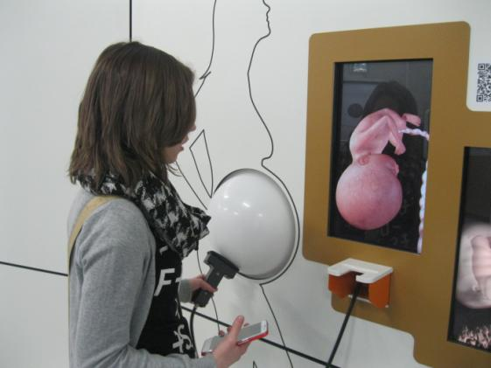
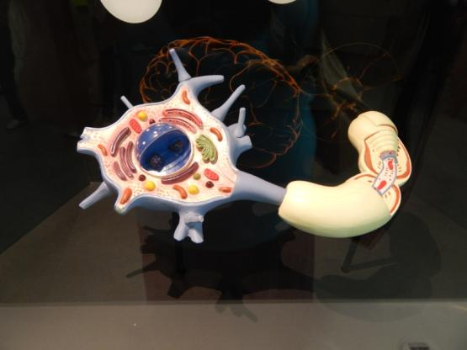
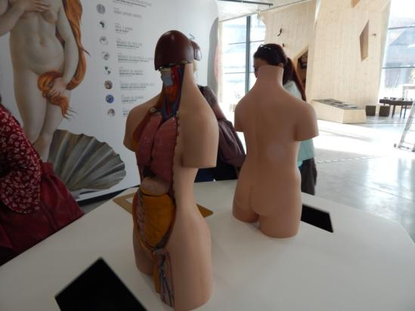
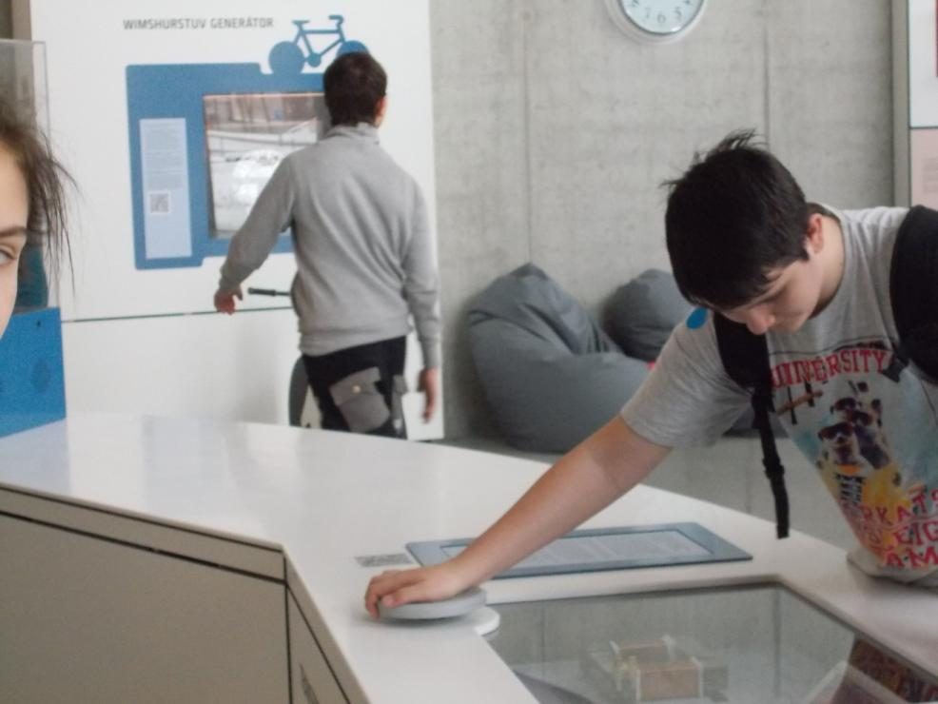

Slide 22
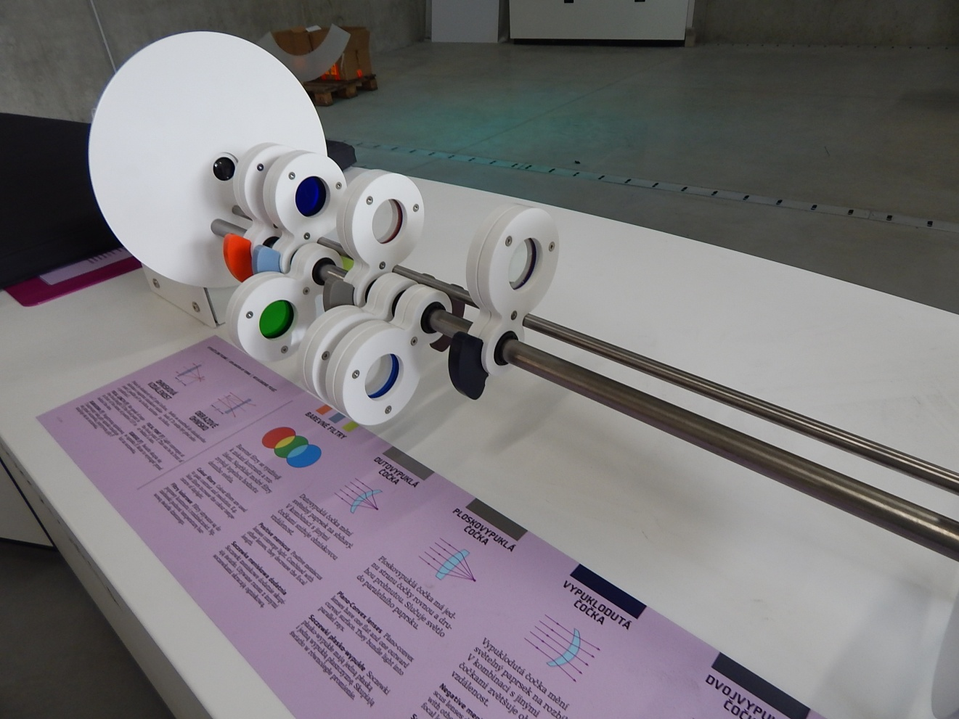

Slide 23
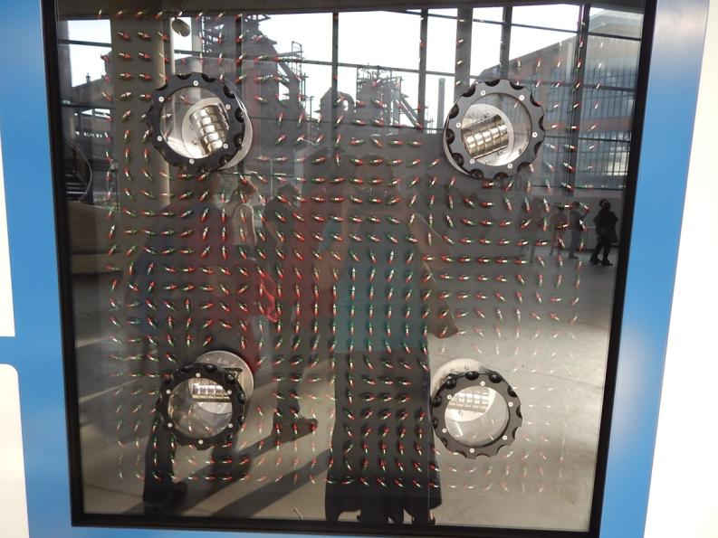
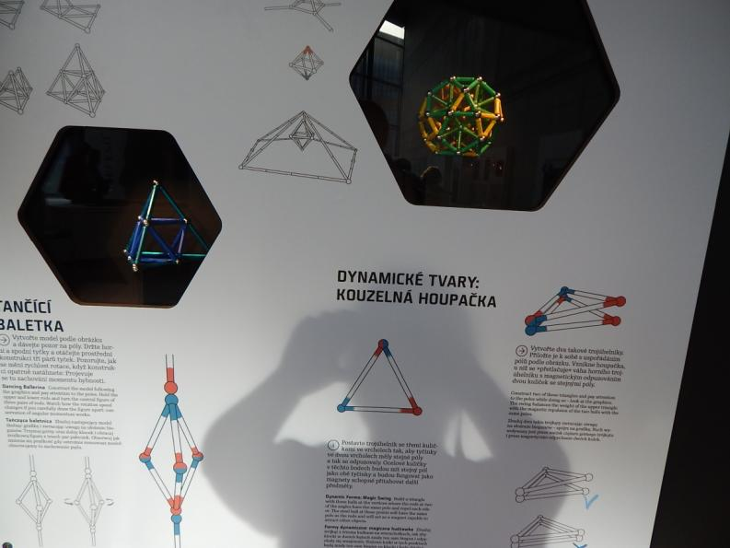
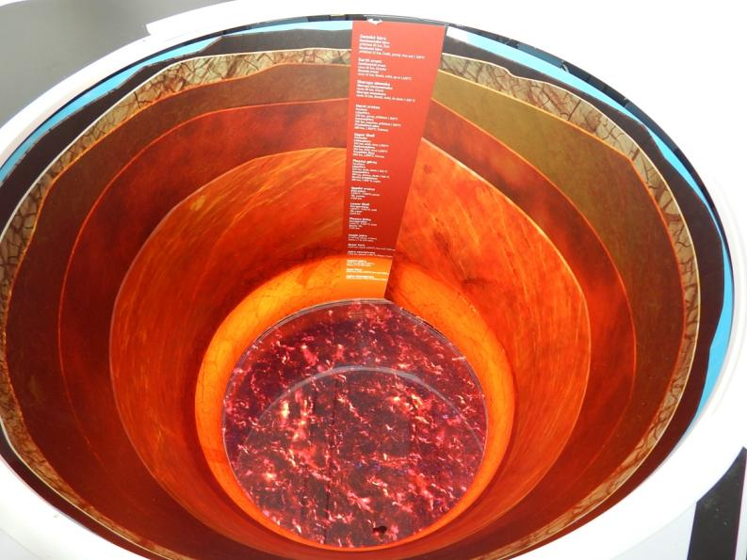

Slide 24
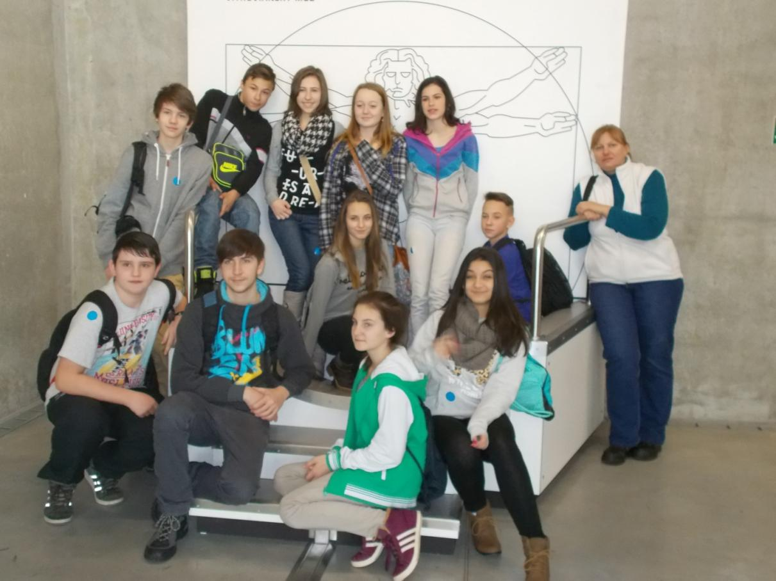
Class 8. enjoyed the exhibitions

