Slide 1
The Monastery of Prophet Ilias Iliovounio - Preveza
Senior High School of Thesprotikο
Erasmus+ “Vasileios Zormpas”
ARCH December 2019

Slide 2
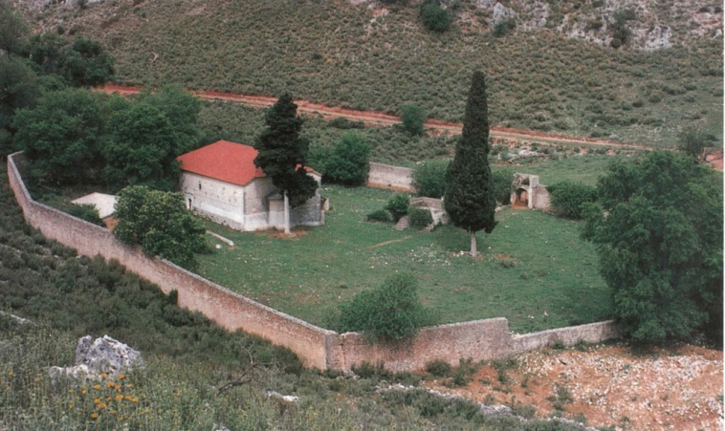

Slide 3
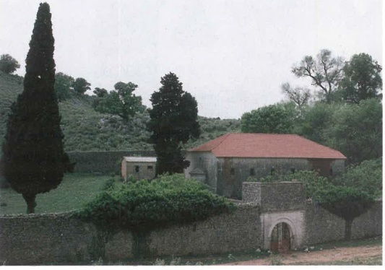
Location and History
The holy monastery of Prophet Ilias is built on a small plateau on the top of the Iliovounion mountain, between the villages of N. Kerasounta and Stefani. The monastery was once destroyed,
but then was rebuilt in a cave under
the summit of the mountain.
The renovation of the monastery
took place in 1852.

Slide 4
Location and History
The monastery was the wealthiest one in the province of Louros.
That’s the reason why it donated money to the local schools and even contributed to the construction of the Louros (Kalogeros) Bridge by spending 1000 Ottoman pounds for it.
Remarkable examples of such acts were the abbots Dionysus B’ and Ierotheos Mpaikos.

Slide 5
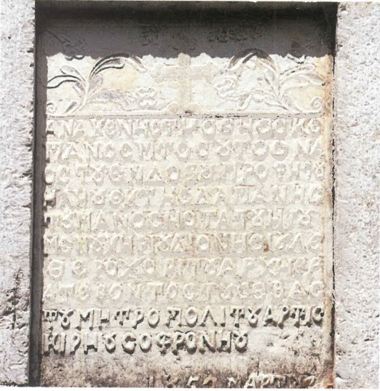
The exterior
The entrance is located on the southern side of the temple and the floor is nearly 6 steps lower than the ground .
Above the entrance on the southern side
an epigraph that confirms the renovation
of the monastery in 1852 is inscribed.

Slide 6
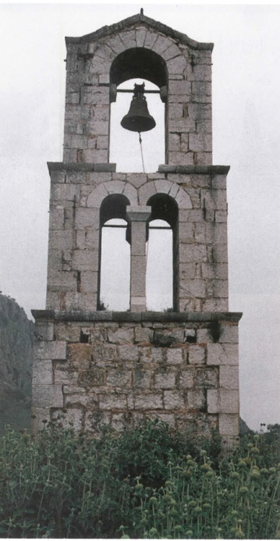
The exterior
The bell tower is built in 1908 in a
prominent position on the western part
of the monastery.

Slide 7
The interior
The cathedral of the monastery, three aisled basilica is divided into narthex, the main temple and the sanctuary. The first one lacks iconographies as well as the two last mentioned are full of ruined murals dating back to 1878.
The narthex is seperated from the main temple with an old trellis, while the main temple with two rows of three pillars in three aisles.

Slide 8
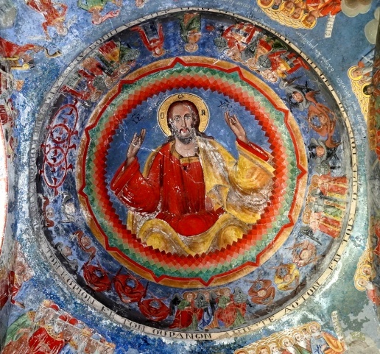
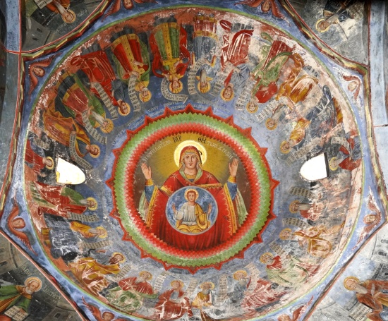
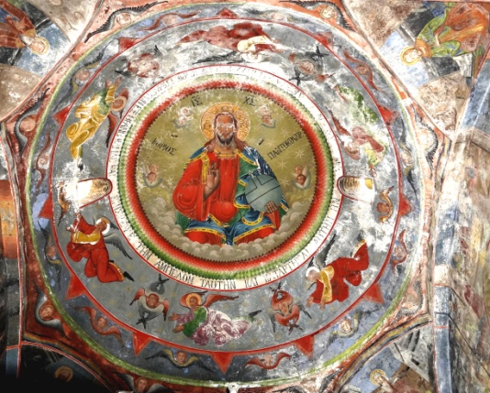
The interior
There are nine domes in total:
Three inner domes on the roof of the narthex
Four inner domes on the roof of the main temple
Two big domes in the main aisle

Slide 9
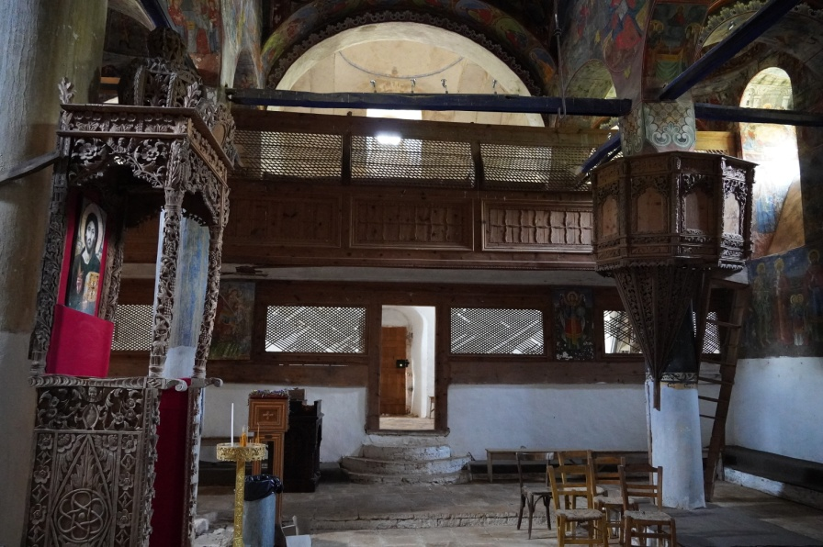
The interior
The iconostasis of the church is made of carved marble and is full of Despotic icons. All of them are painted on a canvas.
The ambo as well as the Despotic throne are finely carved on wood.

Slide 10
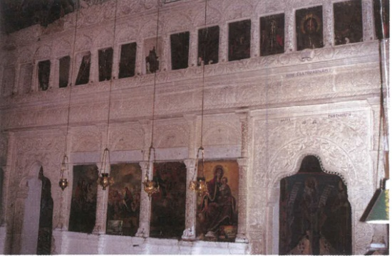
Here is a view
of the interior
of the monastery
and the astonishing
icons

Slide 11
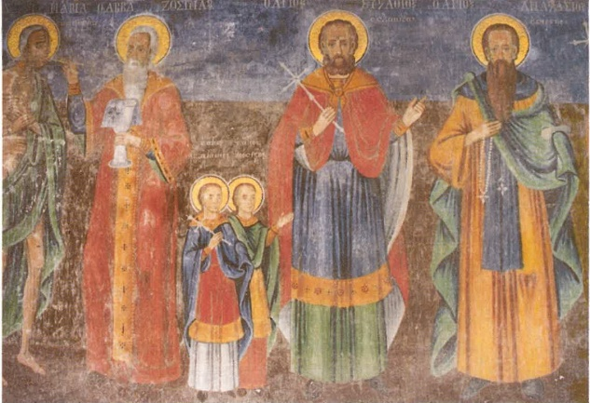
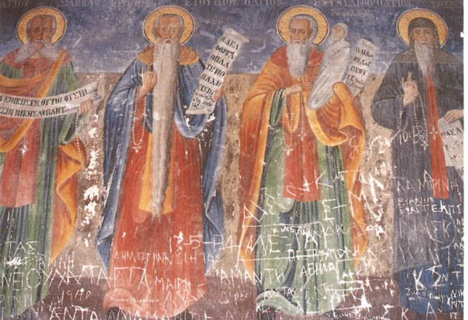
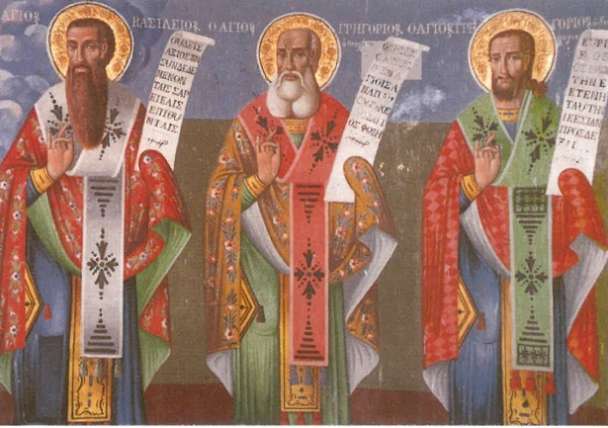

Slide 12
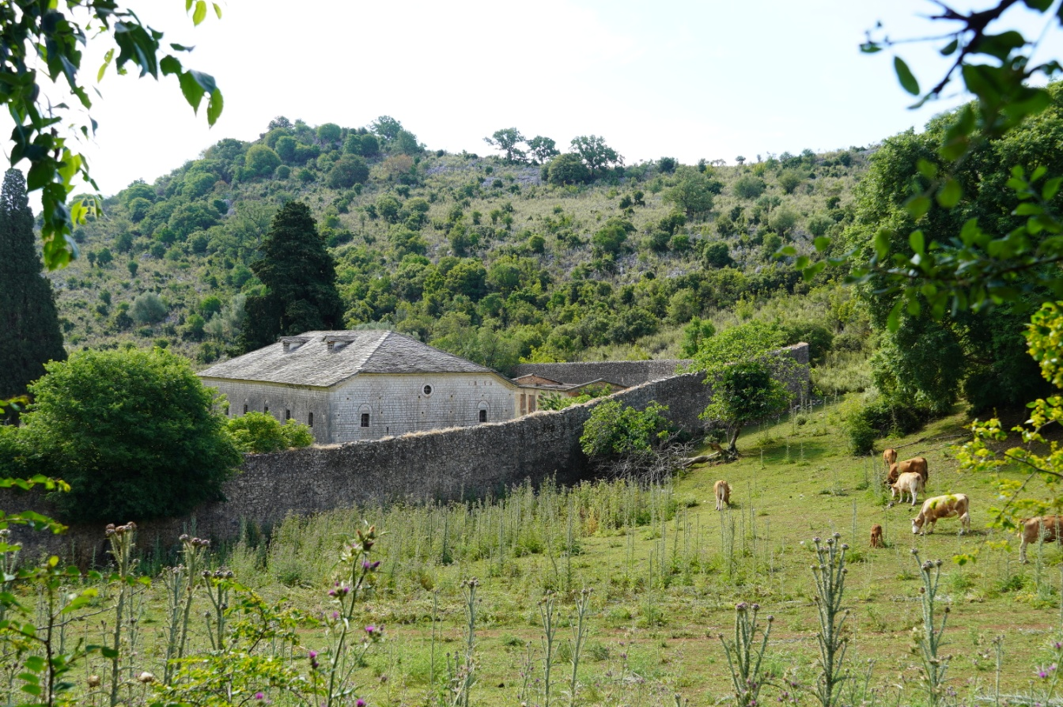
Although the monastery
is still considered
to be functioning
unfortunately,
it is abandoned.

Slide 13
THANK YOU
FOR
YOUR
ATTENTION

