Slide 1
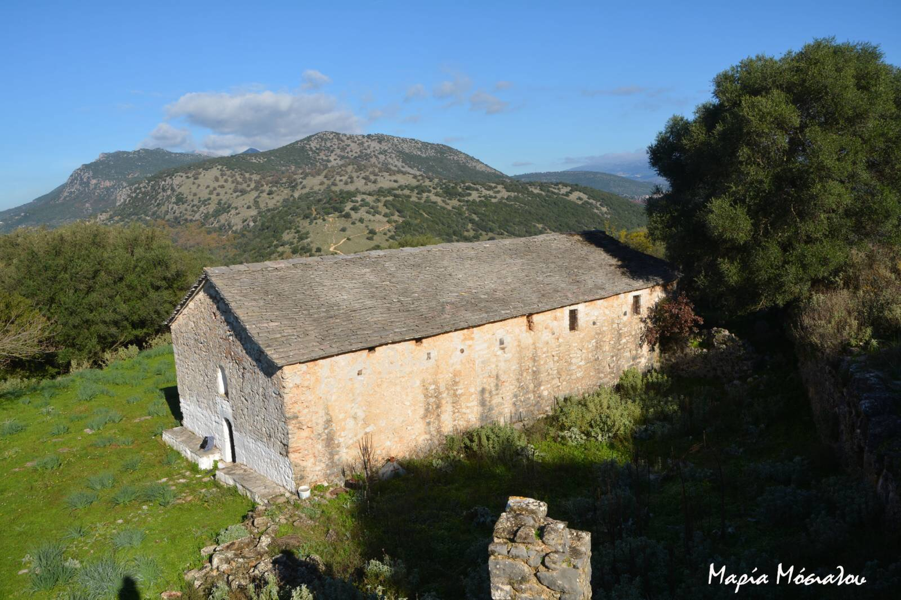
Church of the Dormition of the Virgin Mary (Panagia-Kastri)

Slide 2
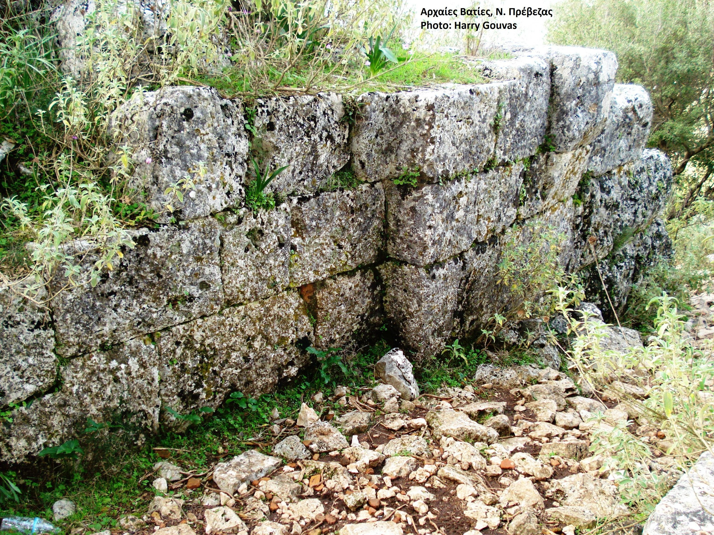
Church of Panagia-Kastri
In the small hill of Kastri, in the south of Rizovouni village, there are ruins of an unknown ancient city belonging to the ancient Phylaki in the 8th century. It was surrounded by a polygonal wall, whose parts are preserved until now. It was 1,400m long and dates back to the 7th - 6th century BC.

Slide 3
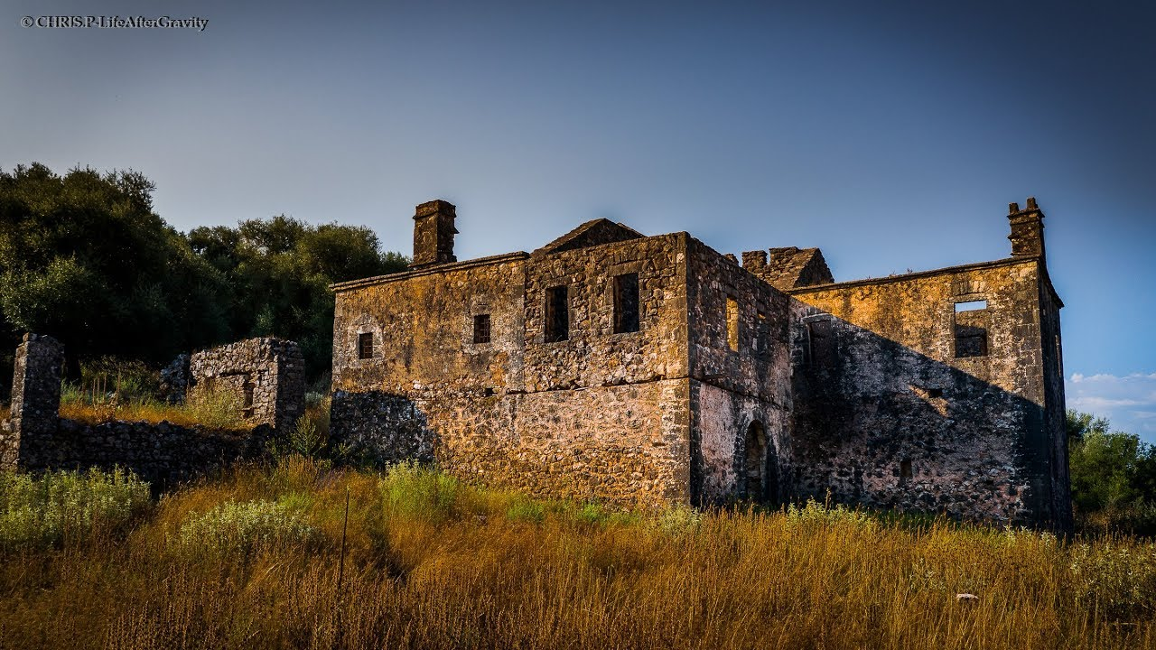
Church of Panagia-Kastri
The ancient town was destroyed by the Roman General, Emilio Paul (167 BC), but its walls were reconstructed by Justinian (527-565 BC) in order to protect the inhabitants.

Slide 4
Church of Panagia-Kastri
In 1045 or 1095 a small Christian temple was built on the Akropolis of Kastri and in the north side of the hill, on the ruins of the pagan temple. Later in 1670 the Virgin Mary monastery was built on the ruins of the Christian temple. The cells of the monastery are in the west part of the cathedral, which are built on a ‘’ Γ’’ shape in the mid of 19th century. They were bombed during the 2nd World War and have been destroyed since then.

Slide 5
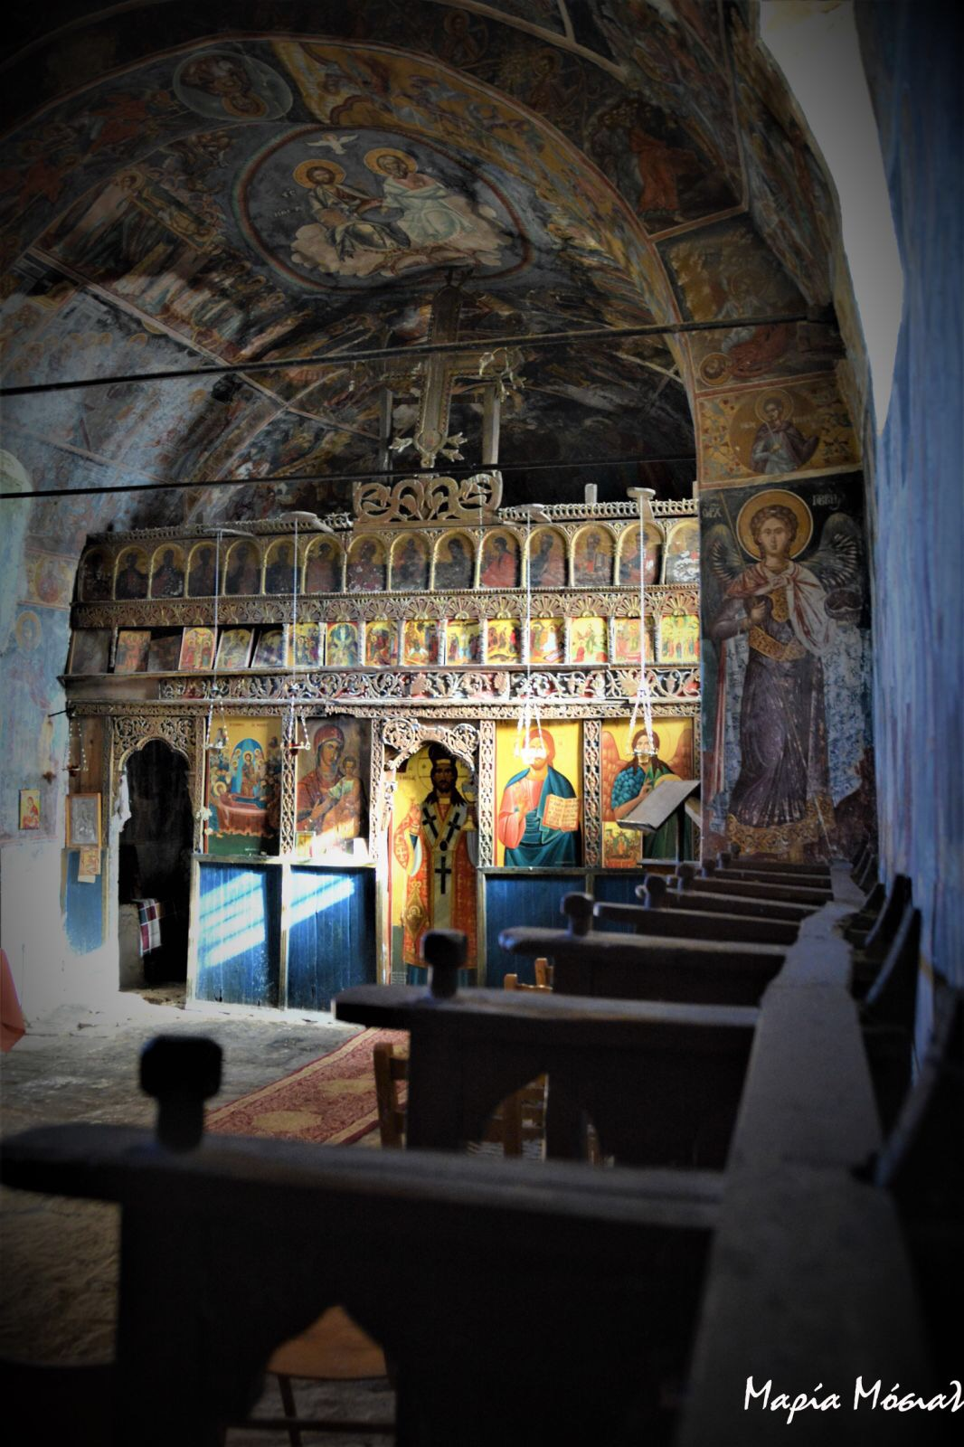
Church of Panagia-Kastri
The cathedral of the monastery is small, single-aisled basilica with a narthex and sanctuary.

Slide 6
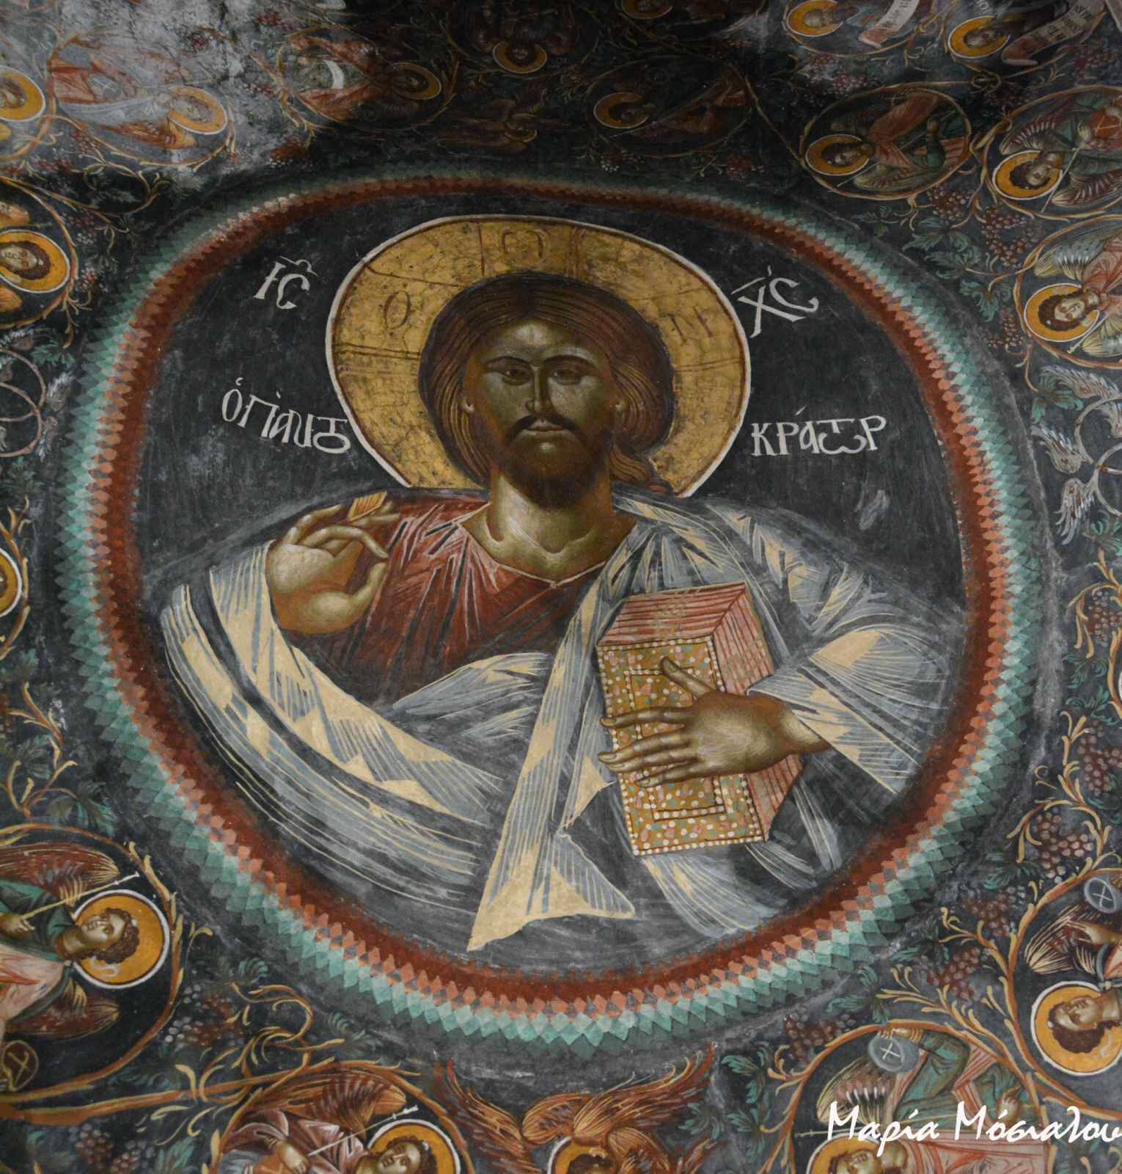
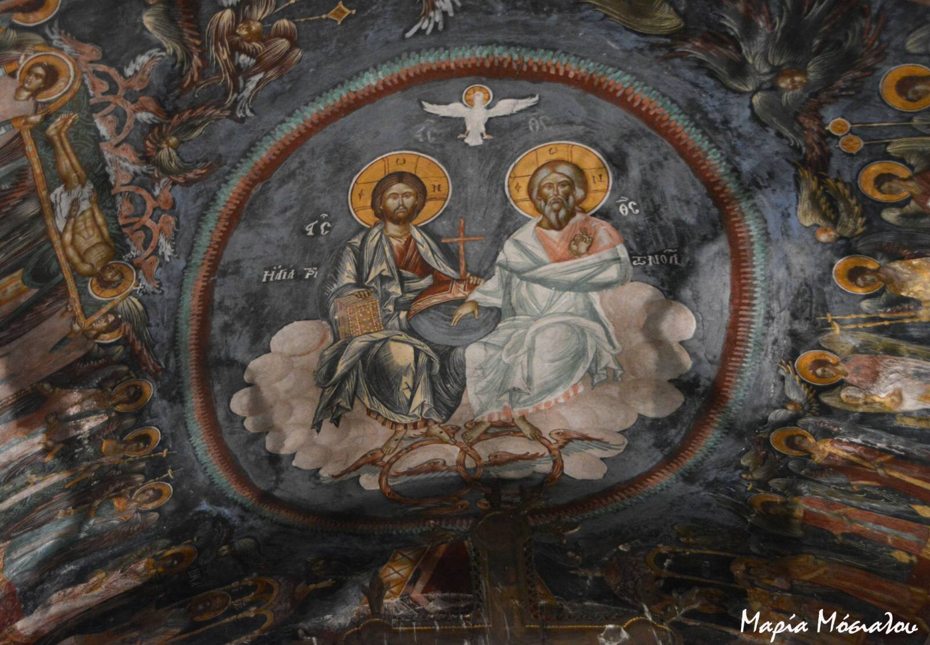
Church of Panagia-Kastri
The Pantocrator and the Holy Trinity painted on the roof of the stage, predominate in the church.

Slide 7
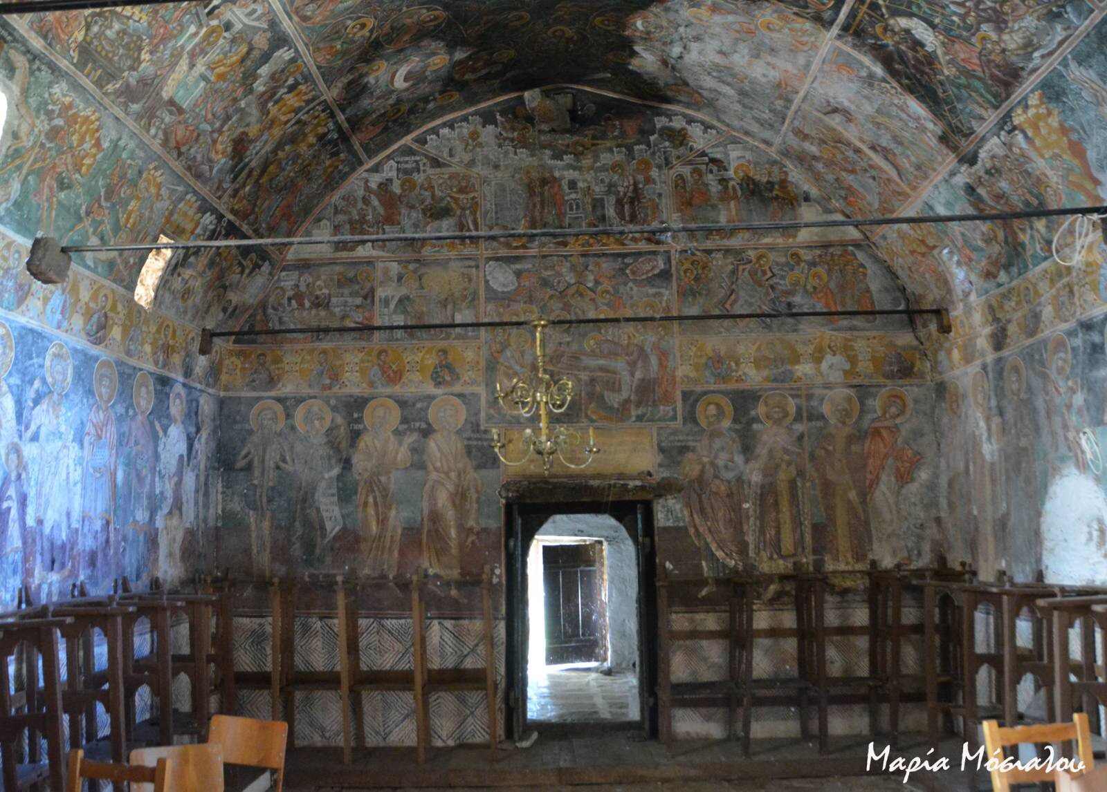
Church of Panagia-Kastri
The fact that the current temple was built in 1670, is referred to a writing that is inscribed on the door, leading from the main temple to the narthex.

Slide 8
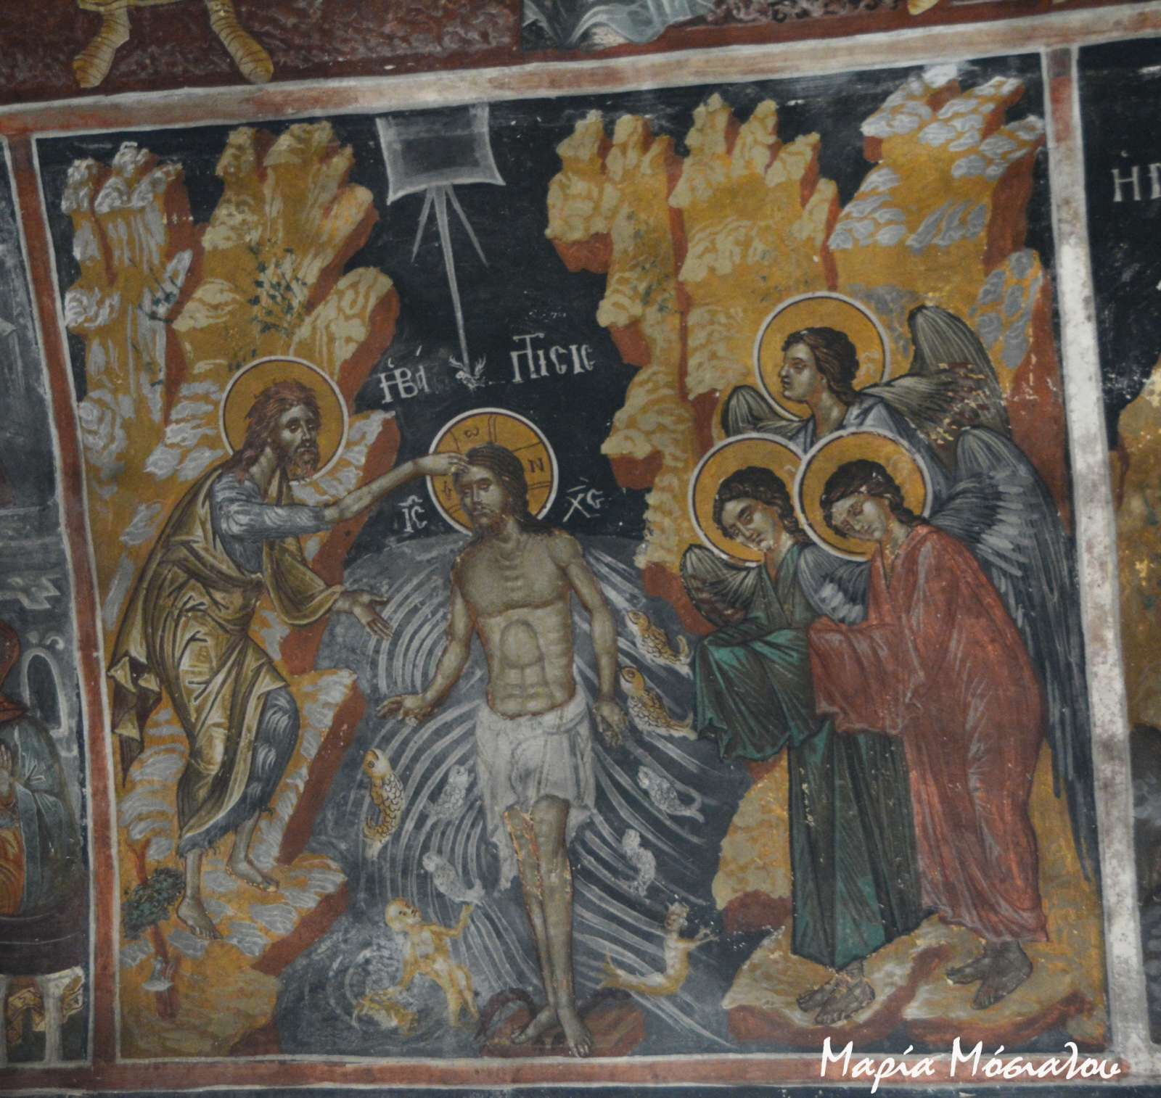
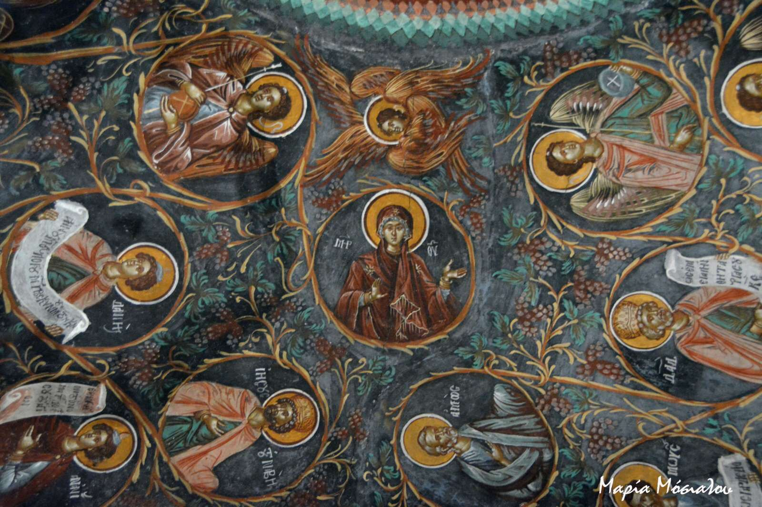
Church of Panagia-Kastri
The interior of the temple is full of murals, others well preserved and others faded. However, the murals and the wood-carved iconostasis possibly date back to 1670.

Slide 9
THANK YOU for your attention
Vasilis Goulas

