Slide 1
St. Athanasios
Vassios Panagiotis
Dalagianni Panagiota
Dimou Euaggelini
Zisi Alexia

Slide 2
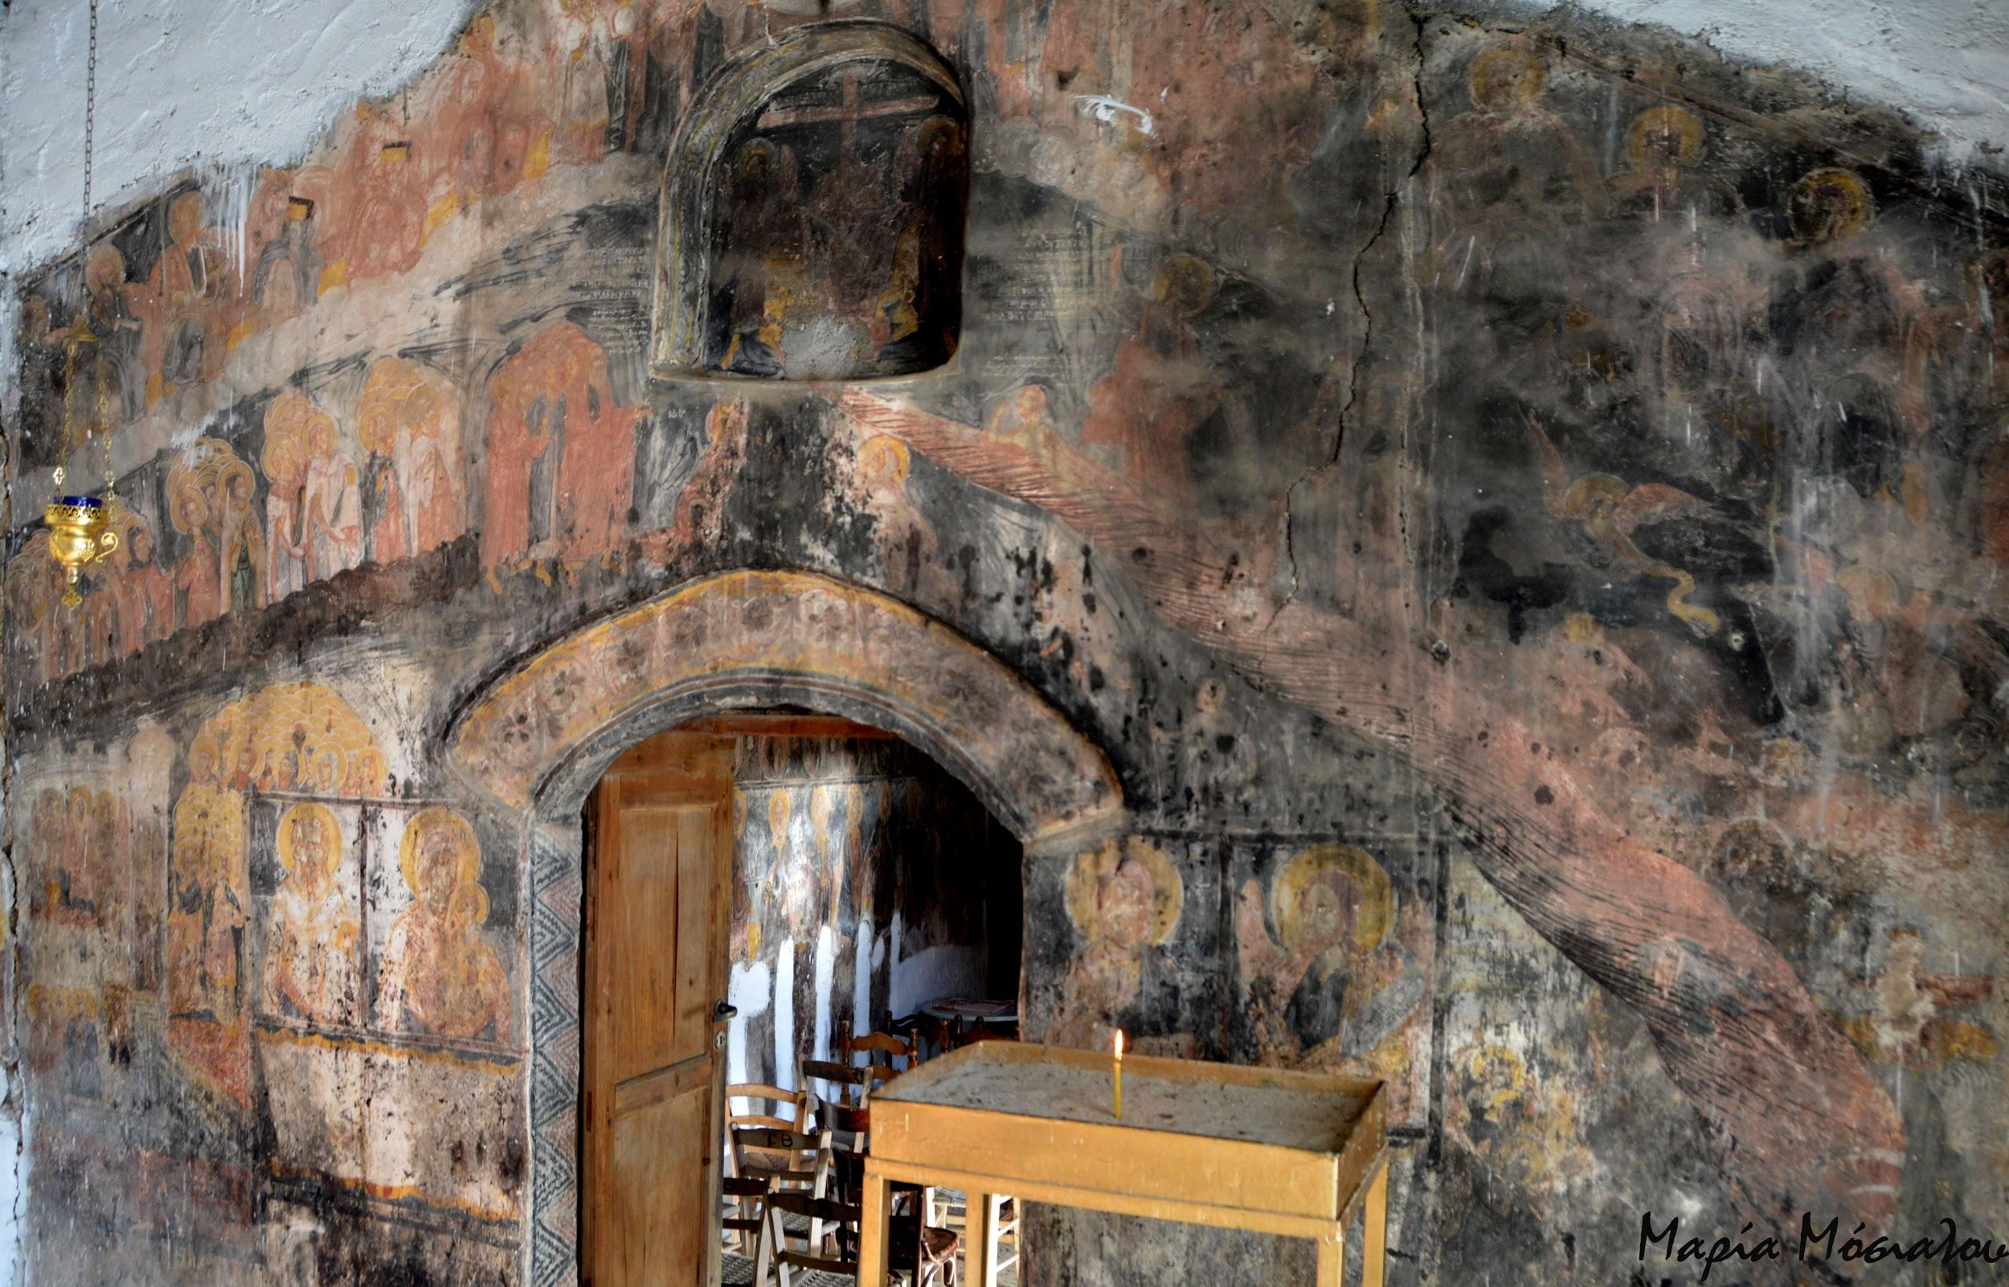
The church of St. Athanasios belongs to the type of a single-nave temple with narthex. Today, the western part of the narthex is shaped into an ossuary. The east wall of the narthex near the respective corners are decorated with murals.

Slide 3
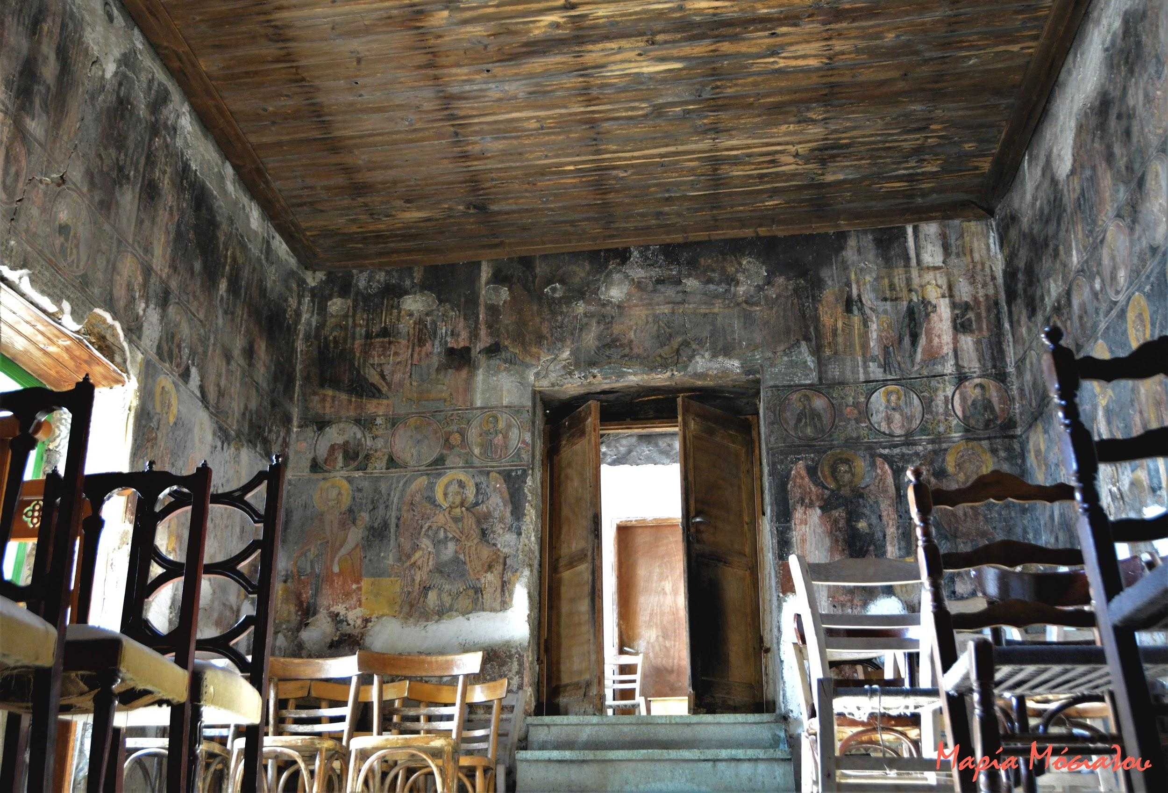
The entrance to the main temple is through two arched doors. The interior of the temple was originally only lit by the small window of the nave of the sanctuary. The floor is paved with mosaic.

Slide 4
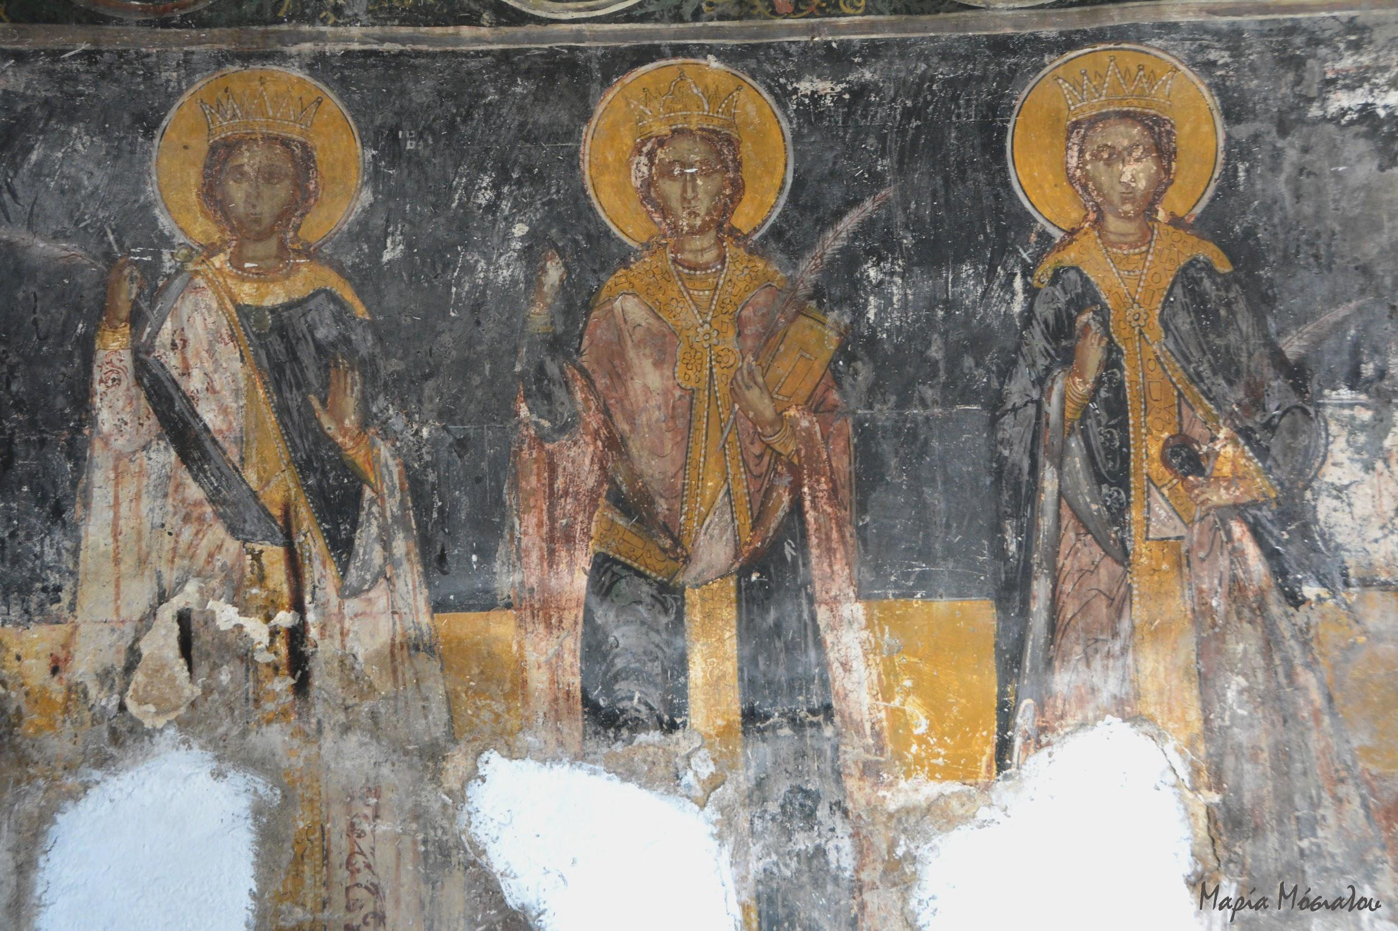
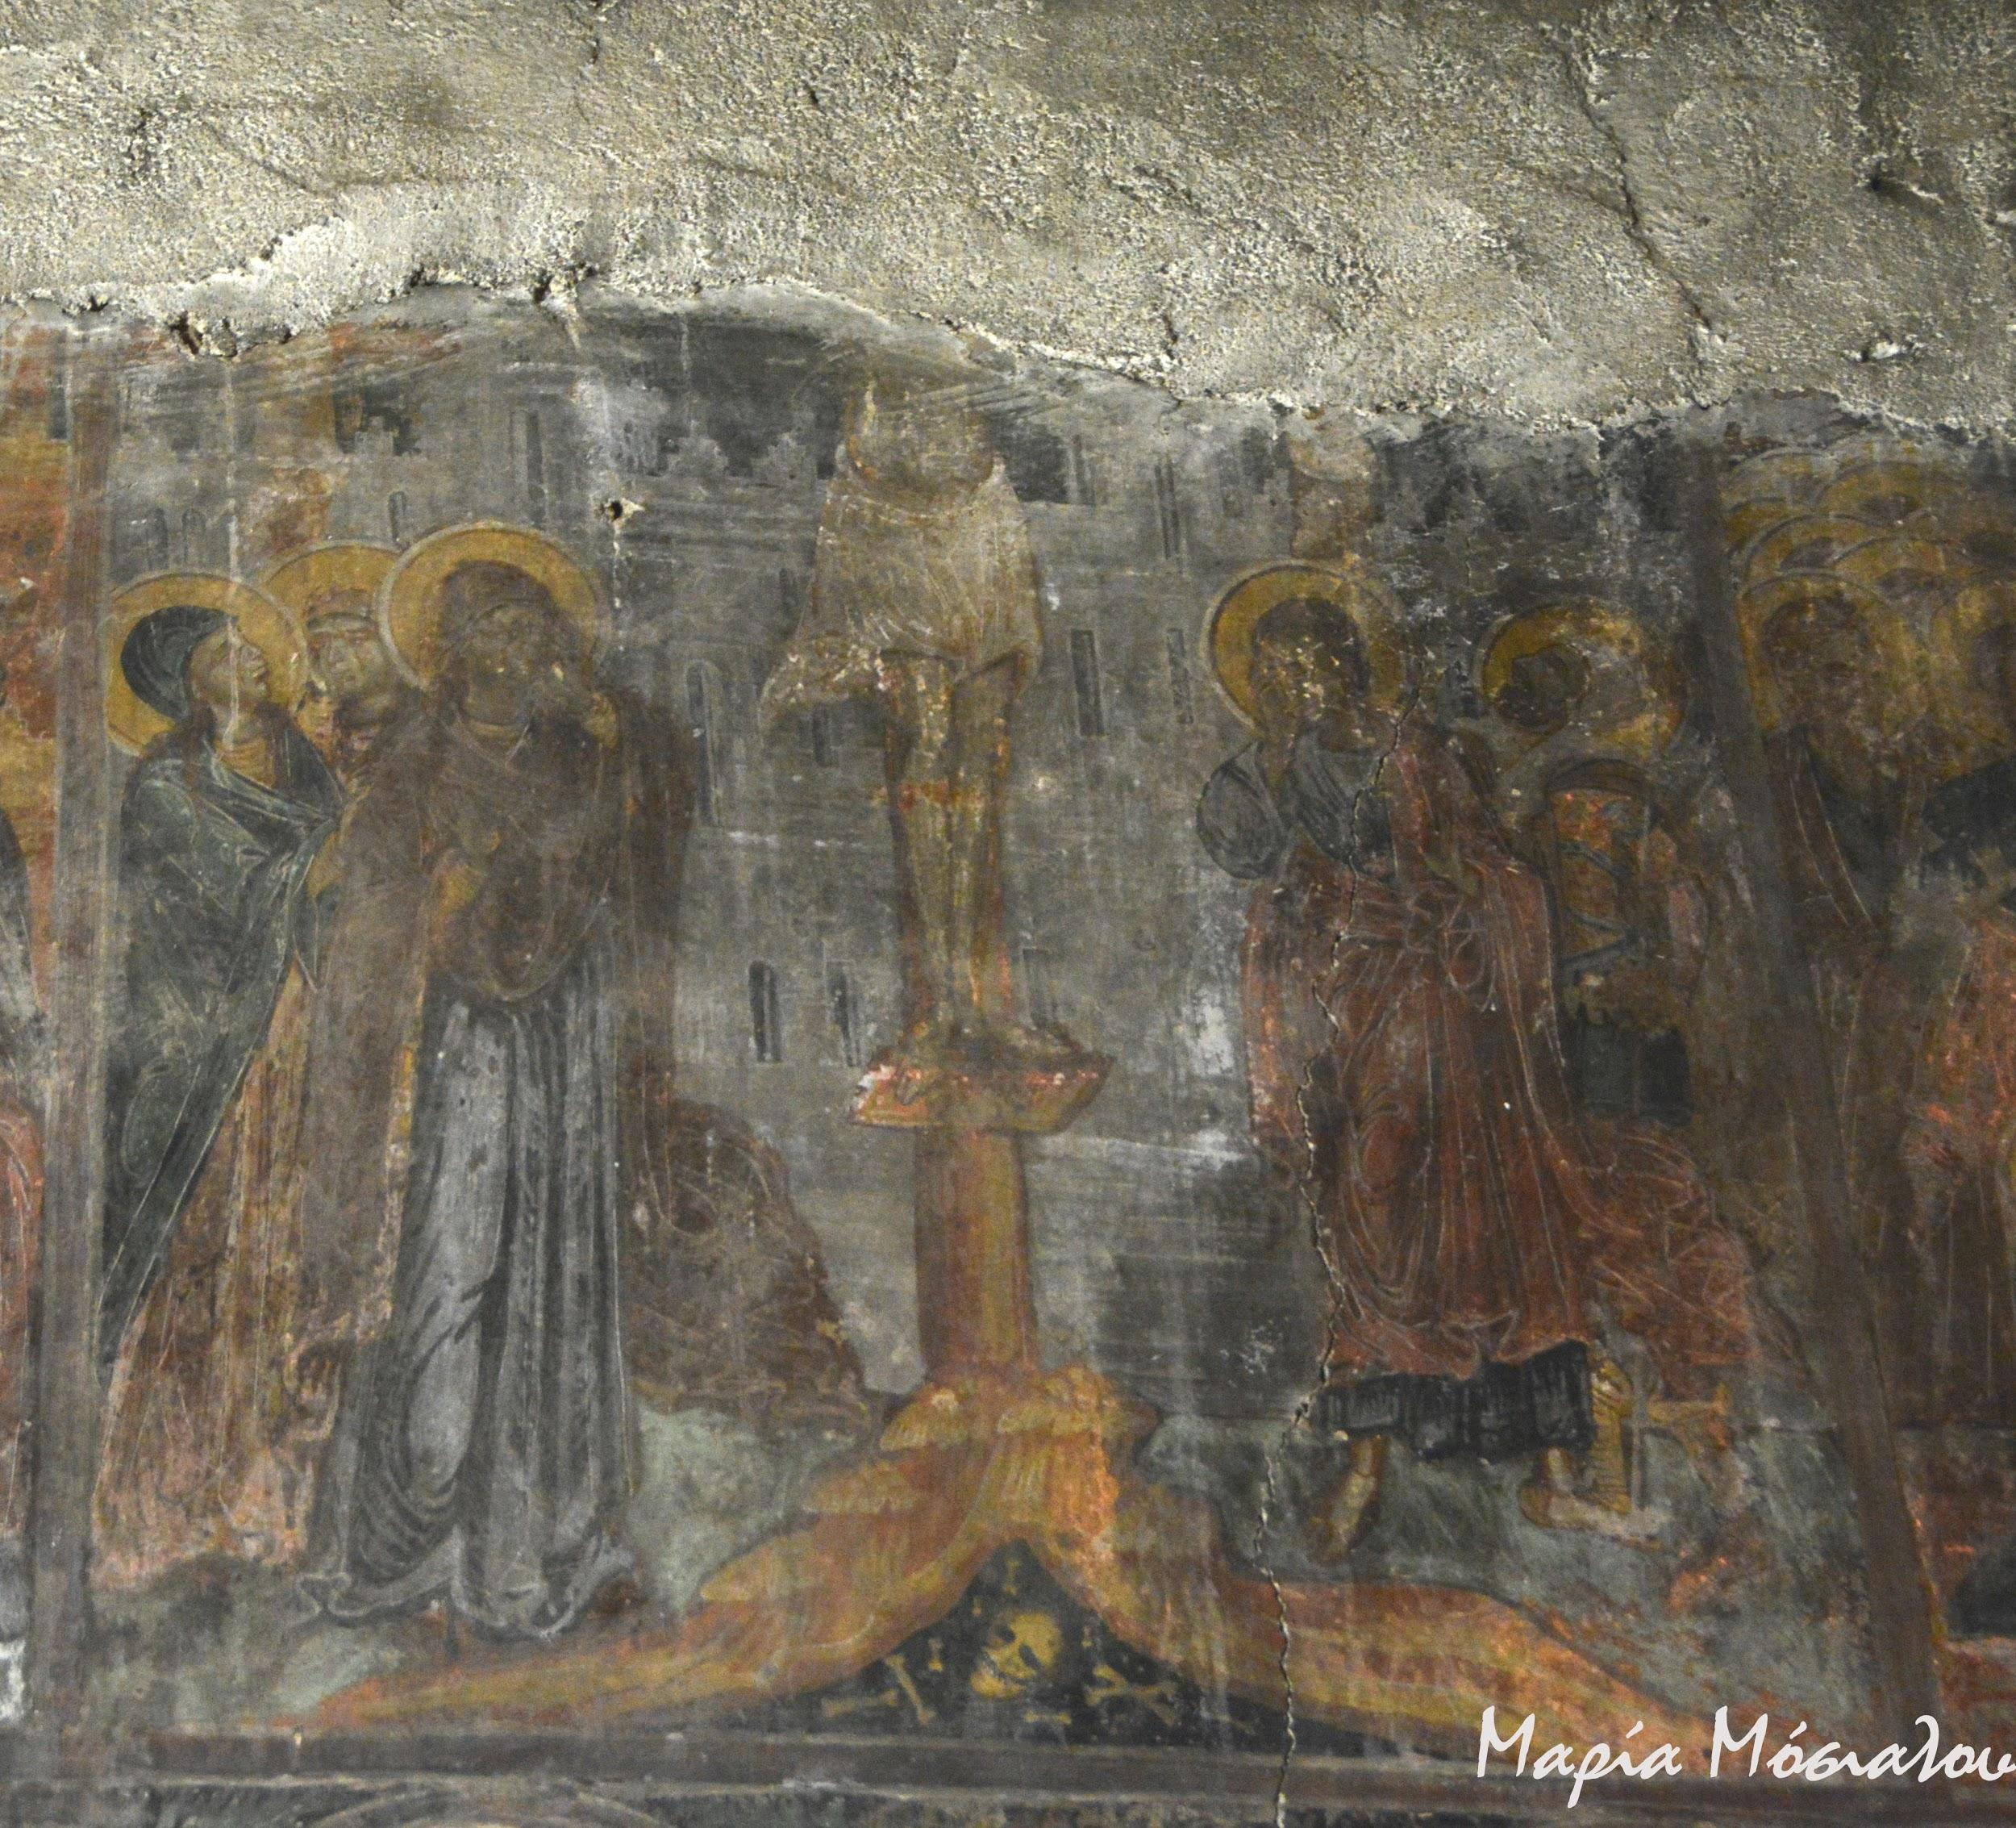
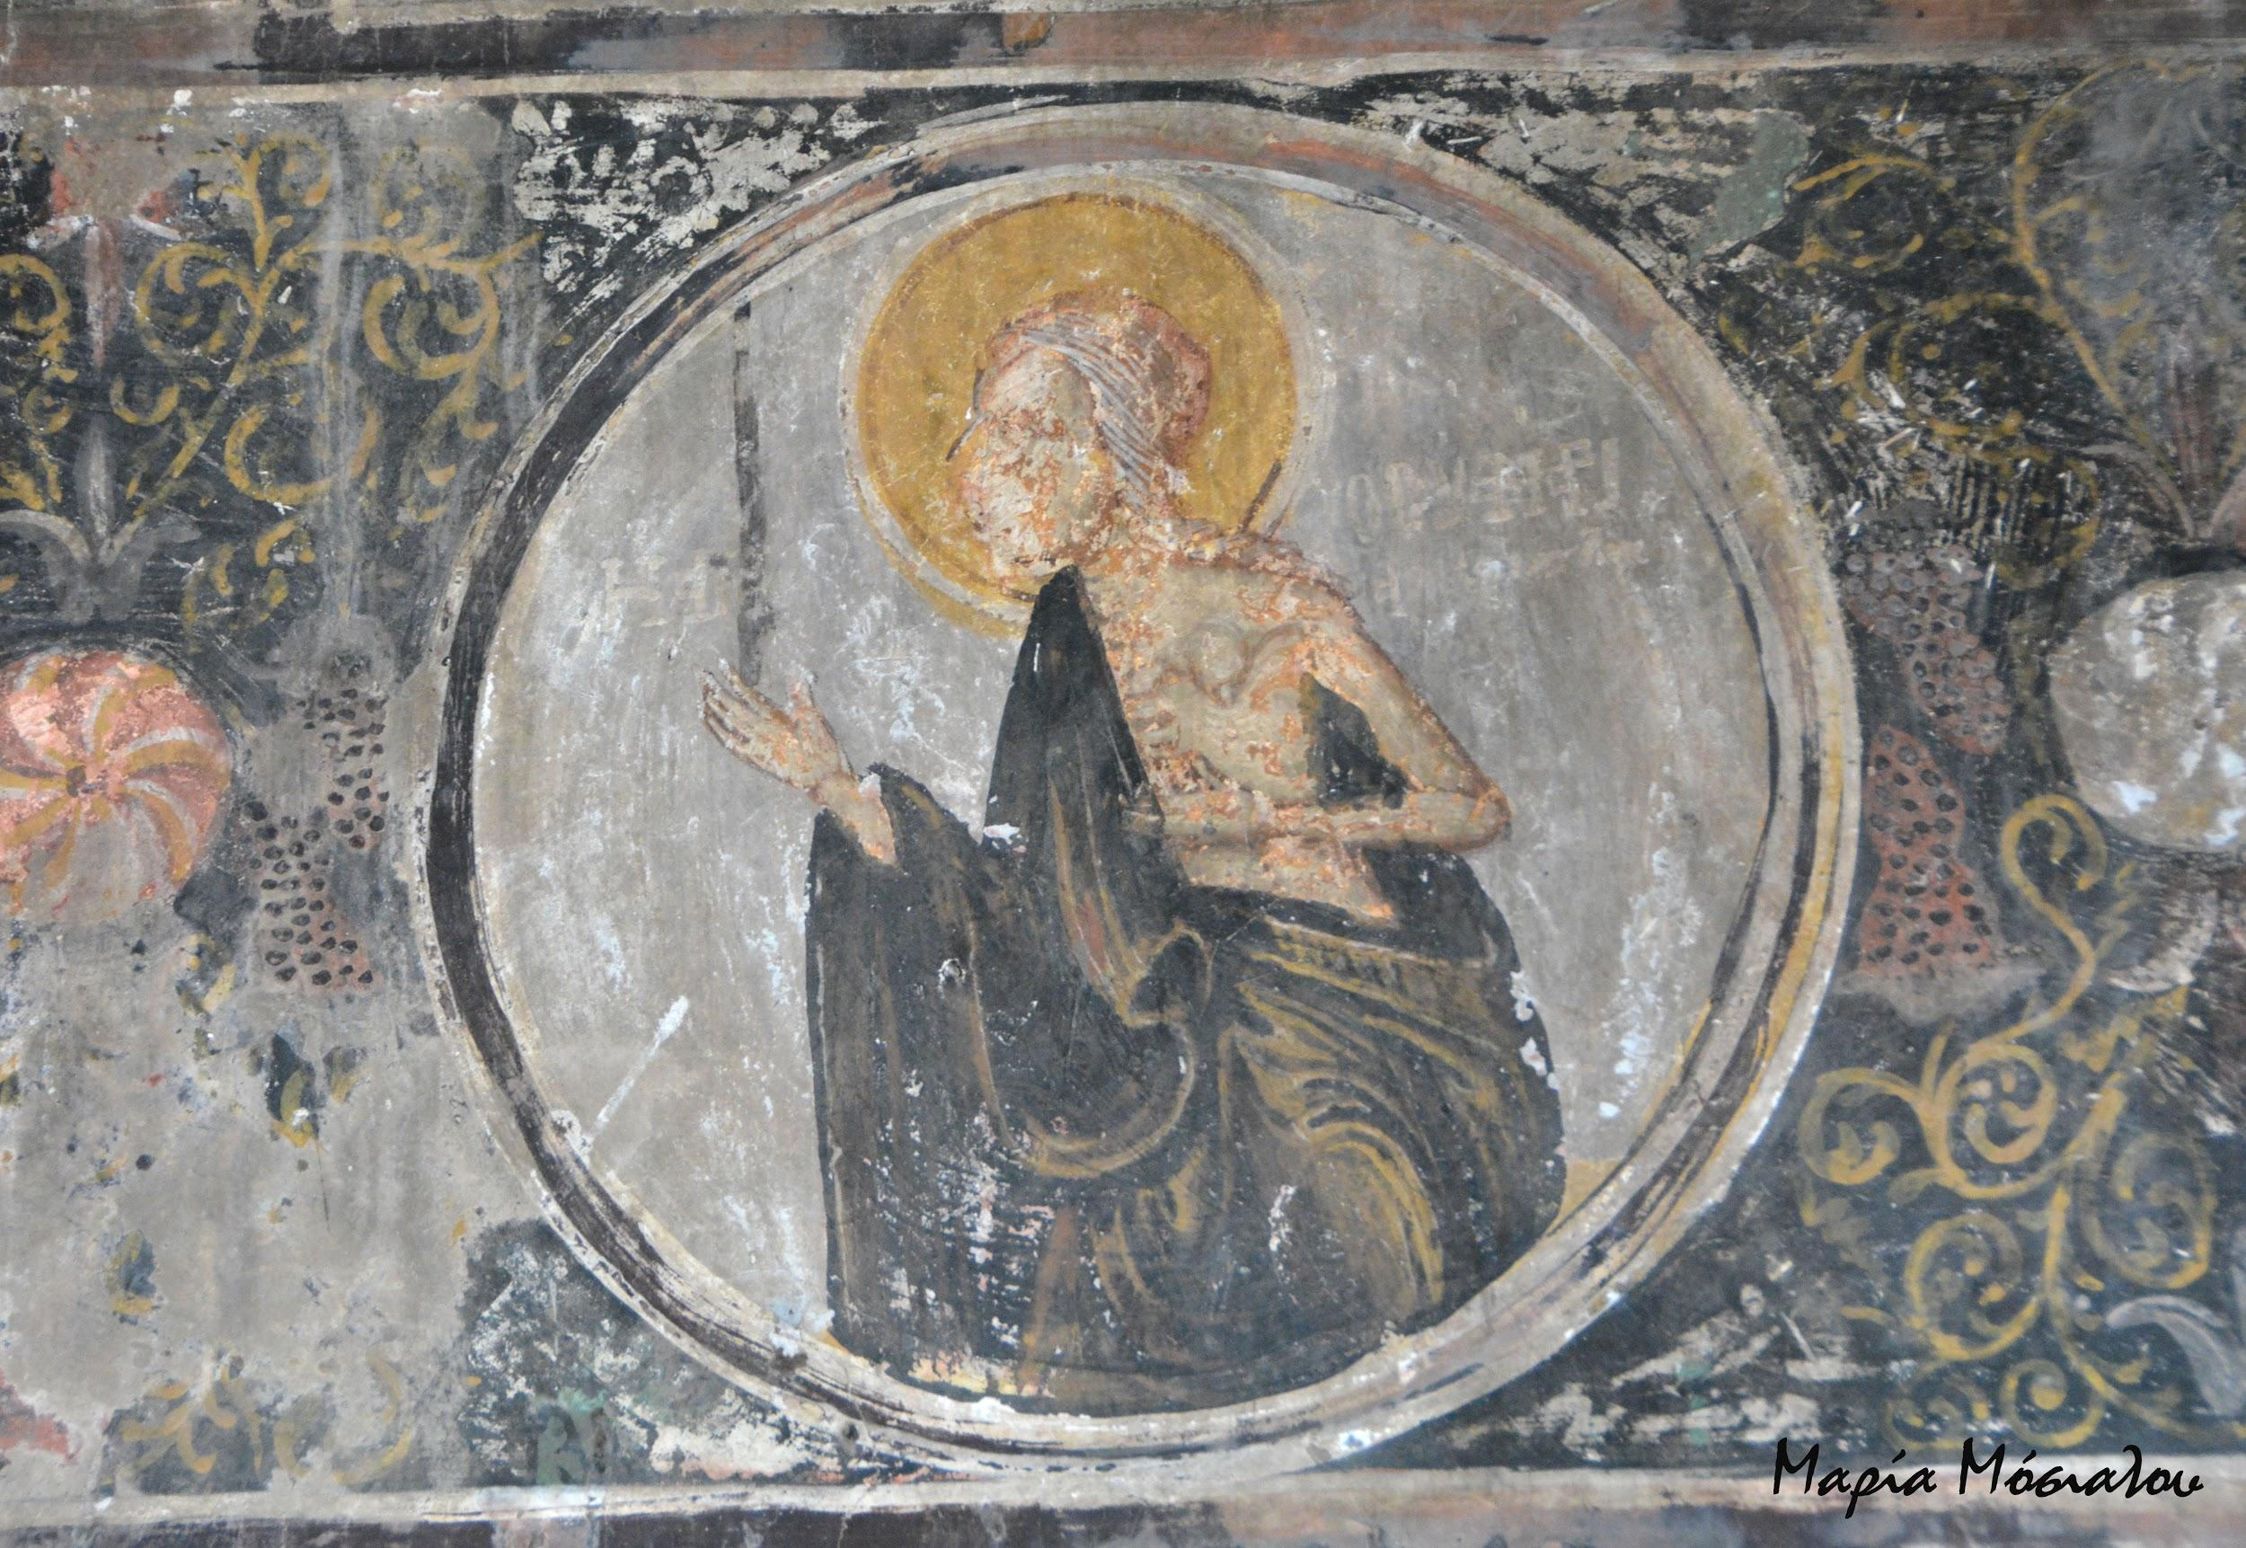
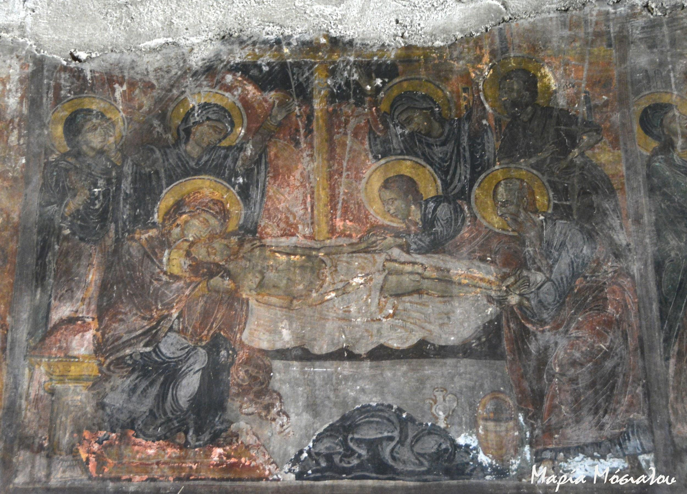
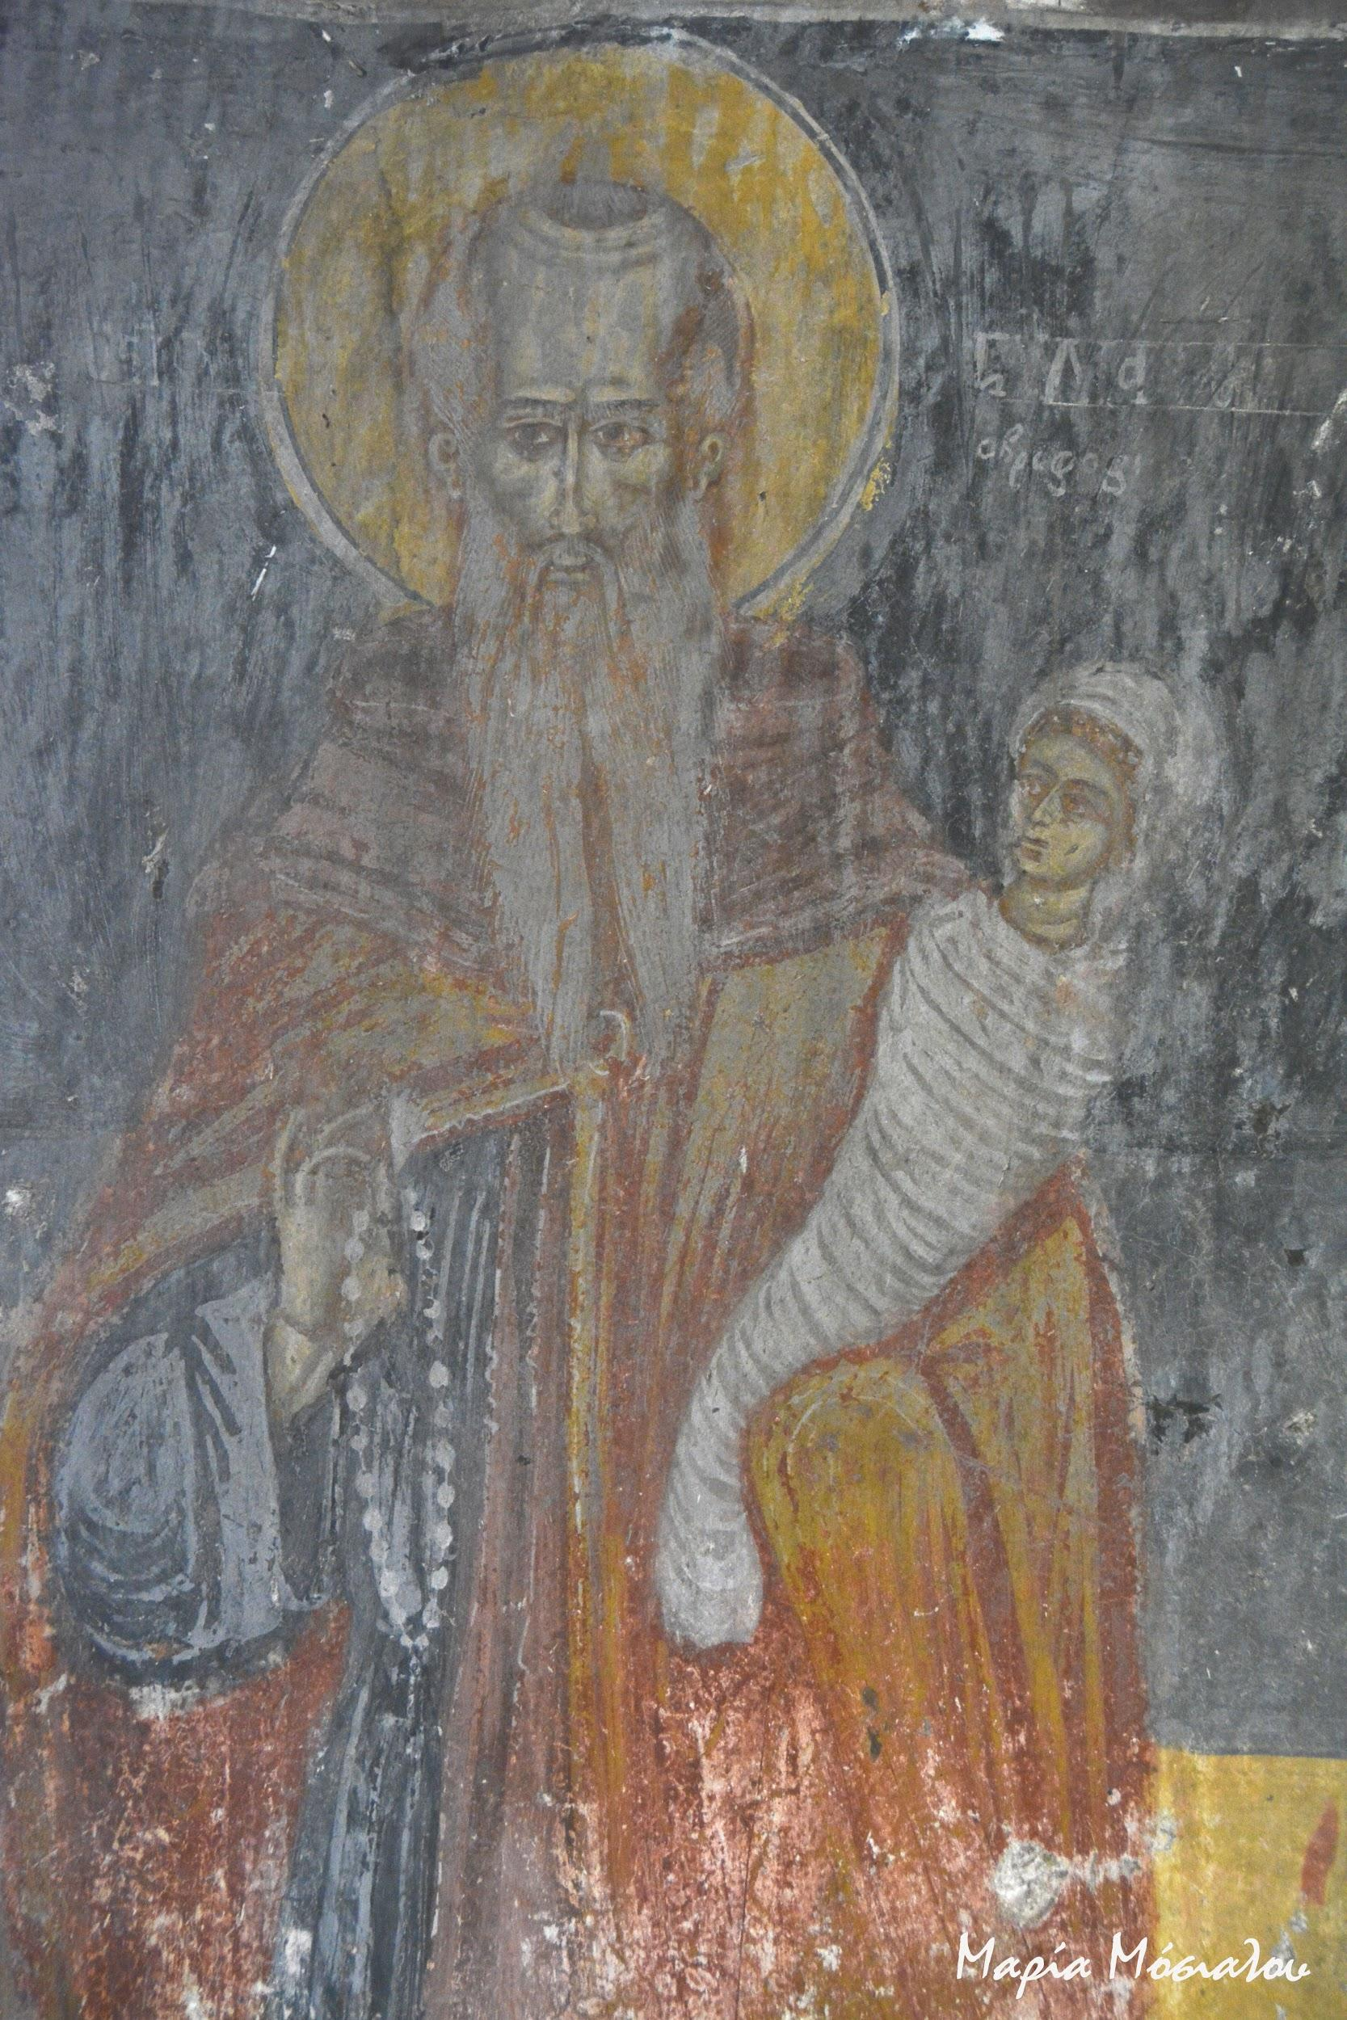
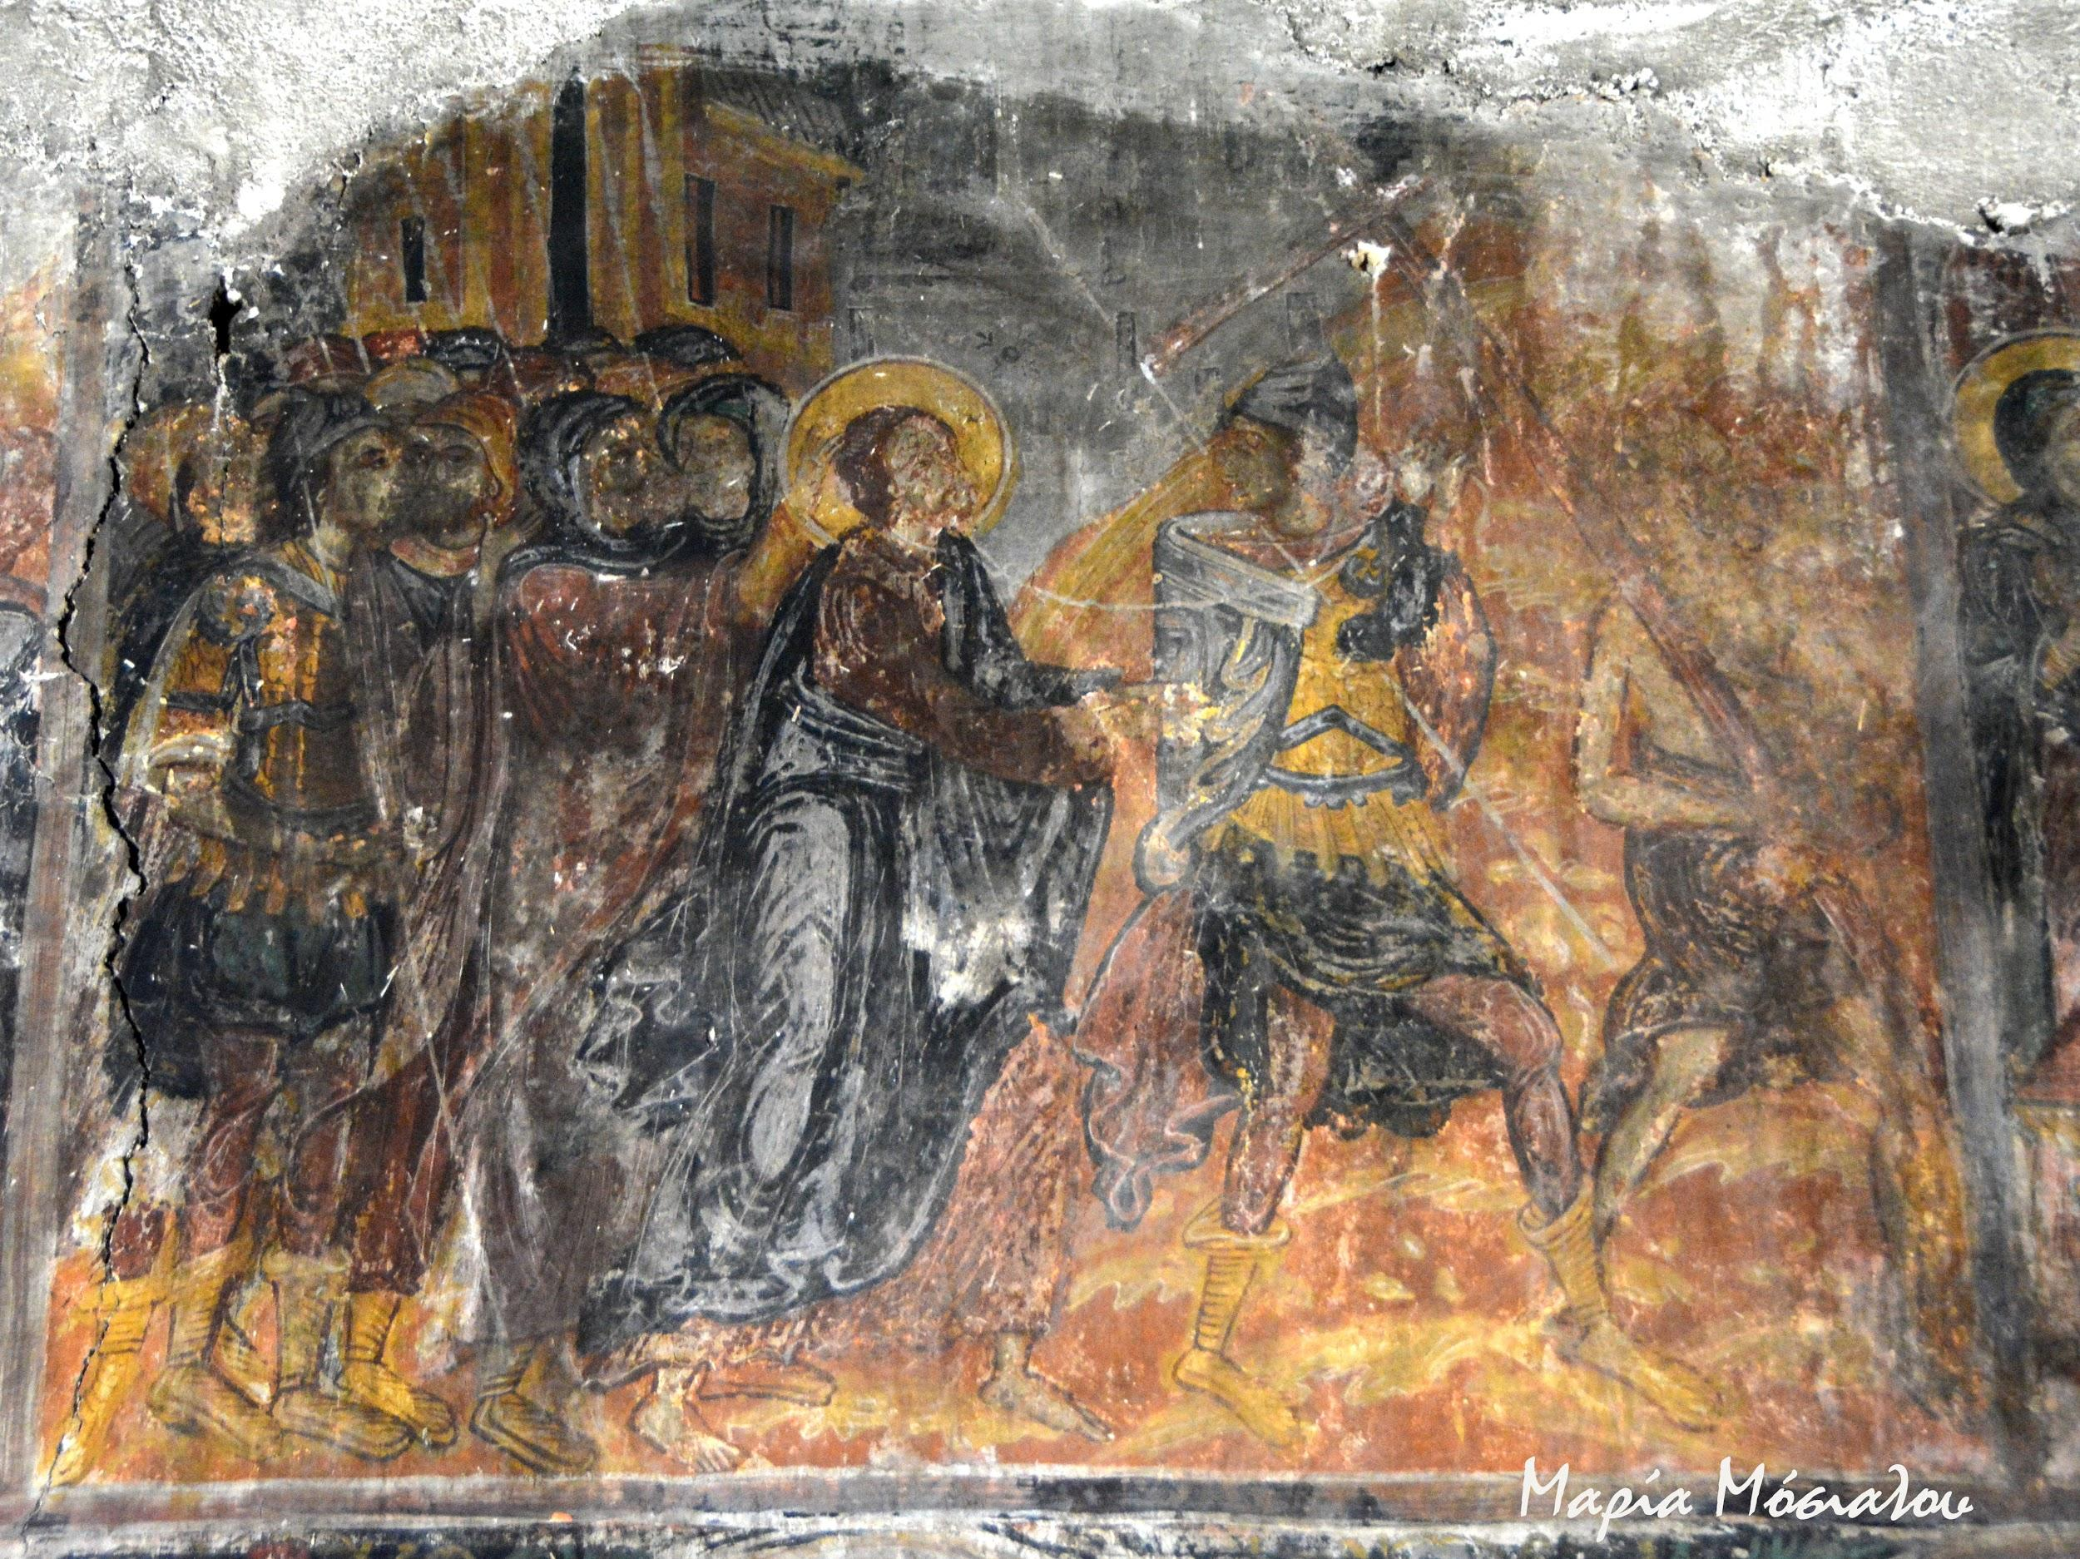
The original frescoes are preserved on all the interior surfaces of the temple

Slide 5
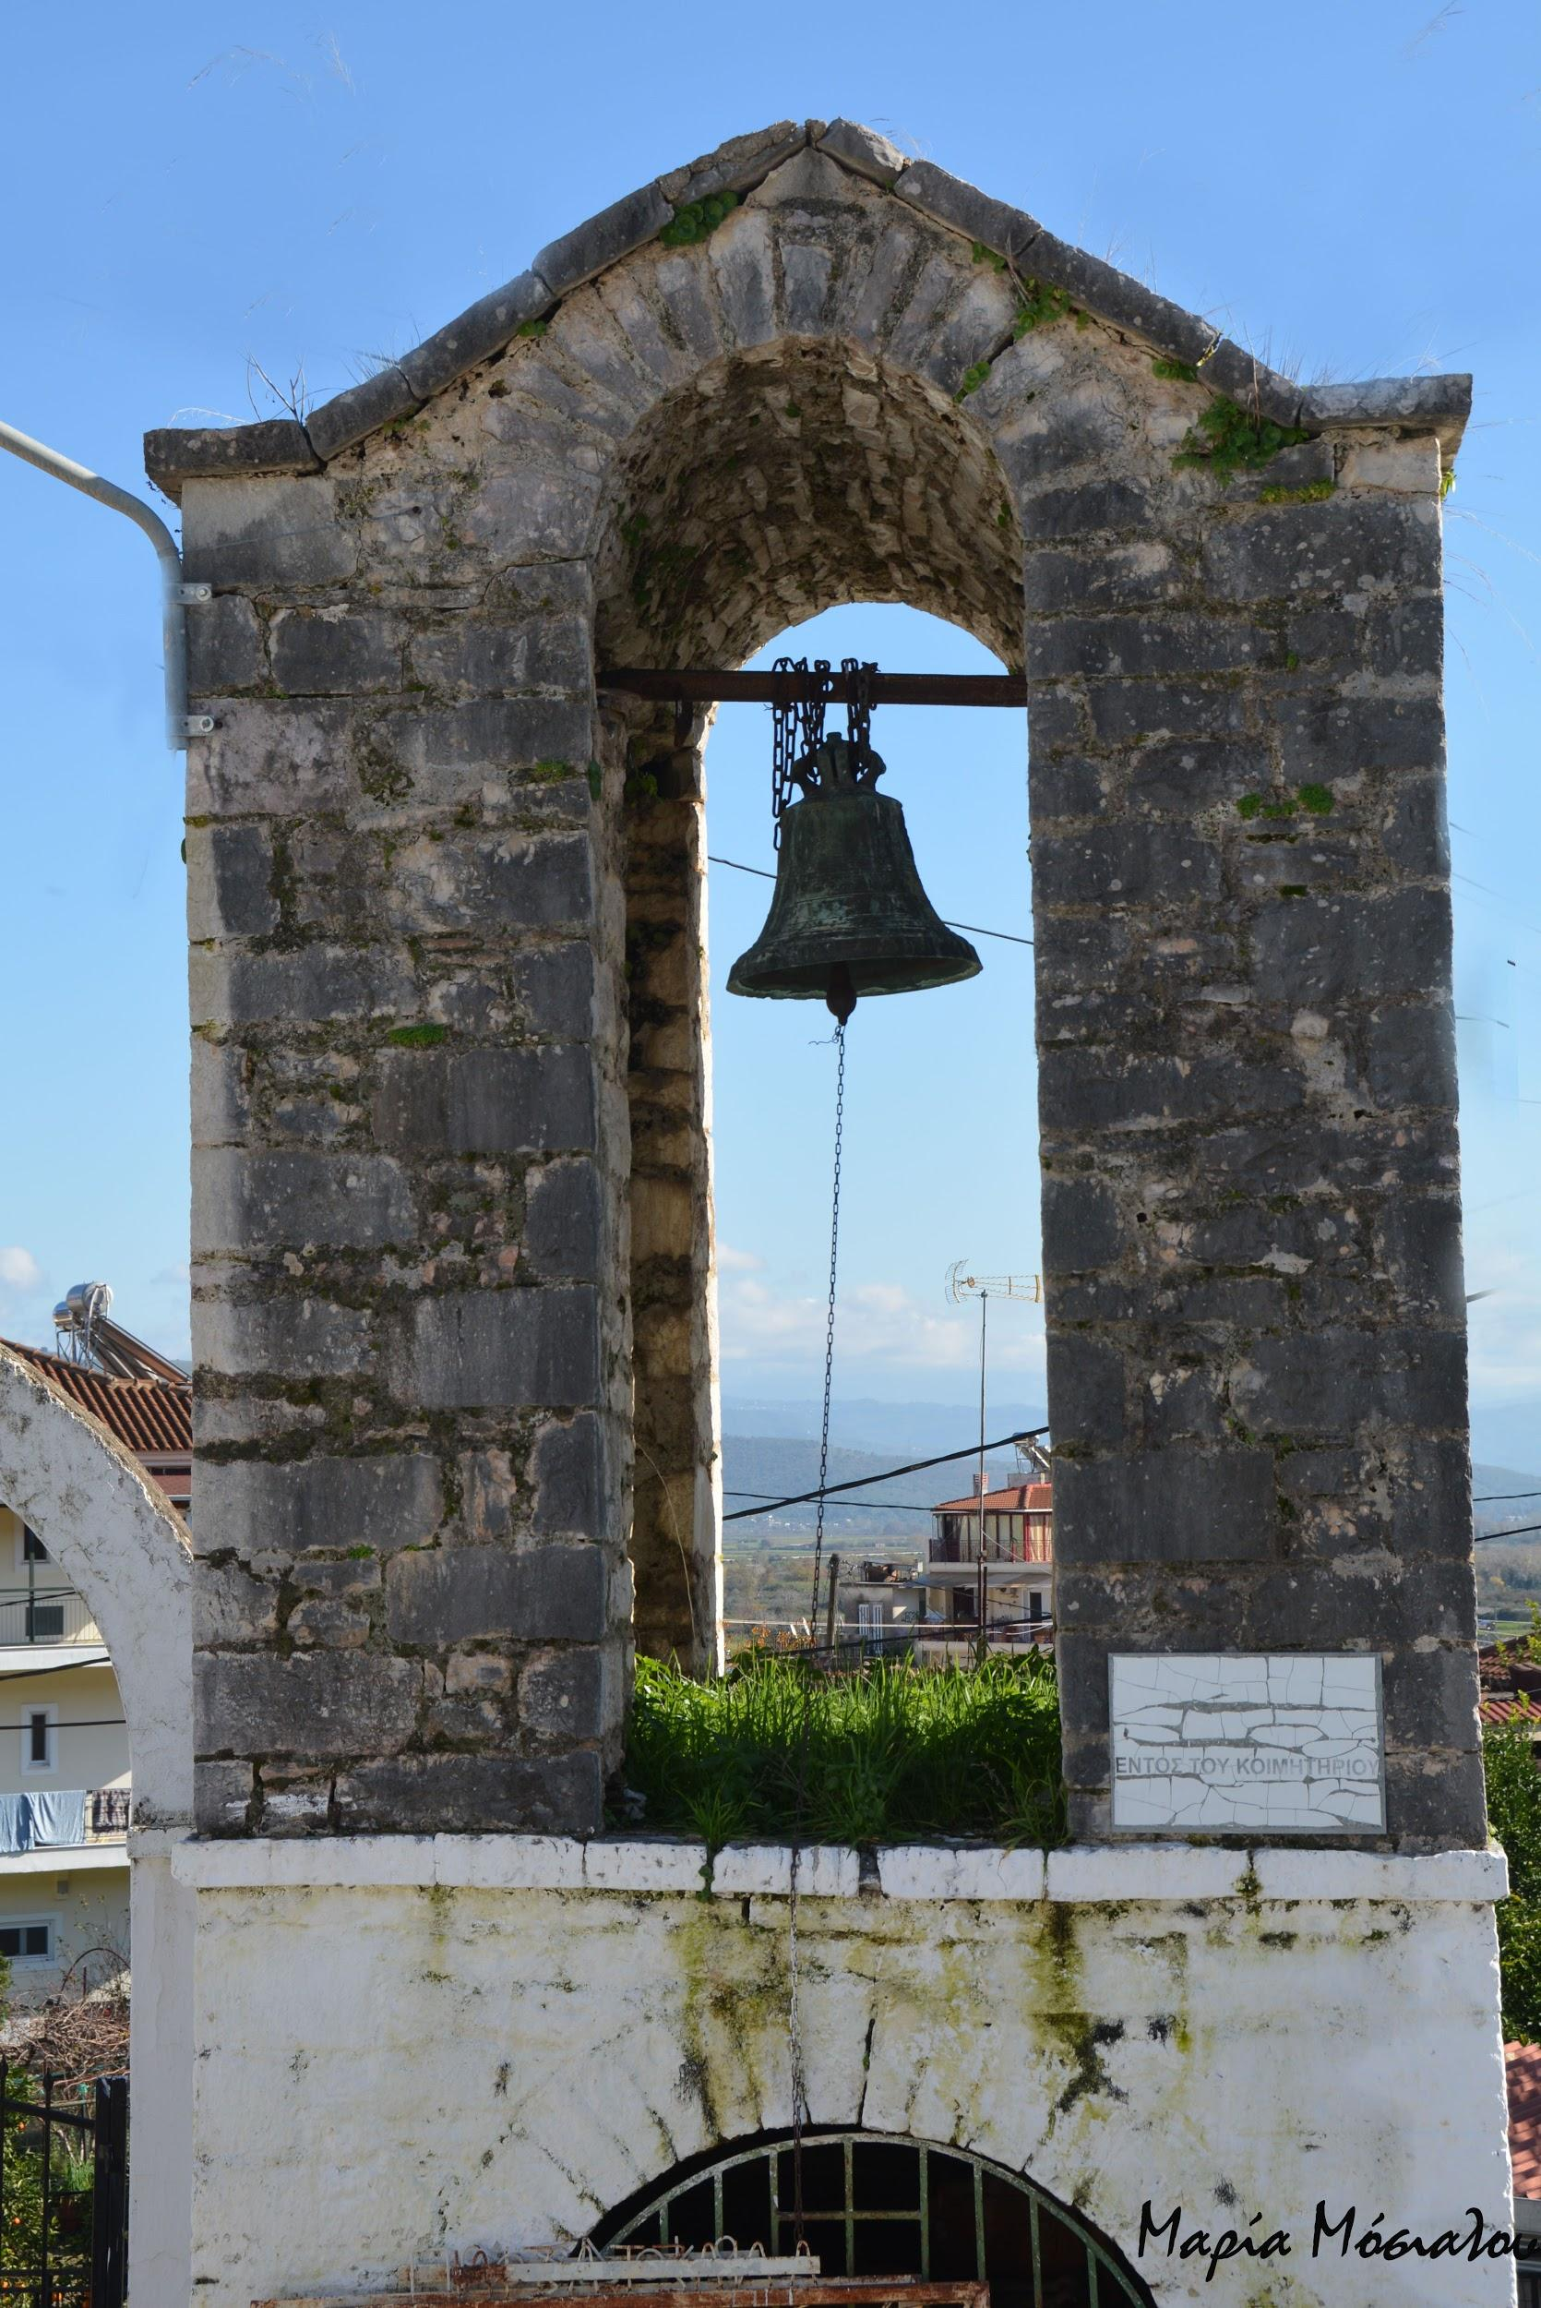
The old wooden iconostasis of the church probably as old as the wall painting was unfortunately removed and replaced by a simple built.
The pillar-bell tower of the temple consists of approximately one square foot plan through which the arched passage of the narrow and low arched gate opens.

Slide 6
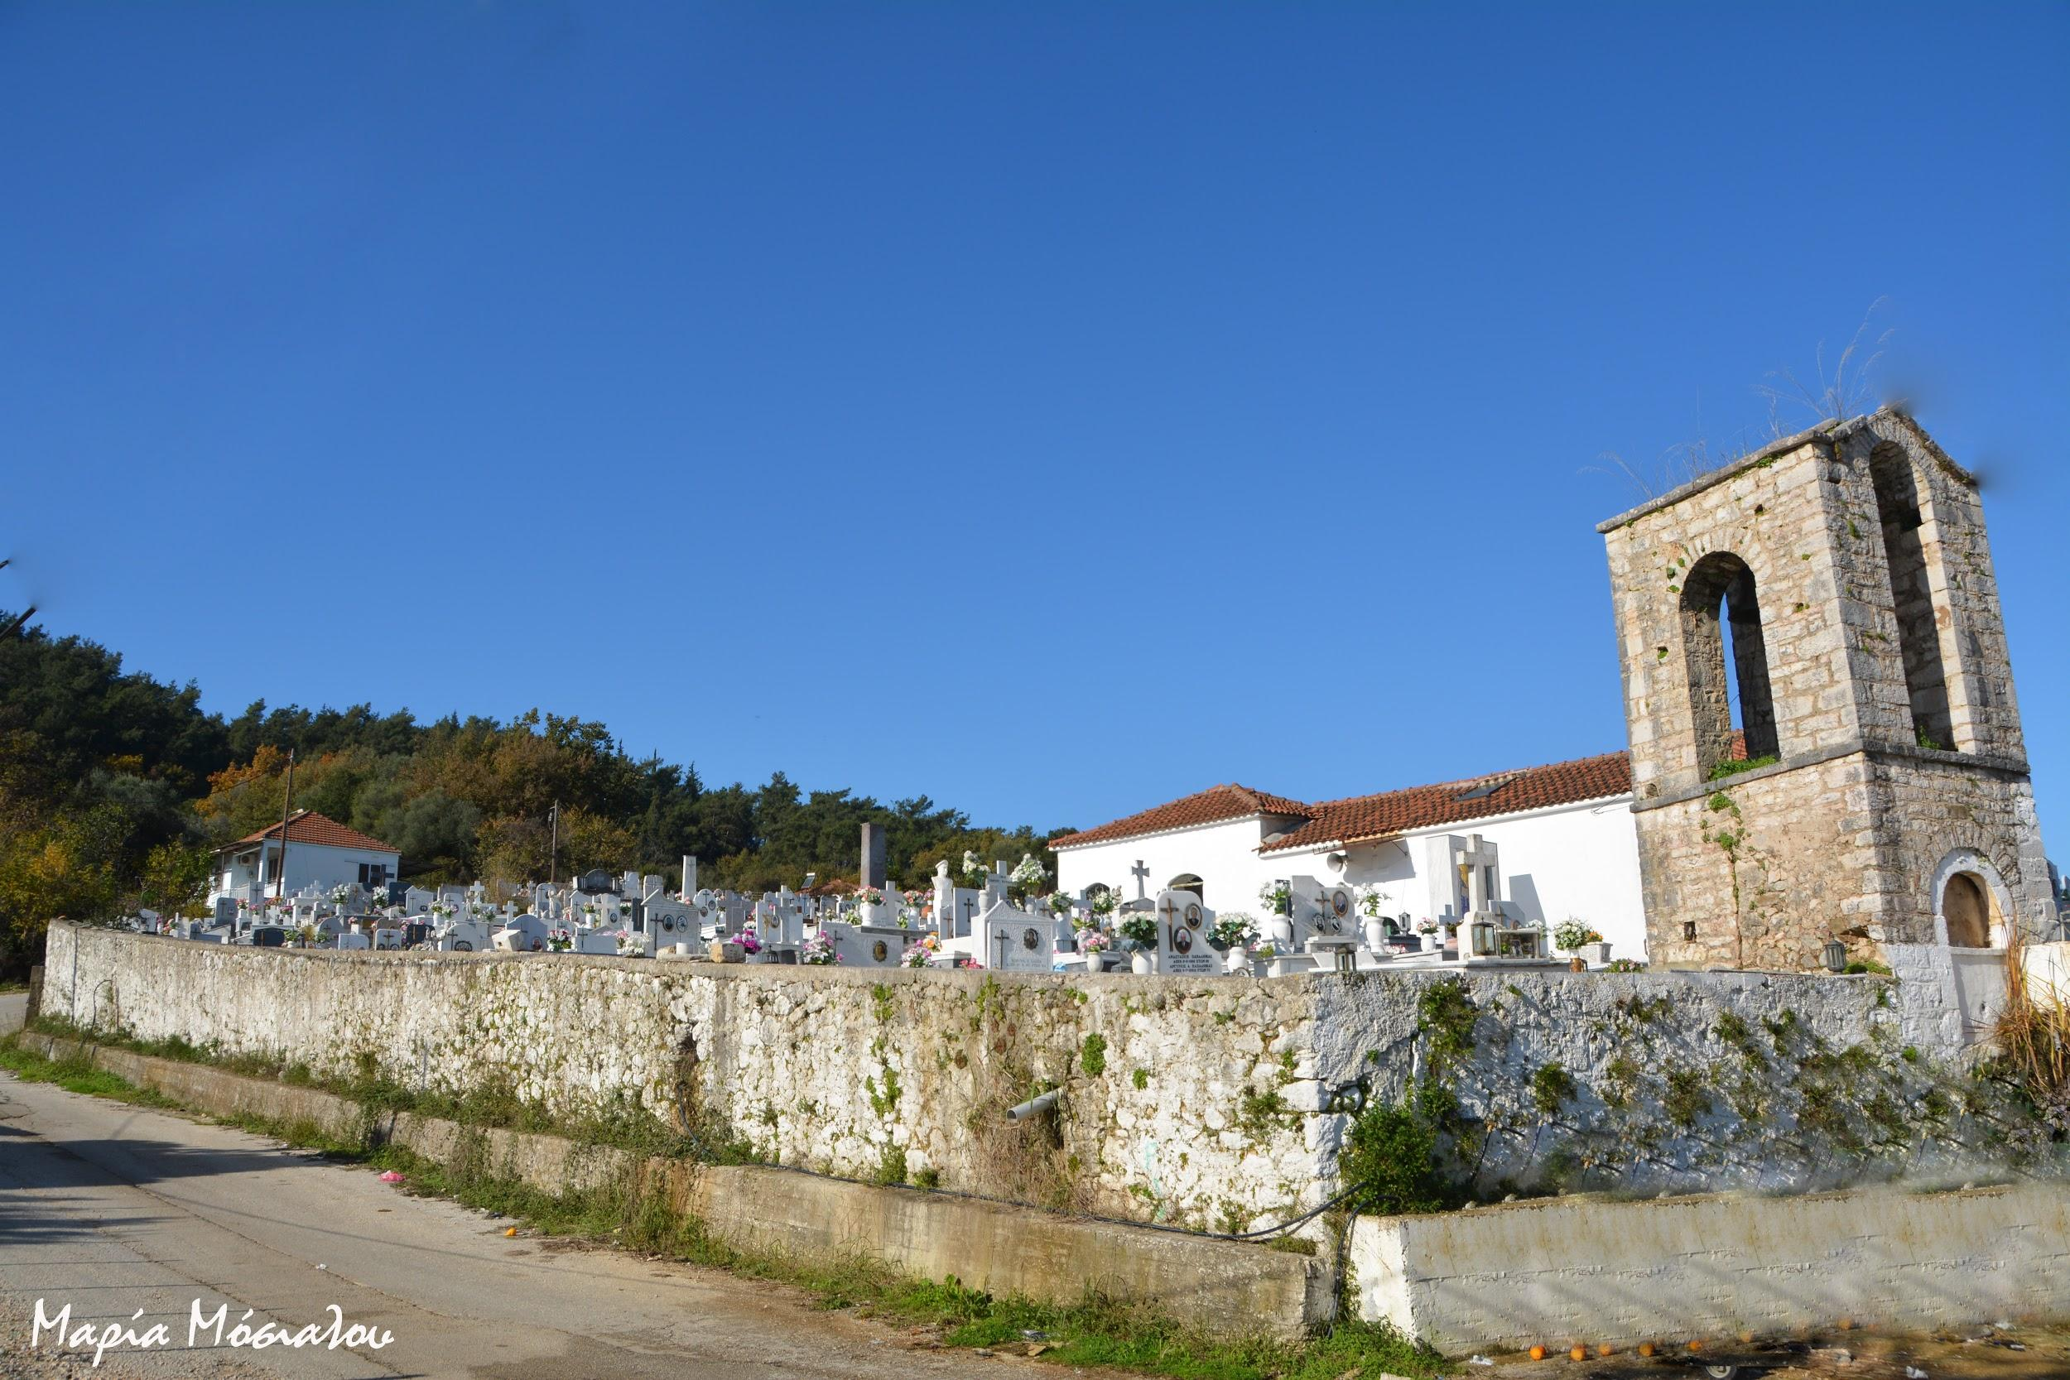
The building has two main building phases. The first phase dating back to 1847 belongs to eastern part of the pedestal with the pillar. In the second phase, dating back to 1866, the pedestal took its final form and the present bell tower was built.

Slide 7
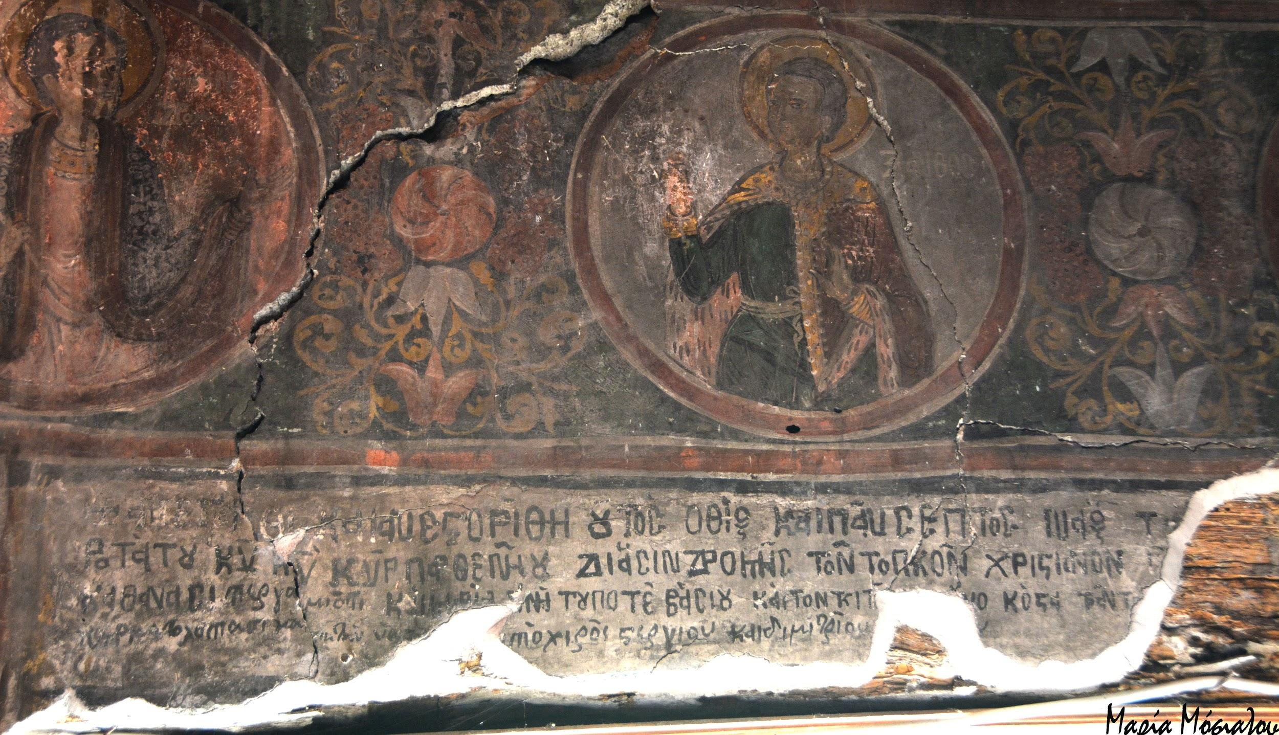
A written inscription approximately dating back to 1740, unfortunately, partially destroyed, is above the south entrance of the main church. It provides enough information for the construction and wall painting of the monument.

Slide 8
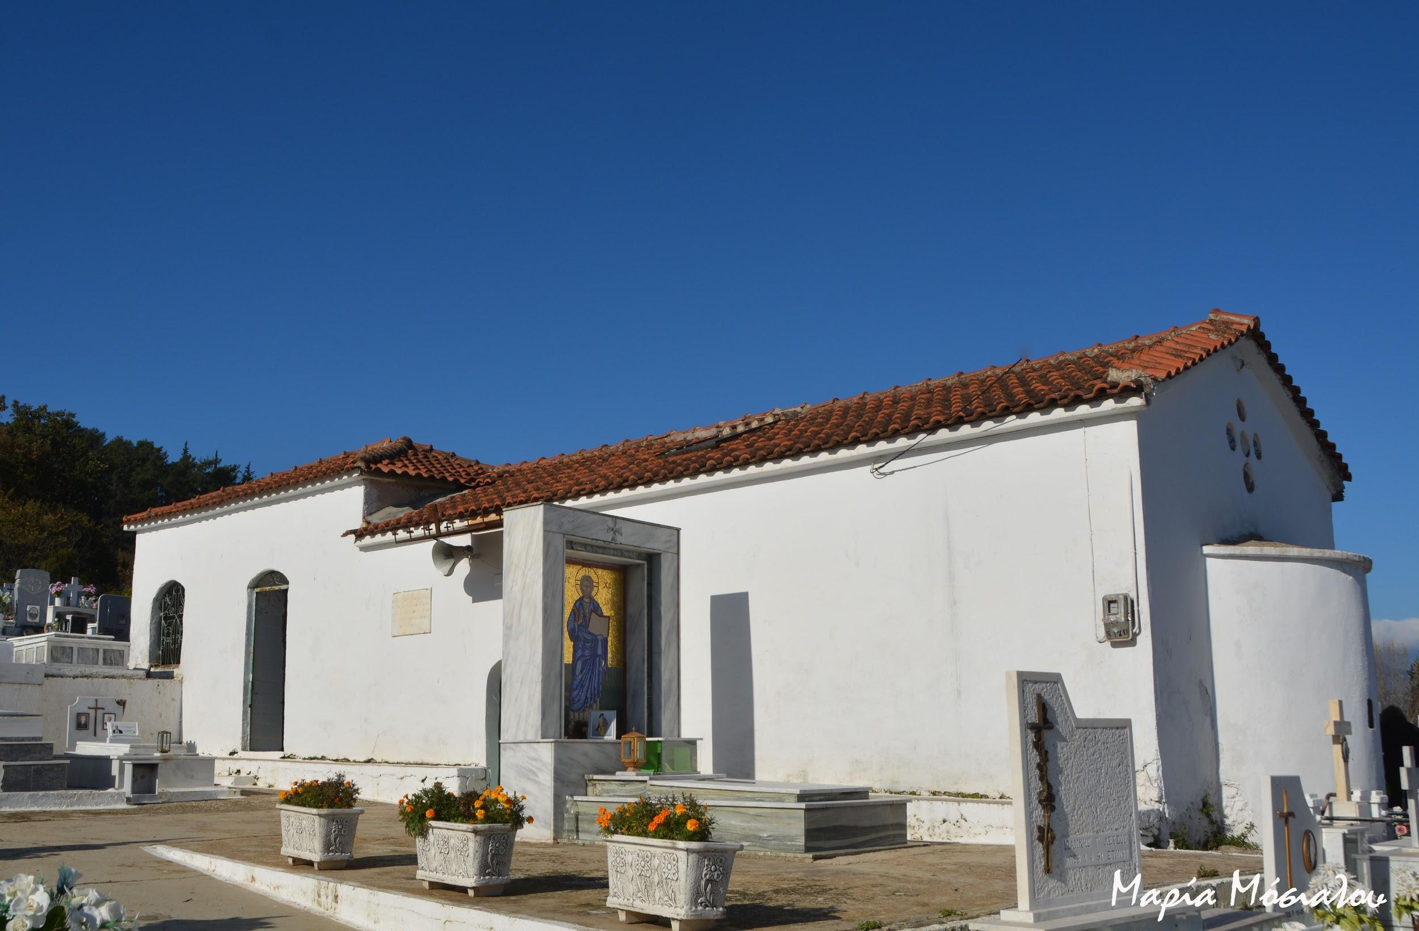
The church was built as a parish and a cemetery. The building, according to the inscription on the old pillar of the cemetery, enclosure in 1847, reinforces this view of the double function of the church.

Slide 9
THANK YOU FOR YOUR ATTENTION!!!

