Slide 1
Avenza Maps is offline maps, GPS location and a digital map store on your phone or tablet.
Use maps on your mobile devices and locate yourself without the Internet or network connections. Stay safe and aware of where you are, even in the remotest of places using the Avenza Maps app.
Take Avenza Maps hiking, biking, climbing, camping and anywhere you need a map outdoors. Offline location helps you stay on track, on the trail, and out of restricted areas.

Slide 2
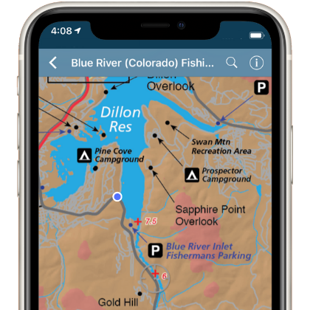
1)Download The App From The App Store Or Google Play
2)How it Works :
The Avenza Maps® app uses your device's built-in GPS to locate you even when you are out of range of a network or internet connection.
The blue dot follows you wherever you go so you always know where you are on the map. Zoom in and out, navigate from place to place, mark points of interest and easily attach photos exactly where they were taken.

Slide 3
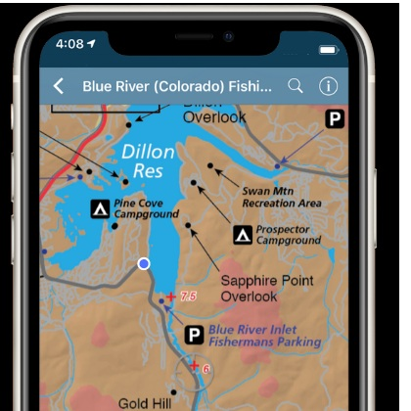
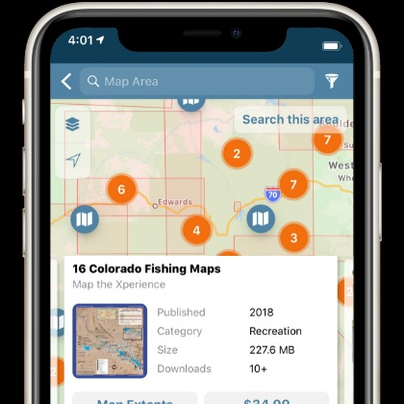
Use mapping tools to record GPS tracks, add placemarks,addphotos and more.
Maps used in the app are geospatial PDFs, GeoPDF or GeoTIFFs. Import your own, or find just the right one in the Avenza Map Store.

Slide 4
Use one of the following methods to get your maps

Slide 5
The map

Slide 6
Saint Kyriaki
The church is located at “Agia Kyriaki” or “Vakoufika” 700m south of the village. It is a medium size, single nave, oblong structure with closed hayat in the south side and a current narthex “gynaikonitis” in the south. The monument is dated to the 13th cent. In the exterior, it is surrounded by a stone wall with a current pillar-bell tower in the west side.

Slide 7
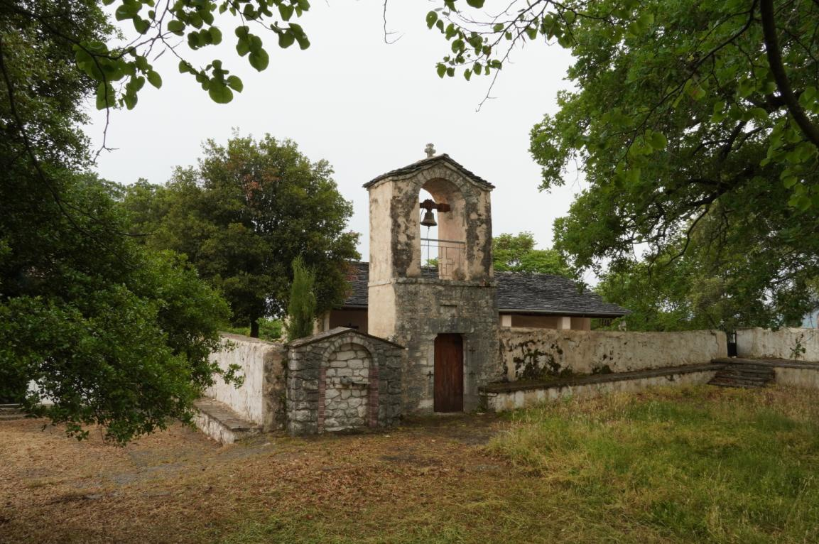
Faneromeni Monastery
Faneromeni monastery was built in1709.The main church, recently renovated, is single nave, timber roofed, separated in narthex, main church and altar with interesting and well preserved wall paintings dated in 1718. During the Turkish occupation, it is said that it was a school until 1910.

Slide 8
Pantanassa Monastery
The Holy Monastery of Pantanassa was one of the two monasteries founded by Michael B, Aggelos, Dukas, Komninos, Despotis of Ipirus as a proof of regret to his wife queen Theodora (later saint) for his bad behavior towards her. We can suppose that the monument was founded in the middle of the 13th century (1250-1260).
It was destroyed in 1692. An early Christian Ambon discovered at the monument, indicates that there was a temple long before the 13th cent

Slide 9
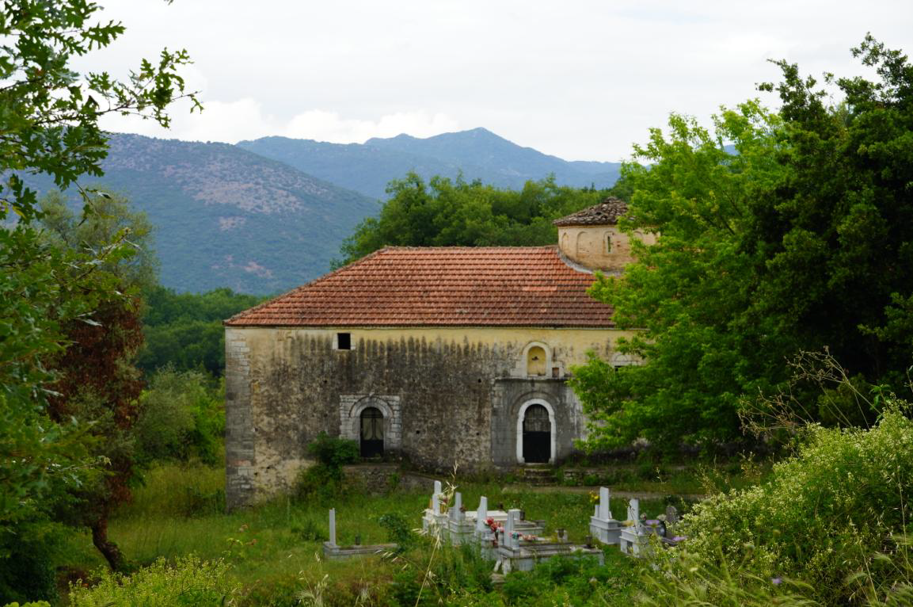
Saint Ioannis
It is a big size, triple nave basilica with a dome and timber roofed narthex (gynaikonitis). It was built in 1859 in the place of a former byzantine church built or restored in 1669. The partly preserved perimeter stone wall was constructed in 1859.

Slide 10
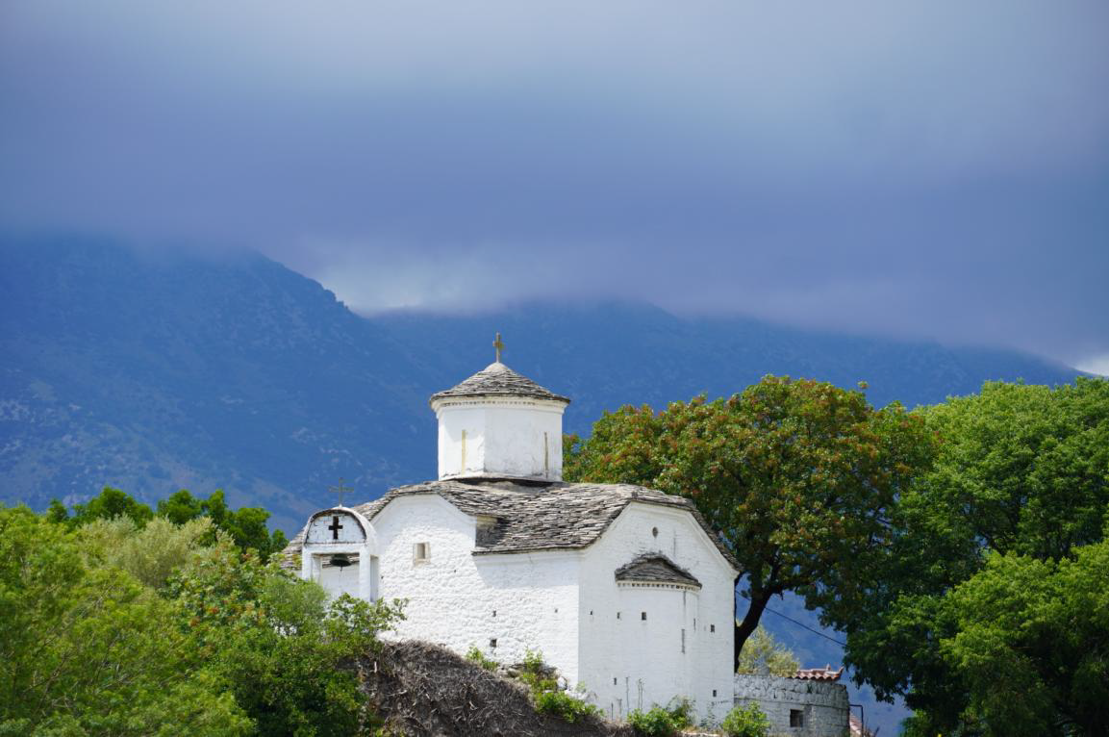
Saint Paraskevi
It is about a cruciform type church with a dome, built in 1856 (according to an inscription). It has a contemporary perimeter stone wall with a pillar in its north side.

Slide 11
Birth of Theotokos
It is the main parish church of Thesprotiko. It dates back to the 18th c. It is a triple nave basilica with narthex (gynaikoniti). The temple is covered with wall paintings from 1797. The stone, octagon bell tower, built in 1808 is in the west of the church. In the altar there is an inscription with the construction date (1794). The honored icon of the church was made in Lampovo monastery of N. Ipirus in 1678.

Slide 12
Prophet Ilias
The holy monastery of Prophet Ilias is built on the small plateau on the top of the Iliovounion mountain. The Monastery of was once destroyed, and then rebuilt in a cave under the summit of the mountain. It was renovated in 1852 .

Slide 13
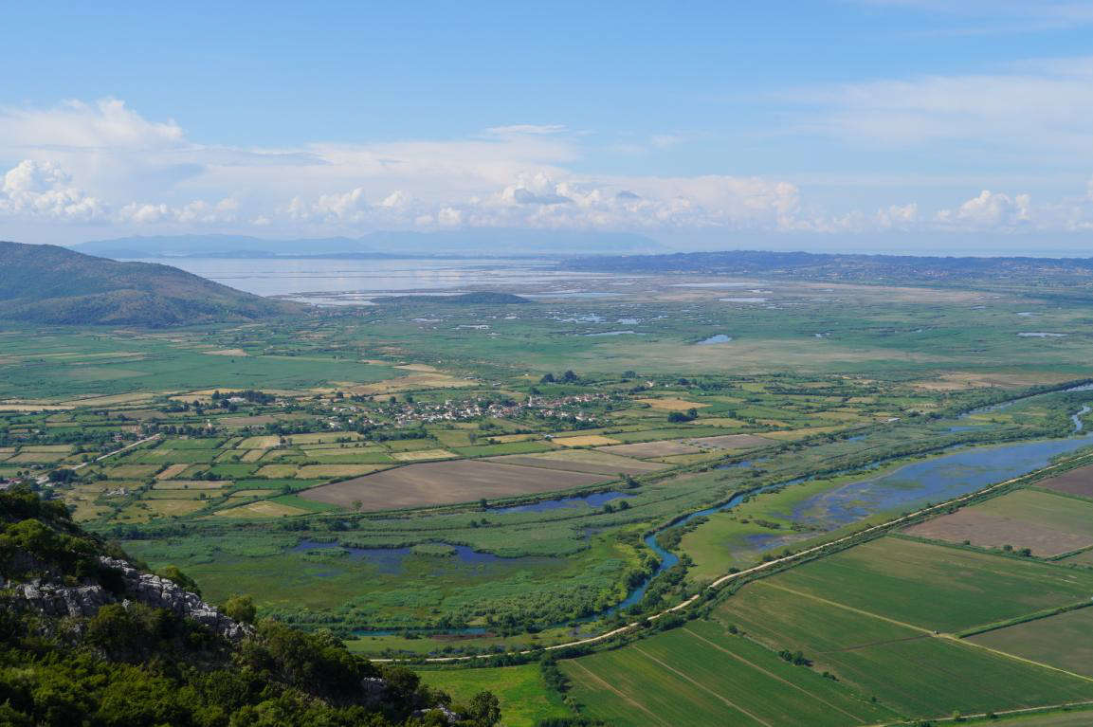
The cathedral of the monastery, three aisled basilica, is divided into narthex, the main temple and the sanctuary. The entrance to the church is accessed through the south side of the temple, the floor of which is six steps lower than the ground. The narthex lacks iconographies while the main temple and the sanctuary are full of ruined murals dating back to 1878. Although the monastery is still considered to be functioning nowadays, it is abandoned .

Slide 14
Dormition of Theotokos
The old parish church of Palaia Filippiada is dedicated to the Dormition of the Theotokos. It consists of a main church and a narthex (called “gynaikeio”). The interior is covered in wall paintings.
A partially destroyed inscription on the western entrance to the main church informs us that the church was painted in 1800 by well known 18th and early 19th century wall painters. Lastly, the 1883 portal - bell-tower of the single wall type, is a typical specimen of this type of buildings of the late 19th and early 20th century in the area.

