Slide 1

ORTHODOX CHURCH ARCHITECTURE

Slide 2
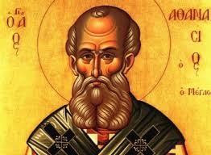
THE THEOLOGICAL PRINCIPLES
“God became man so that man might become god” said St. Athanasius the Great. This is a synergy of God offering Himself and man offering himself. The ultimate role of church architecture is to reflect this truth.
This means that a comparison of Orthodox churches throughout the world and in different periods shows that they have the same principles in common and that they are yet each unique. A common experience of God unites them, while the local character, climate, building materials and community needs distinguish them.

Slide 3
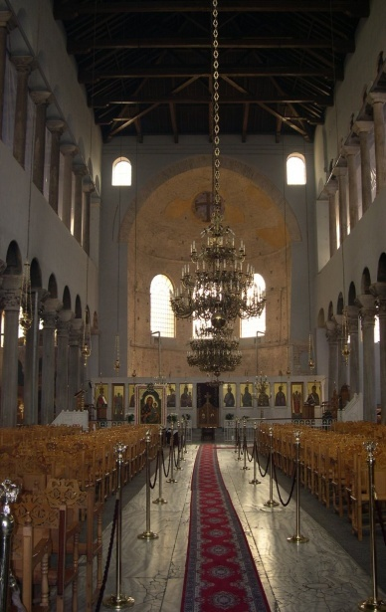
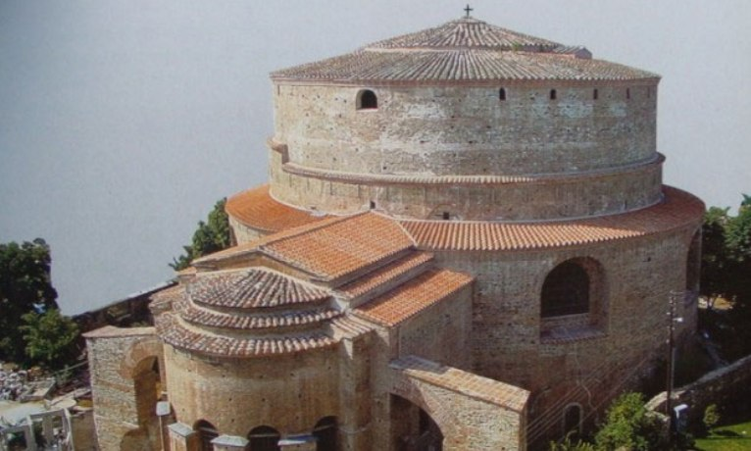
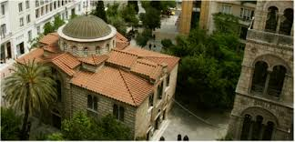
TYPES OF CHURCH DESIGN
There are three types of church design:
Centrally oriented (octagonal, square or circular design)
Basilica
Cruciform

Slide 4
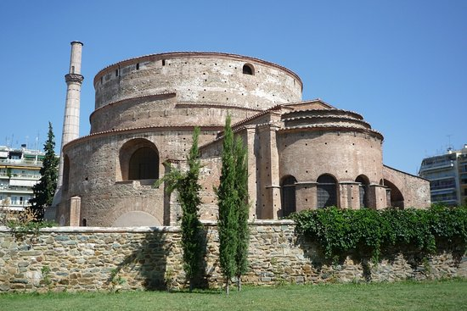
CENTRALLY ORIENTED BUILDINGS
Christianity affirms that we are on a journey closer to God. Consequently the Divine Liturgy requires churches with a certain forward movement - along the east-west axis. It is for this reason that Orthodox churches are designed with elements of the centrally oriented church.

Slide 5
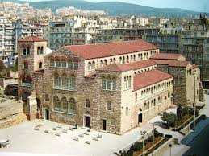
THE BASILICA CHURCH
The basilica is the earlier design, and is a rectangular structure. It usually has a curved apse in the eastern end. The roof is most commonly of timber, and the ceiling is sometimes painted with designs.

Slide 6
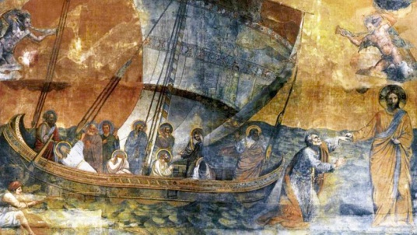
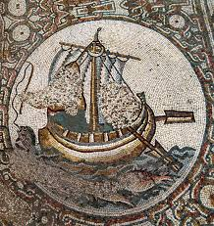

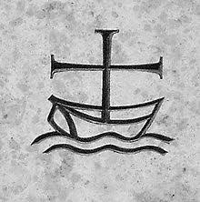
THE BASILICA CHURCH
The basilica was basically adopted with little adaptation from a Roman secular building type. The word basilica means royal. Another early symbolic reading of the basilica relates it to ship. According to the “ Apostolic Constitution” “ the house of the believers is long in shape like a ship and directed towards the east”.
The basilica is primarily, therefore, a church plan which emphasises action and motion.

Slide 7
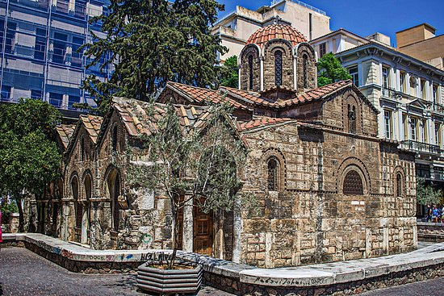
THE CRUCIFORM CHURCH
The basic form of the cruciform type is the central dome supported by columns or can sit directly on the walls. Variations on the theme involve the number of domes (five in common), the type of roof over the interior dome, the roof shape of the cross arms, the proportion, the geometric shapes given emphasis and of course the materials used.

Slide 8
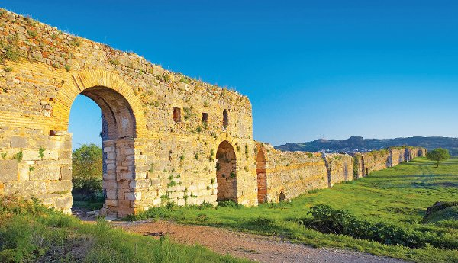
Early Christian Monuments
Of Nikopoli
Made By: Lamprini Lioska, Margarita Siorou, Apostolis Kokkalis.

Slide 9
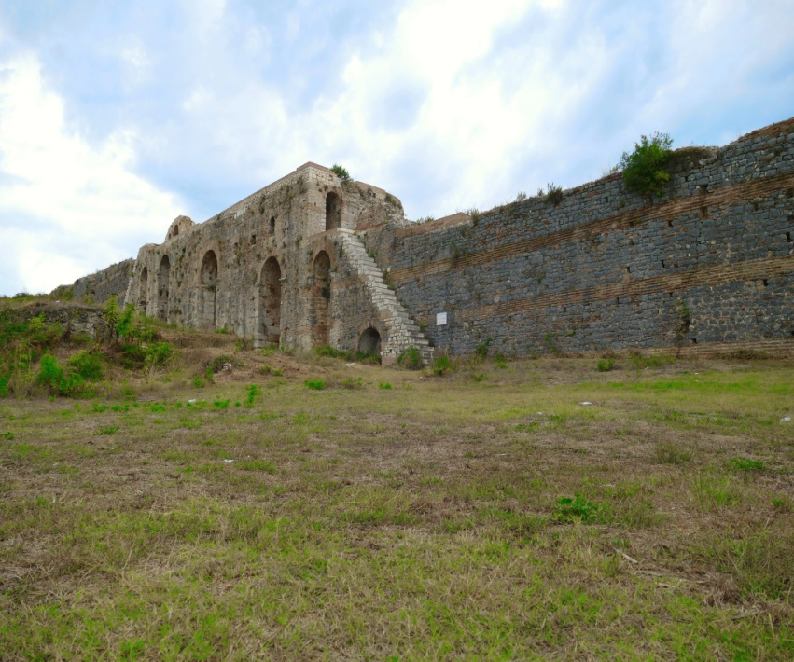
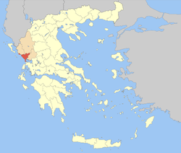
Nikopoli
Ancient Nikopolis was a city of Epirus that was founded by the Romans in southwestern Epirus near today’s Preveza. It’s archaeological site is today the largest in ancient Greece.

Slide 10
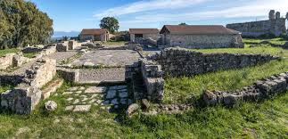
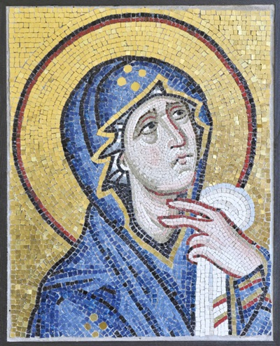
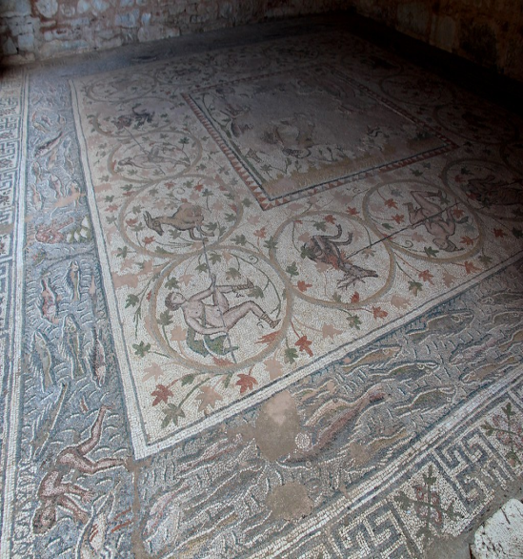
Basilica Of Dometios
The Basilica Of Dometios dates back to the 6th century and was dedicated to Agios Dimitrios.
It belongs to the type of a three-aisled basilica and it also has a protruding transverse aisle.
It also has beautiful mosaics with interesting compositions and visuals from the environment.

Slide 11
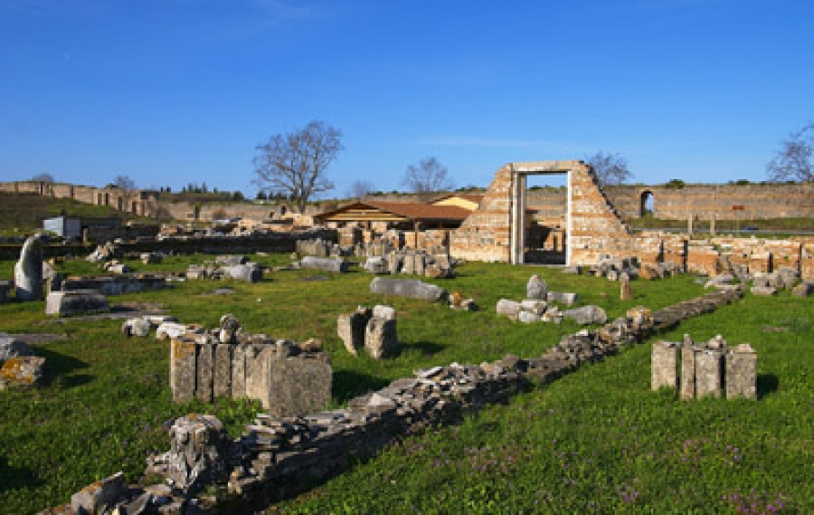
Basilica B’ of Alcisson
The Basilica B’ of Alcisson was built from the middle of the 5th century until the beginning of the 6th century A.D. Also it is five aisled and is located within the Early Christian walls.
It was most likely destroyed by raids during 1821 and only the ruins have remained.

Slide 12
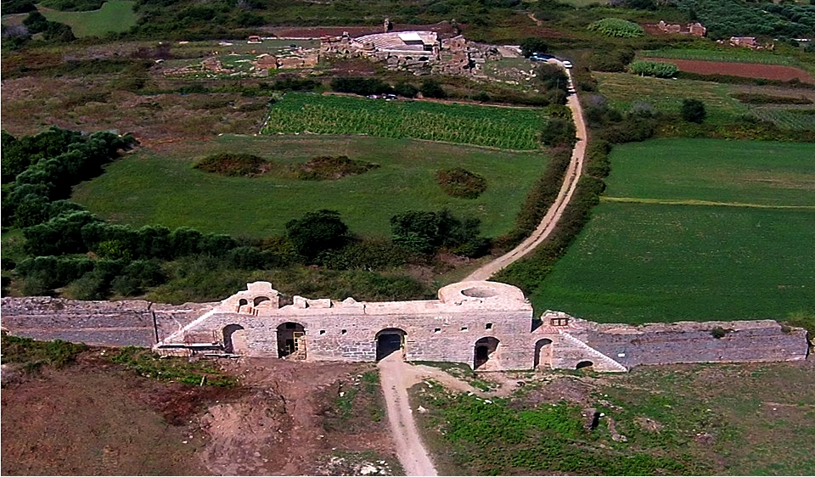
Basilica D’ Of Withdrawal
Basilica D’ of Withdrawal is a three-aisled basilica with a protruding transverse aisle with splinters and a patio.
Mosaics floors are preserved in the narthex and diaconate.
It dates back to the first half of the 6th century A.D.

Slide 13
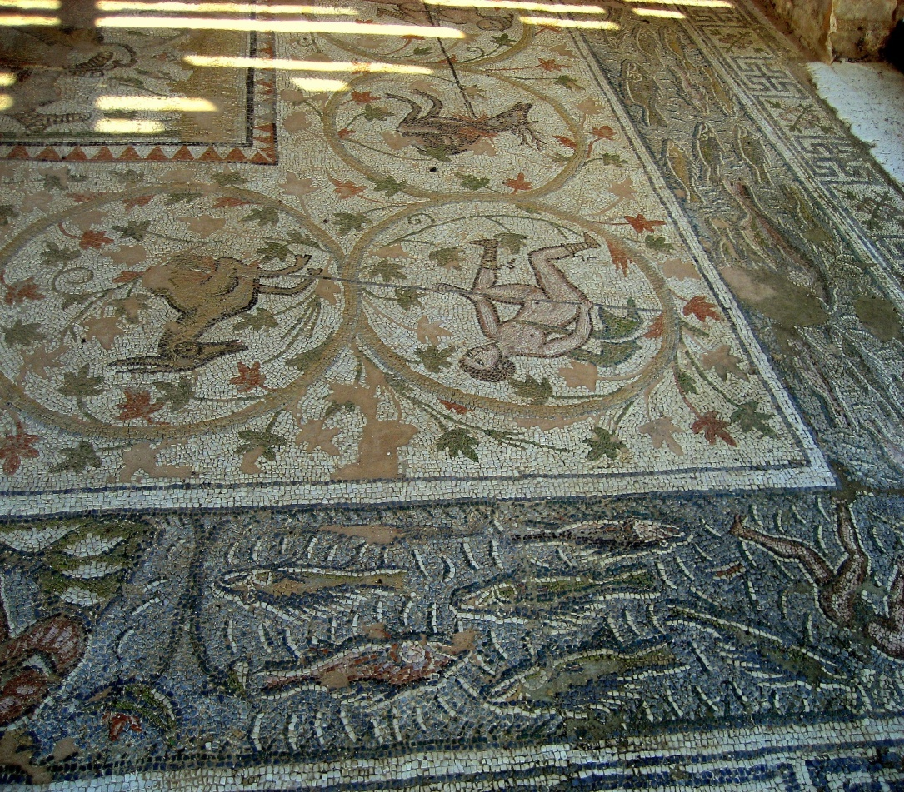
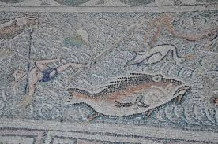
Mosaics of Basilica D’ of Withdrawal.

Slide 14
Byzantine Monuments
Made by: Katerina Mitou, Anastasia Dossi, Konstantinos Katsenos, Basilis Dimos.

Slide 15
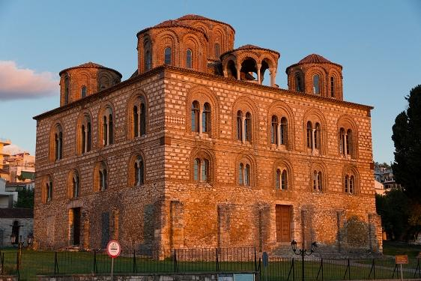
The Church of Parigoritissa
The church of Parigoritissa was built in Arta during the 13th century A.D.
It is of the octagonal type, with a central dome supported by eight piers divided into three tiers.

Slide 16
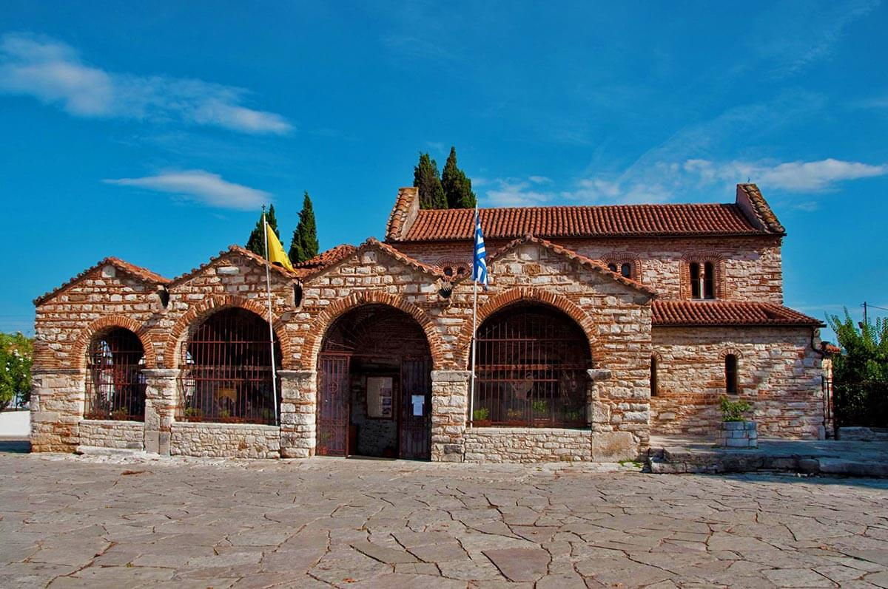
The church of Saint Theodora
Saint Theodora was built during the 11th century and has the structure of a three-aisled basilica.
The church is named after an old queen and the patron saint of the city.

Slide 17
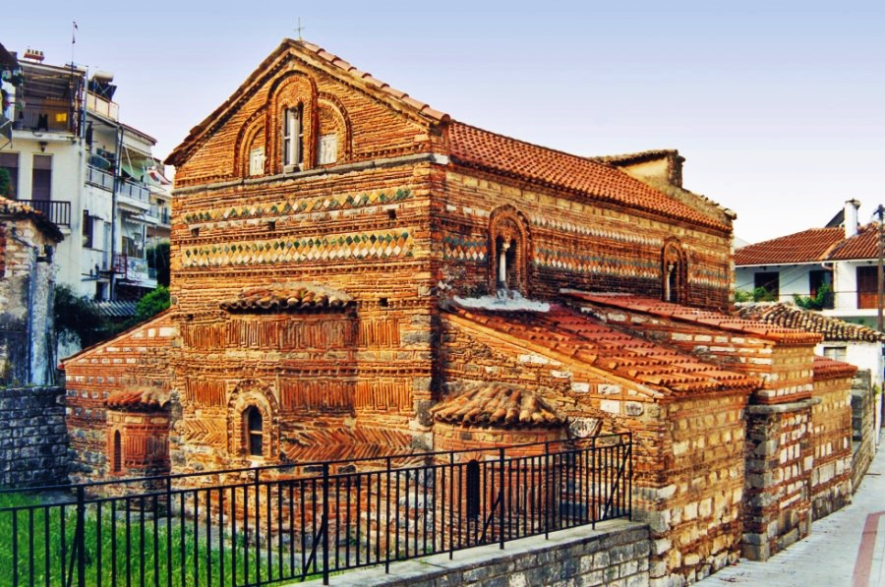
The Church of Saint Basil
The church of Saint Basil was built in the 13th century and has the rhythm of a one storey, timbered basilica.
The interior of the monument is filled with wall paintings that were mostly destroyed when it’s roof was burned in 1821.

Slide 18
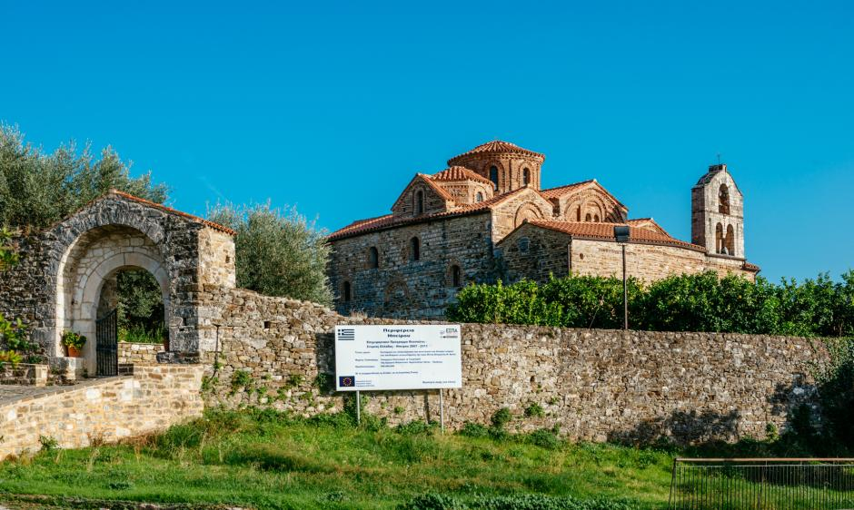
The Virgin Mary of Vlacherna
The Virgin Mary of Vlacherna was founded at the end of the 11th century as a three-aisled vaulted basil.
Rich and exquisite paintings were painted in two phases; the first at the beginning of the 13th century and the second at the end of it.

Slide 19
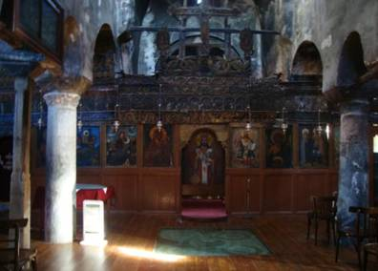
Wall Paintings of the Virgin Mary of Vlacherna.

Slide 20
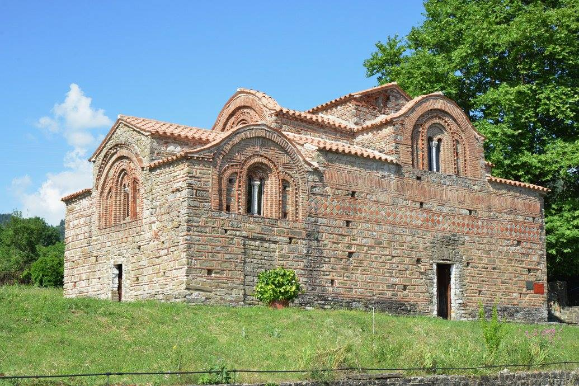
The Red Church
The Red Church was built during 1281. It has the structure of a cruciform church, without a dome, in the type of a double roof with a variety of roofs.
The interior of the monument is covered in wall paintings that lead until it’s narthex.

Slide 21
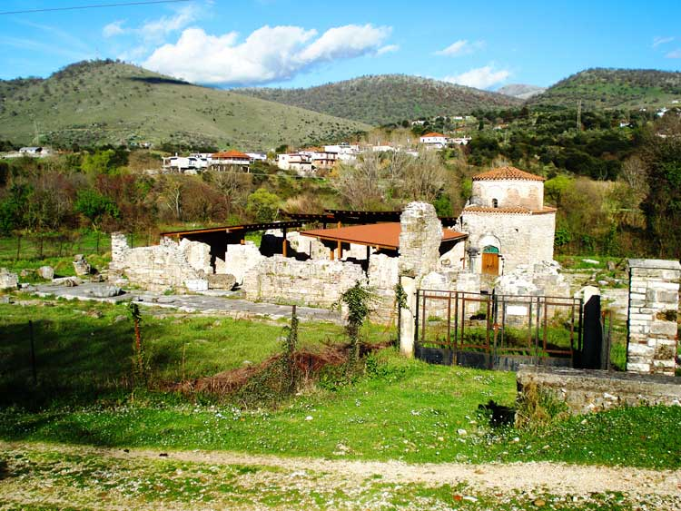
The Church of Pantanassa
The ruins of the church of Pantanassa are located near the town of Fillipiada. It was built during the decade of 1250- 1260.
Before it’s destruction it had the rhythm of a cross-signed with a dome.
Only a few wall paintings were found but they’re were destroyed.

Slide 22
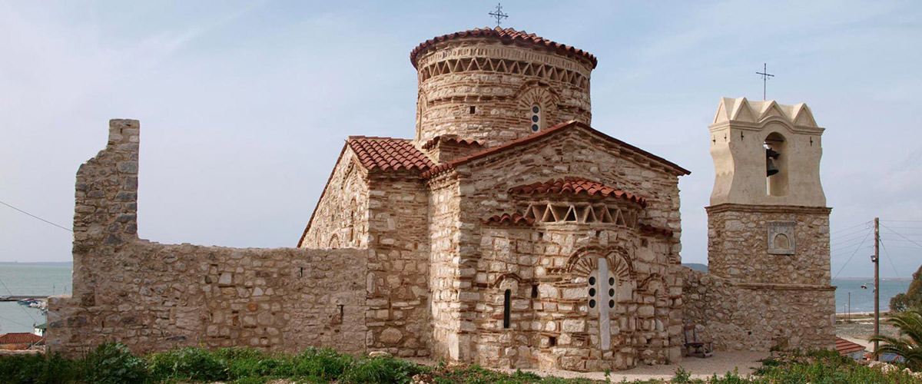
The Virgin Mary of Koronisia
The Virgin Mary of Koronisia was built during the 10th century A.D. It’s structure is one of the rarest, a semicircular cross-section with a dome.
The interior is covered in wall paintings.

Slide 23
Modern Monuments
Stratos Panousis
Anastasia Euthimiou
Evaggelia Kotsi
Zoe Zika

Slide 24
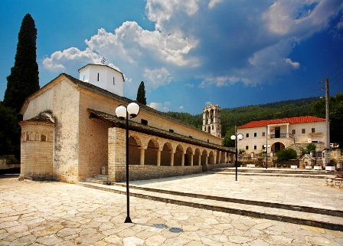
The birth of Theotokos Church
The Birth of Theotokos church is located in our village, Thesprotiko. It was built in 1794.Its architecture structure is basilica with a dome.
We celebrate our church on the 8th of September and a festival takes place in the village in the honor of its.

Slide 25
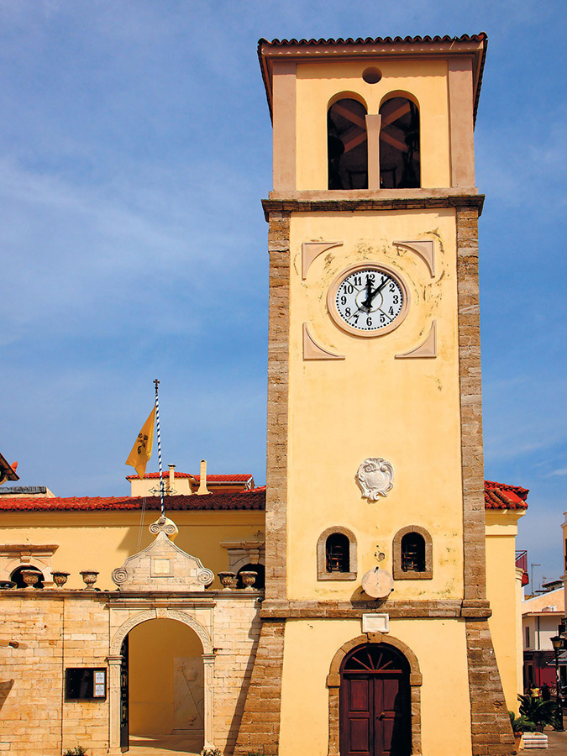
The church of Saint Charalampos
The church of Saint Charalampos in Preveza, dating back to 18th century was built on the ruins of an older church on a single-aisled basilica.
It was named after Saint Charalampos because citizens believed that he healed them from the plague, an illness which decimated many people.

Slide 26
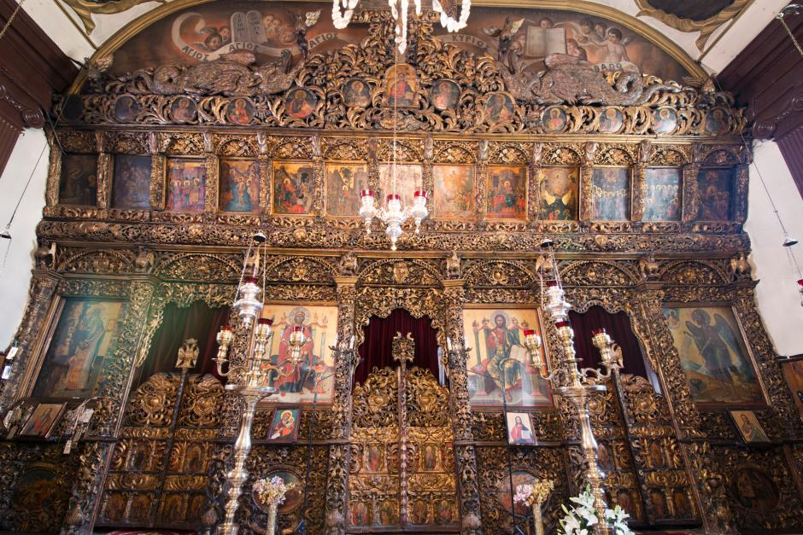
it is famous for its wood-carved and gold-plated temple.

Slide 27
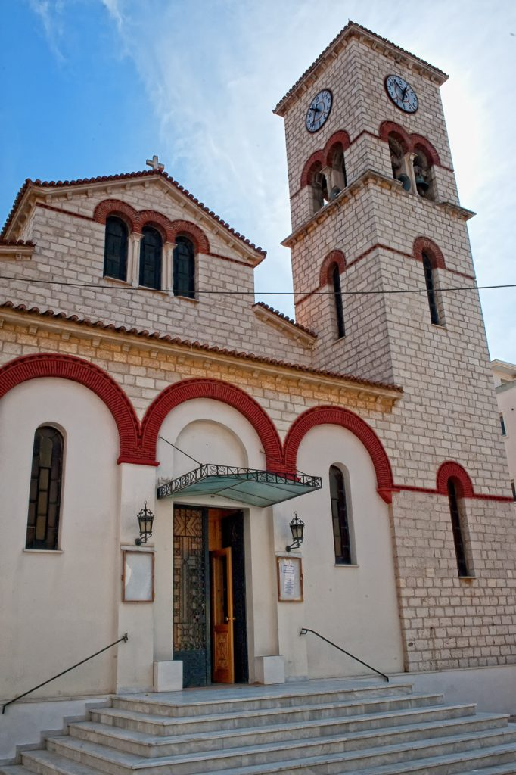
The church of Saint Athanasios
The church of Saint Athanasios is located in the city of Preveza
It is one of the oldest churches of Preveza and its architecture structure is one-storey basilica.

Slide 28
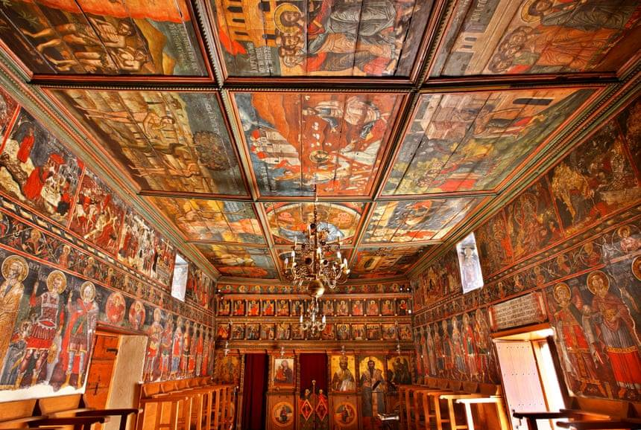
The interior of Saint Athanasios church.
It’s full of wall paintings which are dating back to 1780.

Slide 29
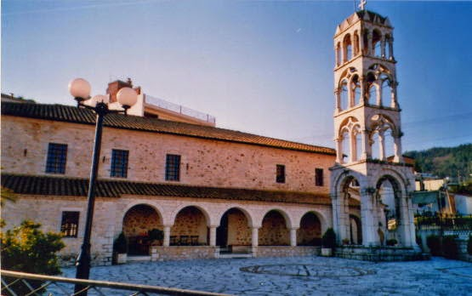
The church of Saint Vissarion
The church of Saint Vissarion is located in the old town of Filippiada.It was built in 1912 and it impresses with its elaborate bell tower.
On the 14th September a big festival is organized in the village in honor of the Saint.

Slide 30
Monastery of Preveza.

Slide 31
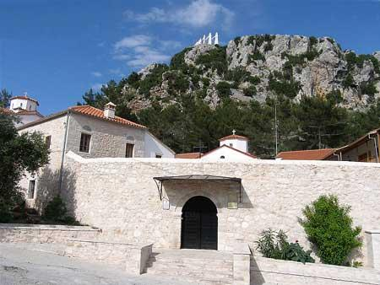
The Monastery of Saint Dimitrios
The Monastery of Saint Dimitrios in Zaloggo , functioning as a female monastic brotherhood.
It has suffered many destructions in its history, the largest of which was during the Occupation,when it was burned down.

Slide 32
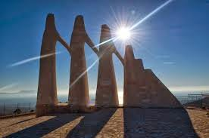
History of Zaloggo.
Zaloggo became legendary because of the fall of Souliotisses from the top of the rock.They were women who decided to turn towards the cliff's edge together with their infants and children rather than surrender during the war.According to the tradition they did this one after the other while dancing and singing.

