Slide 1
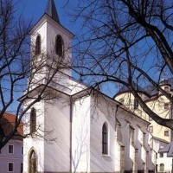
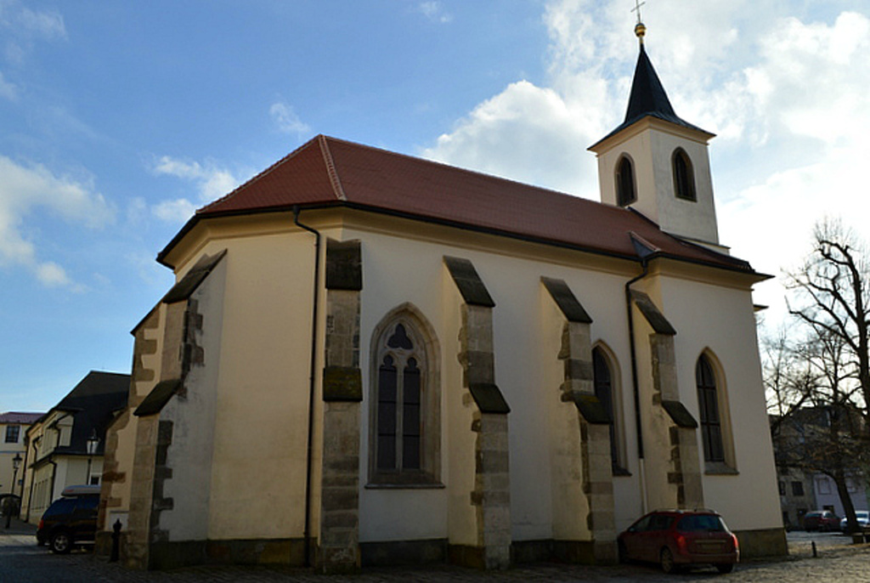
Church of the Misson of the Saint Apostles
a gothic church in the city centre
built in 1407
used to be a part of the poorhouse

Slide 2
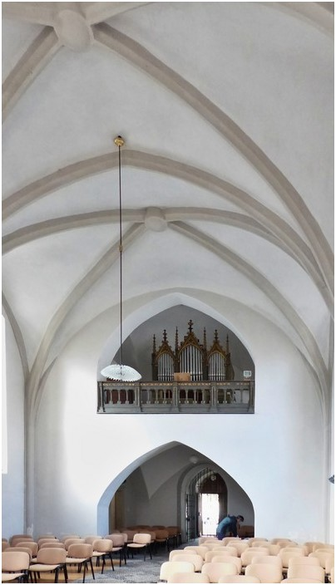
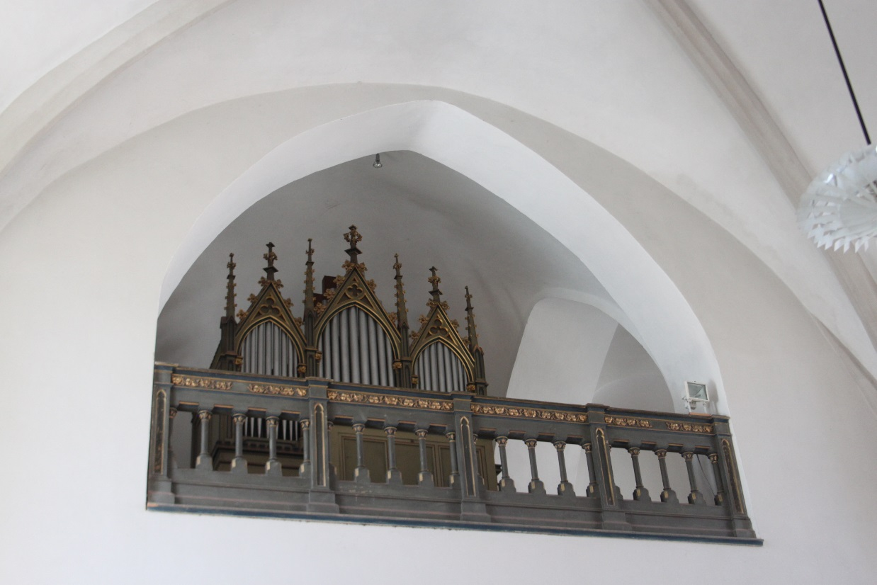
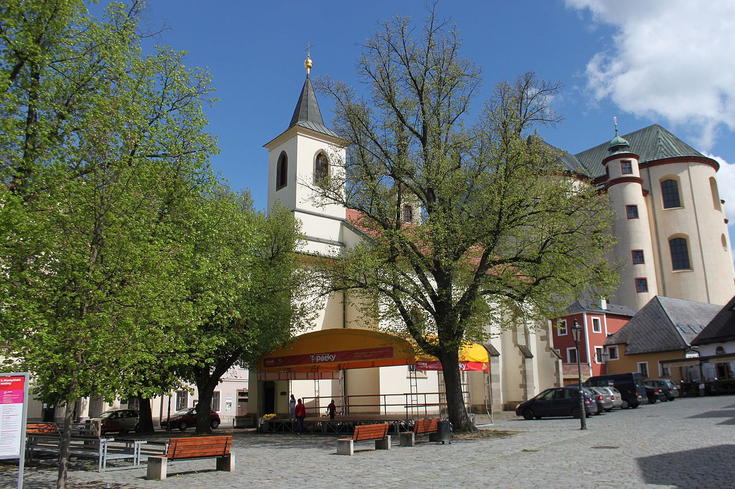
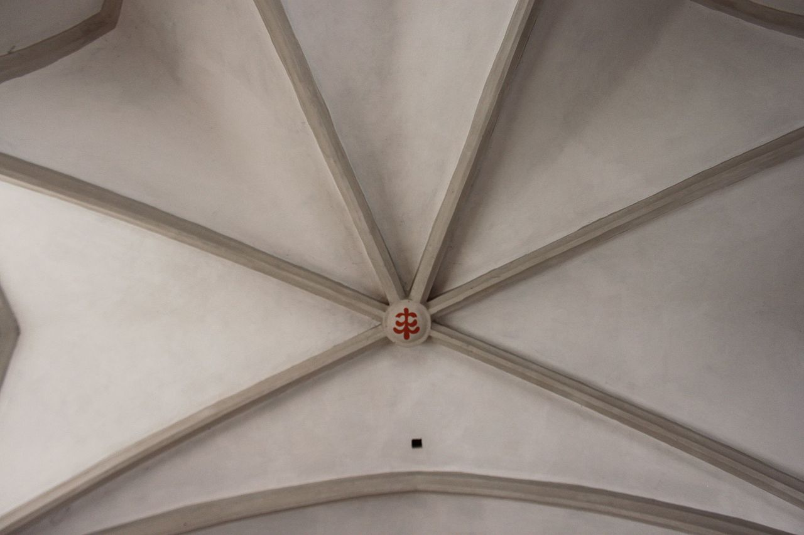
There is the organ and balustrade
There is one nave with a Litomyšl emblem

Slide 3
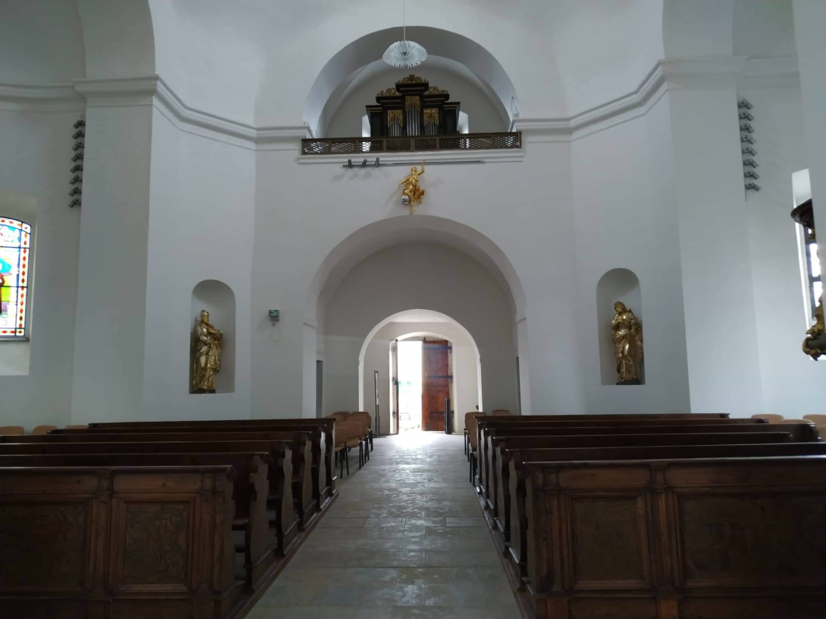
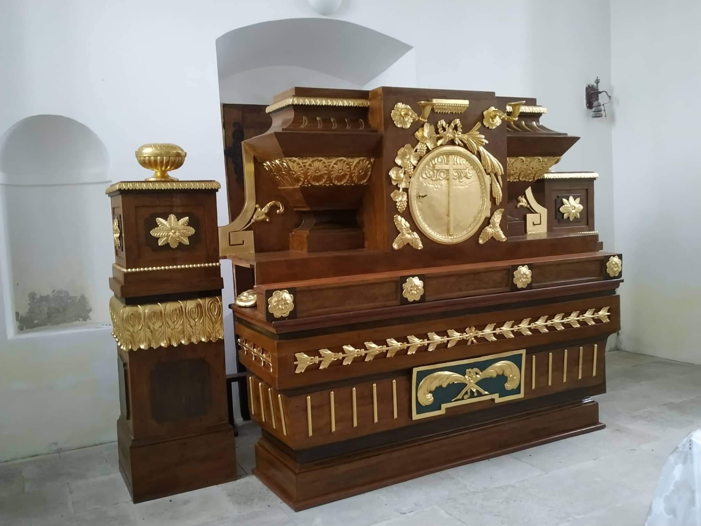
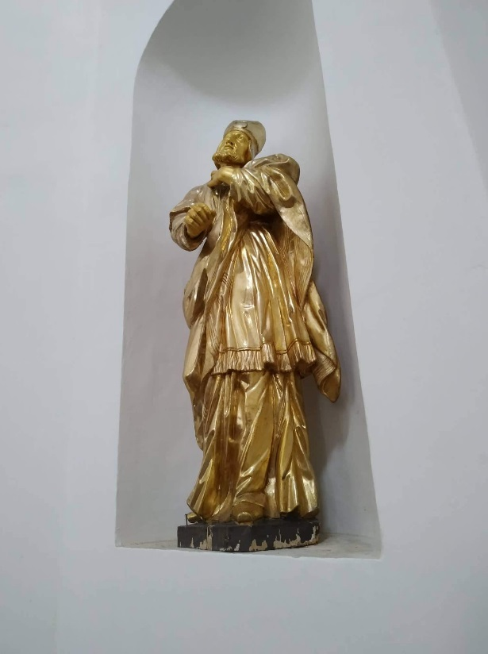
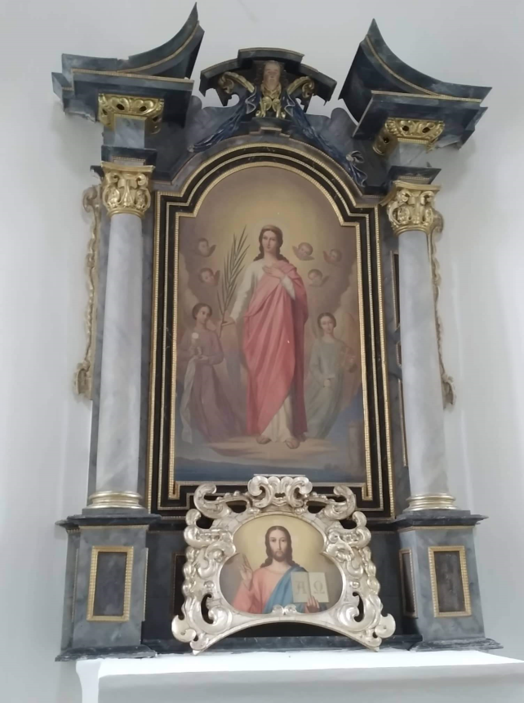
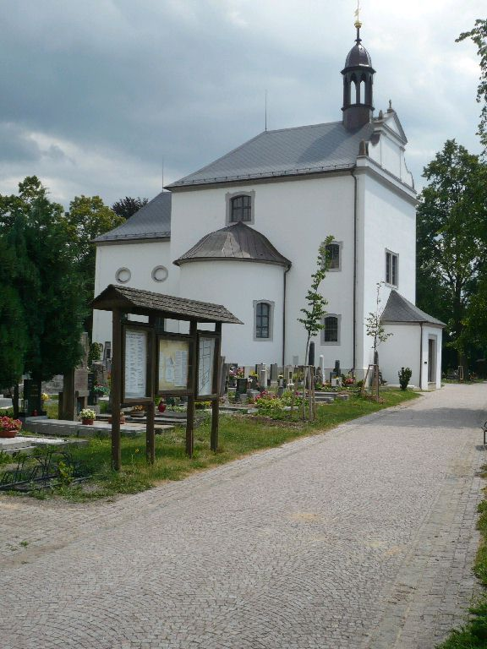
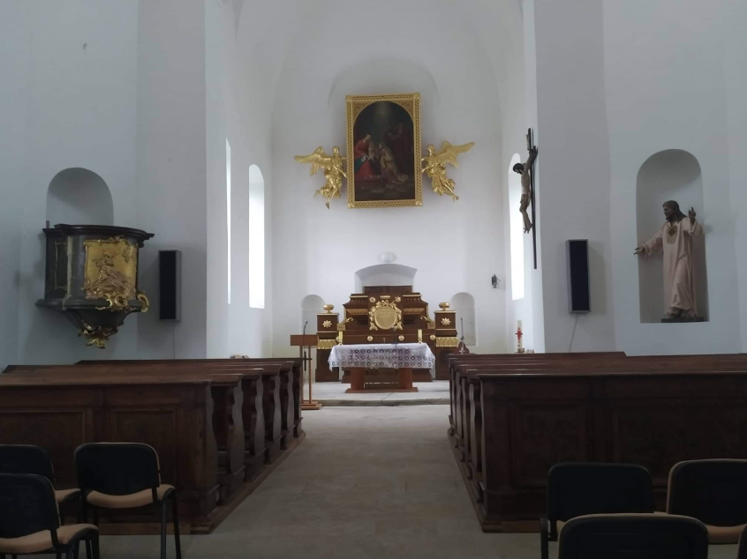
Church of Saint Anna
an early baroque church from 1670-1672
architect: Antonio Alfier
the interior partly from 17th century and partly from 18th century
the church built as a plague church
in 21st century a complete reconstruction of the building
used for religious needs and also concerts or public lectures

