Slide 1
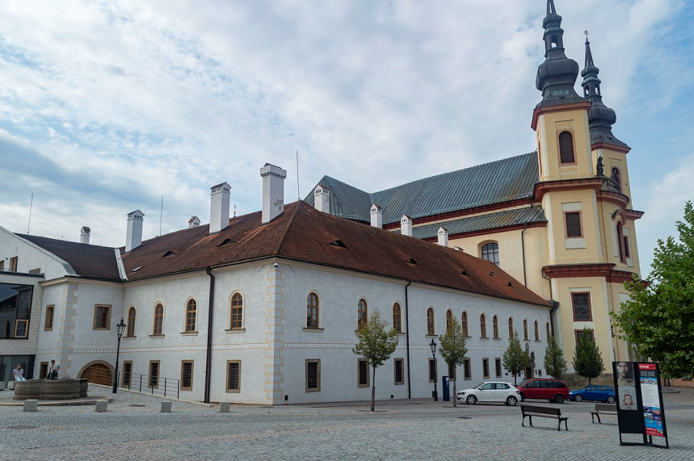
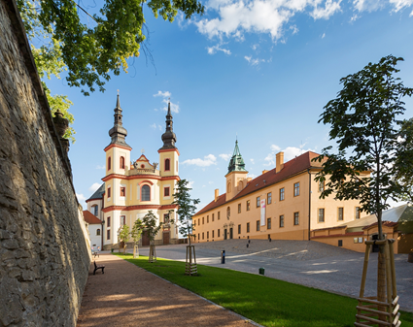
Piarist Church of the finding of the Holy Cross
1714-1725
a radically baroque church
architects: G.B.Alliprandi (Italian), F.M.Kaňka
comprises: a building of Piaristic residence from 1680 a hall garden
a hall garden
a building (before a piarist school, today a regional museum )
Piarists= special religion
free education, missionary
actions…

Slide 2
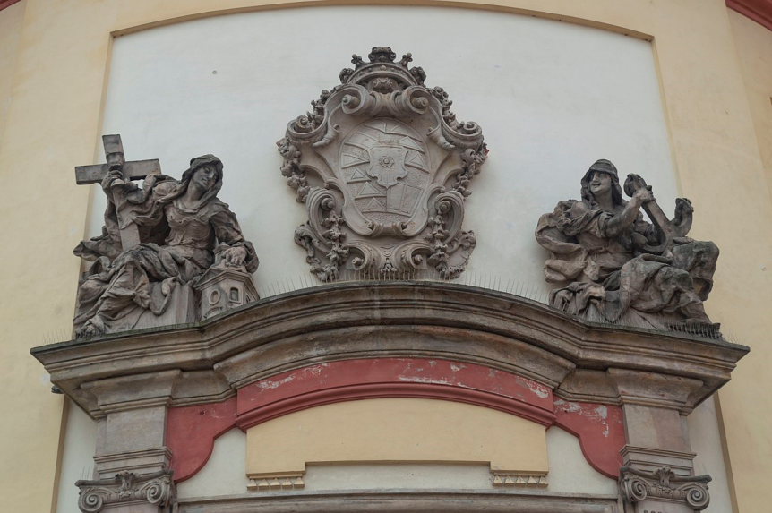
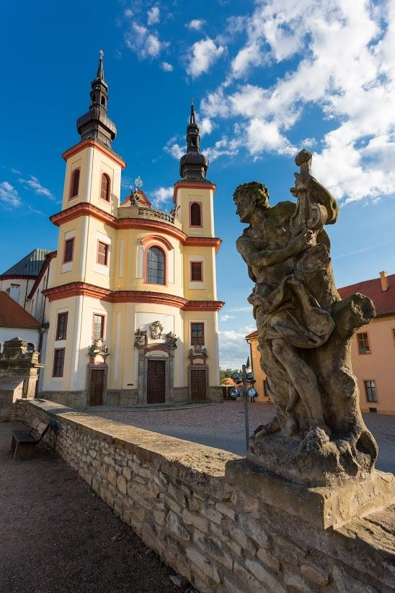
Architecture
allegory of hope and faith (M.B.Braun)
Square oblique standing towers
Convex facade
statues of st. Wenceslas a st. Prokop (Braun)
statuary decoration by an Austrian artist Antonín Appeler and artists of central Europe F. and J. Pacákové and M.B.Braun

Slide 3
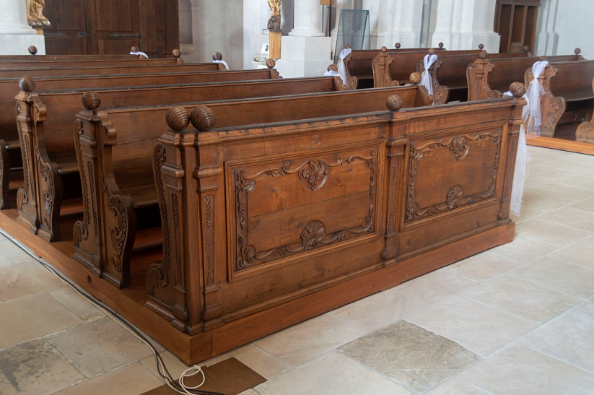
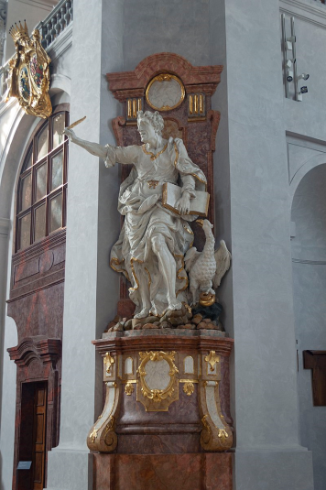
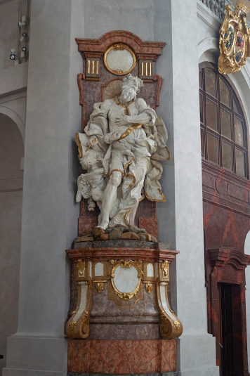
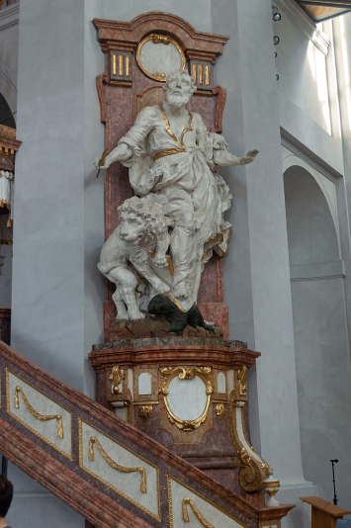
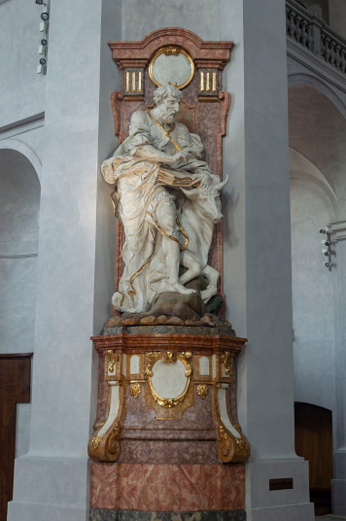
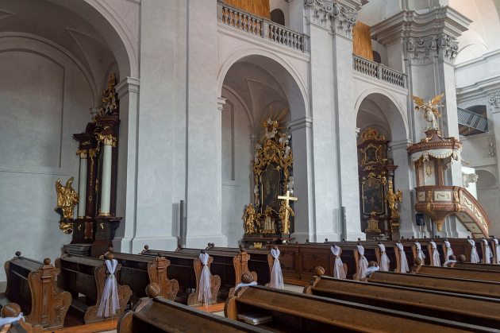
Inside
baroque oak desks
wooden white statues of four evangelists (Braun)
a side oltar
Jan
Matouš
Marek
Lukáš

Slide 4
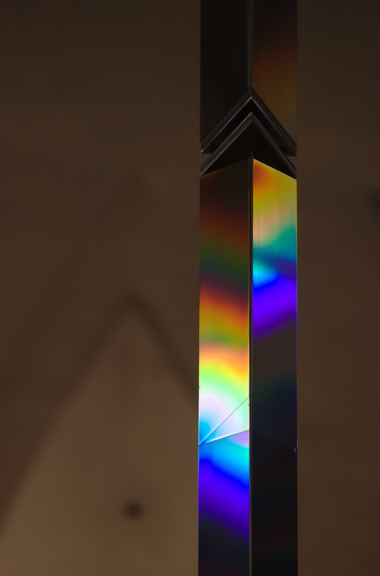
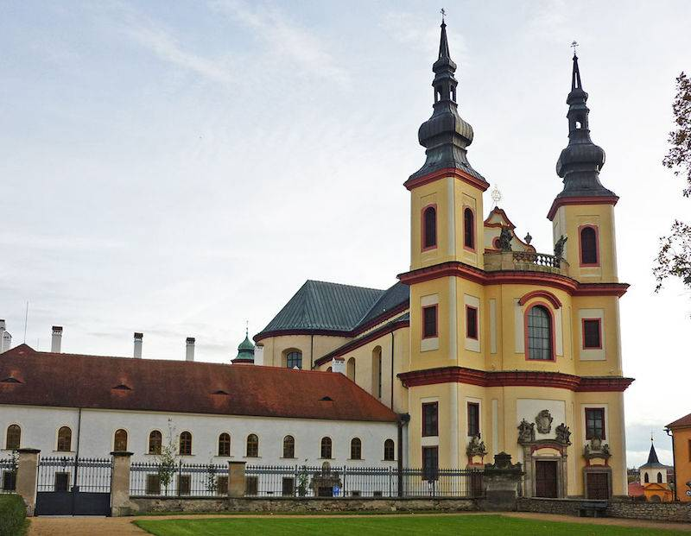
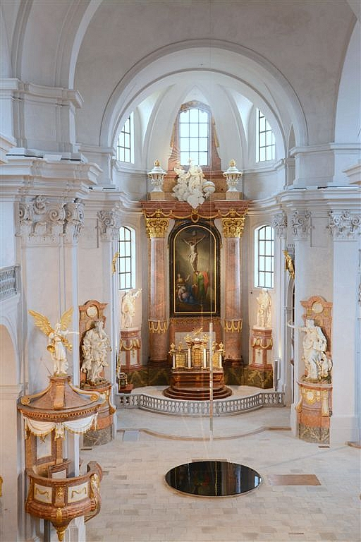
modern installation
a column with reflecting surface
a prism made of optical glass refracting light and create rainbow
renovation in the 21st century by the EU money
today a gallery of baroque art and cultural events

