Slide 1
ICON Greece
Colegio Concertado Bilingüe Leonardo Da Vinci, Murcia
TPM for KA 201 «Let’s know each other: Strategy for the Equity Inclusion of Roma Students»

Slide 2
I.CO.N
Inclusion in COmmuNity
I.CO.N
Image in Greek
focus on the image of the other
activities that promote empathy, through the image we have of ourselves and others around us
hug all the images and enhance a mosaic of diversities

Slide 3
I.CO.N is a Greek non-governmental and non-profit educational organisation in Rodos, Greece. It was founded in 2011 in order to offer a broad spectrum of educational and social activities in Greece and involve in European issues.
ICON Greece was initiated as an informal group of educators and students aiming to enhance inclusion in the school community –for students with special skills, different cultural backgrounds or belonging to vulnerable groups as Roma, foreign, repatriate, refugee. ICON Greece started by implementing volunteer activities and educational projects at the context of extra curricular activities

Slide 4
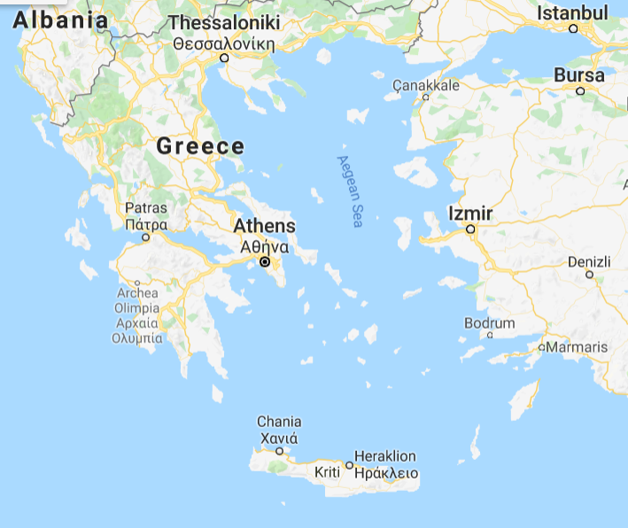

Slide 5
ICON encourages non-formal education as a powerful tool
to support personal and professional development of individuals and thus increase their employment
to encourage multilingualism and integration of cultures
to promote active citizenship and volunteering
to stimulate creativity and new ideas for entrepreneurial initiatives
to encourage protection of nature and animals and and respect for the environment
to suggest a healthy lifestyle for personal well being
to provide educational opportunities for young people with fewer opportunities
to endorse the elimination of stereotypes

Slide 6
Activities
Erasmus KA1 training seminars
Erasmus KA2 partnerships
Erasmus Youth
Training programmes and seminars
Conferences and festivals
Consulting
Voluntary and internship programs
Vocational education and training programs
Implementation of local activities
Surveys
Information and awareness campaigns
Creation of promotional material, toolkits and guides

Slide 7
Mission of ICON Greece
Inclusion in community regardless of the images and stereotypes that each group has of each other
Inclusion of individuals together with their families and friends who support them
Promotion of empathy and respect for people of all backgrounds and abilities
Providing support and guidance to vulnerable groups
Mentoring and life coaching of young people for the creation of a life plan
Assistance to young people in perfecting their skills, obtaining knowledge and increasing qualification, thus having better career prospects

Slide 8
Support of creativity and entrepreneurship
Digital learning
Promotion of volunteering, cooperation, democracy and active citizenship
Participation of young people in initiatives at local, regional and European level
Enrichment of European cultural diversity
Promotion of alternative and sustainable tourism and development
Implementation of cultural events as a means of social cohesion
Improvements in education and society

Slide 9
ERASMUS new and old partners in our projects
ERASMUS + KA 105 Youth KA105-AD9535F5 2020 Cultural heritage as a path in migrants’ inclusion
Exchange promoting the importance of culture from all nations

Slide 10
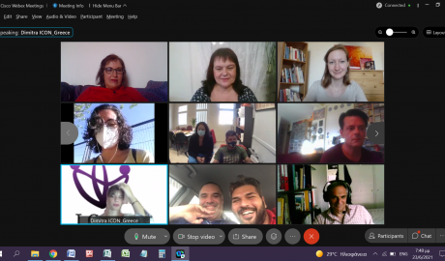
ERASMUS + KA 227 Strategic Partnerships 2020-1-EL01-KA227-SCH-094519 Culture heritage and Gamification in Education
Creation of digital application as a game for cultural heritage

Slide 11
ERASMUS + KA 201 Strategic Partnerships 2020-1-NO01-KA201-076430 Inclusion Team for ICT and Special Education
Creation of Guide for IT for students / adults with special needs so that they follow the digital culture of our times
ERASMUS + KA 201 Strategic Partnerships 2020-1-EL01-KA201-078810 Let’s know each other: Strategy for the Equity Inclusion of Roma Students
Support for Roma families and students in education and society

Slide 12
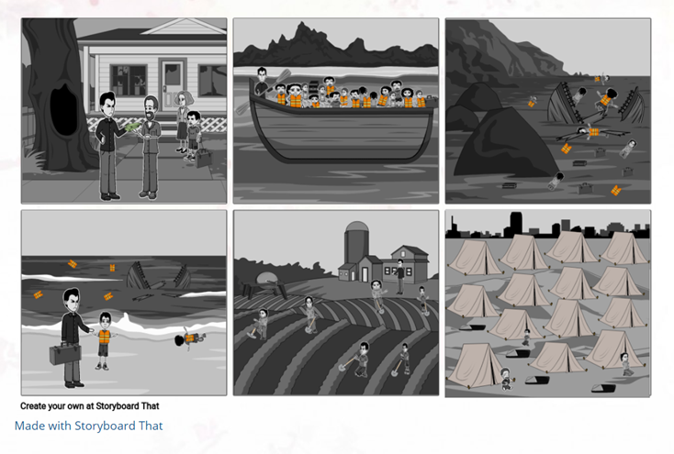
National projects
Hellenic Hope “Training of teachers on children’s rights”
https://blogs.sch.gr/paidikiprostasia/
Educational material, interactive exercises, teaching scenarios

Slide 13
Active Citizens Fund “Workshop for the promotion of gender equality and the fight against gender-based violence and pedagogical interventions in the classroom”
Teacher training and educational material
Bodossaki foundation “Support for vulnerable groups and families”
Workshops and meetings

Slide 14
Website
https://icongreece.gr/
Facebook
https://www.facebook.com/icongreece/
Instagram
https://www.instagram.com/icon.greece/

