Slide 1
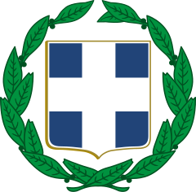
Gymnasio Zipariou, Kos island Dodecanese, Greece
TPM for KA 201
«Let’s know each other: Strategy for the Equity Inclusion of Roma Students»
at Colegio Concertado Bilingüe Leonardo Da Vinci, from 21st to 22nd September 2021, Murcia, Spain

Slide 2
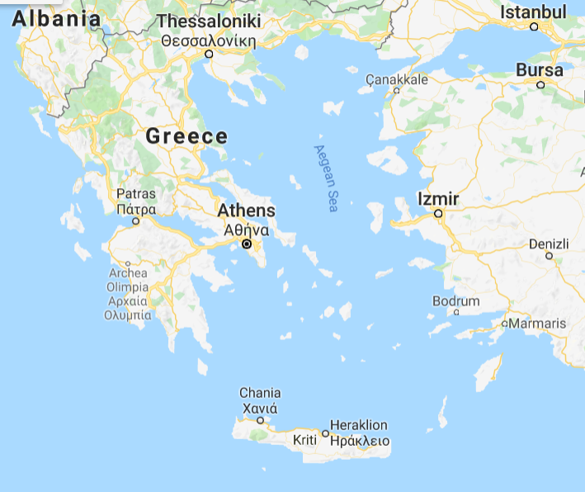
Gymnasio Zipariou, Lower Secondary School of Zipari

Slide 3
Gymnasio Zipariou, Kos
Gymnasio Zipariou is a public school on the island of Kos. The school receives students from four small villages at a rural area around the city. It offers general secondary education and it has 25 teachers and 300 students, aged 12-15. The area of the school has received many immigrant and refugee families that work in the agricultural sector and the hotel industry. The students come from different social, financial and cultural backgrounds. The school aims at improving the education and the school life of all the students.

Slide 5
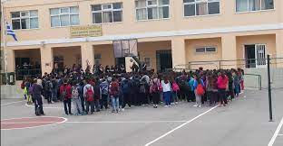

Slide 6
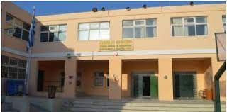

Slide 7
Aims (1/2)
The school promotes
Integration of all students. Differentiated learning, variety of activities, different pedagogical practices and support to weak students.
2. Active citizenship. The school supports social and personal development of students in order to prepare them as future citizens. There is an emphasis on school as a microcosm of society where students are expected to behave as active citizens.
3. Digital citizenship. The school provides guidance for students and their families in order to prepare them for the digital era in personal and professional level. Digital competences are considered basic for further development of students

Slide 8
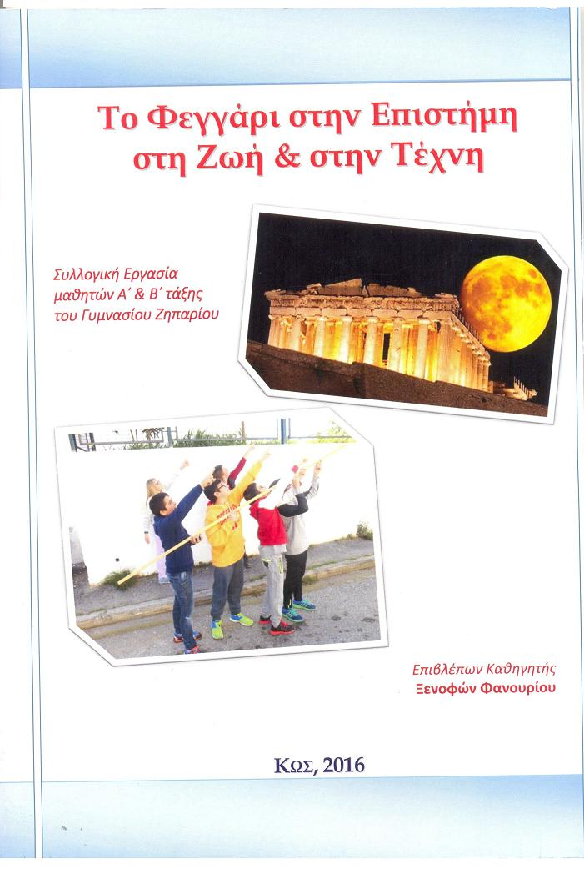
Aims 2/2
4. Working together with families and community. The school has succeeded a close cooperation with guardians association and each family gets a special attention for the improvement of their children.
5. European projects to support European citizenship. The school aims at students and teachers mobility in order to support communication and combat xenophobia

Slide 9
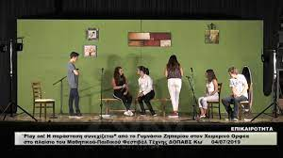
Our school participates in various competitions, winning a variety of distinctions (1st place in Ancient Drama "Troyades", 1st place in Modern dance, 2nd place in Traditional dance, 1st place in Francophonie 2009-2010 with Song, 1st place in Francophony 2010-2011 with Song , distinctions in Painting competitions, Patents, etc.).

Slide 10
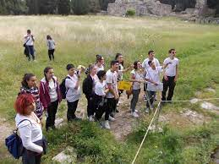
The school and its teachers have previous experience in national pilot
projects such as Environmental Education, Cultural Heritage and Extra Curricular projects.
The pedagogical team of the school will be the director and teachers who have motivation to learn new pedagogies and to introduce new practices in their lessons.

Slide 11
Differentiated School
The diversity of student population
Cultural background of students and their families
• Social and financial status
• Learning performance
• Religion
• Special needs
• Children of immigrants and refugees
• Children of Roma families
Safe school for all
Physical environment
Positive school climate for the well-being of students’ life
Academic performance
Extra curricular activities
Cooperation at European level
European citizens of a multicultural society

Slide 12
Greek education
The provision of free education to all citizens and at all levels of the state education system is a constitutional principle of the Greek State.
The Greek educational system is centralised. National laws, presidential decrees and ministerial acts are prevalent within it.
Regional and Local Levels
At regional level, the Regional Education Directorates oversee the implementation of the national educational policy.
At local level, the Directorates of Primary and Secondary Education supervise all schools in their area. In their turn, school units make sure they run smoothly.

Slide 13
Teachers’ appointment
Teachers
Educational officials of the country are Higher Education graduates. The main route into teaching in primary schools is to take a 4-year degree in a pedagogical department. In secondary schools, most teachers follow a 4 or 5-year subject-based degree at a teacher education faculty.
Permanent teachers’ appointment or substitute teachers’ recruitment under a fixed-term employment contract governed by private law, when there are vacant posts to be filled.
Successful participation in the Supreme Council for Civil Personnel Selection (ASEP) examination.
Teachers’ appointment / employment is based exclusively on ranking lists including the names of those who have successfully participated in the above mentioned examination. Αcademic qualifications, social criteria and actual prior teaching service are taken into consideration.
800 substitute teachers

Slide 14
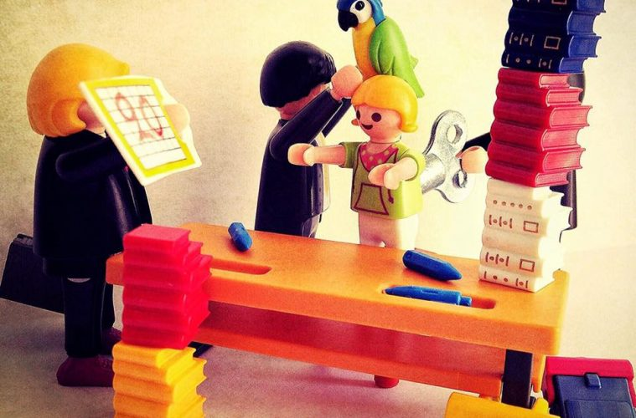
Ministry of Education, Research and Religious Affairs
At central level, the Minister of Education and Religious Affairs supported by collective, consultative and advisory bodies and institutions, takes the key decisions relating to the long-term objectives and functioning of the educational system.
For instance, the following issues are regulated centrally: definition of curricula content, the writing and distribution of student textbooks, allocation of teaching time, teacher education and initial training, placement of teachers and other school staff, teacher salaries and school financing.

Slide 15
Regional Education Directorates
At regional level, administrative control is exercised by the corresponding Regional Education Directorates, referring directly to the Minister of Education and Religious Affairs.
The Regional Education Directorate is responsible for the administration and the scientific and pedagogical guidance of education in the region. It supervises the implementation of the national education policy, tailoring it to match the specific requirements of the region, and connects the regional educational services with the central education authorities. The Regional Education Directorate consists of the Department of Administration and the Department of Scientific and Pedagogical Guidance under which school advisors fall.

Slide 16
Directorates of Primary and Secondary Education
At local level, the educational policy is implemented and specified by the Directorates of Primary and Secondary Education, which fall within the competence of the Regional Directorate of Education, and the School Units which fall under the competence of the relevant Directorate of Education.
A director is the head of Education Directorates. Directors of Primary and Secondary Education have the overall responsibility for the administration and control of the operation of the schools in their area of competence.

Slide 17
School units are administered by the school head, the deputy school head and the school teachers board. The school head is located at the top of the school community and carries administrative and scientific-pedagogical responsibility. He/she is responsible for the school's smooth operation, the coordination of school life, compliance with the laws, circulars, official mandates and implementation of the decisions taken by the school teachers' board. He/she is also responsible in cooperation with the school teachers' board, for planning and assessing the educational work of the school, as well as for preparing and implementing integrated action plans to improve it. The deputy school head replaces the school head in all function and helps him/her in his/her daily work. He/she assumes some of the school head's responsibilities, so that the school head can deal with the school's educational work without distractions.

Slide 18
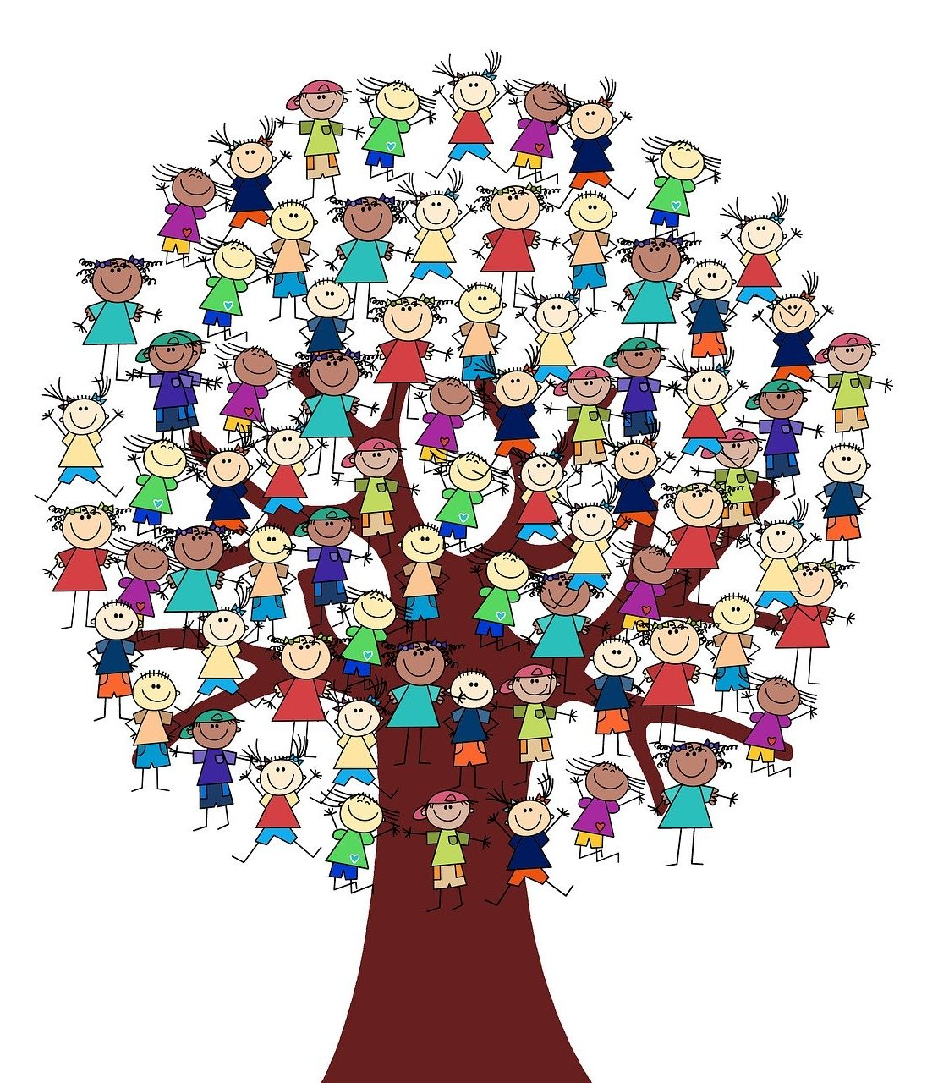
The school teachers board is a collective body composed of the teachers working for the school, regardless of their employment status. It is chaired by the school head or the legal substitute. The school teachers board is responsible for establishing guidelines for the optimum operation of the school. Decisions issued by the school teachers board always comply with the education legislation. Furthermore, the school teachers board is responsible for implementing the curriculum and daily timetable, supervising pupils/students, keeping school areas clean and organising the school. It meets regularly, prior to the beginning of the school year and once at the end of every term and exceptionally, when necessary.

Slide 19
The school life counsellor is provided for in every secondary education school. The school life counsellor is designated by the educational co-ordinator, who is competent for the school unit, upon recommendation of the school head and suggestion of the school board. This institution complements and assists the existing school supporting institutions i.e., the school board, the school head, the educational co-ordinator, without substituting them or the overarching supporting structures. He/She belongs to the school’s teaching staff and contributes to building trust among the members of the educational community. He/She intervenes, guides and informs students, parents and guardians on matters concerning the school unit, such as:
Crisis management (school bullying, cases of violence in school, aggressive behaviour)
Extreme behaviour (racism, diversity) prevention
Learning difficulties
Inclusion and integration
Students with particular capabilities, gifts and talents
Transition to other grades, school mobility
Counselling and parents groups

Slide 20
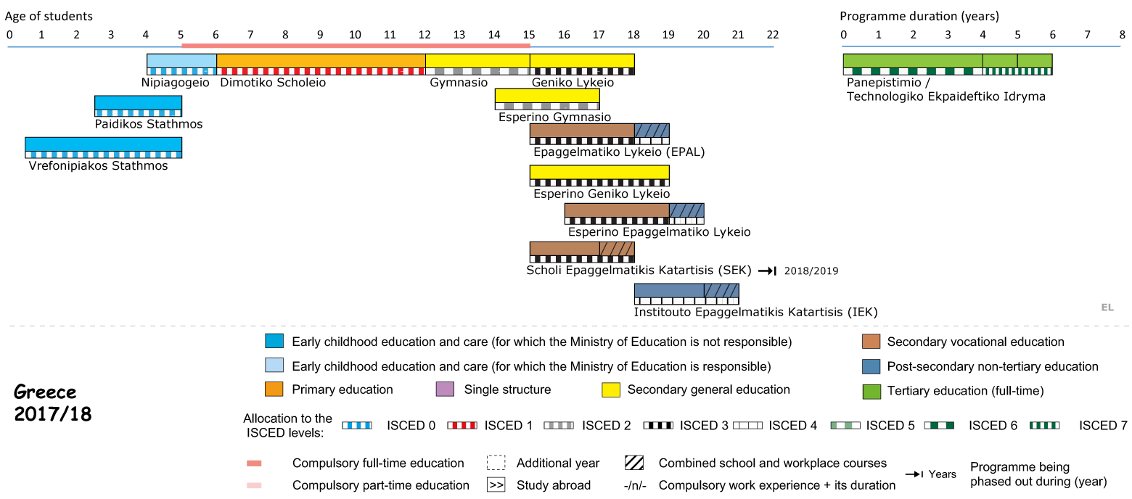
Structure of the National Education System

Slide 21
Primary Education
Pre-primary education in Greece is compulsory for all 4-year-old children.
Infant/Child Centres (Vrefonipiakoi Stathmoi) and Child Centres (Paidikoi
Stathmoi) represent early childhood care.
Primary School
Primary Education is the next stage. Primary School (Dimotiko Scholeio) spans 6 years.
1 to 12 years

Slide 22
2. Secondary Education
Lower Secondary School
The first one is compulsory and corresponds to Lower Secondary School (Gymnasio).
It lasts 3 years
It provides general education
It covers ages 12-15
It is a prerequisite for enrolling at General or Vocational Upper Secondary Schools
Parallel to Day Gymnasio, Evening (Esperino) Gymnasio operates. Attendance starts at the age of 14.
12 to 15 years

Slide 23
Upper Secondary School
The second one is the optional General or Vocational Upper Secondary School (Geniko or Epaggelmatiko Lykeio).
It lasts 3 years
Pupils enrol at the age of 15
There are two different types:
General (Geniko) Lykeio. It lasts three years and includes both common core subjects and optional subjects of specialisation
Vocational (Epaggelmatiko) Lykeio. It offers two cycles of studies:
the secondary cycle
the optional post-secondary cycle, “Apprenticeship Class”.
Parallel to day Lykeia,:
Evening General (Esperina Genika)
Evening Vocational (Esperina Epaggelmatika)
15 to 18 years

Slide 24
Tertiary Education
Higher education is the last level of the formal education system. Most undergraduate degree programmes take 4 academic years of full-time study. Postgraduate courses last from one to two years, while doctorates at least 3 years.
HE comprises:
The University Sector (Panepistimio)
Universities
Polytechnics
The School of Fine Arts.

Slide 25
Lifelong Learning
Lifelong Learning policy in Greece is part of a wider development plan. Non-formal education can lead to certifications recognised at national level.
Lifelong Learning is provided by:
Vocational Training Institutes (Institouta Epaggelmatikis Katartisis)
Lifelong Learning Centers (Kentra Dia Viou Mathisis)
Vocational Training Schools (Scholes Epaggelmatikis Katartisis)
Colleges (Kollegia).

Slide 26
Thank you

