Slide 1
Nature in Sigulda
Kristians Lelis
Sigulda Town Secondary school 5.a

Slide 2
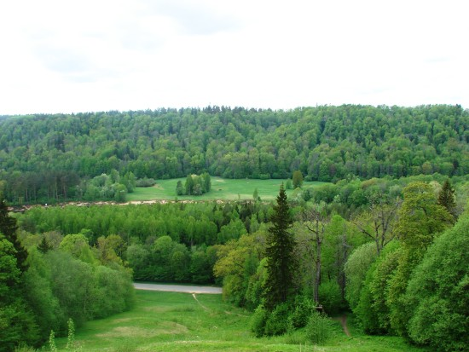
Trees in Sigulda
Trees in Sigulda
Latvian national tree is the oak. It symbolizes strength and endurance. Sigulda Dainu Hill is oak alley. A circle of oaks is formed there and across them flits a big stone sculptures.
In Sigulda there are a lot of trees. Most common are spruce, birch, linden, maple and others. In autumn, when the leaves are red you can see very beautiful views from “Gleznotājkalna” , Festival Square and other locations. Sigulda in autumn is very beautiful.
Sigulda is still known for many spring flowering “ievas-bird cherry tree”. These are trees that bloom with beautiful white flowers. Especially that it blooms here a lot of “ievas”has composed songs for “ievām” wich bloom in Sigulda.

Slide 3
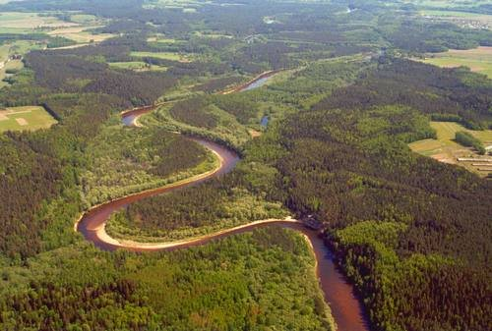
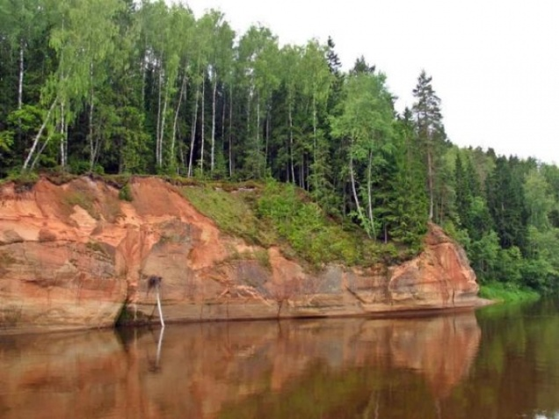
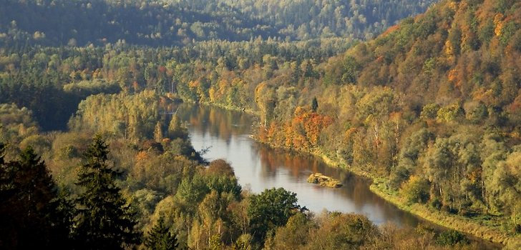
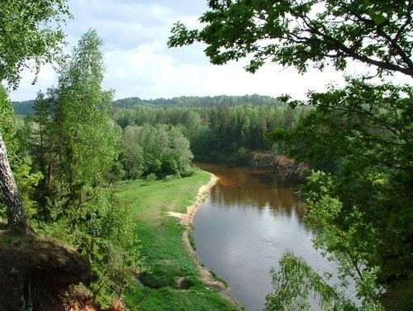
Gauja National Park Sigulda stands out from other Latvian cities for it’s beauty and the fact that it is located in the Gauja National Park. It is the largest national park in Latvia, through it flows the river Gauja. Gauja National Park is full of forests and beautiful scenery.

Slide 4
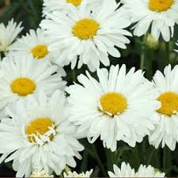
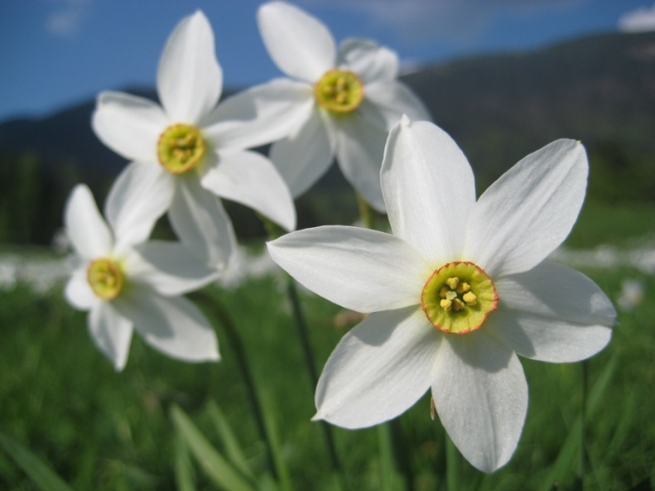
Flowers in Sigulda
The Latvian national flower is marguerite. In Sigulda you may encount them very often. They are very beautiful, but small flowers. They come with a lot of white petals and yellow in the middle.
In Sigulda also grows other colorful flowers. The most popular are tulips, daffodils, snowdrops and other flowers.

Slide 5
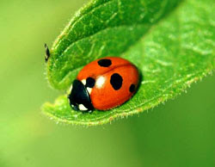
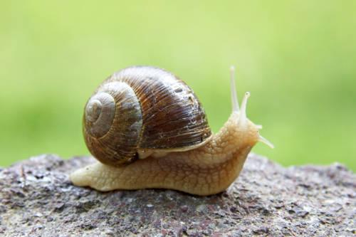
Animals in Sigulda
In Sigulda there are different animals. They can sometimes be seen when coming out from forest to the city. Those people who want a pet at home just buy them at the store. Many insects live in Sigulda. One of them is the Latvian national insect - ladybird lap. It is very beautiful. Yet, there are earthworms, slugs, worms and other insects.
Animals in Sigulda

Slide 6
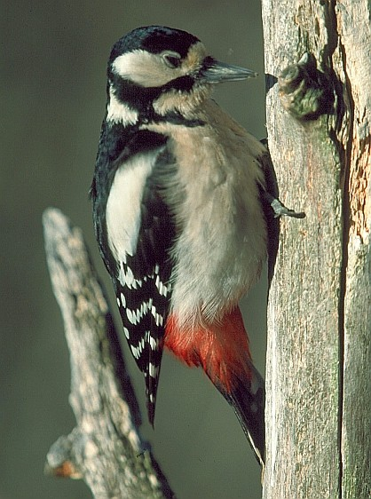
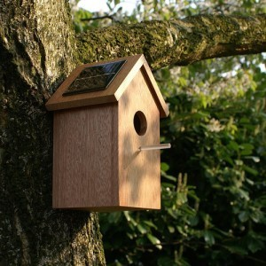
Birds in Sigulda
Sigulda is home to many different birds. They live in nests and sing in the mornings. Birds eat what they find: worms, earthworms, grains, bread, and some other, or look for some man-made cages, where they are fed.
This image shows a woodpecker. This is one of my favorite birds because it is glamorous. Woodpecker differs from other birds in that he mints holes in trees. It eats similarly as other birds.

Slide 7
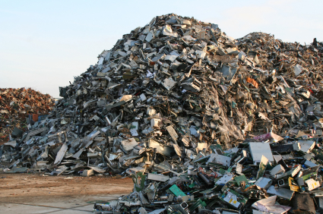
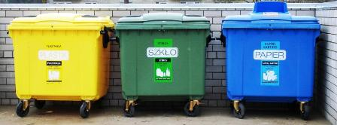
What can I do?
1. I can sort the waste so it can be recycled and reused. The interesting thing is that you can recycle around 84% of home waste.
2. Also I can participate in the joint work and the collection of waste to the surrounding Earth, so it would be cleaner.
3. It is good to install bird feeding areas at home, so that they would not be hungry. However, it must be done carefully, because if you start to feed the birds, they will continue to be feed, because they will be accustomed to what keeps them nourished and keep coming.
4. I can motivate others to separate waste.

