Slide 1
Hi, I’m here because the pollution is very dangerous. And what can we do for it? Or what did we do for it? I’ll tell you what did we do for environment. Let’s do this!!

Slide 2
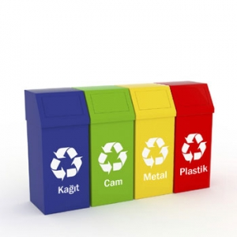
RECYCLE BOX
Recycle box/bin is very cheap and small. Schools can put this their corridor. Students/People can put thier cover in this. When the covers in recycle box, they go to a factory and recycled. This is so easy!!! And not end You can decompose your thing. You can decompose those pine, battery, plastic, food.

Slide 3
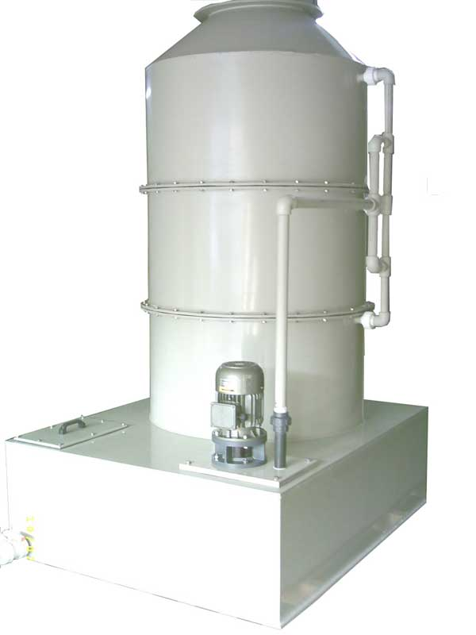
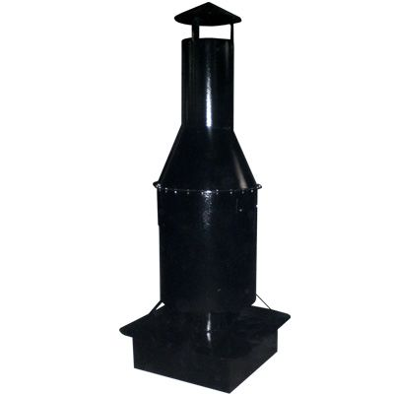
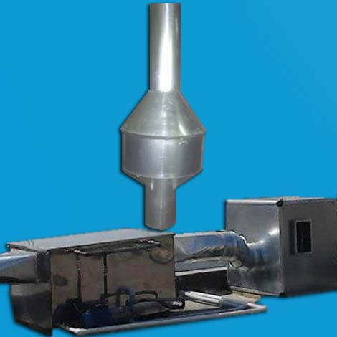
FİLTER
The factories can put a filter on their flue. But this is very expensive so boss aren’t buy this. İf it isn’t there air won’t good!!!

Slide 4
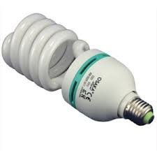
SAVİNG BUMB
You can use this for light but there isn’t so light. You can do this for buy a recycle bin. İf you do this you’ll have 150 try/50 dollars. I have a surprise!! İts so cheaper than a normal bumb. Normal bumb= 5try Saving bumb=2try.

Slide 5
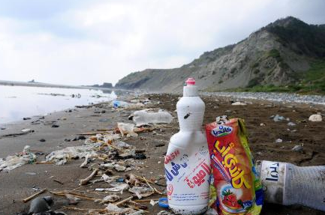
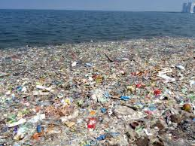
DON’T THROW İN GROUND
Don’t throw Your garbage. Because it’ll make pollution. You can throw it a bin.

Slide 6
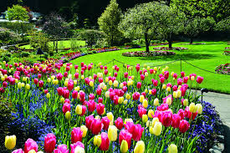
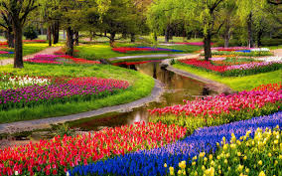
PLANT FLOWERS
İf you have a garden you can plant flowers in your garden. İt is beatiful

Slide 7
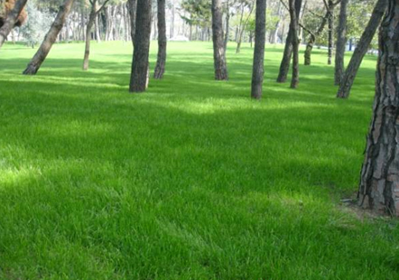
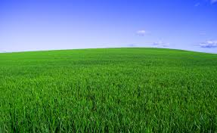
GROW UP TO LET
İf you have a garden , you can to let grow up the grass. İt isn’t very big.

Slide 8
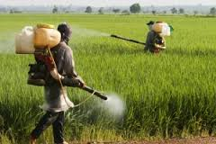
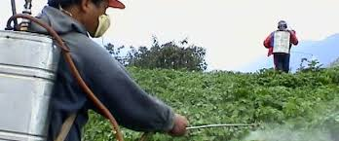
PESTİCİDES
Farmers shouldn’t use pesticides. Because pesticides is very dangerous for animals. İt is dangerous for people too.

Slide 9
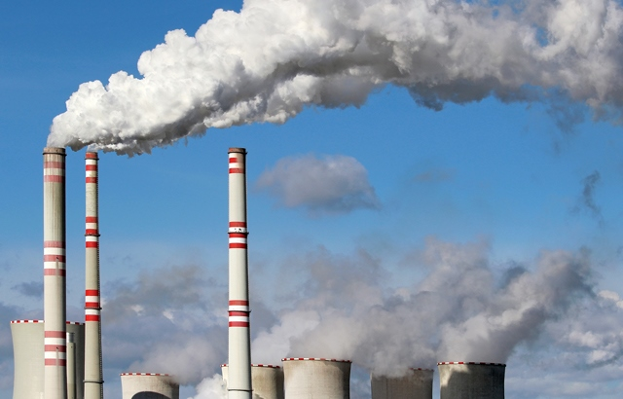
TOXİC GASES
Planes are give this. İt is fatal. And it make air pollution. And birds die.

Slide 10
END THANKS FOR WATCHED THİS

