Slide 1
GREEN IS EVERYWHERE
BUT NOT NECESSARILY NOW BECAUSE it IS AUTUMN➢
TAMARA DYMEK

Slide 2
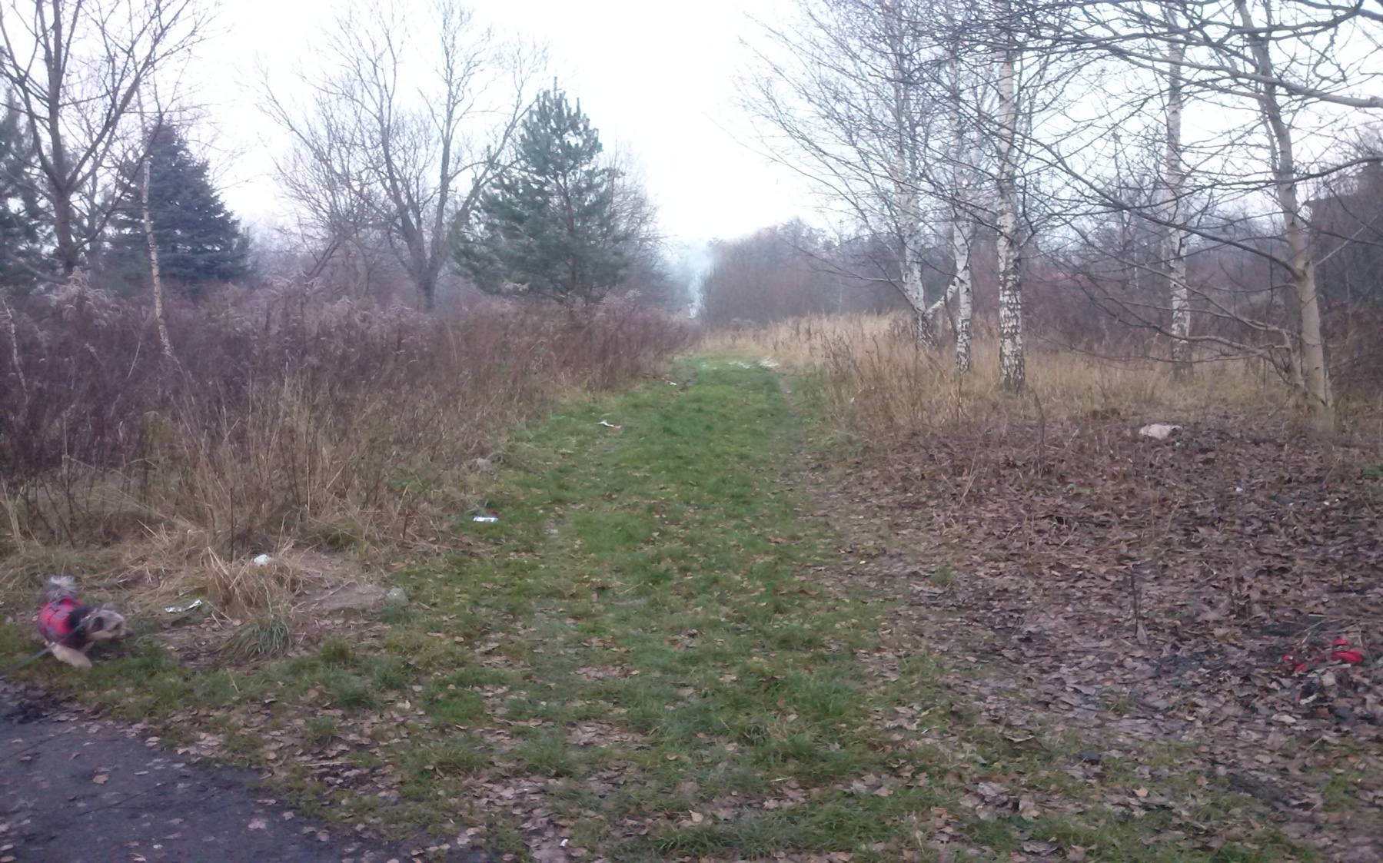
GREEN GRASS
PIMPEK IS NOT GREEN

Slide 3
GREEN IS ON MY WALL

Slide 4
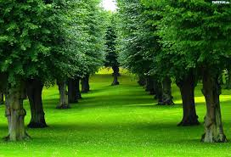
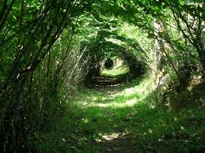
GREEN TREES it the nearby park
Photo from the spring

Slide 5
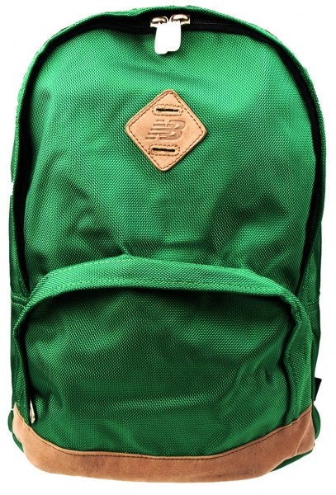
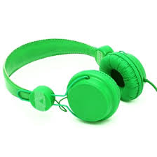
GREEN COLOR IS BEAUTY

Slide 6
IN HOUSE WE HAVE LOT OF GREEN THINGS
◻↓

Slide 7
VERY BEAUTIFUL VIEW FROM THE SPRINGTIME

Slide 8
GREEN ISN’T A COLOUR
GREEN IS LIFE

Slide 9
GREEN IS EVERYWHERE
GREEN

