Slide 1
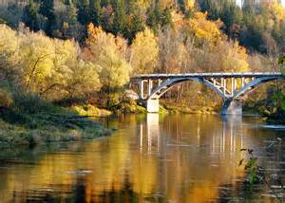
Sigulda
By Krisjanis Salenieks
From
Sigulda Town Secondary School
5.A class

Slide 2
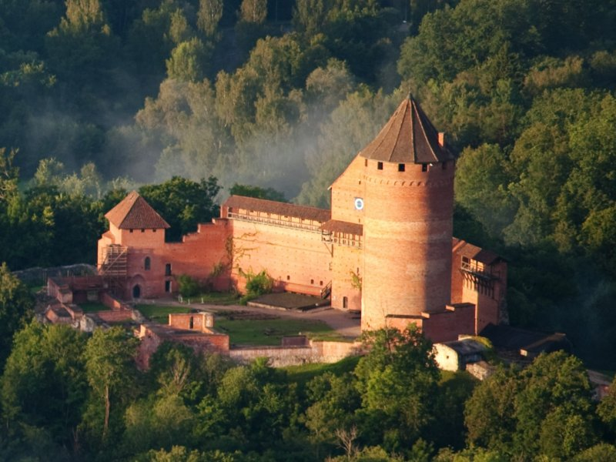
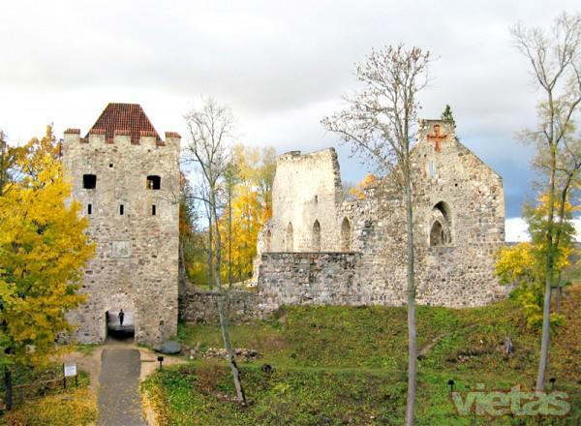
Ruins of castles in Sigulda
This is Turaidas castle was ruled by Livs . Turaida means ‘’The garden of the gods.’’
This is Siguldas old castle ruins . Once it was ruled by The order of Livonia

Slide 3
River Gauja
This is river Gauja
It is about 452 kilometers long . It has a bridge going over it .The bridge connects Sigulda to Turaida.

Slide 4
Foto gallery

Slide 5
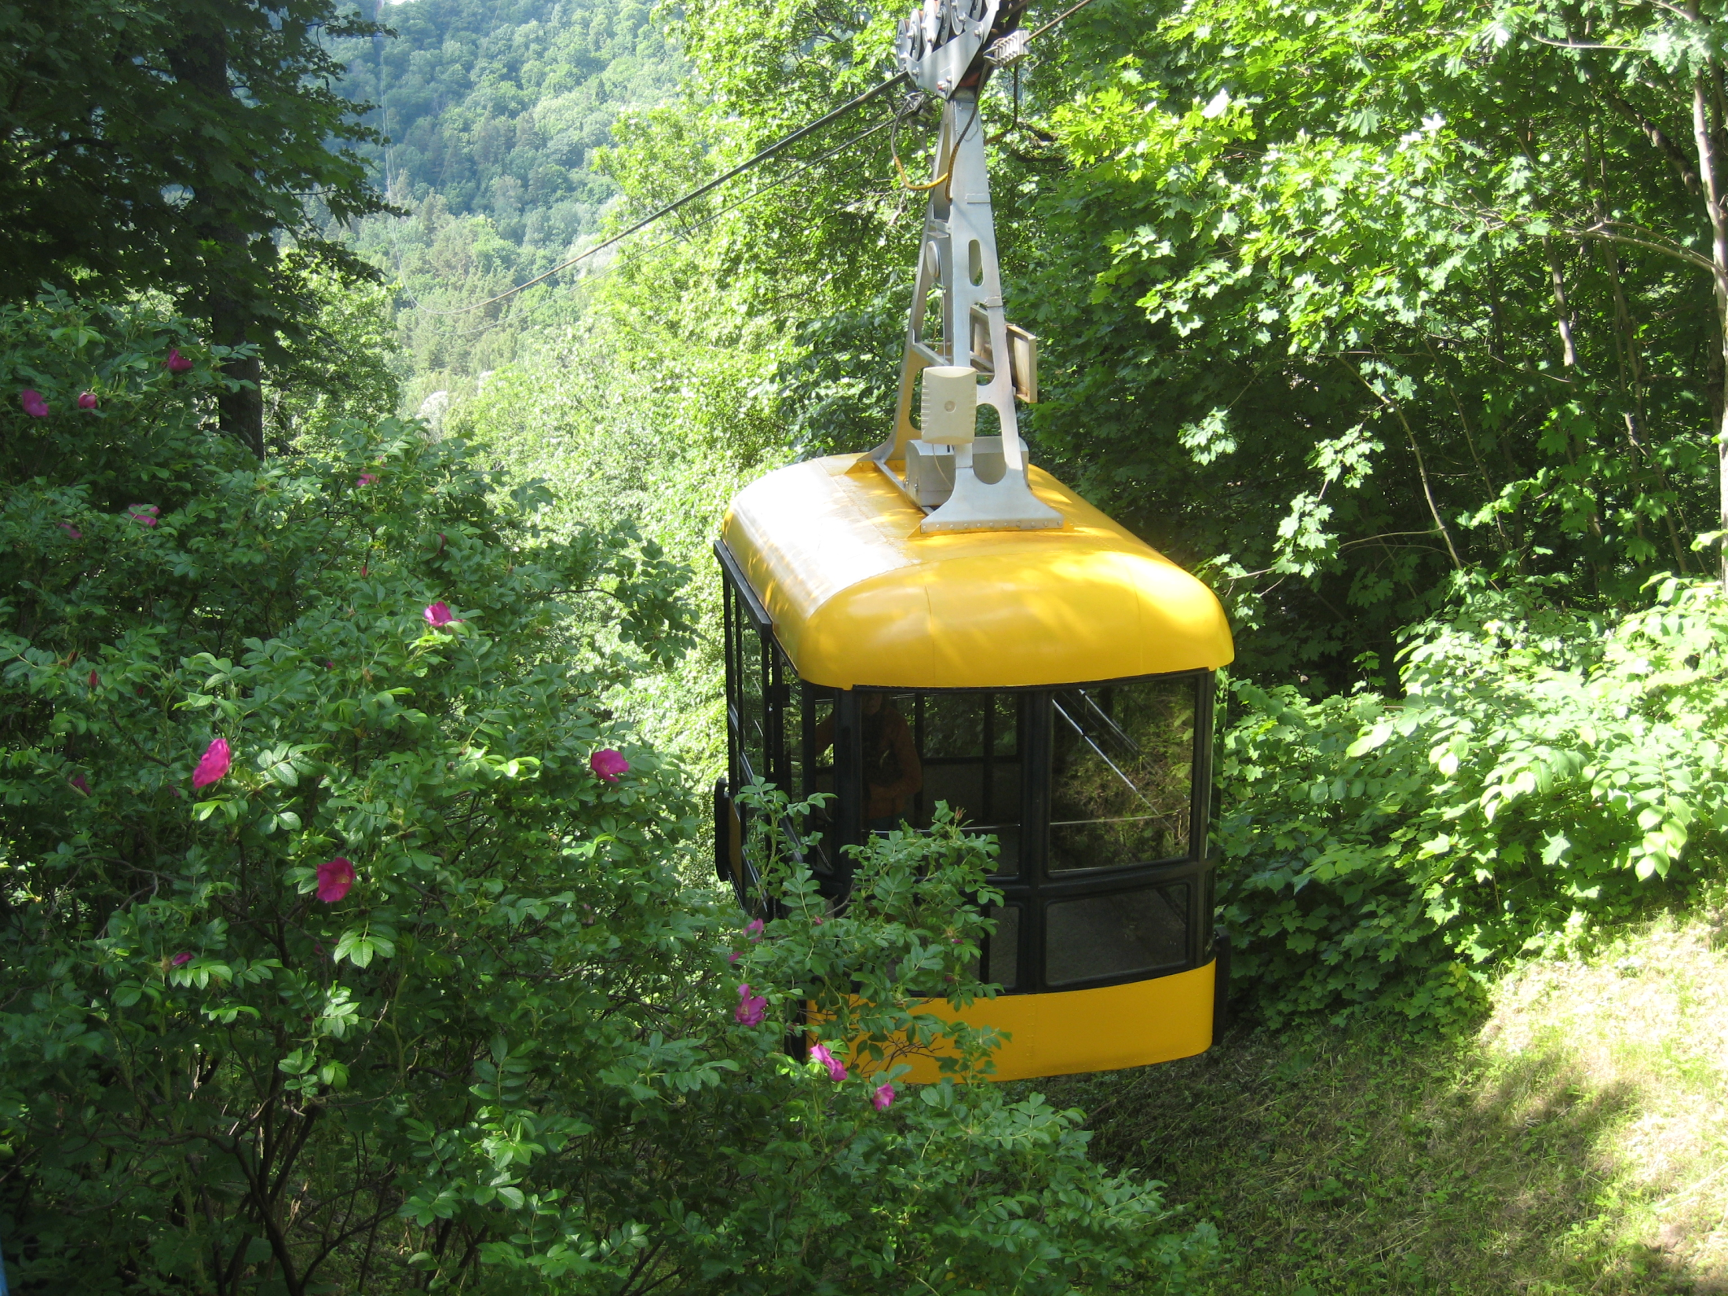
Sigulda’s cable car

Slide 6
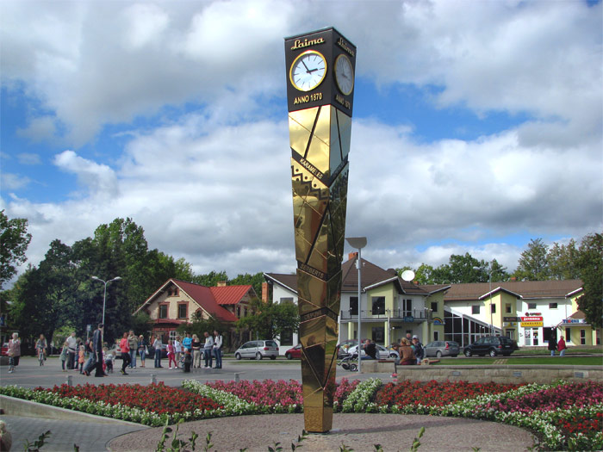
Laimas clock

Slide 7
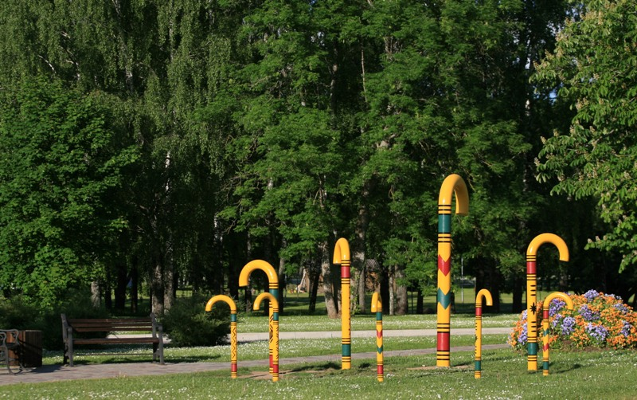
Cane park

Slide 8
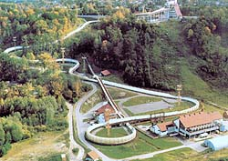
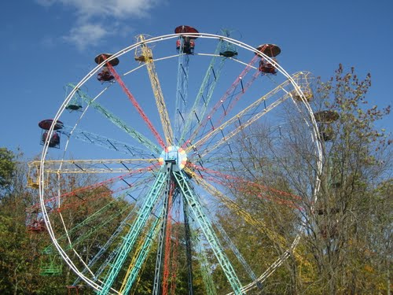
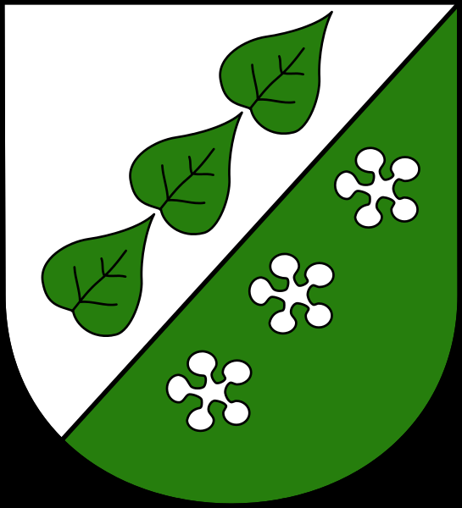
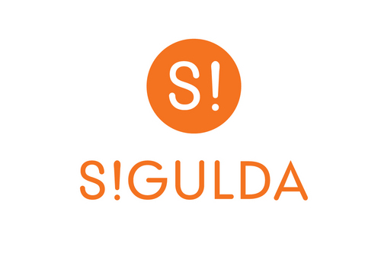
Sigulda’s symbols

