Slide 1
If you love animals you must be a good man!
We choose the best photo of a students and their pets.
Every year action:
Me and my pet

Slide 2
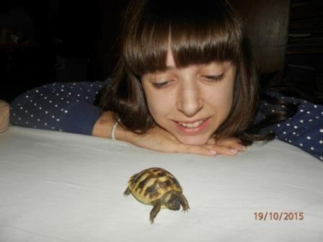
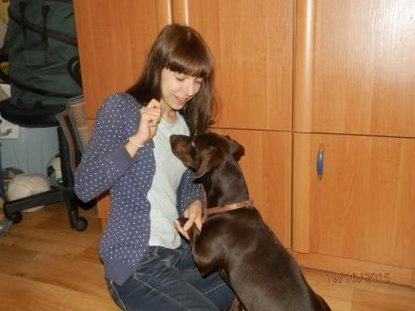
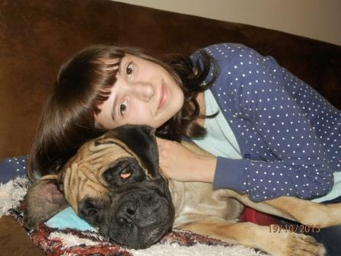
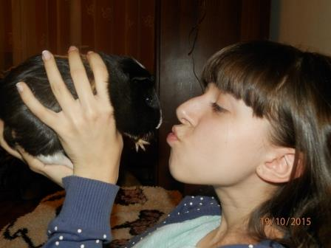
A
G
A
T
A
S
Z
C
Z
E
P
O
C
K
A
I
P
U
P
I
L
E
NIKO
ATOS
NUKA
PIGI

Slide 3
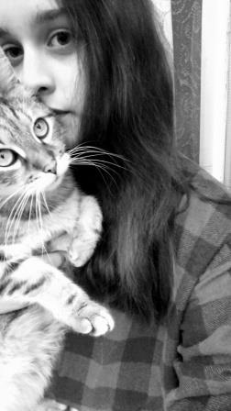
Diana Czypionka & Pucuś

Slide 4
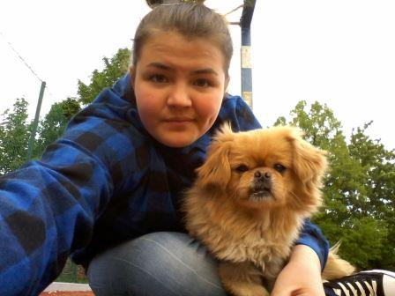
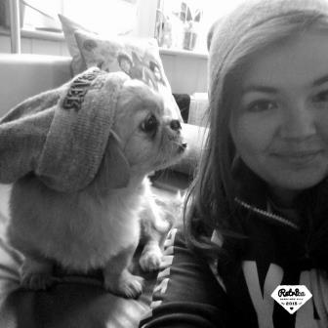
Natalia Kasprzyk
I
SUSU

Slide 5
Wanesa Stefaniak & Maniek

Slide 6
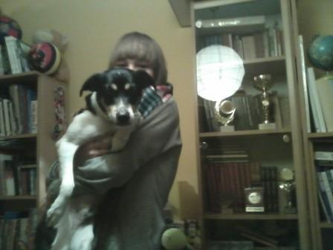
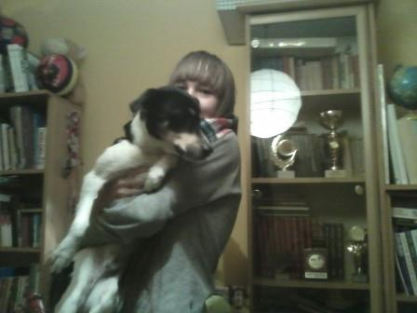
Oliwia Mandat
and her Dropsik;-)

Slide 7
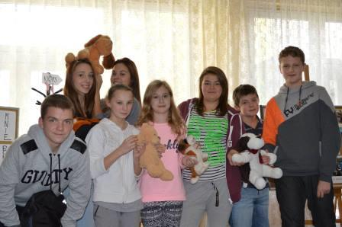
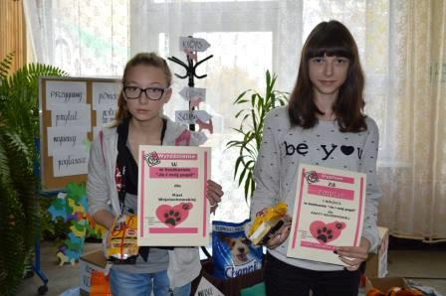
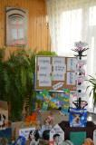
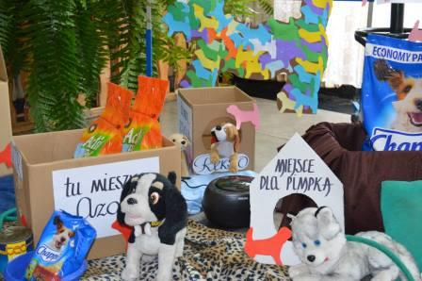
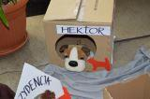
The every year action is summed up with raising food and
warm blankets for the homeless animals in the shelter.

