Slide 1
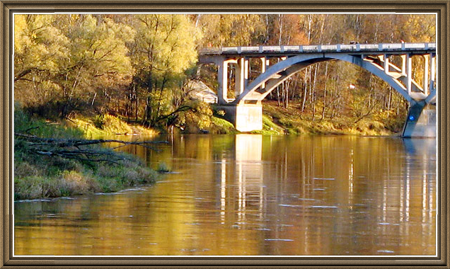
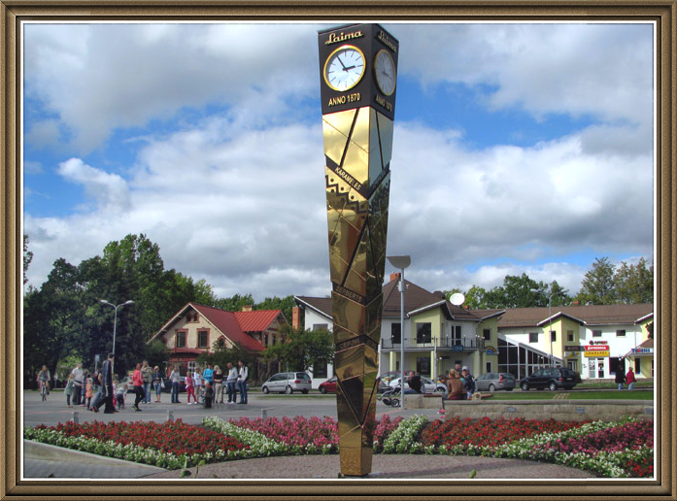
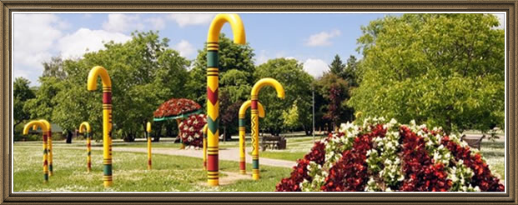
Sigulda
Sigulda is beautiful.
In Sigulda is Gaujas Nacional park.

Slide 2
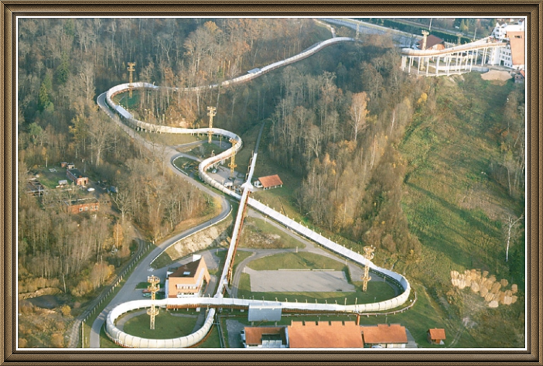
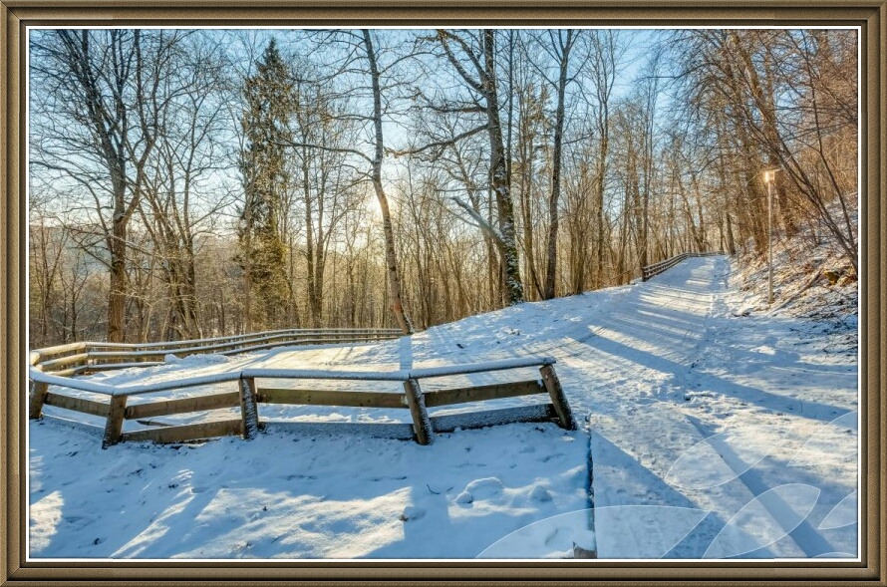
In Sigulda is Bobsleight track.
In Sigulda are two Serpentine tracks.

Slide 3
This is Siguldas castle

Slide 4
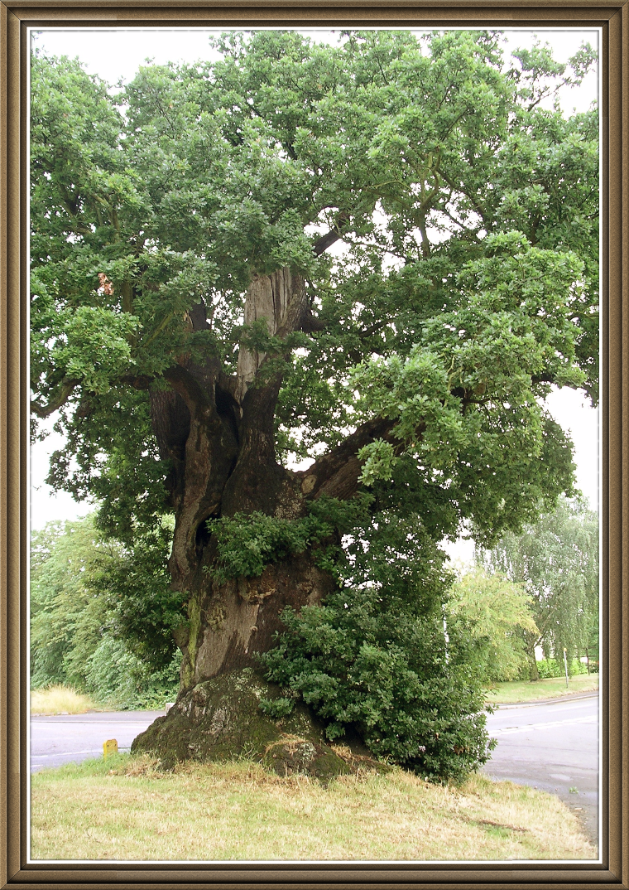
Ozols is Nacional tree (Oak)

Slide 5
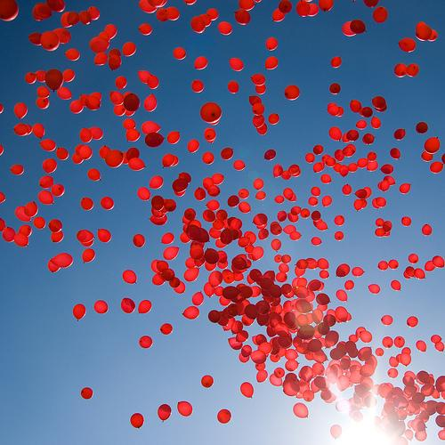
Made Luize Indriksone and Sindija Šefere

