Slide 1
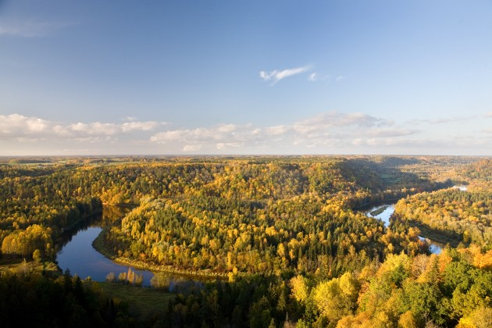
Green S!gulda
We live in Gauja National Park.Our city is green and beautiful!It`s called Sigulda.

Slide 2
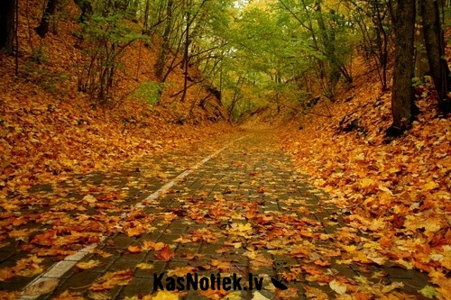
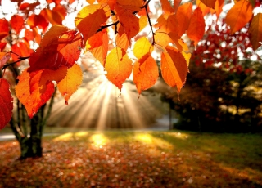
Golden Fall!<3
A few beautiful sights of our town in autumn.Amazing, right?

Slide 3
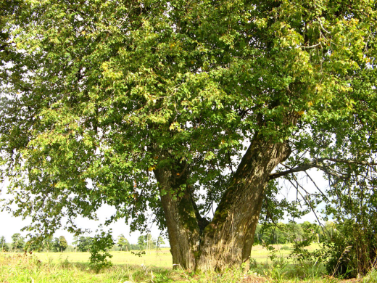
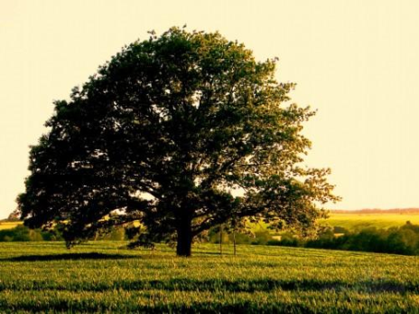
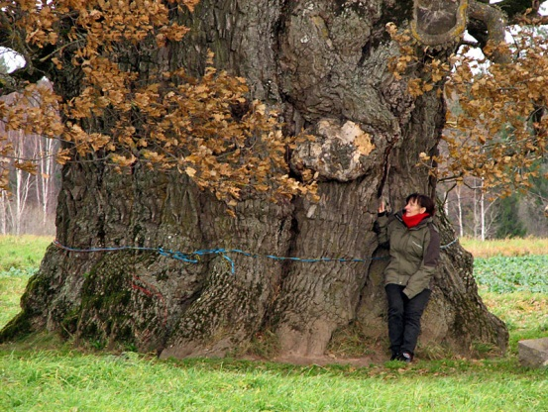
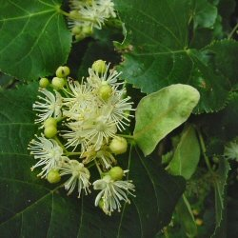
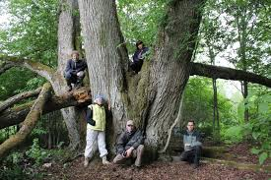
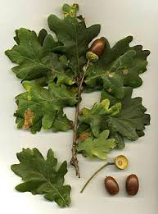
Nature
This may be not in Sigulda, but I`ll show you some of our national trees.
Let`s make nature look more beautiful!
One of our national trees in oak.It can grow very big like in the picture below.These trees are protected with law.
Our second national tree is called small-leaved lime.It can also grow very big but it`s not protected.

Slide 4
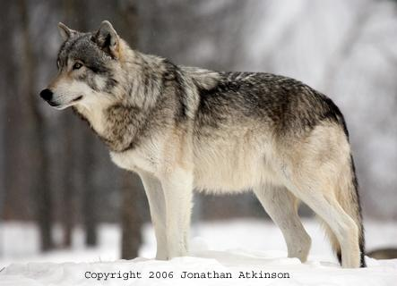
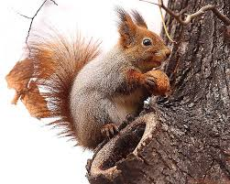
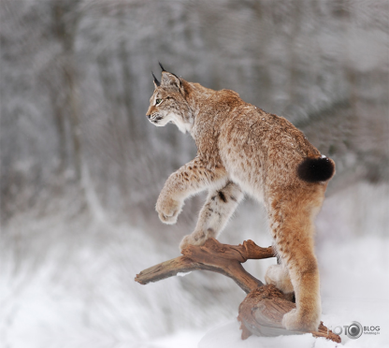
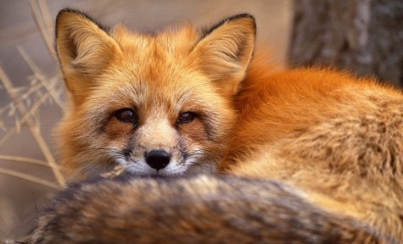
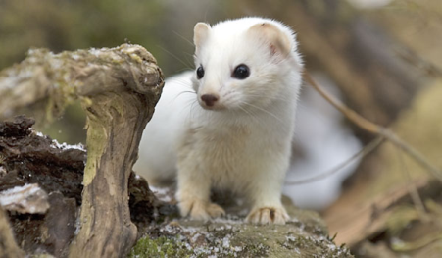
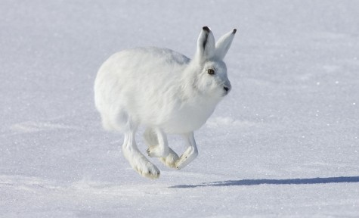
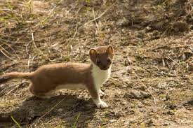
Animals
We have a lots of beautiful wild animals.
Translation:
vāvere – squirrel
rudā lapsa – red fox
zaķis – hare,bunny
vilks – wolf
lūsis – lynx
sermulis - stoat

Slide 5
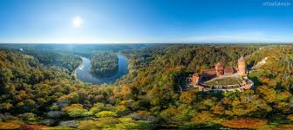
At the end
My presentation is over!At the end I wanted to say that I love my town, country and nature!I hope you do love yours!Let`s keep our nature green – ’’Green is Everywhere!’’

