Slide 1
Green Sigulda green is everywhere
Latvija

Slide 2
Content 1.Green is everywhere. 2.Animals. 3.Herbs. 4.Oaks 5.Sigulda herbs

Slide 3
Green Sigulda Green is everywhere
We live in Sigulda. Here is the Gauja national park. Sigulda is known for the golden autumn. Sigulda is the tarzan advanture park and the air ropewav. Sigulda is a lot of cafes where you can eat.

Slide 4
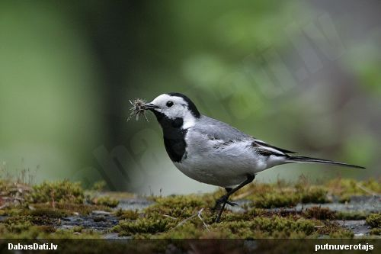
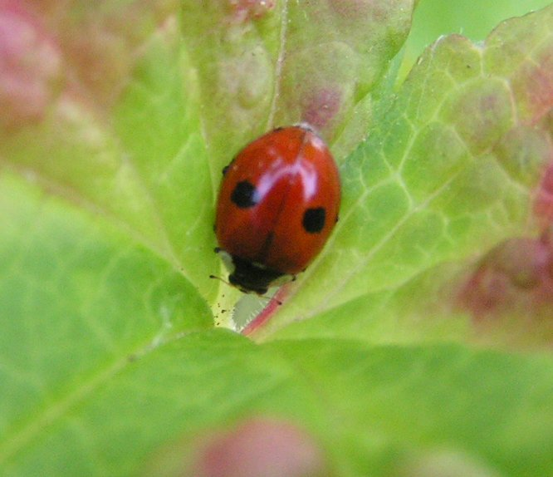
ANIMALS
Wagtail
Ladybird
Sigulda is the national bird wagtail.
People consider that a ladybird brings happiness.

Slide 5
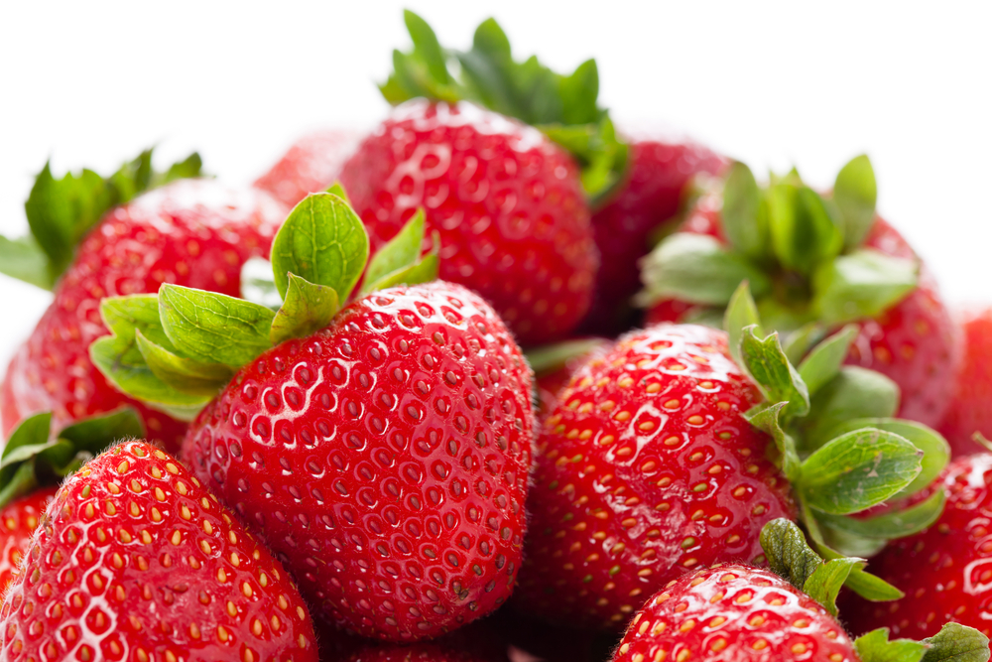
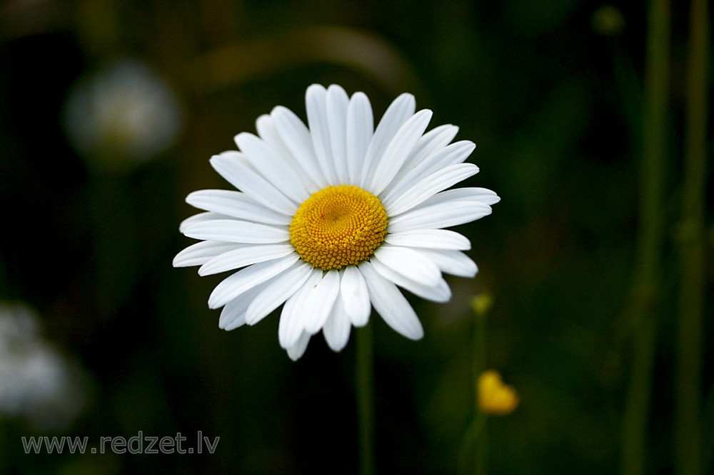
Herbs Sigulda national plant has daisy. Sigulda tasting a strawberry plant.

Slide 6
oaks
Černovsku oaks.This is bigest tree in Sigulda.
This tree grows here for a couple hundred years.

Slide 7
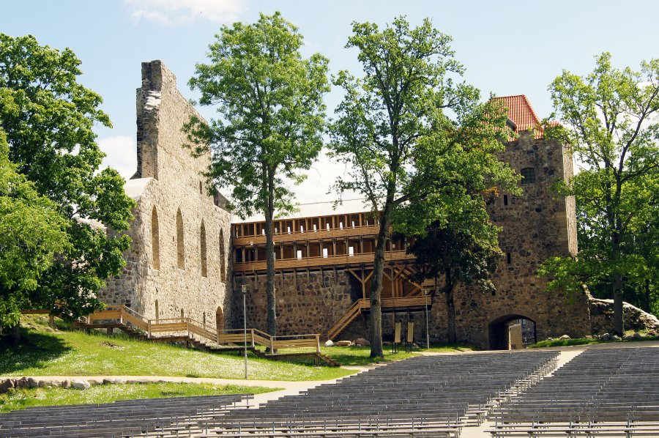
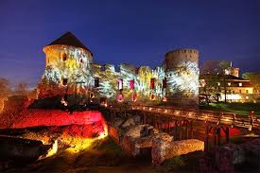
Sigulda building
Siguldas most famous building is the Sigulda castle.
Day Night

