Slide 1
Does river Toplica extince.
Autors:Jovan Vucetic,Andjela Veljic,Kristina Savic,Teodora Ivanovic.

Slide 2
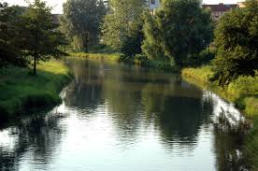
River fairytale
Toplica for centures was a real sorcceress.Apart fromo being watersd fields and livestock,at eery access place from Kopaonik to the South Moraa on it over the summer refeshment found remember the clear and rapid rivr who in a large harbor descibes the Hisar hill with old tor tress at the top.

Slide 3
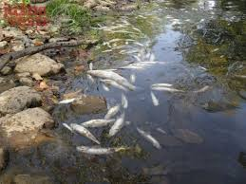
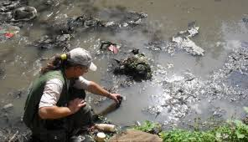
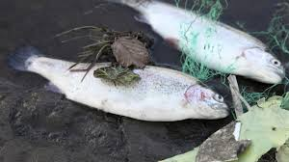
Animal
Unifortunately,this is all stories that look like on Plants.Today,this river is with the fourth level of pollution.
Dragan Stamerkovic, one of the most famous spor fishmar of tgis area,says thatin Toplica there aren,t seashells,crabs,and there are less indigenous fish.That is conseauence of pollution ih which there aren,t worms and other insects that are the main food for fish.Killing fish,that happend in Toplica, is still the main topic.Waredens have collected dead fish for two days, and there were some citizens that collected that fish,not knowing thedanger.

Slide 4
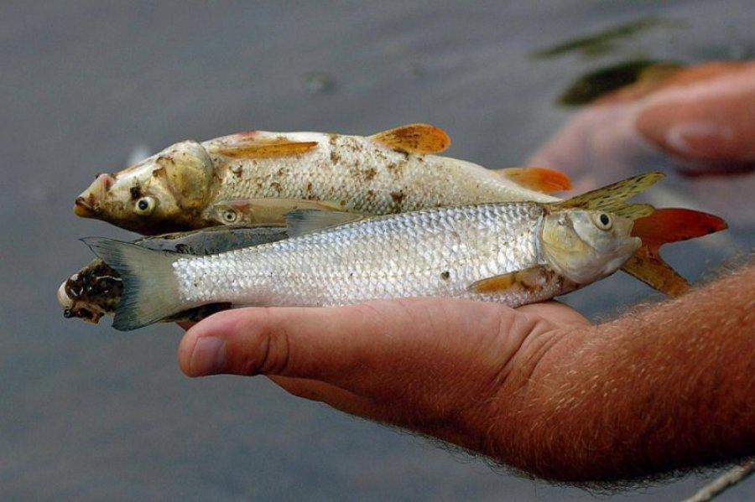
Galery

Slide 5
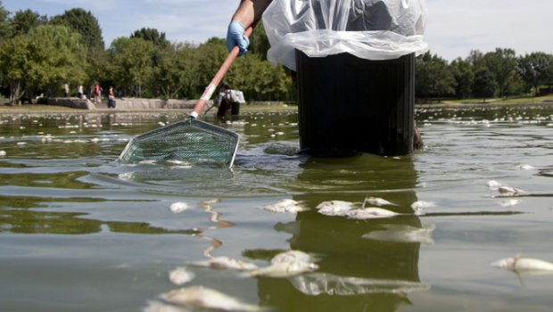

Slide 6
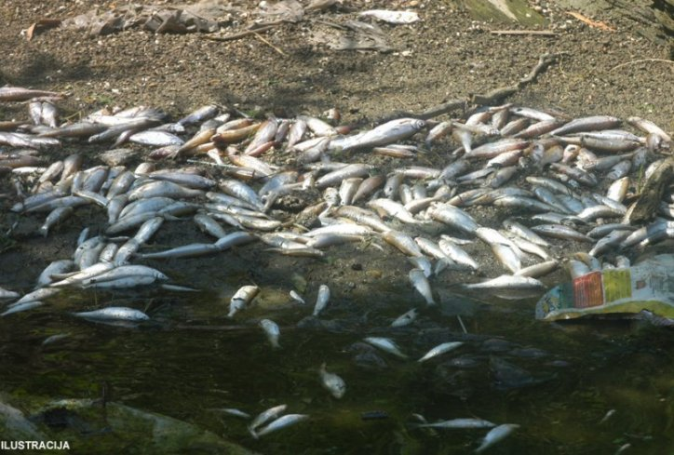
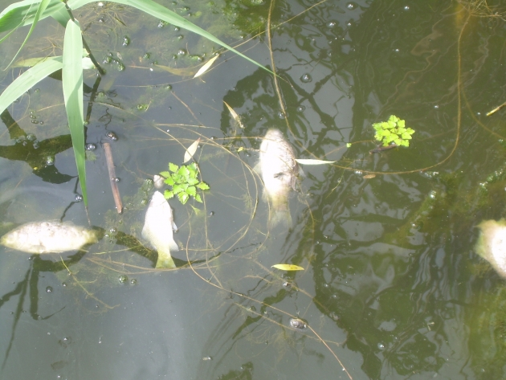
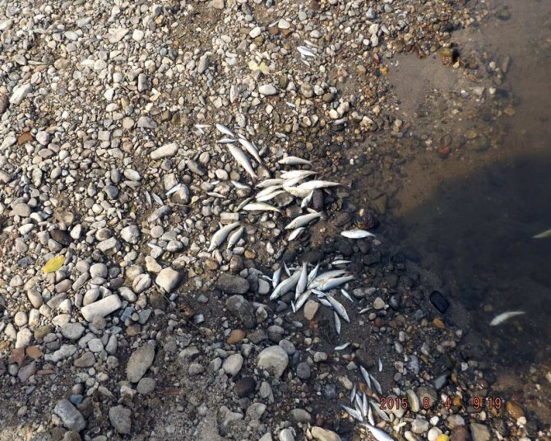
Pictures of event.

Slide 7
Thank you for your attention.

