Slide 1
OUR STUDENTS

Slide 2
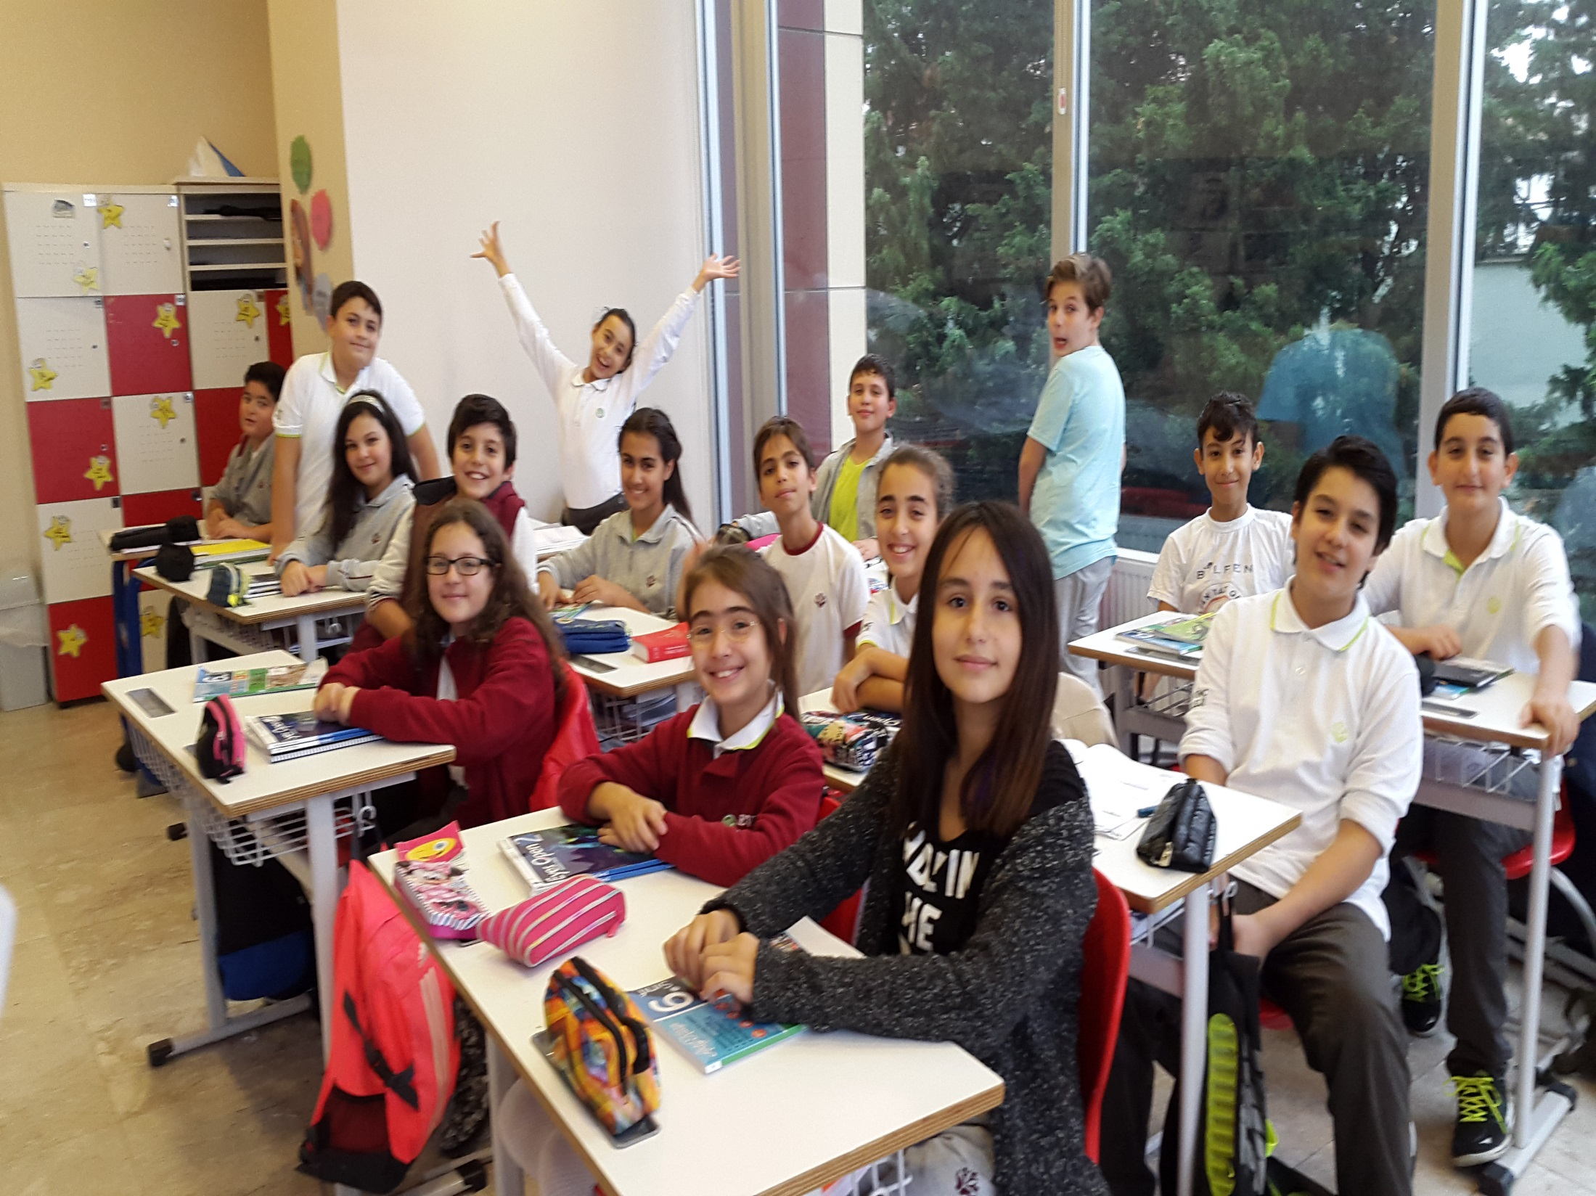

Slide 3
Hello,
my name is
Serhat KONYAR

Slide 4
Hello,
My name is Ali Umut Kazak

Slide 5
Hello,
my name is
Melih Emre AYDOĞAN

Slide 6
Hello,
my name is
Mehmet Ali GÜLTEKİN

Slide 7
Hello,
my name is
Mehmet Eren TEKİN

Slide 8
Hello,
my name is
Şevval Yükselen

Slide 9
Hello,
my name is
Tolga ÖZKAYA

Slide 10
Hello,
my name is
Sena KARABIYIK

Slide 11
Hello,
my name is
Harun EMİR ERDEM

Slide 12
Hello,
my name is
Yusuf DOĞRUER

Slide 13
Hello,
my name is
Şimal DERNEK

Slide 14
Hello,
my name is
Azra ALKAN

Slide 15
Hello,
my name is
Doruk UÇAR

Slide 16
Hello,
my name is
Senay HASANOĞULLARI

Slide 17
Hello,
my name is
Tutku CANAVAR

Slide 18
Hello,
my name is
Zeynep ATAY

