Slide 1
NATURE IN SIGULDA
Dārta Auziņa
Sigulda Town Secondary Scholl
Grade 5a

Slide 2
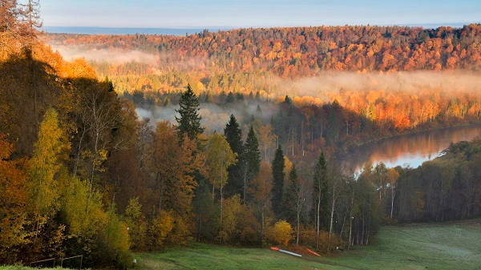
NATURE IN SIGULDA
We live in Gauja National Park
Our nature is green and beautiful
Main value of Gauja National Park is valley of Gauja river

Slide 3
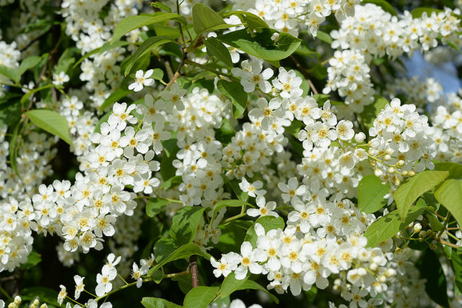
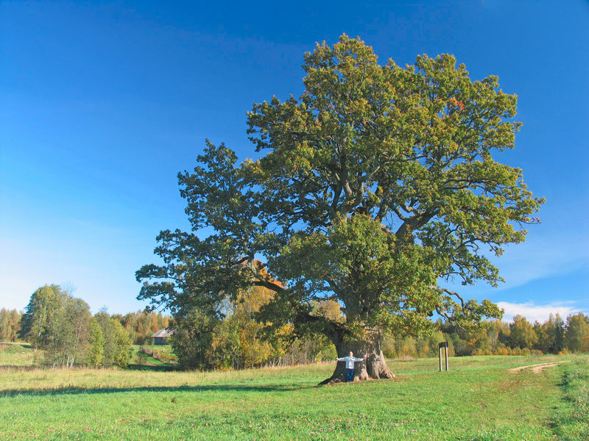
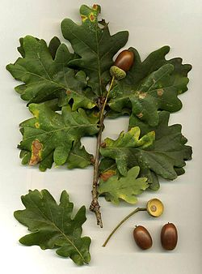
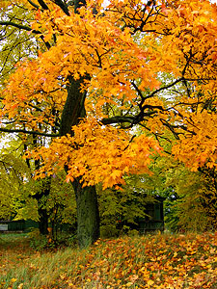
TREES
Ieva - bird-cherry is spring symbol of Sigulda covering banks of Gauja river
Kļava – Norway maple colouring Sigulda town in gold every autumn
Ozols - pedunculated oak is holy tree in Latvia and found in many places around Sigulda

Slide 4
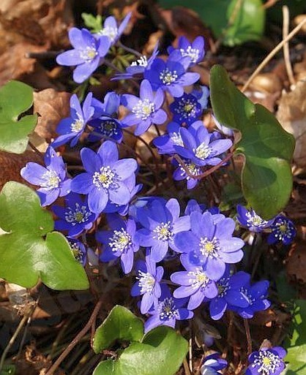
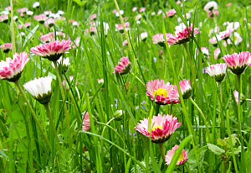
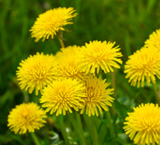
FLOWERS
Zilā vizbulīte – liverleaf creating blue carpet under oaks
Pienene - common dandelion often found around houses and along streets
Mārpuķīte – daisy you can see almost in every lawn

Slide 5
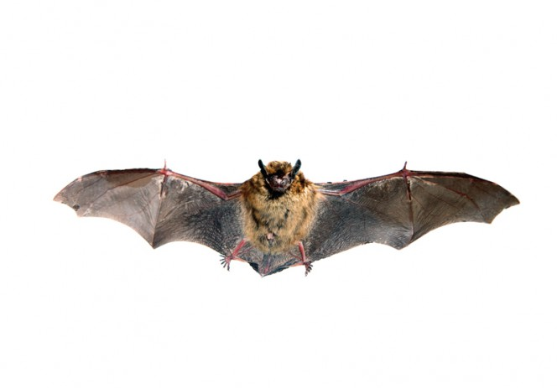
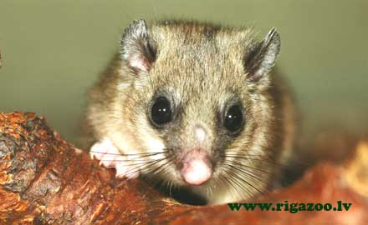
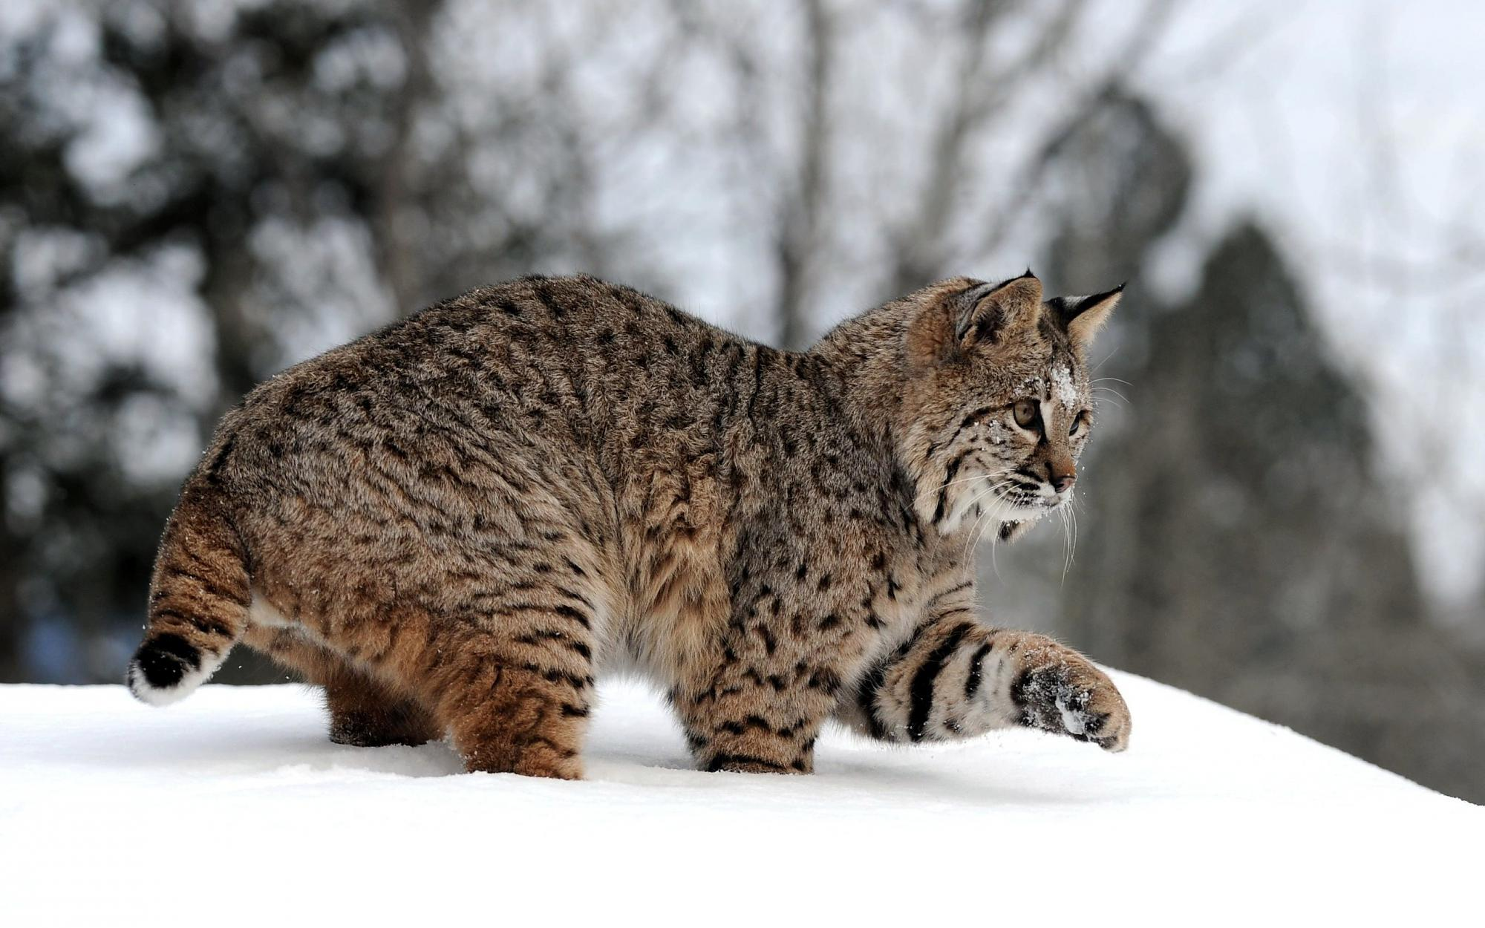
ANIMALS
Sikspārņi – here in Gauja National Park live 12 species of bats
Lielais susuris – fat dormouse is found only in few places in Latvia and also in Gauja National Park
Lūsis – lynx footprints some people have seen in Sigulda

Slide 6
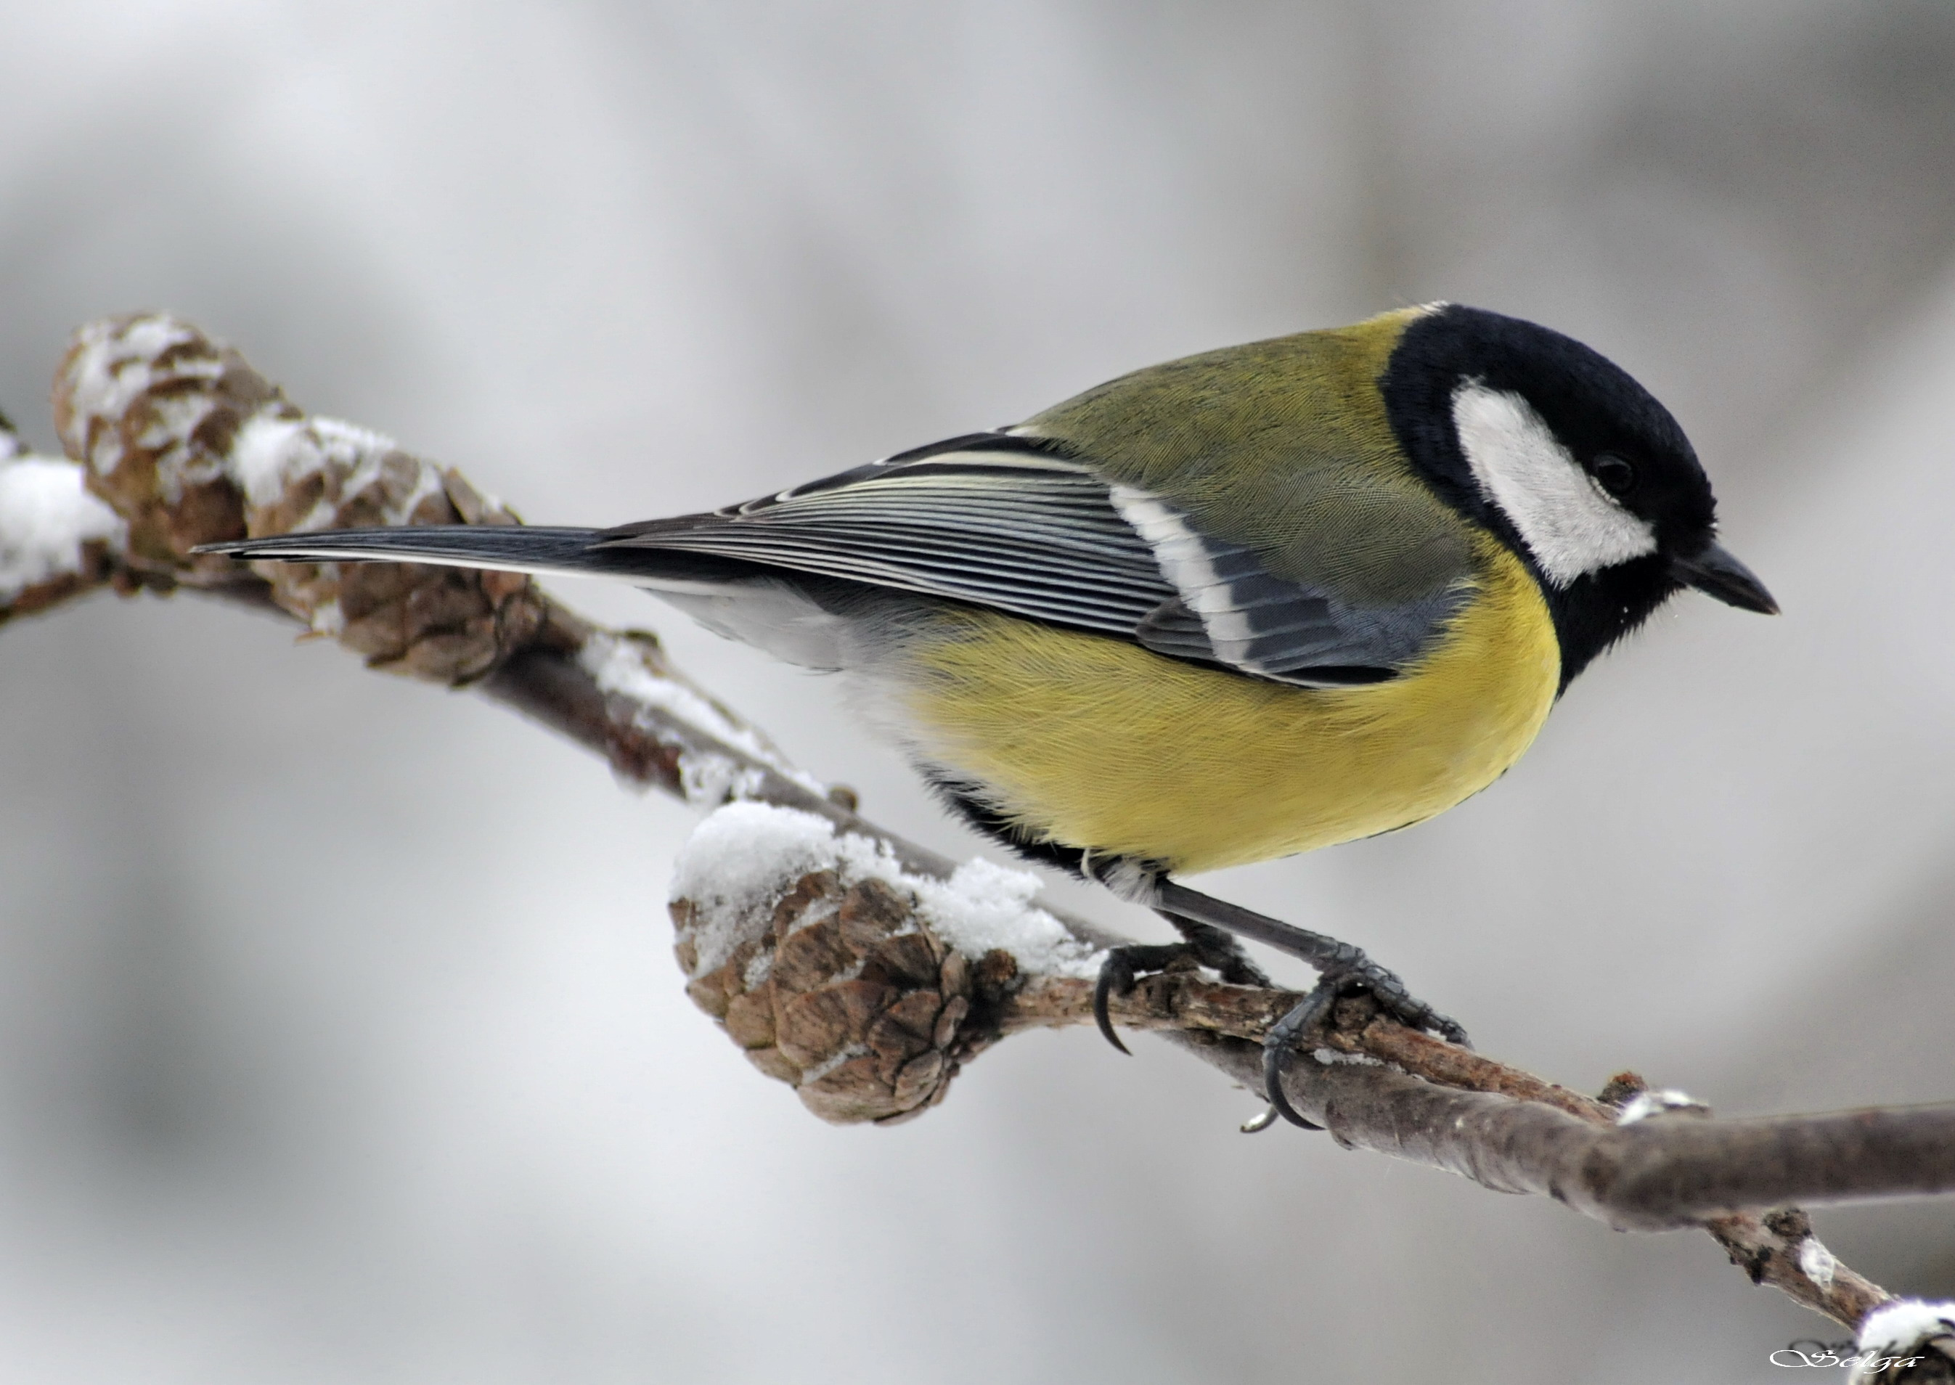
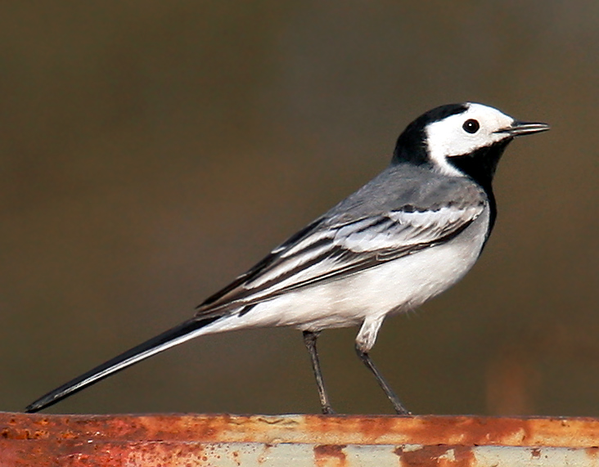
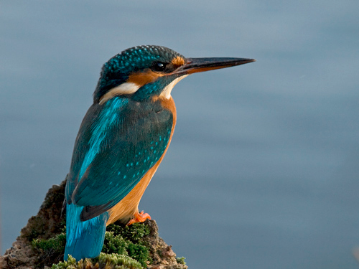
BIRDS
Lielā zīlīte – great tit I see very often from my window
Zivju dzenītis - common kingfisher is very colourful and you can see it along small rivers
Baltā cielava - pied wagtail is national symbol of Latvia and common in Sigulda

Slide 7
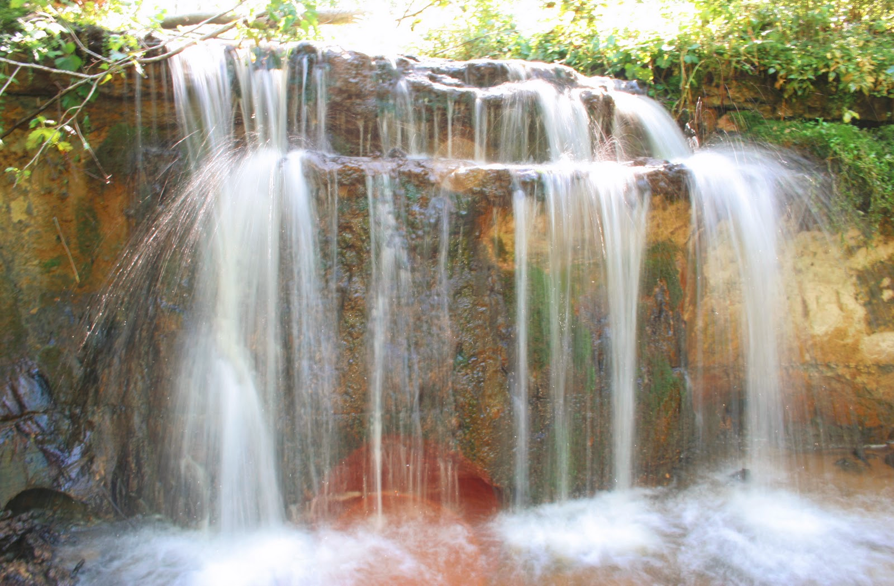
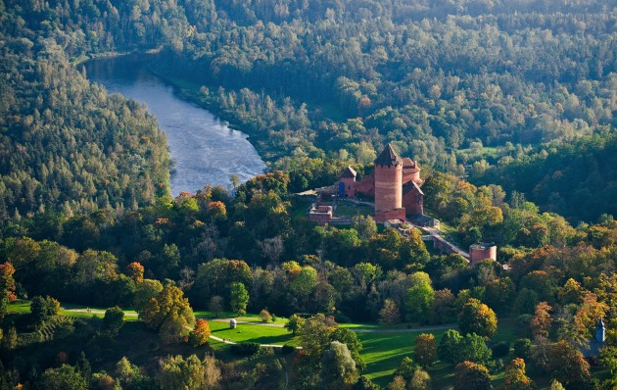
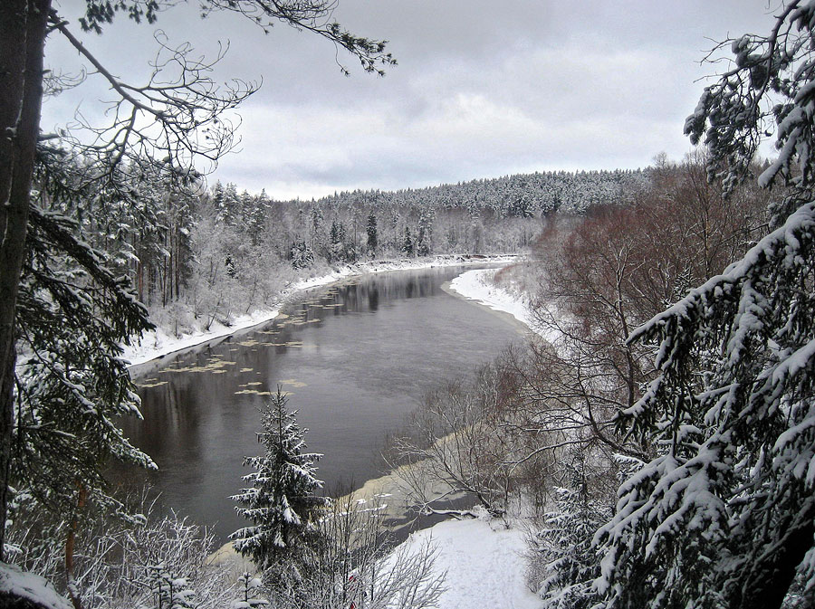
What can I do…
I never litter out in nature
I enjoy flowers and trees in nature, do not bring them home
When I am out in a forest I am quite
I know, I am a guest in nature

Slide 8
WELCOME TO SIGULDA

