Slide 1
GREEN IS EVERYWHERE
Karolina Kudela
Nicole Golek

Slide 2
Hello, folks!
Welcome to the presentation about the most beautiful colour in the world.
And, of course, it’s GREEN! We want to show you, that green is EVERYWHERE!

Slide 3
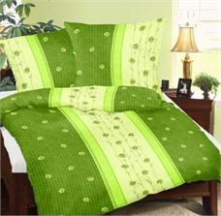
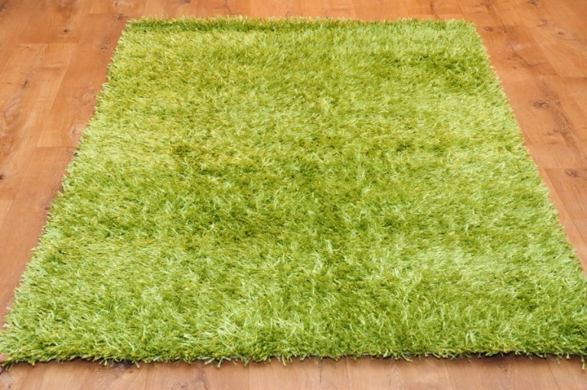
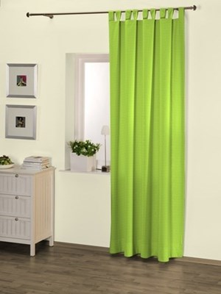
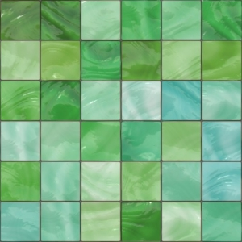
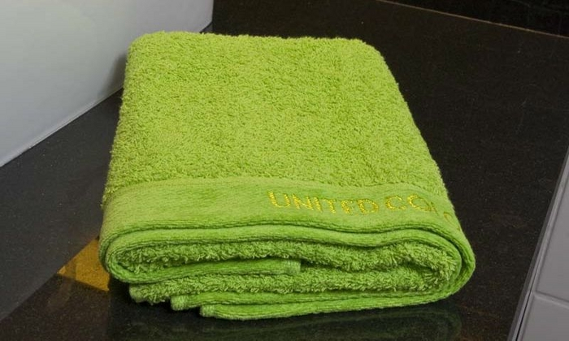
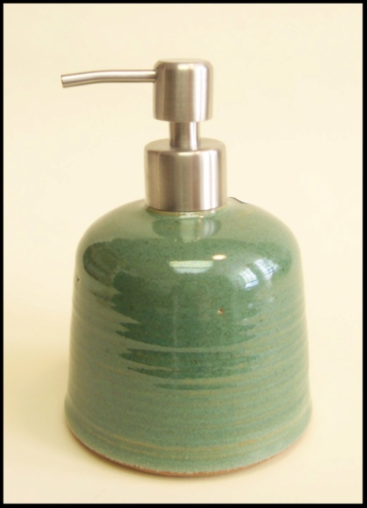
GREEN is in your house
Green accesories and furniture are very popular these times.

Slide 4
Katowice is all green!
Our city, Katowice (Poland) has got a lot of green places. It’s true, that there’s a lot of grey, sad places too, because of road works and stuff. But don’t worry- we love green, and green loves us!

Slide 5
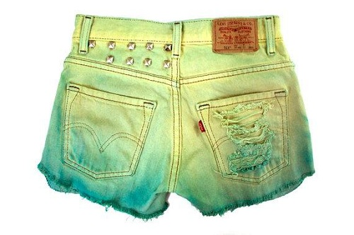
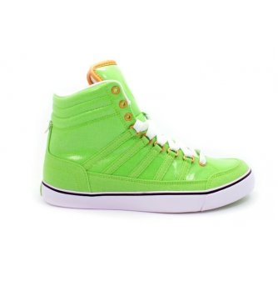
Green fashion
People like to wear green .
It’s a happy and warm colour.

Slide 6
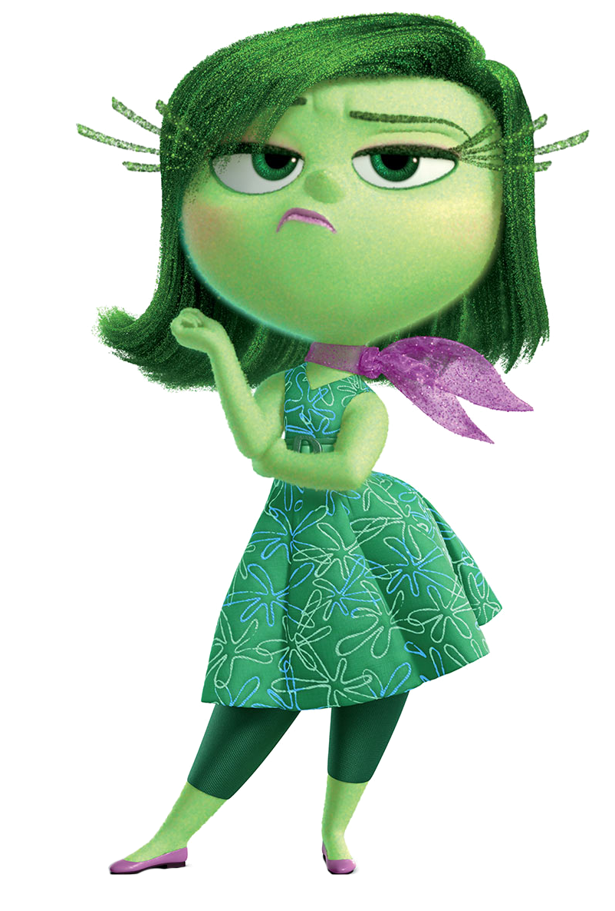
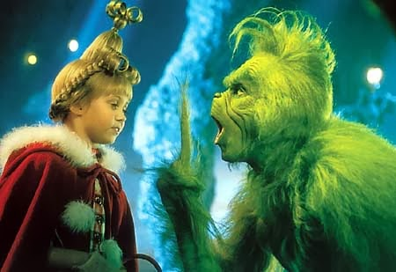
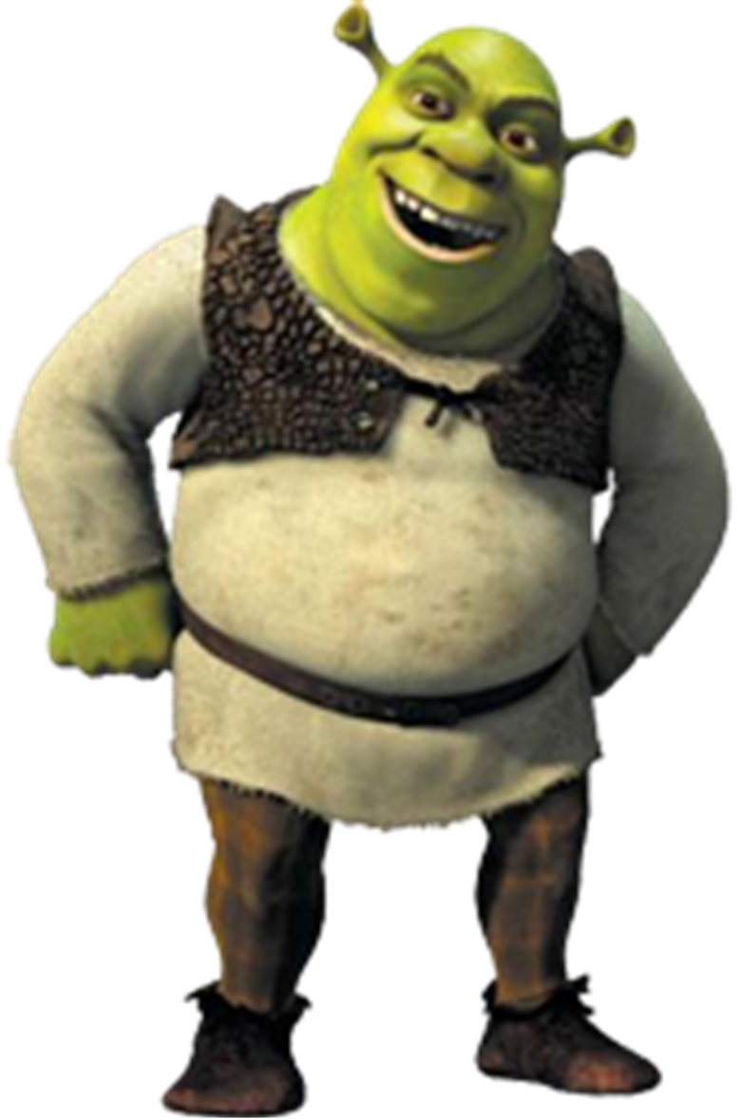
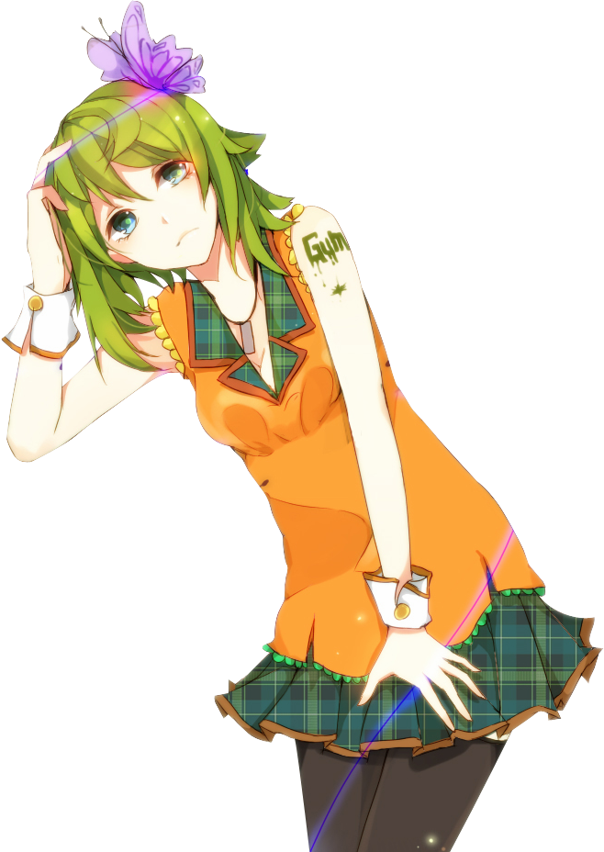
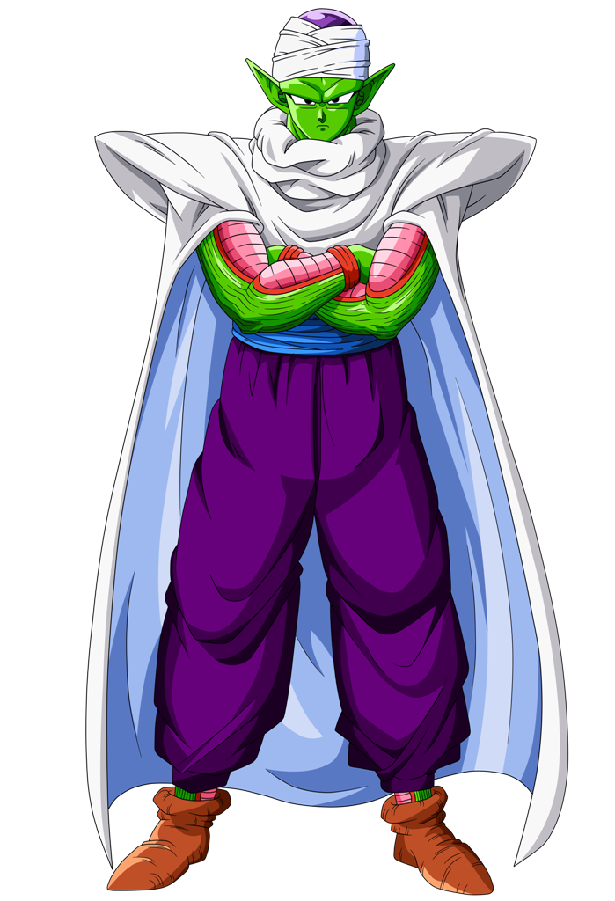
Green like in a fairytale

Slide 7
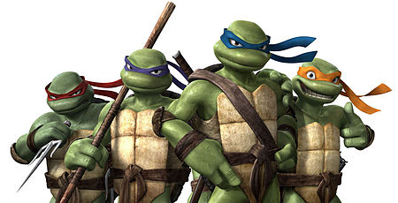
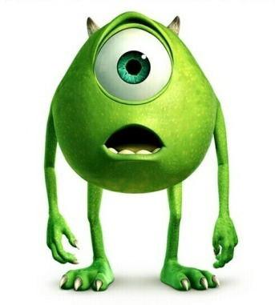
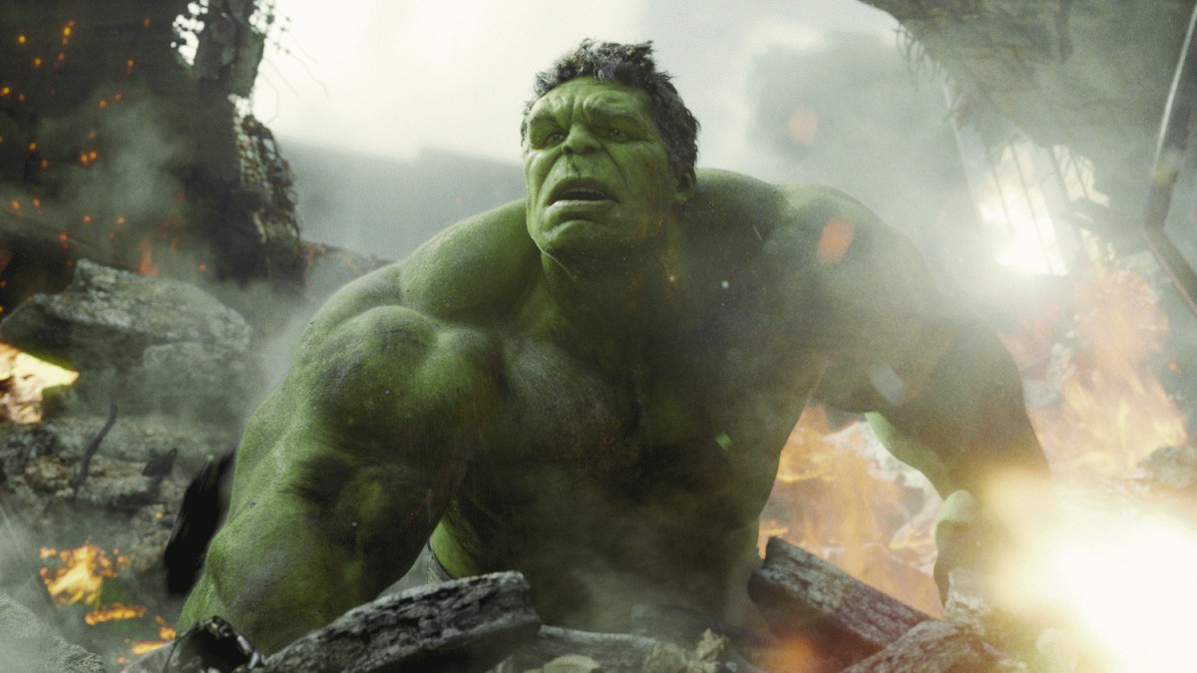
Green like in a fairytale x2
There’s a lot of green charcaters in movies, comics and books. Green skin, green hair… or green clothing.

Slide 8
So now, you see, that our favourite colour is everywhere. Let’s say it loud:
GREEN IS EVERYWHERE!
Bye! Thanks for watching!

