Slide 1
Pollution
Autori: Teodora Ivanović,Ivona Tomić, Nikoleta Stevanović

Slide 2
Blatašnica
Blatašnica River flowing through Blace and empties in Racine, close to its confluence with the lake Cells, was turned into a collector of sewage and waste water. For twenty years, in that river, from Blace to the casting in Racine, no wildlife.

Slide 3
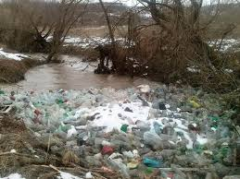
About a thousand black inhabitants of the village, who live along the river Blatašnicu, say the most polluted rivers in Serbia, and that jeopardizes their health and survival in the region.

Slide 4
Apart from these rivers is no life, say locals who would like to leave their "Anyone alive avoiding that way to go, unless you must, let alone live," said Vladeta Veljić from the village of Cuca. "I have 75 years, I'm used to drinking water to bathe, caught the fish, now there is nothing."? Move, only to have nowhere to go.

Slide 5
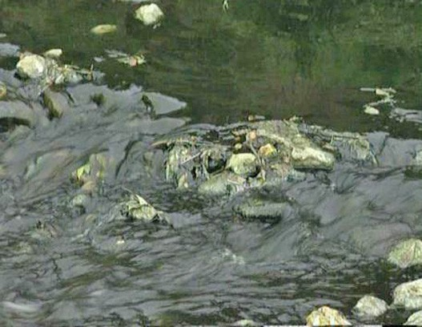
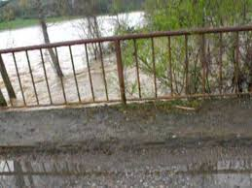
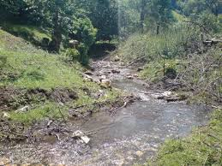

Slide 6
Lake Čelije
Among the hundreds of visitors who come on weekends at the lake near Krusevac cells, much of the real nature lovers, but also unscrupulous owners of boats and watercraft that might jeopardize the safety of swimmers and pollute the water.

Slide 7
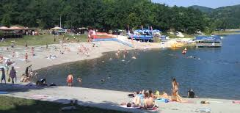
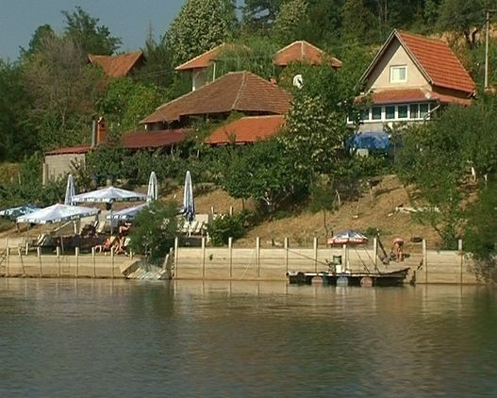

Slide 8
As the law of the sea in the early hours of the morning on the shore of Lake coming swimmers. Many spend the entire summer kampujući and enjoying. Although the conditions for rest and recreational an ideal, is increasingly dissatisfied.

Slide 9
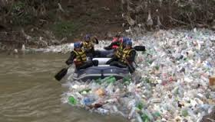
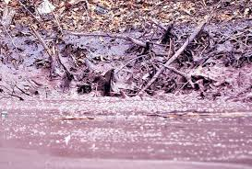
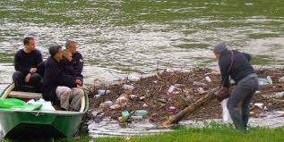

Slide 10
Pleasing weekenders as well as fishermen and visitors this summer lake record attendance records. The beauty of nature and plenty of fish caused that in the past decade at the cellular lake held all the important domestic competitions in sport fishing.

Slide 11
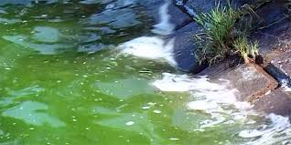
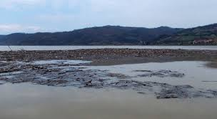

Slide 12
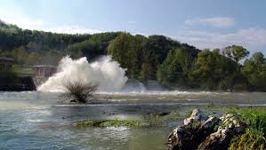
The adoption of a spatial plan will create conditions that already next year in Vasic, the most visited part of the coast is open camp, with all the necessary infrastructure, and it is planned and set up video surveillance system, which will enable visitors to better quality rest and contribute to greater safety and protection of the lake.

