Slide 1
Green is everywhere
By Paweł & Piotr Białek

Slide 2
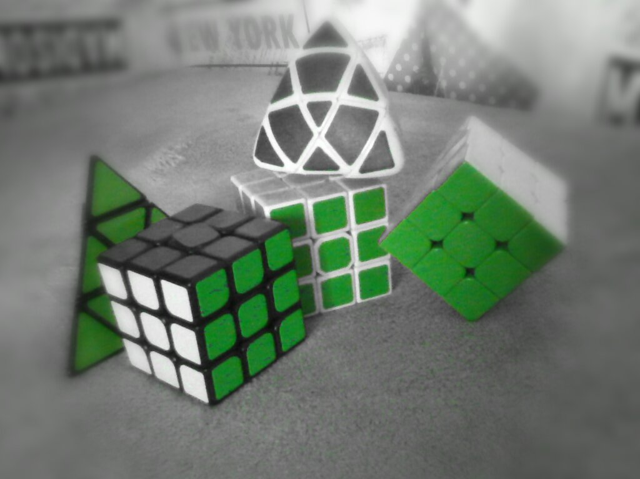
There are my Rubik Cubes. They have green parts.

Slide 3
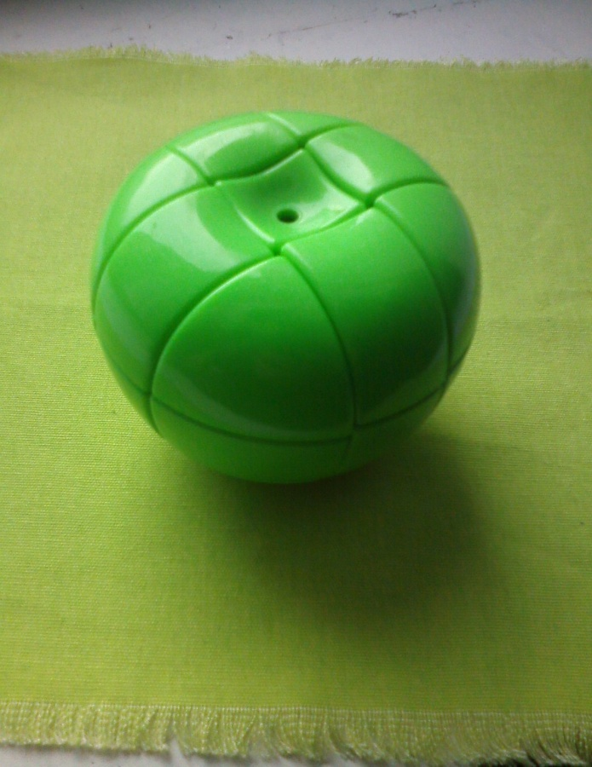
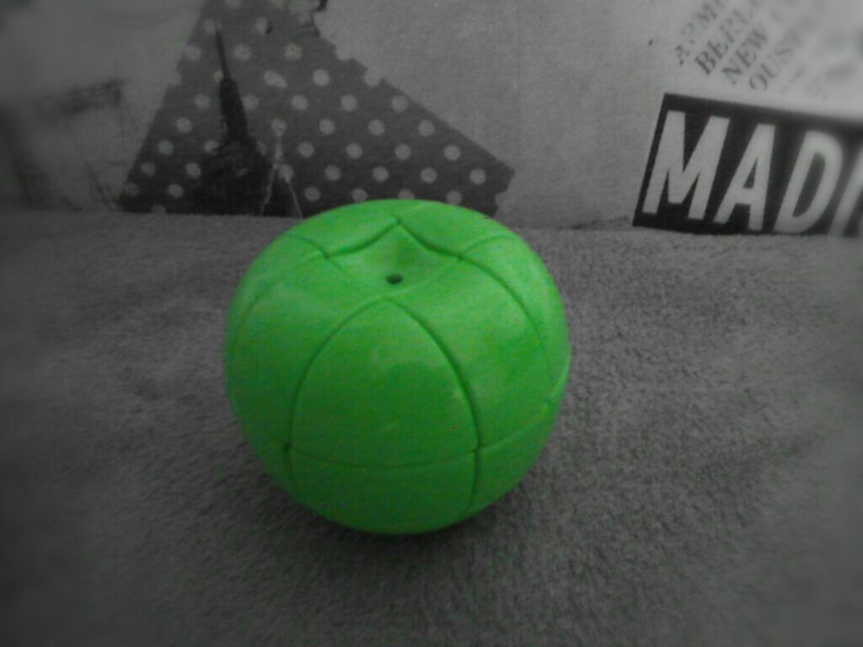
This is apple cube

Slide 4
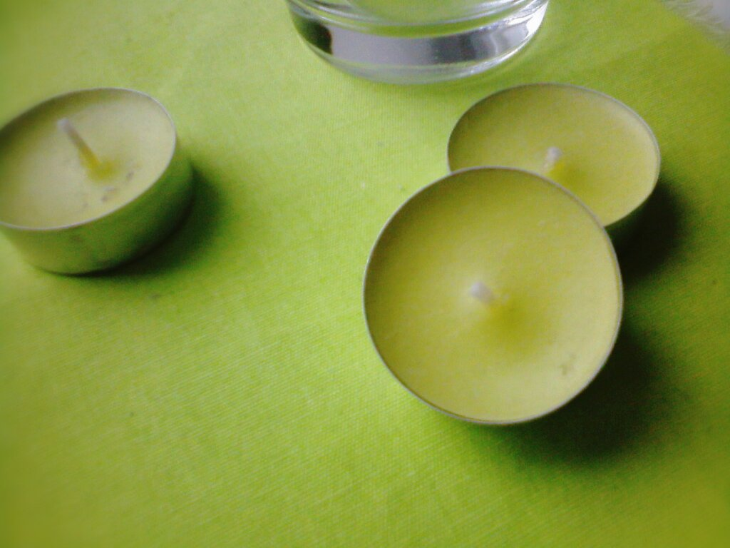
There are candles.

Slide 5
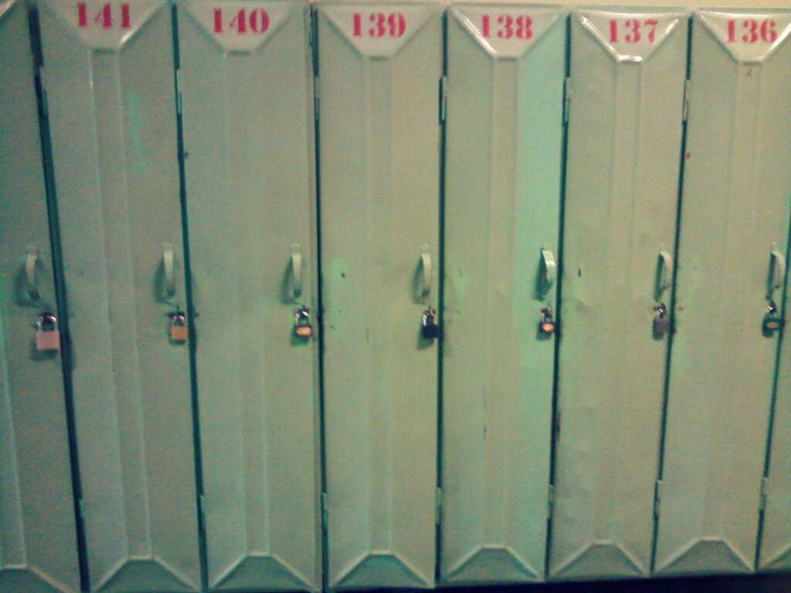
They are green lockers in my school.

Slide 6
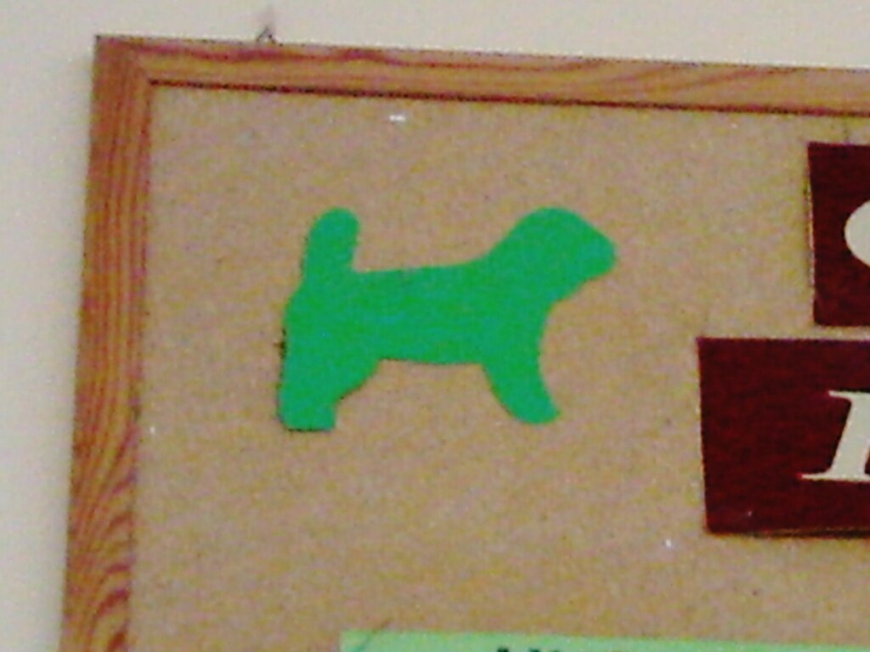
This is green dog on the pin board at the corridor!

Slide 7
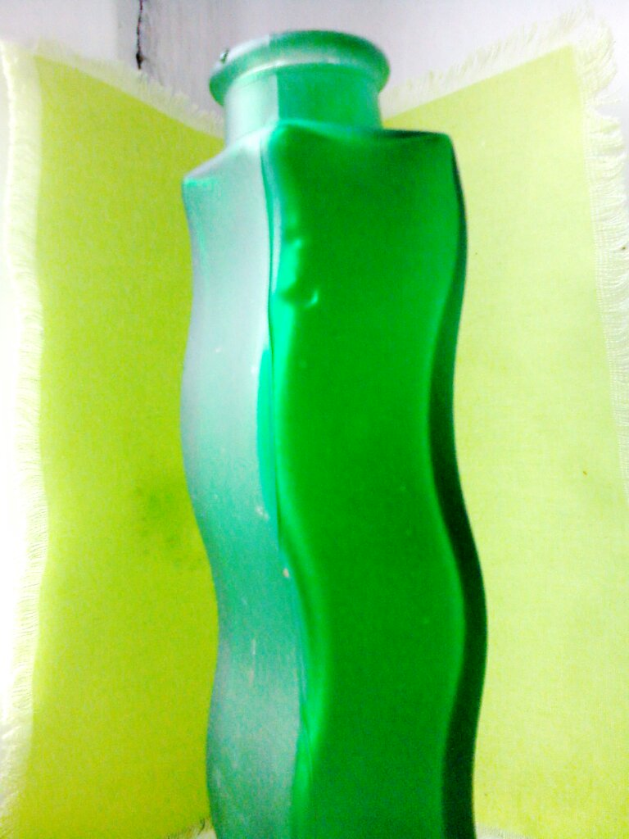
This is green vase in my house!

Slide 8
Green END

