Slide 1
green
In my house, in my neighbourhood and my city

Slide 2
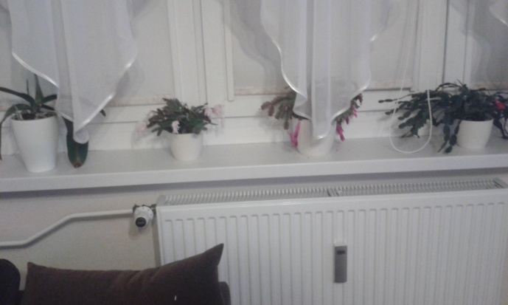
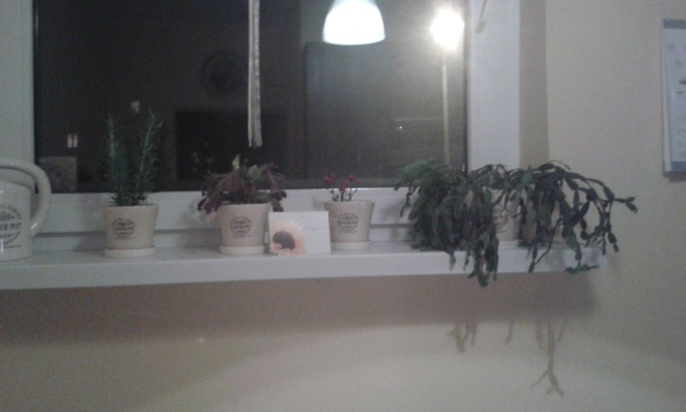
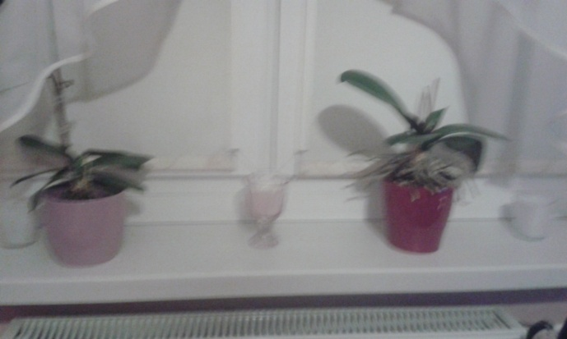
Green in my house
I have plants on my windowsills.

Slide 3
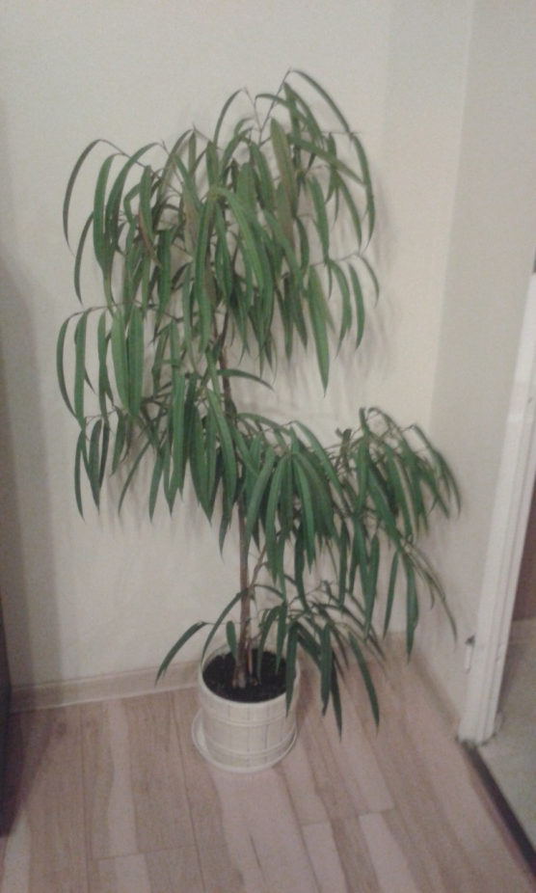
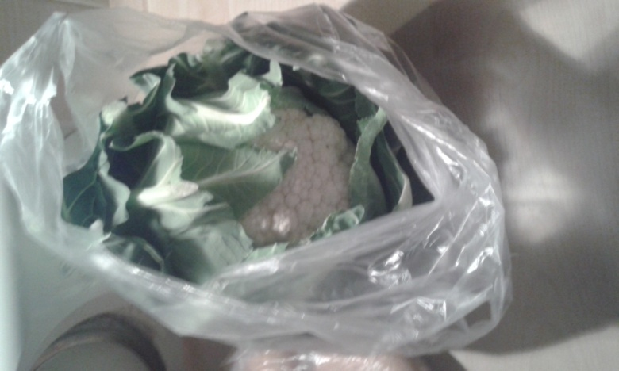
Green- from the ground and farm fields
Yes, it’s a cauliflower…

Slide 4
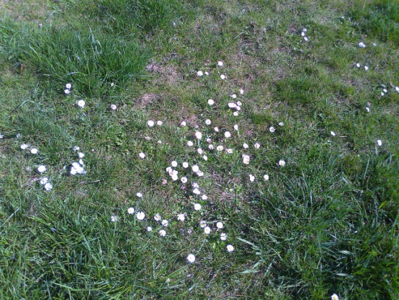
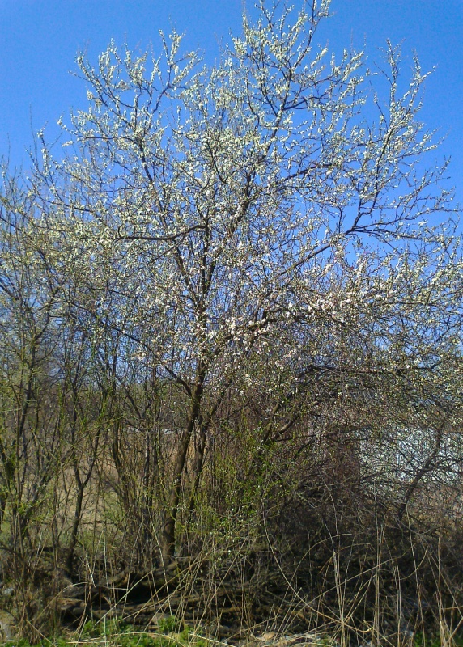
Green in my neighbourhood
There are catkins, forsythias and so on…

Slide 5
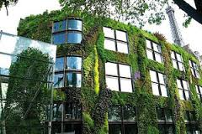
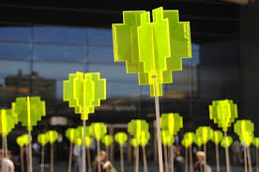
Green in my city
Photos in the Spring

Slide 6
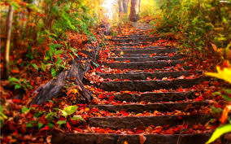
But we have autumn…

Slide 7
Thanks for watching!!!
Kacper Żok
^^

