Slide 1
CODVID-19 & CLIMATE CHANGE
A collaborative online session
Marta Pey Pratdesaba
eTwinning & FCL Ambassador
European Programmes Advisor, Department of Education of Catalonia
English teacher at Institut Jaume Callís (Vic, Barcelona)

Slide 2
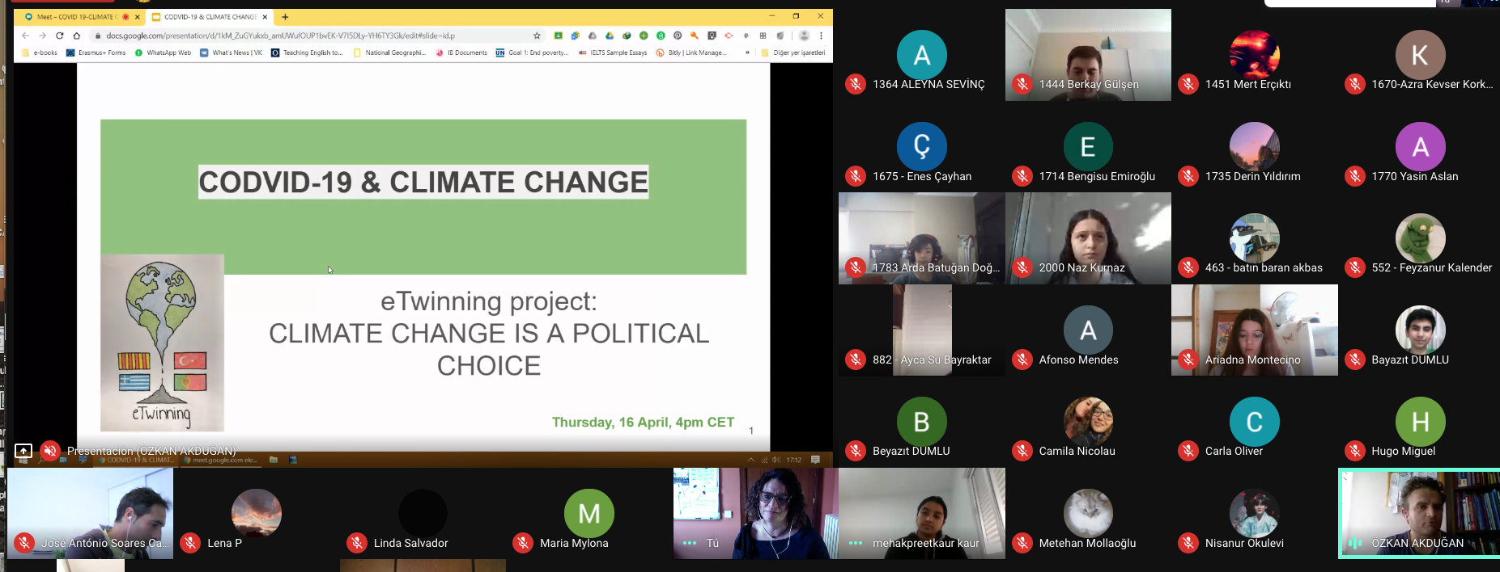
cXhar
What was it about?
1 h -1 h 30 min session
Interactive; students are prompted to talk
14-18 year olds
Done twice during confinement:
As part of an eTwinning project: CLIMATE CHANGE IS A POLITICAL CHOICE with students of Turkey, Greece, Portugal and Spain
My students of English (after unit about the environment)

Slide 3
OBJECTIVES:
To compare the situation of CODVID-19 crisis in each partner country
To express feelings
To talk about how the CODVID-19 crisis is affecting or not the climate change crisis
LINK TO THE PRESENTATION

Slide 4
tatb
What did we talk about?
(for our eTwinning project): CODVID-19 & OUR COUNTRIES:
Compare government measures in each country
CODVID-19 & US:
Interactive activities using www.mentimeter.com
How are you feeling?
In which zone are you?
CODVID-19 & CLIMATE CHANGE
Discuss excerpts from https://sciencebusiness.net/news/covid-19-cutting-air-pollution-it-will-not-slow-climate-change
Air quality & climate change
World policies re: climate change
Energy sources
Individual actions

Slide 5
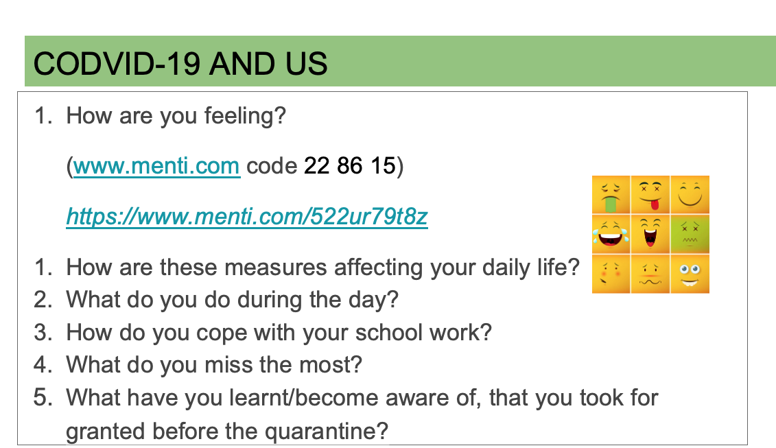
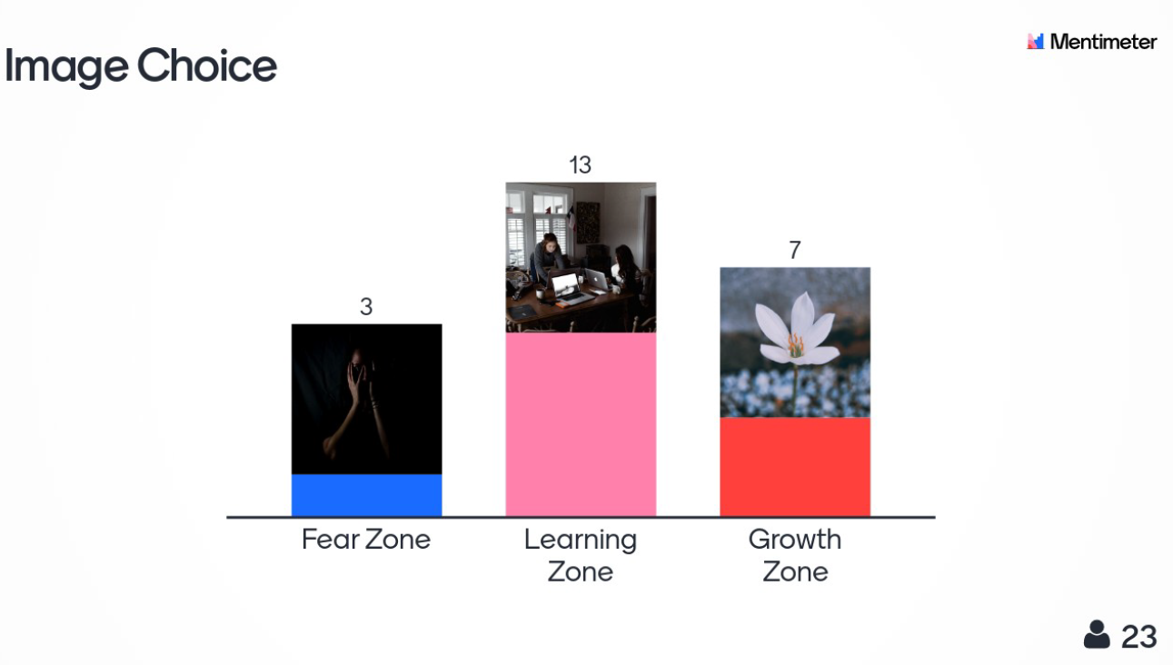
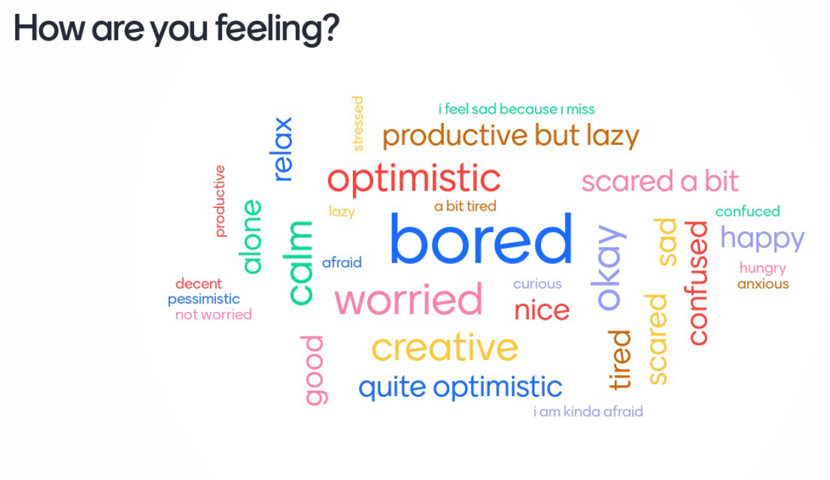

Slide 6
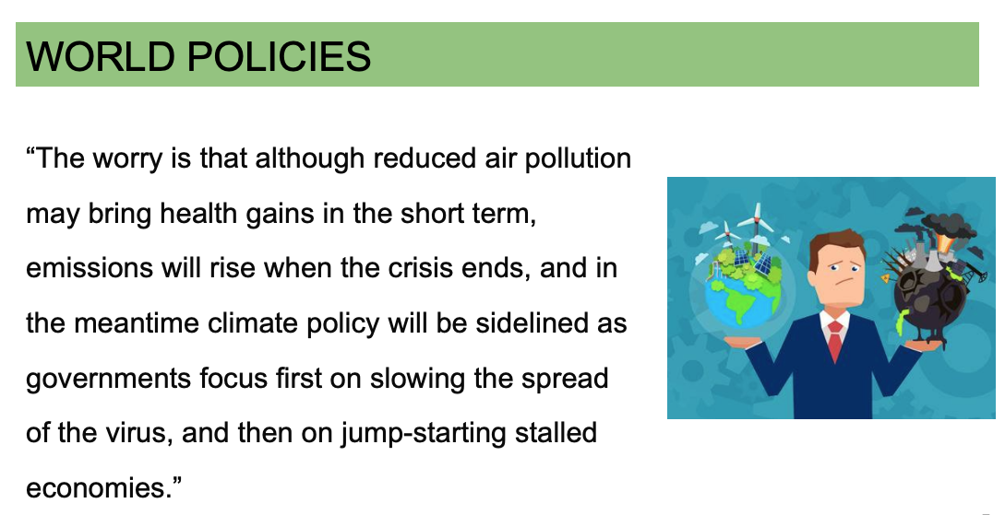

Slide 7
dd
HOPE THE PRESENTATION HAS PROVED INTERESTING AND INSPIRING
MARTA PEY PRATDESABA
mpey@xtec.cat
@mpeyprat

